Slide 1



Public Finance Management System
PFMS
LEPL Financial-Analytical Service, Ministry of Finance
October, 2015
George Kurtanidze, Head of FAS

Slide 2

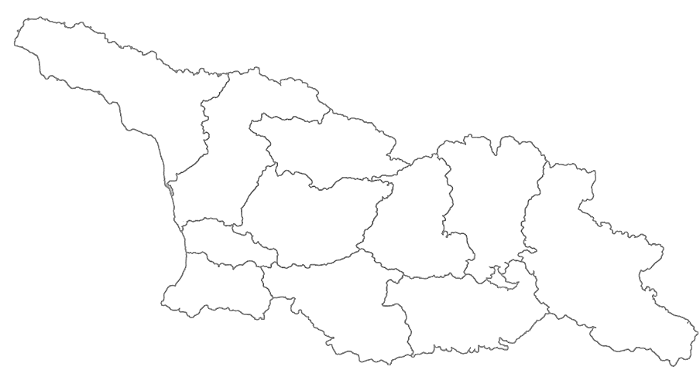
Public Finance Management System
Central Government
76 Self-Government units
2 Autonomous Republic
PFMS
PFMS
PFMS
PFMS
PFMS
PFMS
PFMS
PFMS
PFMS
PFMS
PFMS
PFMS

Slide 3
Public Finance Management System
Central Government
76 Self-Government units
2 Autonomous Republic
PFMS
PFMS
PFMS
PFMS
PFMS
PFMS
PFMS
PFMS
PFMS
PFMS
PFMS
PFMS
PFMS

Slide 4

GOAL (Advantages)
One System
Provide support for all public finance operations
Reduce financial transaction costs
Collect accurate, timely, complete, reliable and consistent information on all
financial events
Provide adequate management reporting
Provide complete audit trail / auditable financial statements
Infrastructure
Notes:
Forest management system to add.

Slide 5
Public Finance Management System
eTreasury
eHRMS
eBudget
PFMS
eCustoms
eDMS
RS

Slide 6

Public Finance Management System
eTreasury
eHRMS
eBudget
PFMS
SPENDING UNIT
eCustoms
eDMS
RS
NBG

Slide 7
eBudget
System capabilities:
Annual and quarterly consolidated budgets, as well as program budget development and management.
Management of the current approved budget adjustment process.
Adapted functionality of analyzing and reporting to the customer needs.
The control mechanism of the financial data of LEPL’s, NPO’s and GOE’s, budget execution control mechanism.
System advantages:
Simple and intuitive interface;
Minimization of the execution time of the state budget related issues;
Dynamisation of main dimensions
Multi-lingual support

Slide 8
eTreasury
Control, monitoring and analyzing system for public funds, revenues and expenditures, that is used for all budget organizations.
Online Banking and Accounting for state bodies.
Ensures transparency in the work of the Treasury
Automated pay-roll process
Daily 9.8 Million transaction
Daily 1.2 Million accounting transactions
Support of 892 organizations, 4667 Users
Online assignment from any point within 5 seconds
Management of the general ledger

Slide 9
eDMS
Integrated set of tools for the implementation of an advanced computerized states debt and loan management system. The system gathers all types of data regarding state debts, loans and grants in order to produce reliable and complete financial information.
Complete automation of state debt service schedule.
State debt payments online-service
Annual emissions plans preparation automation
Investment Project Management automation

Slide 10
eHRMS
The system is a country-wide database for human resources management which is a part of PFMS through its integration with the payroll and mission modules of the eTreasury system
Complete, continuously updated electronic information about employees
Employee attendance records
Organizational structure and staff management
Registry of employee mission
Registry of employee salary

Slide 11
Future Plans
From 2015 to 2020 the system will be Expanded
Further Integration with State Procurement System
From December 1, 2015
Single Tax Code
From January 1, 2016
Around 400 NLE (Non Business Legal entities)
Around 1000 users
From January 1, 2018
Around 3000 Public Schools, Around 6000 users
From January 1, 2020
Assets and inventory, non monetary operations and other
accrual accounting modules (PFMS becomes fully functional
according to the World Bank reference model)
Infrastructure
Notes:
Forest management system to add.

Slide 12

Thanks for your attention!

