Slide 1
State Treasury Electronic Service System
eTreasury
LEPL Financial-Analytical Service, Ministry of Finance
October, 2015
Aleksandre khuskivadze, Head of the Research and Systems Analysis Department

Slide 2
Personal Introduction and Agenda
Personal Introduction
eTreasury – System designation, development phases
eTreasury structure and modules
Functionality of the System
Questions And Answers

Slide 3
eTreasury development phases
eTreasury – State Treasury electronic service system is developed by LEPL Financial-Analytical service (In-House Development)
eTreasury system development stages:
2010 - established first version of the System;
2012 – launched a new version of the System;
2015 – SGE and LEPL’s are involved in the System.

Slide 4
eTreasury - State Treasury electronic service system designation
The system enables budget spending organizations to submit documents and annexes in electronic format and manage the budgetary funds;
This system enables budget spending organizations to transfer their funds online;
Main goal of the system is to provide effectiveness and transparency of the State Treasury activities and reduce operational and financial risks;
Also, the system features include ability to generate/compile different types of reports, that provide complete and classified information about state expenses.

Slide 5
eTreasury structure
eTreasury system consists of three Sub-System (with 3 different access points):
Front Office (Spending unit) – resource and transaction management for government-financed organizations;
Middle Office (Spending unit) – the assembly of necessary tools for Self-government entities to carry out operations and cost control, monitoring and analysis;
Back Office (Treasury) - the assembly of necessary tools for State Treasury to carry out state funds and expenses control, monitoring and analysis.

Slide 6
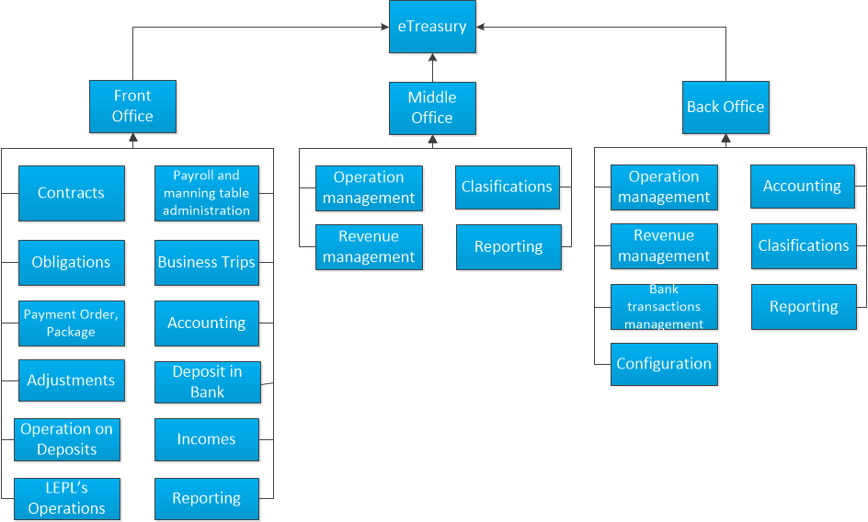
eTreasury system modules
Infrastructure
Notes:
Forest management system to add.

Slide 7
Procurement process in eTreasury
Make Offer
Announces Tender
Vendor A
Spending Unit
Make Offer
Spa.ge
Sending Details of Tender via e-service
Make Offer
Register Contract
Vendor B
Infrastructure
Retrieve
Vendor X
eTreasury.ge
Treasury Database
Notes:
Forest management system to add.

Slide 8
Procurement process in eTreasury
Contract Data Received From State Procurement Agency in eTreasury
Contract Date
Contract Number
Contract Amount
Winner Organization
Purchased Goods (Using CPV – Current Procurement Vocabulary)

Slide 9
Payment process in eTreasury
Send Payment
Registers Payment
Confirm Payment
Spending Unit
eTreasury.ge
National Bank
(RTGS )
Sending Payment Details via e-service
Procurement DB

Slide 10
Payment process in eTreasury
Payment Data Sent To Procurement Agency from eTreasury
Payment Amount
Payment Date
Payment Receiver

Slide 11
Payroll process in eTreasury
Package approval
Treasury empoyee
Spending Unit
eTreasury.ge
(Back Office)
Generate the payroll registry, Payroll registry accrual,
Automatic creation of package,
Package approval
Send Package to the treasury
Send Package to the bank
Approval of Package and send to the treasury
Infrastructure
Confirm Payment
Send Package
National Bank
(RTGS )
eTreasury.ge
(Front Office)
eTreasury.ge
(Middle Office)
Notes:
Forest management system to add.

Slide 12
Payroll process in eTreasury
Payroll Data Generated in eTreasury
Preparation Date (filled automatically)
Number, Name and Document type
Basis (application or targeted grant)
Period
Type of Data generation (manning table, file upload)
Structural unit
Accrued and deductible amounts

Slide 13
Benefits Achieved
Automated information exchange process between State Treasury and spending organizations
Simplified budget services provided to organizations
Increased information exchange effectiveness and efficiency
Simplified transaction process
Minimized administration expenses
Effective management of the processes

Slide 14
Future Plans
From 2015 to 2020 the system will be Expanded
Further Integration with eHRMS
Automation of non-financial assets procurement operations and accountings of budget organizations
Improve capital asset management by establishing a register of capital assets
Implementation Assets/inventories and other non-monetary operations
Reflection of all the accrual and cash transactions in the main book of accounting of the system
Infrastructure
Notes:
Forest management system to add.

Slide 15
Thanks for your attention!

