Slide 1
Budget management
March 20th 2017

Slide 2
Table of contents
IT systems for budget preparation
  Technical budget process
  Master data used for budget preparation
  Budget planning tool of the federal Austrian government (PBCT)
  Budget documents with performance budgeting
Preparation of budget execution (BM-SAP)
Reports & disclosures – Budget information system (German acronym: HIS)

Slide 3
Technical budget process
PBCT
Budget documents with performance budgeting
Budget planning
Reports & disclosures
HIS
Master Data
BM-SAP
HV-SAP
Budget execution

Slide 4
Master data - budget structure
Central administration of federal master data
Annual creation of master data
Application „Budget structure“ delivers master data for all other applications

Slide 5
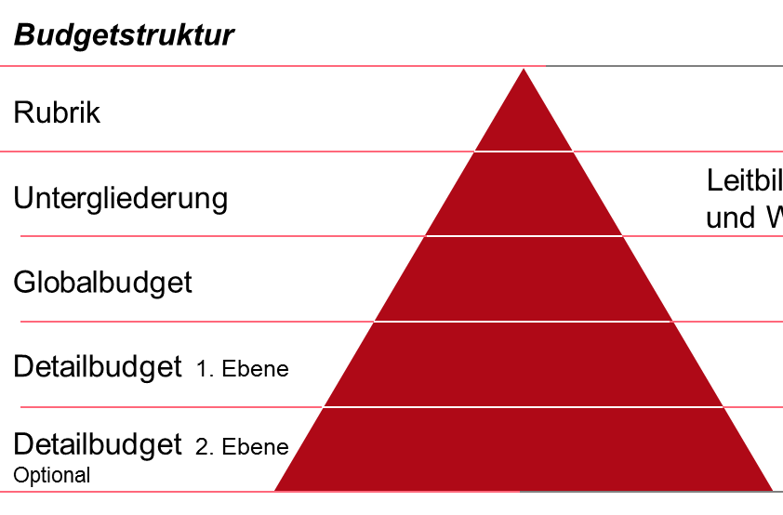
Budget appropriation – organizational structure
Budget structure
Federal budget
Example Number
Rubric
General Government Affairs
1
Budget chapter
Interior (MoI)
11
Global budget
Security
11.02
Detail budget 1st level
Police
11.02.01
Detail budget 2nd level
Police Department Vienna
11.02.01.09
complete budget appropriation
Explains the formal structure of budget

Slide 6
Accounts – economic side
Cash flow statement
Operating (P&L) statement
Allocation of funds groups and funds raised groups (German acronym: MVAG)
311 Disbursement from operational administrative activities
231 Personnel expenditure
Key account figures (German acronym: KKZ)
50 Personnel expenditure
Accounts
5000.000 Officials

Slide 7
Account
Account consist of 7-digits
  4-digits account number
  3-digits partition (for closer specification)
Must fit into an account interval
Must comply with the regulation of chart of accounts
No input level for operativ accounting

Slide 8
Key account figures
Used for the detailed presentation of financal position statement, cash flow statement and operating statement.
Passes down operational aspects to accounts
Covers one or more account intervals
No input level for operativ accounting

Slide 9
Master data – MVAG
= “Allocation of funds groups and funds raised groups”
Basis of the economic side
Comprises multiple key account figures
Figured in annual “Federal finance act”
No input level for operativ accounting
9

Slide 10
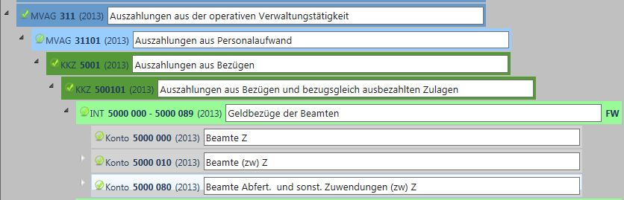
Master data – economic side
Allocation of funds groups and funds raised groups
(German acronym: MVAG)
Key account figures (German acronym: KKZ)
Account interval
Accounts

Slide 11
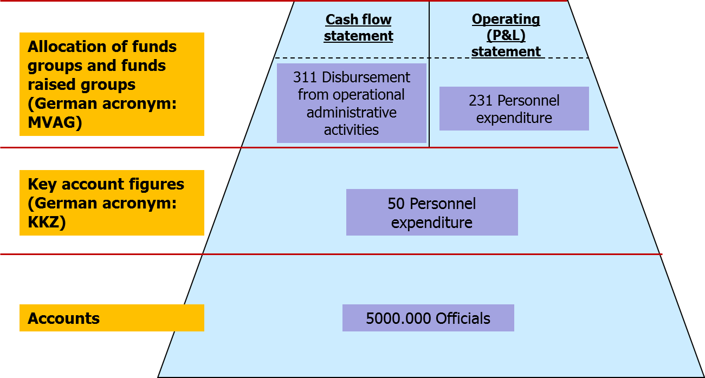
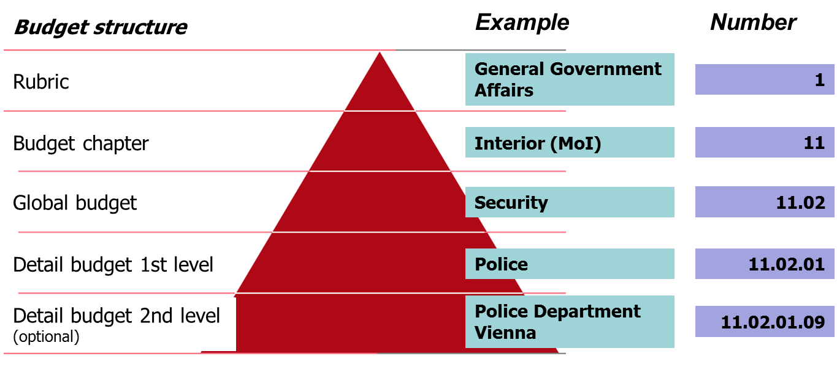
Master data – Budget position
expense /
revenues
codes
+
1 / 2
+
B u d g e t p o s i t i o n
(Budget appropriation + expense/revenues
code + account)
11.02.01.09 - 1 - 5000.000
11

Slide 12
Master data – number
Master data 2016 (status May 2016):
397 8-digit Budget appropriations
89 Allocation of funds groups and funds raised
groups
430 Key account figures
13,523 accounts
49,866 budget positions

Slide 13
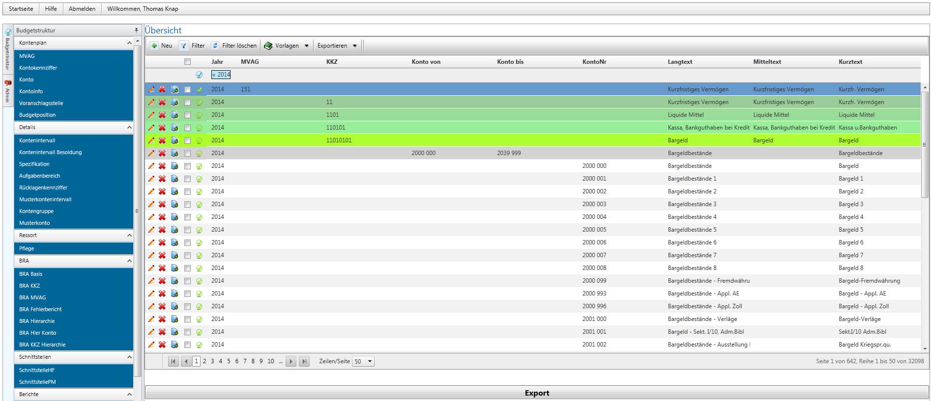
Application “Budget structure”

Slide 14
Technical budget process
PBCT
Budget documents with performance budgeting
Budget planning
Reports & disclosures
HIS
Master Data
BM-SAP
HV-SAP
Budget
execution

Slide 15
Budget planning tool (PBCT)
PBCT – Planning, Budgeting and Controlling Tool
is used for:
  Budget planning
  Budget controlling
Based on the standard software suite “SAP Business Warehouse - Integrated Planning (SAP BW-IP)”
approx. 500 users throughout Austria

Slide 16
Budgeting – process overview
Simultaneous budgeting of departments and dispatch of upper budget limits by the MoF to the departments
Preparation of department budget proposals and comparison with upper budget limits
Delivery of the departmental budget proposals to the MoF
Consolidation of department budget proposals within the MoF & possibly counter-procedures
Budgeting
Preparation and delivery of departmental budget proposals
Dept.
Fed. Govt.
Dispatch of upper budget limits
Consolidation of departmental budget proposals & counter-procedures
Spec. dept.
Review of departmental budget proposals

Slide 17
Operating and cash flow statments
Operating (profit & loss) statement
Cash flow statement
Expenses
Revenues
Expenditures
Receipts
The operating statement shows the expenses and revenues within a fiscal year, irrespective of the specific time of payment.
INFO
The cash flow statement shows the expenditures and receipts at the specific time of payment.
INFO

Slide 18
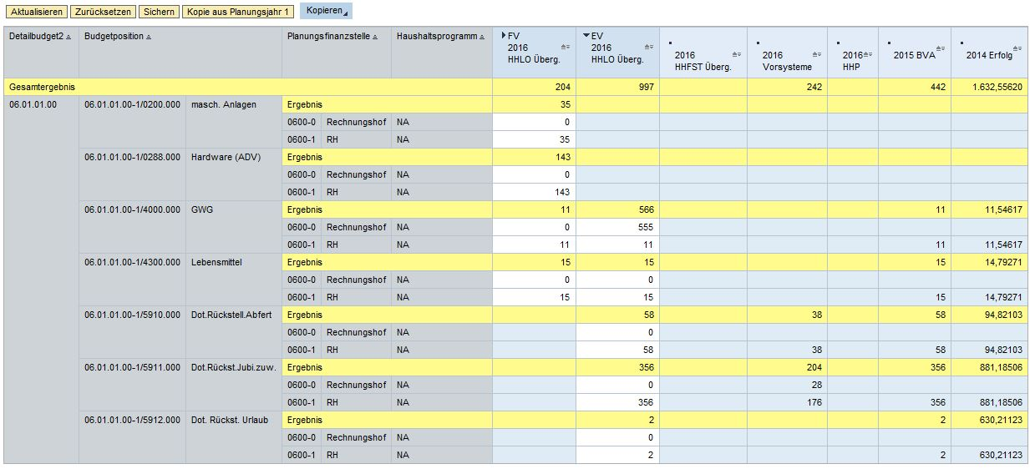
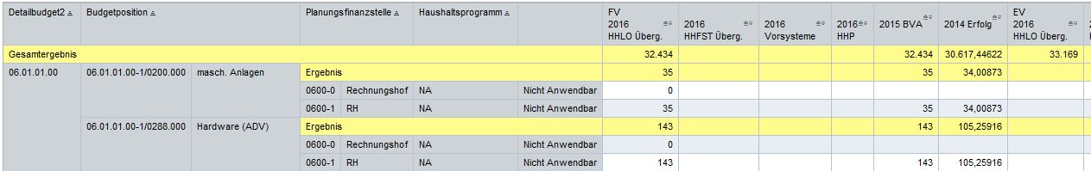
PBCT – department budget view
real-time reporting
and data transfer

Slide 19
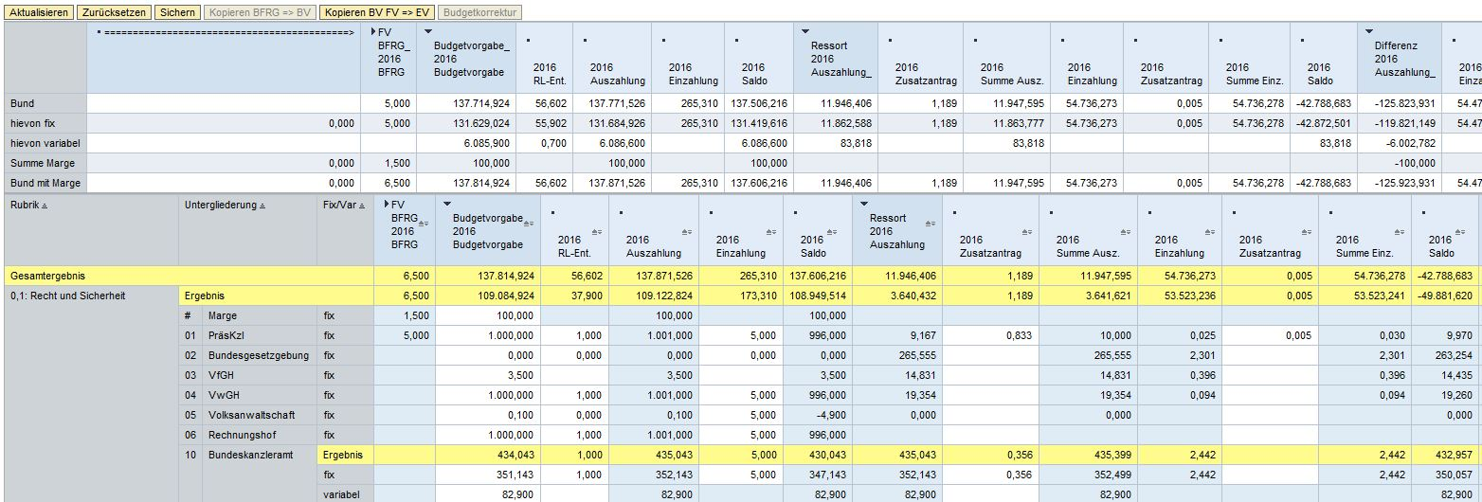
PBCT – federal budget view
Budget limits
Budget proposals –
departments

Slide 20
Technical budget process
PBCT
Budget documents with performance budgeting
Budget planning
Reports & disclosures
HIS
Master Data
BM-SAP
HV-SAP
Budget
execution

Slide 21
Budget documents with pb
Budget documents with performance budgeting (pb)
  Federal finance act
  Explanatory budget documents (one document per budget chapter)
  Additional explanatory budget documents (for budget chapters with detail budgets on 2nd level)
  Index of assessed accounts
Application based on Telerik Framework
approximately 500 federal users

Slide 22
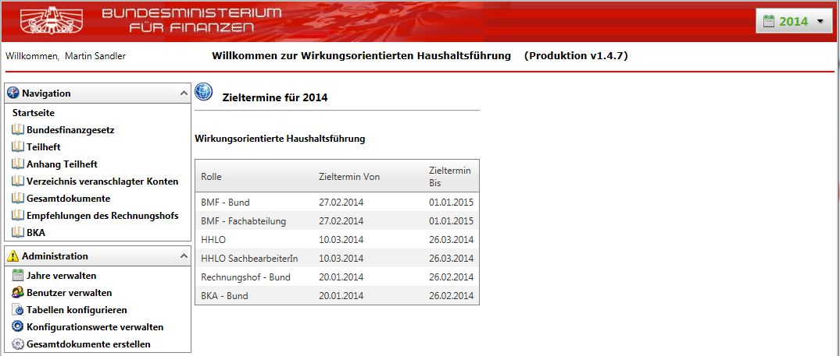
Budget documents with pb (1)

Slide 23
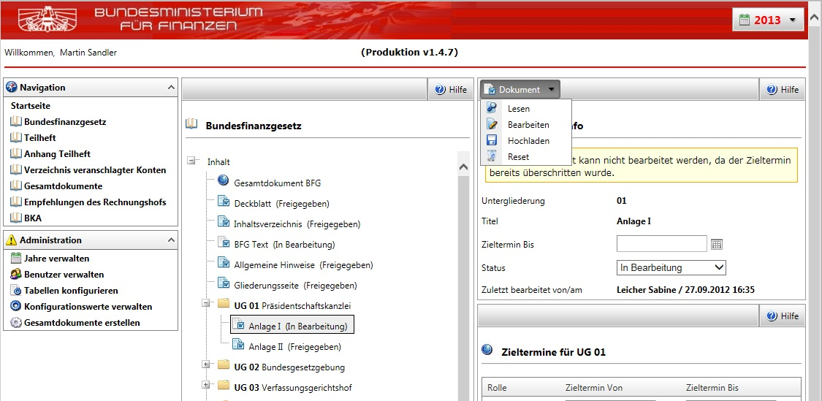
Budget documents with pb (2)

Slide 24
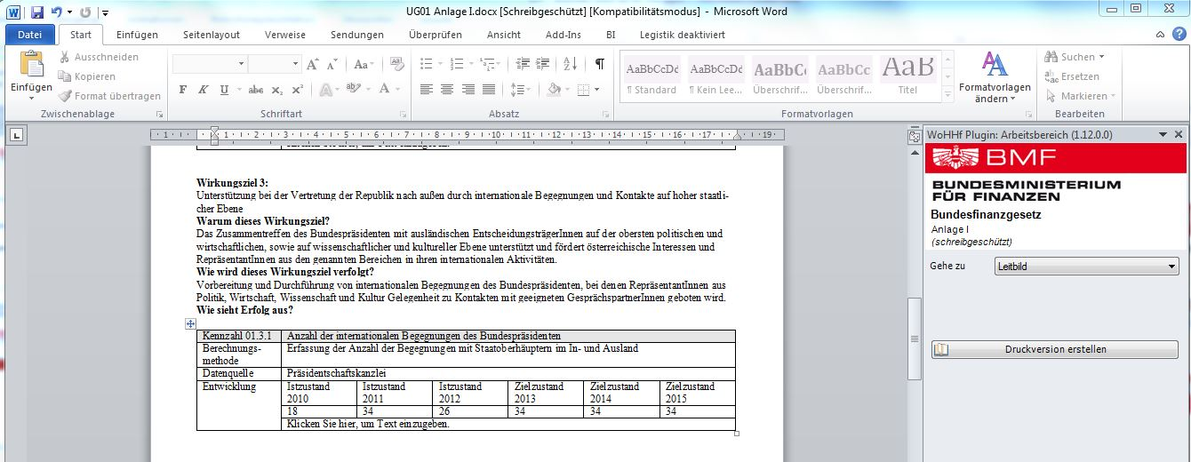
Budget documents with pb (3)

Slide 25
Technical budget process
PBCT
Budget documents with performance budgeting
Budget planning
Reports & disclosures
HIS
Master Data
BM-SAP
HV-SAP
Budget
execution

Slide 26
Overview Budgeting
At the end of the year:
Budget transfer from PBCT for the new fiscal year - Provision of the budget (seperate budget version)
Distribution of the budget according to budget responsibility (distribution budget version)
Creations of commitments (control objects)
Provision of the budget (original budget version)
In the current year:
Budget modification

Slide 27
Budget version concept
+ Transfer
+ Addendum
J98 (approved budget)
J99
(budget allocation)
0
01.01.
AVK
PBCT
Copy
Copy
(Availability check)
- Transfer
- Return
The approved budget is taken from PBCT in version J98 .
Here the departments can distribute the budget to subordinate funds centers.
In version 0 availability control is active and only budget modification are carried out during the year .

Slide 28
BCS =Budget Control System
Active availability control:
  Immediate check against the available budget with the disposed amount ( obligo / actual) considering the derivation rules for control objects and the tolerance profile
  Budget tools:
    Budgeting Workbench
      In BCS all budget postings can be performed using the same transaction.

Slide 29
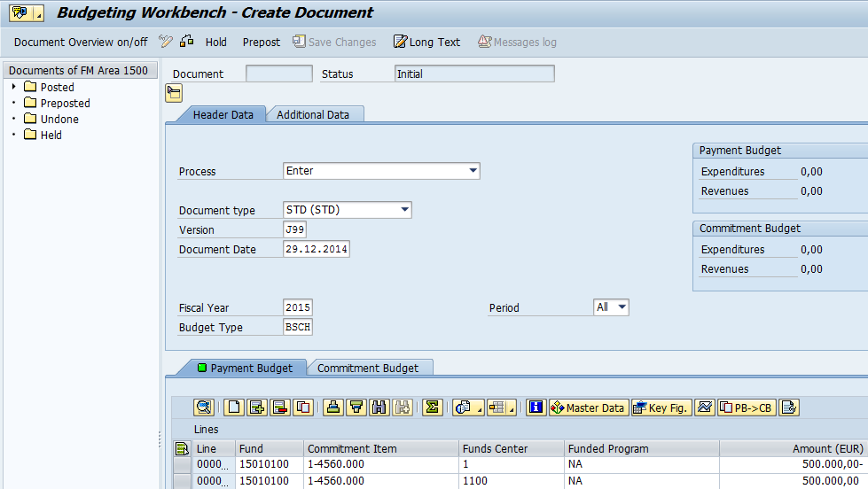
Budget allocation J99

Slide 30
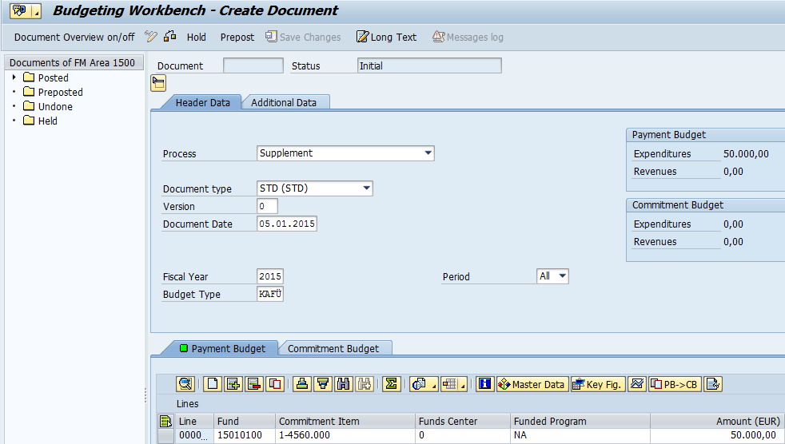
Budget modification

Slide 31
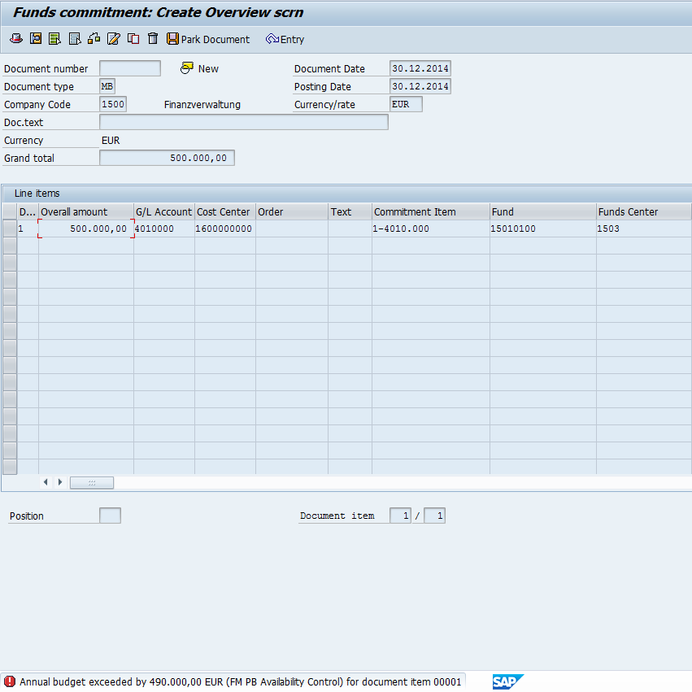
Availability check

Slide 32
Monthly budget statement
Budgeting of the monthly budget statement (german acronym: MVA) values happens on the same master data as in the yearly budget statement, although aggregations are possible.
Availability control of payments
  Warning messages
    In opposite to the yearly budget statement, where overruns will trigger error messages.

Slide 33
Monthly budget statement
The monthly budget statement (MVA) is planned in different versions and copied from one version to the next at specified points in time.
The final MVA version in the system will get named version M.
In this case, it is necessary to enter the month for the correct booking.

Slide 34
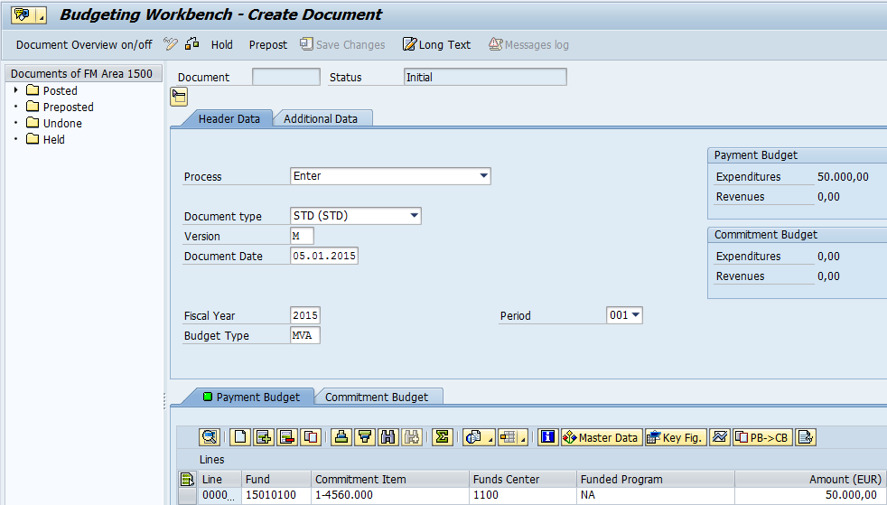
Monthly budget booking

Slide 35
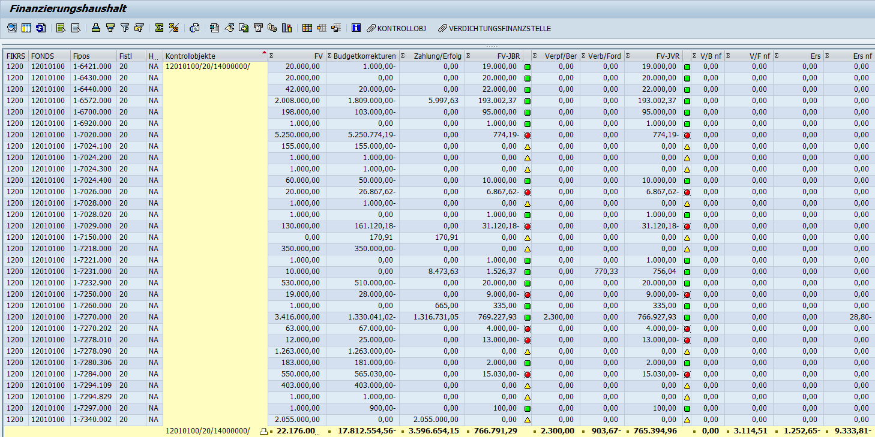
Reports
Budget cashflow statement report
Account assignments
Control object
Budget statement
Budget adjustments
Payments
Obligo
Invoices
Remaining budget

Slide 36
Technical budget process
PBCT
Budget documents with performance budgeting
Budget planning
Reports & disclosures
HIS
Master Data
BM-SAP
HV-SAP
Budget
execution

Slide 37
Budget Information System (1)
How data will be provided
  Federal level (sum federation – all ministries)
  Department level (sum budget chapter)
  Administrative office level (sum detailed budget)
  Organisational (sum finance position)
  economically (allocation of resources, accounting code digits)
  Additional information (specifications, controlling instances,…)

Slide 38
Budget Information System (2)
Which data will be provided
  Budget figures
  Billing data (as is)
  Budget corrections
  Previous impacts running year
  Previous impacts future years
  Annual /monthly remains

Slide 39
Budget Information System (3)
Which reportes will be provided
  Annual reports
  Monthly reports
  Annual / monthly series
  Reports for cash flow statement and operating statement
  Budget correction reports
  others

Slide 40
Budget Information System (4)
Report navigation
  Drag and Drop
  Filtering options
  Text view
  Creation of sub totals/intermediate totals
  Calculations
  others

Slide 41
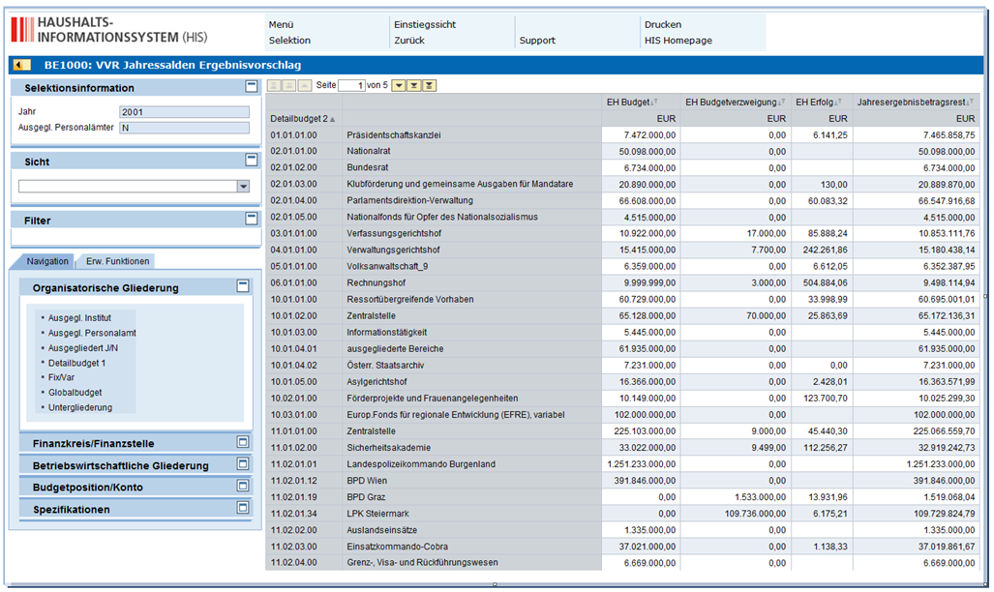
Budget Information System (5)

Slide 42
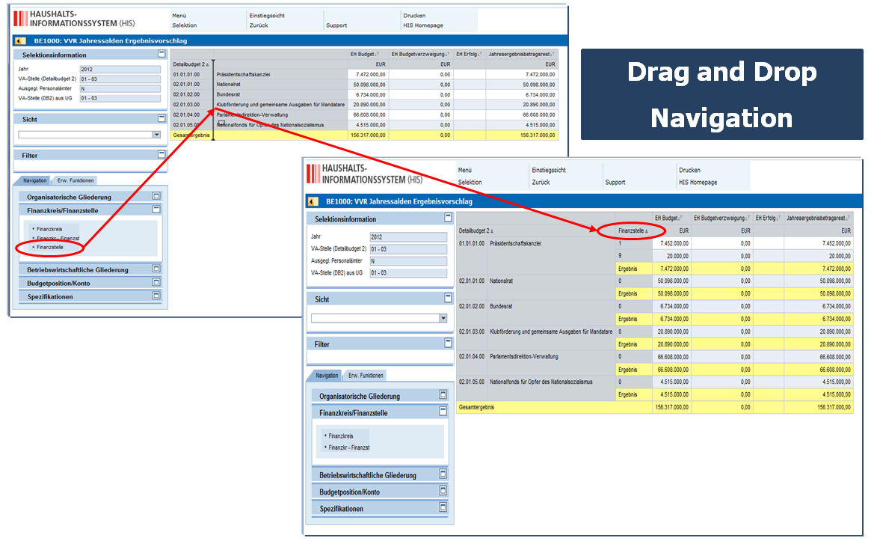
Budget Information System (6)

Slide 43
Thank you for your
kind attention!

