Slide 1
Budget Management Electronic System
eBudget
LEPL Financial-Analytical Service, Ministry of Finance
October, 2015
Guram Shvangiradze, Chief Analyst

Slide 2
eBudget
Personal Introduction and Agenda
Personal Introduction
System Purpose, Modules, Phases Of Budget Cycle, Files
Planning Dimensions, Classifiers, Interactions
Analytical Strengths – Year Types, Dynamic and Function Report Builders, Budget Project Builder, Reports From Other Systems
System Features, Some Statistics and Live Demonstration
Discussion (Questions And Answers)

Slide 3
eBudget
eBudget
eBudget is the electronic system designed to manage budget process of state and local governments.
eBudget is one of the most widely used online systems provided by MoF. The system provides the automation and streamlining of the planning and execution monitoring processes.
Main objectives of the system are to:
Simplify and streamline budget planning process by providing flexible and mobile data flow.
Automate multiple budgeting process steps, dramatically increasing effectiveness and productivity of users.
Decrease the error rate during the budgeting process.
Enable advanced data analysis by providing multifunctional analytical support.
Provide customized sets of reports for various user categories.
Providing data storage into the unified database.

Slide 4
eBudget
System Modules
Revenues
Expenses
Balance
Administration
Consolidation
Configuration

Slide 5
eBudget
Revenues
Expenses
Balance
Administration
Annual Revenues
Annual Expenses
Annual Balance
Annual Budget
I
PHASE
Annual Revenues
Analytical tools and Reporting
Organizational Structure
Annual Assignations
Program Budget
Analytical tools and Reporting
Annual Balance
Analytical tools and Reporting
Quarter Revenues
Quarter Expenses
Quarter Balance
Quarter Budget
II
PHASE
Quarter Revenues
Analytical tools and Reporting
Quarter Assignations
Analytical tools and Reporting
Quarter Balance
Analytical tools and Reporting
Revenue Adjustments
Expense Adjustments
Balance Adjustments
Adjustments Quarter Budget
III
PHASE
Adjustment to Quarter Revenue
Reserve Funds & Transfers
Targeted Grants
Analytical tools and Reporting
Structure Adjustment
Quarter Assignation Adjustment
Reserve Funds & Transfers
Targeted Grants
Adjustment Chains and Baskets
Analytical tools and Reporting
Adjustments to Quarter Balance
Reserve Funds & Transfers
Targeted Grants
Analytical tools and Reporting

Slide 6
eBudget
Expenses
Module
Spending Unit
Supervisor
Draft
Draft
Forwarded To Management
Received From SU
Received From SU (Approved)
Sent to Supervisor
Received From SU
Sent to Supervisor (Approved)
Draft
Draft
Received From SU
Sent to SU
Draft
Received From Supervisor
Draft
Sent To Management
Draft
Draft
Administration Module
Budget Versions
Forwarded From Supervisor
Approved Budget
Forwarded From Supervisor (Approved)
Draft Budget
Sent by Supervisor
Draft Budget

Slide 7
eBudget
Revenues
Expenses
Balance
Administration
Annual Revenues
Annual Expenses
Annual Balance
Annual Budget
Annual Revenues
Analytical tools and Reporting
Organizational Structure
Annual Assignations
Program Budget
Analytical tools and Reporting
Annual Balance
Analytical tools and Reporting
Draft
Approved
Quarter Revenues
Quarter Revenues
Quarter Revenues
Quarter Budget
Quarter Revenues
Analytical tools and Reporting
Quarter Assignations
Analytical tools and Reporting
Quarter Balance
Analytical tools and Reporting
Draft
Approved
Revenue Adjustments
Expense Adjustments
Balance Adjustments
Budget Adjustments
Quarter Revenue Adjustment
Reserve Funds & Transfers
Targeted Grants
Analytical tools and Reporting
Structure Adjustment
Quarter Assignation Adjustment
Reserve Funds & Transfers
Targeted Grants
Adjustment Chains and Baskets
Analytical tools and Reporting
Adjustments to Quarter Balance
Reserve Funds & Transfers
Targeted Grants
Analytical tools and Reporting
Visa I
Visa II
Visa III
Visa IV

Slide 8
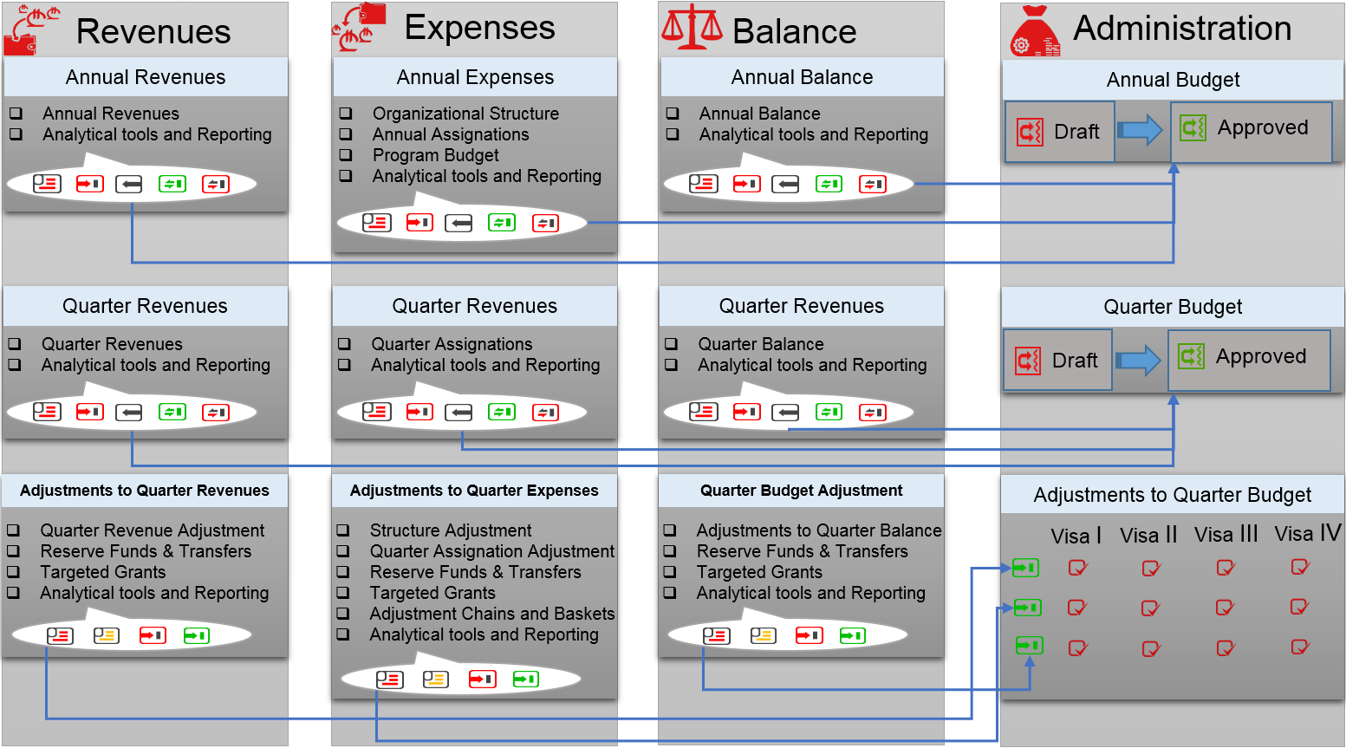
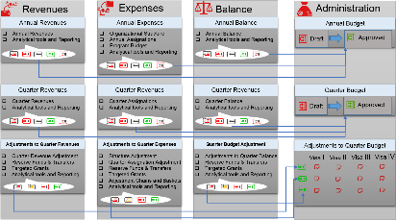
eBudget
Configuration Module
System Classifiers Management
Interface Customizer
Customized Report Builder (Similar to BI)
Management of Bridges Between Work Periods
Consolidation Module
Annual Consolidated Budget For All Municipalities
Quarter Consolidated Budget For All Municipalities
Rules For Consolidation
Analytical Tools and Consolidated Reporting
04 – Tbilisi Municipality
02 - Autonomous
Republic of Abkhazia
01 - State Budget
03 - Autonomous
Republic of Adjara
And Other
Municipalities
Total 79 Self-Governing Units

Slide 9
eBudget
Expenses
Revenues
Balance
Work-Period
Work-Period
Work-Period
Budget Units
Budget Units
Budget Units
Organization
Financing Source
Financing Source
Financing Source
Financing Sub-Source
Financing Sub-Source
Financing Sub-Source
Revenue Classifier
Balance Classifier
Expense Classifier

Slide 10
eBudget
Classifier which corresponds to budgeting cycles.
Currently system counts 6 Work-Periods:
2010-2011 Budgeting Cycle
2011-2012 Budgeting Cycle
2012-2013 Budgeting Cycle
2013-2014 Budgeting Cycle
2014-2015 Budgeting Cycle
2015-2016 Budgeting Cycle
For example, last one (2015-2016 work-period) corresponds to the budget cycle that started in 2015 and is aimed at planning and adjusting the budget of 2016.
All the other classifiers depend on work-periods which ensures intactness of historical data through corresponding classification versioning.
Expenses
Work-Period
Budget Units
Organization
Financing Source
Financing Sub-Source
Expense Classifier

Slide 11
eBudget
Expenses
State, autonomous republics and municipalities.
For example in 2015-2016 work-period:
01 - State
02 - Autonomous Republic of Abkhazia
03 - Autonomous Republic of Adjara
04 - Tbilisi Municipality
… and other municipalities.
Total 79 Self-Governing Units
Work-Period
Budget Units
Organization
Financing Source
Financing Sub-Source
Expense Classifier

Slide 12
eBudget
Expenses
State budget as well as each municipality and autonomous republic has its own structure of spending units. Assignation ceilings are determined for each spending unit at the beginning of budget cycle, after which they are decomposed into tree-like organizational structure within the files.
For example state budget in 2015-2016 work-period has about 60 spending units. there are many files for each spending unit and hundreds of organizations inside each file.
01 - State
01 00 – Spending Unit
01 01 – Organization
01 02 – Organization
01 02 01 – Organization
01 02 02 – Organization
01 03 – Organization
…
02 00 – Spending Unit
…
Work-Period
Budget Units
Organization
Financing Source
Financing Sub-Source
Tree-like structure within each file
Expense Classifier
Spending units exist only in expenses module. They don’t depend on files (there can be many files within spending unit). They may correspond to line ministries, state attorney offices, priorities or other structural or virtual units that are needed.

Slide 13
eBudget
Expenses
PFMS uses financing sources to differentiate types of assignations which can or must be processed and reported with respect to their unique features.
Examples of financing sources:
Grant
Credit
Special Transfer
Targeted Transfer
Targeted Grant
Presidential Reserve fund
Government Reserve fund
…
There are 18 financing sources in 2015-2016 work-period.
Work-Period
Budget Units
Organization
Financing Source
Financing Sub-Source
Expense Classifier

Slide 14
eBudget
Expenses
Some financing sources may require data flow management with additional details which can be provided via sub-sources.
Examples of sub-sources:
Grant
Grant_Donor1
Grant_Donor2
…
Credit
Credit_Donor1
Credit_Donor2
…
Targeted Grant
Grant Agreemant1
Grant Agreemant2
…
Presidential Reserve fund
By-Law Document1
By-Law Document2
…
…
Work-Period
Budget Units
Organization
Financing Source
Financing Sub-Source
Expense Classifier

Slide 15
eBudget
Economic Classification of Expense
Annual expense files use the most detailed classification while quarter expense files use a less detailed one.
Example:
2.1 Compensation of employees
2.1.1 Wages and salaries
2.1.1.1 Wages and salaries in cash
2.1.1.2 Wages and salaries in kind
2.1.2 Social contributions
2.1.2.1 Actual social contributions
2.1.2.2 Imputed social contributions
2.2 Use of goods and services
2.3 Consumption of fixed capital
2.4 Interest
2.4.1 To nonresidents
2.4.2 To residents other than general government
2.4.3 To other general government units
2.5 Subsidies
2.5.1 To public corporations
2.5.1.1 To nonfinancial public corporations
2.5.1.2 To financial public corporations
2.5.2 To private enterprises
2.5.2.1 To nonfinancial private enterprises
2.5.2.2 To financial private enterprises
2.6 Grants
2.6.1 To foreign governments
2.6.1.1 Current
2.6.1.2 Capital
2.6.2 To international organizations
…
Expenses
Work-Period
Budget Units
Organization
Financing Source
Financing Sub-Source
Expense Classifier

Slide 16
eBudget
Expenses
Example:
2015-2016 work Period
01 – State Budget
01 01 – Parliament of Georgia
Grant
Grant_EBRD
2.1.1.1 Wages and salaries in cash
Work-Period
Budget Units
Organization
Financing Source
Financing Sub-Source
Expense Classifier
Amount
100 GEL

Slide 17
eBudget
Analytical Strengths
Year Type Comparison within the work-period
Dynamic Reporting Tool
Function Reporting Tool
Budget Project Builder
Access to Reporting Outside eBudget

Slide 18
eBudget
Year Type Comparison within the work-period
Currently main purpose of budgeting is to plan and adjust next year budget within allocated ceilings. For that purpose there is special year type named “next year budget under ceilings”, but along with that system provides possibility to configure new year types dynamically. New year types can be used for analytical purposes. Currently there are following year types in use:
Previous year actual amounts
Current year actual amounts
Next year actual amounts
Current year approved budget
Current year adjusted budget
Next year budget under ceilings
Next year budget above ceilings
Budget version of ministry of finance
Can be imported from etreasury
Can be imported from Previous Work Period
Must be filled
Analytical Strengths
Year Type Comparison within the work-period
Dynamic Reporting Tool
Data can be copied from one year type to another. Also there are several mathematical tools like proportional and equal changes that can dramatically increase effectiveness of planning process.
Function Reporting Tool
Budget Project Builder
Access to Reporting Outside eBudget

Slide 19
eBudget
Dynamic Reporting Tool
System has powerful dynamic report builder through which users can build needed reports. Builder enables users to configure tree-grid type reports by defining set of classifiers that should construct tree rows as well as the set of financing sources that should construct columns.
Set of input parameters also can be customized after which report is ready to be published in the needed module.
Currently dynamic reports count about 80% of all.
It is possible to put data from different work periods and year types side by side using dynamic report builder which makes it powerful tool for data analysis and benchmarking.
Analytical Strengths
Year Type Comparison within the work-period
Dynamic Reporting Tool
Function Reporting Tool
Budget Project Builder
Access to Reporting Outside eBudget

Slide 20
eBudget
Function Reporting Tool
Function reporting tool enables user to construct each row and column manually and define function (formula) for the cell of their intersection.
Formula has access to every type of data that is stored in files throughout all modules, but it can be constructed only for current work-period.
Currently functional reports count about 10% of all.
Analytical Strengths
Year Type Comparison within the work-period
Dynamic Reporting Tool
Function Reporting Tool
Budget Project Builder
Access to Reporting Outside eBudget

Slide 21
eBudget
Budget Project Builder
Budget Project Builder is a tool that can combine static, dynamic and function reports filtering with a specific predetermined input data putting them into one report which is called budget project.
Budget project builder also has its own MS WORD editor where authorized users can format text along with adding some calculable values from other reports.
Budget project builder is used for building the most important report – State Budget. It is also used by autonomous republics and municipalities for the similar purposes.
Analytical Strengths
Year Type Comparison within the work-period
Dynamic Reporting Tool
Function Reporting Tool
Budget Project Builder
Access to Reporting Outside eBudget

Slide 22
eBudget
Access to reporting outside eBudget
The reports that are made in other systems within PFMS can be accessed from some modules.
Those kind of reports are processed in provider system using input data that was chosen by the user from eBudget.
Analytical Strengths
Year Type Comparison within the work-period
Dynamic Reporting Tool
Function Reporting Tool
Budget Project Builder
Access to Reporting Outside eBudget

Slide 23
eBudget
System Features and Some Statistics
System is being developed since April 2010.
System is multilingual
System is used by state budget, 2 autonomous republics and 76 municipalities throughout the country.
There are approximately 800 spending units, 400 LEPLs and 550 users involved in one budget cycle.

Slide 24
eBudget
Live Demonstration

Slide 25
Thank you for your attention! Please feel free to ask questions.

