Slide 1
Project Management Methodology Used in FAS
LEPL Financial Analytical Service
Oct 2015
Giorgi Gurashvili

Slide 2
Agenda
Overview of Project Management
Frameworks Used By FAS
Overview of FAS Project Management Methodology
Benefits Received
Questions

Slide 3
What is Project Management
A temporary organization that is created for the purpose of delivering one or more business products according to an agreed Business Case
Change
Temporary
Cross - Functional
Unique
Uncertainty

Slide 4
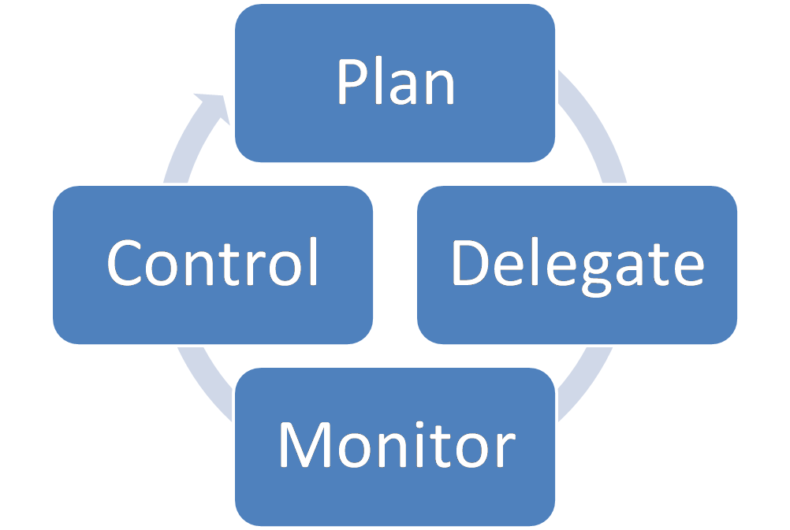
Aim of Project Management

Slide 5
Frameworks Used By FAS
MSF (Microsoft Solution Framework) for Agile
PRINCE2
ITIL
SABSA (Sherwood Applied Business Security Architecture)
MOF (Microsoft Operations Framework)
RUP (Rational Unified Process)

Slide 6
Roles
Project Manager (PM)
Control project timelines
Define priority of the tasks
Approve design packages
Product Manager
Ensure solution delivers business value
Define the solution within project constraints
Ensure customers’ needs and expectations are satisfied

Slide 7
Roles
System Analyst
Design a solution to meet business goals within project constraints
Perform risk and security analysis
Prepare test case scenarios
Development Team Leader
Delegate tasks received by product manager on team members
Code version control
Smooth deployment and transition to operations
Operations Manager
Organize trainings of end users needed for the launch of solution
Ensure smooth operation of the solution

Slide 8
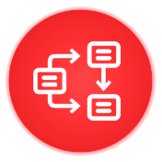
Solution Design Approval by Business
PM Sends User Story via communication channel
Initiation
Requirements Capture
User story is discussed with stakeholders of the system
Design Package
User story is decomposed and solution design created
Request for Approval
Design package is sent to PM via communication channel
PM approves the design package via communication channel
Approval

Slide 9
Design Package
Standardized design package template based on best practices of ITIL and PRINCE2
Comprehensive description of solution to minimize ambiguity between business and IT
Current state of business
Change to business as usual after the implementation of the solution
Affected users
Functional requirements and detailed process description
Non–Functional requirements
Implementation timeline
Required test case scenarios
Requirements for successful launch

Slide 10
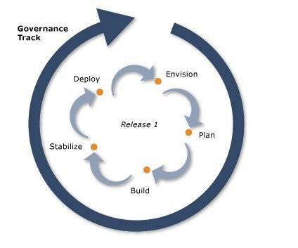
Process - Overview
Governance Track - Balancing efficient and effective use of project resources and delivery of a solution
Enactment Tracks - Detailed sequence of steps by which a solution is defined, built, and deployed

Slide 11
Process - Enactment Tracks
Envision - Develop a clear understanding of what is needed
Plan - Evolve the conceptual solution into tangible design
Build - Build the various aspects of a solution in accordance with Plan
Stabilize – V&V (Verification and Validation)
Deploy – Integrate a solution successfully into production

Slide 12
Process – FAS Approach to Application Lifecycle Management
Management Frameworks
ALM Toolset
MSF
Requirements Management
Software Architecture
ITIL
Coding Activities
Project Management
Change Management
Software Maintenance
PRINCE2
Software Testing
Continuous Integration
RUP
Release Management
FAS uses Microsoft Solution Framework for Agile Development & IBM Rational Unified Process as a core Software Development Framework.
FAS uses ITIL & PRINCE2 as a core infrastructure and process management framework
FAS has developed custom strict management process implementation
FAS has developed official internal manual, that covers all activities, concerning software development and tools usage

Slide 13
Benefits Received
Agility to adapt to changes
Incremental approach to ensure fast value delivery with minimal risks and recourses
Make sure what is delivered has optimal value to business
Minimization of launch failures / Minimal room for errors
Frequent delivery of business value
Business involvement on all stages of the project
Continuous learning
Clearly established accountability and shared responsibility

Slide 14
Thank You For Attention

