Slide 1
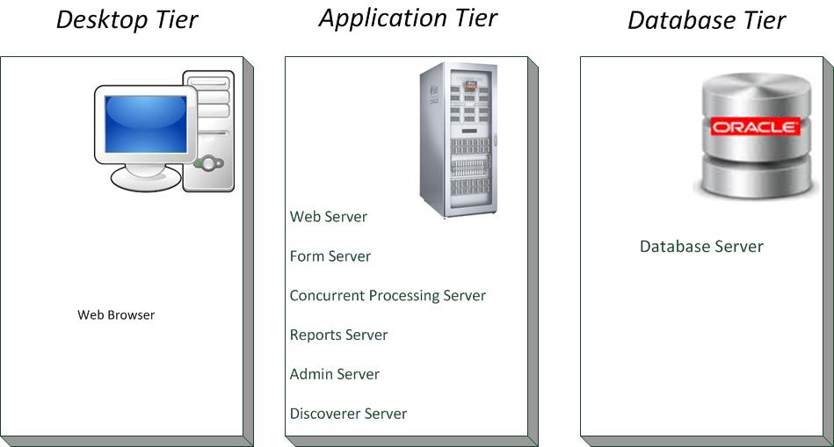
Albanian Government Financial Information System (AGFIS)
AGFIS is the system, through which the Government of Albania performs the entire budget execution processes and financial reporting of the State Budget.
AGFIS is a centralized web-based system.
AGFIS is an oracle product, with an Oracle E-Business Suite (EBS) Architecture, and has also some customized programs and functions.
AGFIS modules :
General Ledger (GL)/ Reporting
Public Sector Budgeting (PSB)
Accounts Payables (AP)
Account Receivables (AR)
Cash Management(CM)
Fixed Assets (FA)
Purchasing (PO)
Levels of budget covered
Central Budget
Local Budget
Special Funds
Users of AGFIS:
7 BIs (CM, TM,ARD,NAIS,MF,AM,RSDA)
MF departments & 36 Treasury Districts (TDOs)
Other (SSI,HCI, INSTAT, MEDTE)
Total : 334 active users
The BCC will be set up at the beginning of 2016

Slide 2
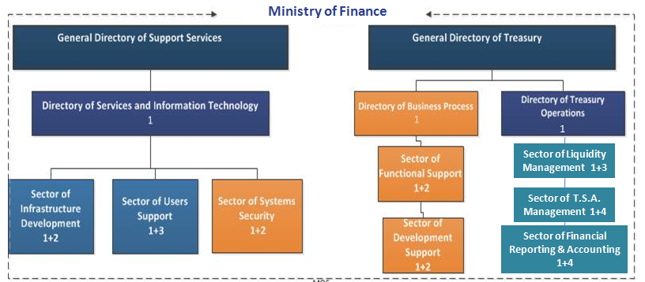
Organization of IT, functions and responsibilities (1)
Sector of Infrastructure Development
Responsible for: network, hardware, software etc.
Sector of Systems Security
Responsible for: administration of AGFIS application, db, servers, interfaces etc.
Sector of Users Support
Responsible for: User management, administration of Debt system, administration of Budget system etc.
MoF IT supports 36 TDOs, their HW, SW and users.

Slide 3
Organization of IT, functions and responsibilities (2)
Third parties:
AGFIS Technical support, which deals with the functional support of any financial transaction error may encountered during their execution/financial reporting.
AGFIS Functional support, which deals with the functional ToR’s preparation, functional configuration development, testing, user training, user manuals preparation in any case of new functional development/integration in/with AGFIS is required.
IT Manual - include policies and procedures for each sector of IT
National Agency on Information Society (NAIS) provide :
Updated standards of HW parameters
Basic SW licenses
E-mail Hosting
BCC hosting
Recommendations for new IT projects
Main responsibilities of MoF IT supporting Treasury:
Policy/Strategy
Coordination
Implementation
Technical Support ( for systems, users, and HW )
Data Protection/Security (networking, firewall, hardening, backups )
System administration/maintenance
Update/upgrade/troubleshooting
All IT functions are centralized. MoF IT support TDO users remote and on site if necessary.

Slide 4
IT Department staff consist on 10 IT specialist and the IT director.
Budget allocation
operating budget investment budget
Key function | IT staff
Computer hardware | 3
Computer software | 3
Telecommunications | 3
Databases | 4
System management | 4
Information security/protection | 3
Support and help desk | 3
Training and knowledgememt | all
Project planning and implementation | 4
2015 | 2016
311,817 € | 330,506 €
2015 | 2016 | 2017
1,778,571 € | 3,290,150 €L | 2,558,514 €

Slide 5
Challenges
Technical (starting and running projects)
New Data Center
Treasury infrastructure upgrade
BCC infrastructure
Non-technical
Improvement of IT procedures based on recommendations of IT assessment.
Thank You !

