Slide 1


Budget Community of Practice (BCOP)
Mid-Term Review of PEMPAL Strategy
BCOP results and issues
BCOP Executive Committee
Cross-COP Executive Meeting, Vienna, July 2015

Slide 2
PEMPAL STRATEGY GOAL/IMPACT
There are several ways that BCOP supports the adoption of good PFM practices:
  Sharing international approaches and country case studies at plenary events helps members identify good and innovative practices in specific PFM areas and gives opportunity to discuss common problems and solutions with peers.
  Identifying reform status compared to international and regional good practice through formal and informal benchmarking surveys
  Providing technical PFM reports and studies in PEMPAL languages to allow member countries to access to the latest trends and approaches.
  Examining reforms in-depth through study visits to specific countries and working groups established for specific topics (eg wage bill management and budget literacy)
Notes:
Objective of presentation: to share with PEMPAL Executive, results as drawn from BCOP’s submission to the MTR.
The draft submission was prepared by the BCOP Resource Team, and reviewed by the BCOP Executive Committee, with additional input provided where needed including provision of success stories and quotes from member country senior officials about benefits and value of PEMPAL.
A presentation on the MTR was also made to all BCOP members at the 2015 plenary meeting in Armenia, and 27/61 (44%) BCOP members including most (7/10) BCOP Executive Committee members filled out the MTR member survey.

Slide 3
IMPACTS OF BCOP WORK - EXAMPLES
Program budgeting | Improved procedures eg Input to Republic Uzbekistan’s Concept of Budget Policy Main Directions and Development. Examples of sector indicators assisted MoFs in providing advice to line ministries. Country case studies assisted to inform approaches.
IT systems in budget planning/ EU funds management | 6 countries examined Georgia system in depth and used procedures to progress their IT projects; and in another study visit 6 countries from western Balkans examined Slovenia approach to EU management of funds to strengthen their approaches.
Wage bill management | Working group examined 5 countries in-depth. Forecast model developed by resource team available to countries as tool to help determine impact of policy options.
Budget transparency | International guidelines on budget transparency translated into PEMPAL languages - Kyrgyz Republic making 8 key budget documents available to public; Russia Federation targeting OBI improvements. Procedures gained from South Africa study visit being used as model for reforms (eg induction manuals for senior officials being used by Albania, and Public Finance Management Act being used by Kyrgyz Republic).
Spending reviews | BCOP Executive Committee examined Ireland approach to spending reviews to help formulate approaches in their countries for formal, periodic review processes.
PEFA | PEFA Secretariat explained proposed changes. BCOP countries have better understanding of tool, particularly countries who have not yet used it.
OECD survey | 13 participating countries have better understanding of what is good practice in budget procedures and international trends through participation in explanatory workshops, benchmarking against 33 OECD countries, and input to final report.

Slide 4

“PEMPAL is unique in offering its members the opportunities to exchange views with the colleagues from other countries which work on the same jobs. This focus on practice rather than theory is very useful. Study visit organization is superb in that it first allows us to shape the agenda by identifying our specific interest prior to the study visit, and then allows us plenty of time to ask questions and discuss throughout and after the presentations with the speakers and colleagues from other participating countries.” (Source: Feedback provided by Milovan Filimonovic, Ministry of Finance, Serbia, at conclusion of 2014 BCoP Study Visit to Slovenia).

Slide 5
Example of recent Budget Literacy Survey results: Availability of Budget Documentation
Note: The question is based on the framework proposed by OBP tracker, however progress status as of April 2015 was collected through PEMPAL survey.

Slide 6
What are the Key Challenges to improving Budget Literacy?

Slide 7
Example of Approach and Value of Working Groups
New Budget Literacy working group – led by Russian Federation MoF
  A number of efforts to prepare citizens’ budget led Russian Federation MoF to conclude that it was not enough to only raise budget transparency, but governments have to focus on citizens’ budget literacy also. (Supported by results of recent survey shown in previous slides).
Main objectives of this Working Group are: to learn from international experience with raising budget literacy among citizens and budget openness and accessibility in order to generalize it and develop recommendations for PEMPAL countries and “new knowledge products” enabling dissemination of such practice across the ECA region (to be developed by February 2016). 15 of the 21 members have registered to participate in this group.
Feedback from members of the wage bill working group after the first year of the working group – it has assisted in reforms and approaches in government wage bill management.
  Area of strengthening - group over-relies on the resource team proposals and there is a lack of ideas for generating “knowledge products”. An example of knowledge product developed by the resource team incudes EXCEL model to assist participating countries to forecast impact of policy options on wage bill.

Slide 8
PEMPAL STRATEGY OUTCOME
Several BCOP Executive Committee members have also become senior officials during their time with PEMPAL, and have contributed some of their success or that of their Ministries to involvement in the network.
  The former Chair of BCOP Executive Committee and now Deputy Chair, Gelardina Prodani, was promoted to Secretary General, of MoF Albania (the highest civil service position in the Ministry of Finance) – see quote below;
  Hakan Ay, was promoted to Deputy Director General, DG Budget and Fiscal Control, in the Ministry of Finance, Turkey; and
  Maxim Ermolovich, Chair of the BCOP Executive Committee from 2011-12 was subsequently promoted to Deputy Minister of Finance of Belarus and uses PEMPAL (both BCOP and TCOP) to support reform progress – see quote below.
  Gelardina Prodani, Ministry of Finance of Albania, “Discussing common public finance issues with my peers has been a tremendous benefit to me both professionally and personally. It helps my work to identify and share good practices not only from BCOP member countries, but OECD and other Ministries of Finance from around the world”. (Source: Quote collected for purpose of BCOP promotional video script used at 2014 Cross-COP meeting).
  Maxim Ermolovich, Deputy Minister of Finance, Belarus, October 15, 2014 at the
  opening of the workshop TCOP PEMPAL "Finance Management Information
  Systems (FMIS) Projects Implementation":"Ministry of Finance of the Republic of Belarus is interested in receiving information from colleagues who have experience with similar projects to improve the efficiency and transparency of public finance management system, in the expert community support PEMPAL.’

Slide 9
PEMPAL Output Objectives
Objective 1: PFM priorities of member governments are addressed by the PFM network platform
DEPTH AND RELEVANCE

Slide 10
Objective 1: PFM PRIORITIES OF MEMBER GOVERNMENTS ARE ADDRESSED BY THE PFM NETWORK PLATFORM (1)
  BCOP Action plans:
  Consultation on priorities is undertaken at the BCOP plenary meeting (February/March each year), within budget parameters approved by Steering Committee.
  Final decisions made by BCOP Executive Committee/members by vote.
  Improvements made in 2015 to more explicitly align the Action Plan to the PEMPAL strategy.
  Plan is monitored by BCOP Executive Committee/Resource Team in quarterly meetings. Chair/Deputy Chair report progress in Steering Committee meetings.
  Value for money pursued jointly with Secretariat through holding back-to-back meetings (eg with annual OECD SBO meeting; with annual plenary meeting, using VCs for working group meetings).
Areas of improvement: BCOP does not have its own strategic plan – BCOP Executive Committee will ensure BCOP is growing in the direction members want it to, by initiating a strategic planning process in FY16 as outlined in its approved action plan. Not many cross-COP initiatives outside formal annual cross-COP executive meetings. However, BCOP has included possible joint meeting with TCOP on accounting and budget reporting in FY2016.

Slide 11
Objective 1: PFM PRIORITIES OF MEMBER GOVERNMENTS ARE ADDRESSED BY THE PFM NETWORK PLATFORM (2)
Konstantin Krityan, Head of State Budget Special Expenditures Planning Division, Ministry of Finance of Armenia, Chair of the BCOP Executive Committee:
“BCOP action plan is a collective effort and we will continue to ensure the plan is shaped to meet the needs of our members.”
(Source: quote provided by Mr Krityan for purposes of promotional Video Script prepared for 2014 Moscow Cross-COP meeting).
According to Mladenka Karačić, Head of State Accounting Division in State Budget Execution, Ministry of Finance of Croatia, and member of BCOP Executive Committee:
  ‘Reform areas identified by PEMPAL are aligned as much as possible with Government priority areas. This is due to an annual consultation process whereby all country members get an opportunity to express their preferences. Not all preferences can be accommodated given the limited budget and time available to participate, but we have found that most countries are working hard on the same reforms. Those reforms are chosen as topics to be addressed in the annual plenary meeting of all members. Other priorities common to a subset of member countries are then accommodated by smaller study visits or working groups.’
(Source: Feedback provided at BCOP 2015 plenary meeting on fiscal consolidation)

Slide 12
PEMPAL Output Objectives
Objective 2: Quality resources and network services, supporting relevant PFM practices, are provided to members

Slide 13
Objective 2: QUALITY RESOURCES AND NETWORK SERVICES (1)
Significant growth in BCOP since CY 2012.
From CY 2012, strengthening of Resource Team and Executive Committee with more members to support increased growth. Now, Resource Team has 3 to 4 core members, and Executive Committee has 10 members from 8 member countries. Back to back meetings held where feasible to reduce costs. NB. Table excludes Executive Committee and cross-COP meetings.
BCOP Events | CY2012 | CY2013 | CY2014 | CY2015
Annual Plenary meeting | 1 (Slovenia: program budgeting) | 1 (Albania:aspects of program budgeting) | 1 (Turkey:results based M&E) | 1 (Armenia:fiscal consolidation)
Annual OECD SBO meeting | 1 | 1 | 1 | 1
Study visits | 0 | 4 (Georgia:IT systems for budget planning, UK:funding education, Ireland:spending reviews, Poland:program budgeting local level) | 2 (Austria:parliament role, Slovenia: management of EU funds) | 3 (South Africa: budget transparency; budget literacy: place TBC, wage bill: place TBC)
VC meetings | 0 | 1 (working group wage bill) | 2 (working group meetings on wage bill) | 3 (working group meetings on wage bill (2), budget literacy (1)
Working Group meetings | 0 | 1 (OECD survey workshop held back to back with SBO) | 2 (PEFA workshop held back to back with SBO, wage bill face to face meet held back to back with Moscow cross-COP) | 1 (budget literacy held back to back with Warsaw SBO)
Total Meetings | 2 | 8 | 8 | 9

Slide 14
8 countries represented on BCOP Executive Committee
Mr. Konstantin Krityan CHAIR Ministry of Finance Armenia | DEPUTY CHAIRS Ms. Gelardina Prodani Ministry of Finance Albania Ms. Anna Belenchuk Ministry of Finance Russian Federation
Mr Alija Alijović Ministry of Finance Federation of Bosnia and Herzegovina Ms. Mladenka Karačić Ministry of Finance Croatia Mr. Hakan Ay Ministry of Finance Turkey Mr. Mikhail Prokhorik Ministry of Finance Belarus | Ms. Elena Zyunina Ministry of Finance Russian Federation Mr. Nikolay Begchin Ministry of Finance Russian Federation Mr. Kanat Asangulov Ministry of Finance Kyrgyz Republic

Slide 15

Objective 2: QUALITY RESOURCES AND NETWORK SERVICES, SUPPORTING RELEVANT PFM PRACTICES, ARE PROVIDED TO MEMBERS (2)
The BCOP Executive Committee rated the performance of the
Steering Committee in leadership and guidance as very highly
and rated the performance of the Secretariat and BCOP Resource team
as highly satisfactory.
  Core support team (Ziva from former Secretariat;
  BCOP RT: Maya, Deanna, Naida. Zac Mills supports wage bill working group
  and supported BCOP plenary preparations in FY15, other experts engaged as needed).
Thirteen meetings of the BCOP Executive Committee were held during the 2.5 years of the strategy period (of which 9 were face-to-face). Thus meetings are held more than quarterly. Minutes are prepared by Secretariat and BCOP Resource Team, and posted on public website.
BCOP Executive Committee members are increasingly taking lead eg in annual plenary meetings including reporting on COP progress, and leading working groups. A list of all resources, by thematic topic, is also kept updated by the BCOP Resource Team and circulated at annual meeting, for new members and as a general update.

Slide 16
Objective 2: QUALITY RESOURCES AND NETWORK SERVICES, SUPPORTING RELEVANT PFM PRACTICES, ARE PROVIDED TO MEMBERS (3)
The 2012 independent evaluation recommended BCOP focus on developing knowledge products. Examples of knowledge products that have been produced:
1) OECD budget practices and procedures survey (13 members participated, identifying good practices and trends against 33 OECD countries).
2) Participation in pre-event surveys on a) aspects of program budgeting b) results based monitoring and evaluation c) fiscal consolidation tools d) budget literacy to identify status of reforms in these areas and to facilitate benchmarking and sharing of information.
3) Preparation of event summaries – after every meeting the Resource Team coordinates the preparation of a report that summarizes the presentations and results which for study visits, also provides an update on the status of reforms in the participating countries and how the knowledge will be used. Reports are used in reporting by members and posted on website.

Slide 17
Objective 2: QUALITY RESOURCES AND NETWORK SERVICES, SUPPORTING RELEVANT PFM PRACTICES, ARE PROVIDED TO MEMBERS (4)
BCOP wiki is used as repository for technical documents, particularly those additional documents shared from country study visits. The BCOP Resource Team is responsible for keeping the wiki updated on instruction from the BCOP Executive Committee.
Mladenka Karačić, Head of State Accounting Division in State Budget Execution, Ministry of Finance of Croatia, and member of the BCOP Executive Committee:
  ‘Often we don't get access to technical materials in Bosnian-Croatia-Serbian languages so by participating in the network, I can see the latest international trends, and discuss public finance issues with peers '
(Source: Quote collected for purpose of BCOP promotional video script used at 2014 Cross-COP meeting).
Areas of improvement: More strategic use of knowledge products eg proposed use of OECD survey results in BCOP strategic plan development. More BCOP produced knowledge products eg proposed budget literacy work. How knowledge products are defined and counted needs further work (as identified in MTR report). Facilitate more active use of wiki (through continued promotion of contents and addressing subscription issues).

Slide 18
PEMPAL Output Objectives
Objective 3: A financially-viable network of public financial management professionals, committed to improving PFM practices, is built and maintained
QUALITY

Slide 19
Objective 3: A FINANCIALLY-VIABLE NETWORK OF PFM PROFESSIONALS, COMMITTED TO IMPROVING PFM PRACTICES, IS BUILT AND MAINTAINED (1)
From the period mid July 2012 to end 2014, there were 61 ‘members’ of BCOP (ie those who had attended two or more events during this period).
Eighteen (18) of the 21 eligible countries have had active participation over the strategy period.
  The following countries have not had active participation: Bulgaria, Kazakhstan (one TCOP rep attended 2015 plenary however) and Ukraine (did participate in type b study visit in CY2014 and has recently joined budget literacy working group).
Those with the most active participation generally come from the 8 countries represented on the Executive Committee
  eg Albania (8), Croatia (6), Kyrgyz Republic (6). Albania also hosted an event and KR usually sends additional participants that it pays for, thus explaining the increased participation from these countries.
  Normally only 2 representatives per country are eligible to participate ie. except in cases where they are members of the Executive Committee and therefore allowed 3, or when they have active involvement in the agenda.

Slide 20
Objective 3: A FINANCIALLY-VIABLE NETWORK OF PFM PROFESSIONALS, COMMITTED TO IMPROVING PFM PRACTICES, IS BUILT AND MAINTAINED (2)
The majority of members are at middle to high management levels.
  Forty-seven (47) members or 77% of participants attending are Heads or Deputy Heads of departments/divisions/units/sections/sectors including 1 Assistant Minister and Main State Treasurer of Croatia, 1 Assistant Minister from BiH, and 1 General Secretary (head of MoF) from Albania.
A significantly smaller proportion of members come from the technical levels.
  Fourteen (14) or 23% of participants attending are at technical levels. Eg advisers, experts, specialists
Two members were from political levels.
  Mr Safaryan First Deputy Minister of Finance of Armenia attended plenaries in 2012 and 2015 and a SBO meeting in 2014; and Mr Ficor the State Treasurer from Croatia who attended BCOP plenary meetings over the last several years.
100% of participants come from target ministries (ie Ministry of Finance or other related central coordinating ministries).

Slide 21

Objective 3: A FINANCIALLY-VIABLE NETWORK OF PFM PROFESSIONALS, COMMITTED TO IMPROVING PFM PRACTICES, IS BUILT AND MAINTAINED (3)
Some evidence of financial contributions or willingness to pay:
  Of the 78 people that were funded by member countries in PEMPAL during the strategy period, 19 self-payers (24%) attended BCOP meetings (largely from Kyrgyz Republic -15 additional participants funded).
  Results from the member survey indicate some willingness
  to pay membership fees or motivate for payment
  (41% of BCOP members).
Unwillingness to pay such fees in some BCOP Executive Committee members due to uncertainty of legislative requirements needed (PEMPAL may need to be recognized legal entity, and international agreement established if PEMPAL to receive formal appropriation from budget) also significant personal in-kind contribution provided already.
BCOP has followed practice of allowing additional participants to attend events (over and above the normal membership strategies applied) on proviso that additional participants must be funded by the governments sending the request.

Slide 22
Objective 3: A FINANCIALLY-VIABLE NETWORK OF PFM PROFESSIONALS, COMMITTED TO IMPROVING PFM PRACTICES, IS BUILT AND MAINTAINED (4)
Significant evidence of in-kind contributions by BCOP members. For example:
  Executive Committee provides significant time in leading and managing BCOP.
  4 member countries hosted annual plenary meetings, one member has hosted a study visit and 16 have prepared and delivered presentations on the status of their reforms during the strategy period ie (RF 6 times, Turkey 4 times, Croatia 3 times, Albania, Georgia and KR 1 time each).
  There is also an increasing trend of member countries wanting to host meetings, with plans already in train for Belarus to host the 2016 BCOP plenary meeting.
  Participation in formal and informal surveys and growing participation in working groups.
Areas of improvement: Information in member database will continue to be improved, to support membership monitoring. Collaborations already established with OECD CEESEE SBO network will be strengthened with proposed future joint work (potential areas include fiscal rules, fiscal risks and program budgeting).

Slide 23
PEMPAL Output Objectives
Objective 4: Awareness of high government and political levels is raised regarding the benefits and value of engaging through PEMPAL
IMPACT

Slide 24
Objective 4: AWARENESS OF HIGH GOVERNMENT AND POLITICAL LEVELS IS RAISED REGARDING THE BENEFITS AND VALUE OF ENGAGING THROUGH PEMPAL
Several Ministers and Deputy Ministers of Finance have shown their support through opening or attending BCOP meetings.
First Deputy Minister of Finance of Armenia Pavel Safaryan attended plenary meeting in Slovenia and OECD SBO in the Hague;
Deputy Minister of Finance of Belarus Maxim Yermolovich participated in the study visit on the UK reforms in financing public education;
Minister of Finance of Kyrgyz Republic, Olga Lavrova participated in the study visit to Austria on the parliamentary role in budgeting;
the Study Visit to Slovenia was attended by two Assistant Ministers from Serbia and Bosnia and Herzegovina;
the Treasurer of Croatia attends BCOP plenary meetings given the value of such meeting: ie -
Although the costs of organizing such events are very high, especially when joint plenary meetings of all three Communities are organized, our opinion is that such exchange of experience, with topics that are of interest for all participant countries, is invaluable, and that they should continue in the future as well, in spite of certain difficulties. Source: Thank You Letter to BCOP from Miljenko Fiçor, Assistant Minister and Chief State Treasurer from Croatia

Slide 25
Conclusions
BCOP has experienced significant growth since before the strategy period, supported by a strong Executive Committee, resource team and Secretariat. Focus on knowledge product development.
Move to smaller working group formats to better target member needs evident (with 3 working groups: wage bill, budget literacy and program budgeting (the last group to be established in CY2016). Study visits also a more useful format, as can learn more about reforms of host country in-depth. However, necessary to have one (plenary) meeting each year of all members to share information on progress.
Working groups dependent on availability of members to lead them, which can be hampered by demands of budget process.
Three languages present in Exec Com so translation needs high. Need to monitor technologies that facilitate communication in such an environment.
Interesting discussions held between BCOP Executive Committee and CABRI – a network similar to BCOP - in 2015. Some approaches could be useful to BCOP and PEMPAL in future.
BCOP members acknowledge value and benefit of their involvement in PEMPAL, and look forward to the future including the proposed strategic planning processes which will further solidify and target growth to meet member needs.

Slide 26
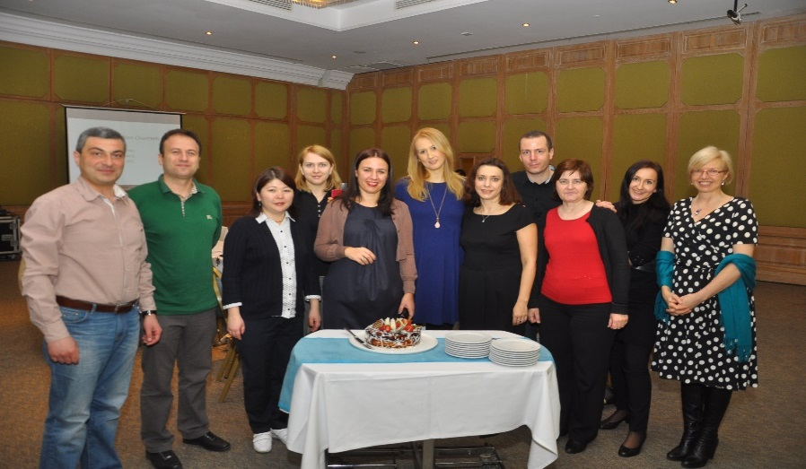
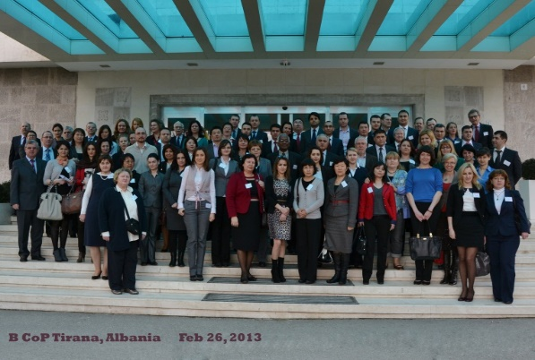
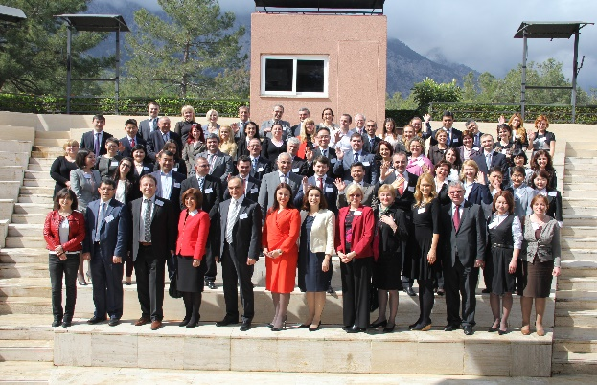
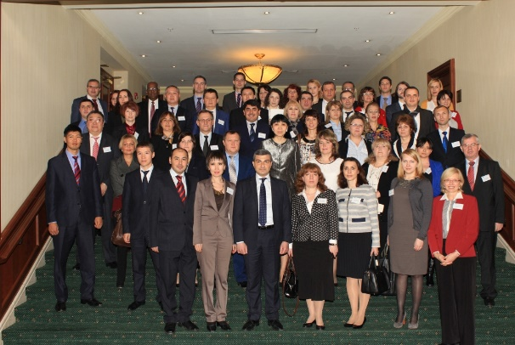
Thank you
BCOP Executive Committee members, Resource Team and Secretariat in Turkey 2014 (Gela’s birthday)!
BCOP 2013, 2014 and 2015 Plenary Meetings in Albania, Turkey and Armenia

