Slide 1
Model of Risk Assessment in Bulgaria
IA – Public sector
Stefan Belchev
Internal Audit Director
Bulgarian MoF
Sofia
18 April 2012

Slide 2
IA - Risk assessment
Why?
When?
How?
Who?

Slide 3
Why?
Law
- art.32
Standards
  – 201 - Planning
IA Manual
MoF IA Charter and Internal rules

Slide 4
When?
Annual base
- November/December every year
Single audit engagement
- On planning stage

Slide 5
How? (Annual base)
Setting the risk factors;
Defining of scale for risk assessing of each factor;
Defining of weight of each factor;
Assessing of every unit/process/activity of audit universe;
Prioritize the most risky unit/process/activity

Slide 6
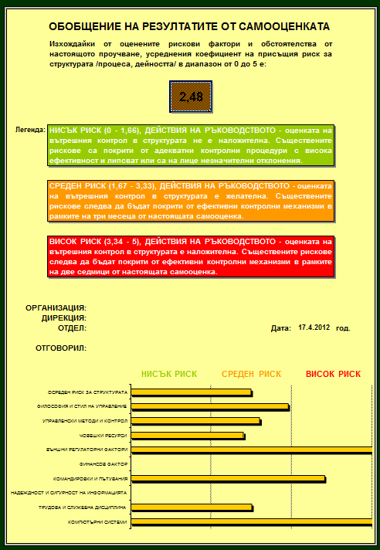
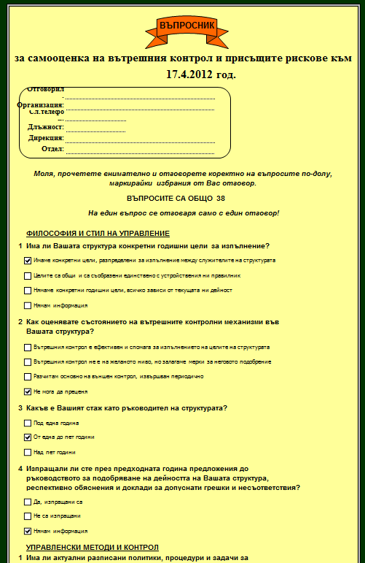
Self - assessment

Slide 7
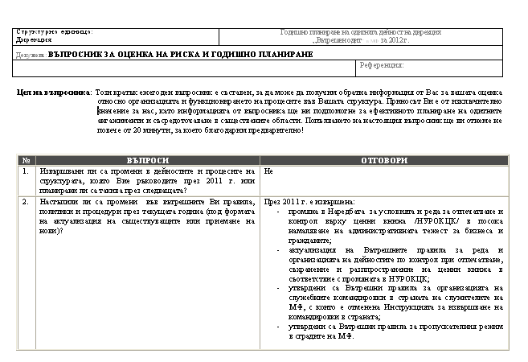
Regular annual questionnaire

Slide 8
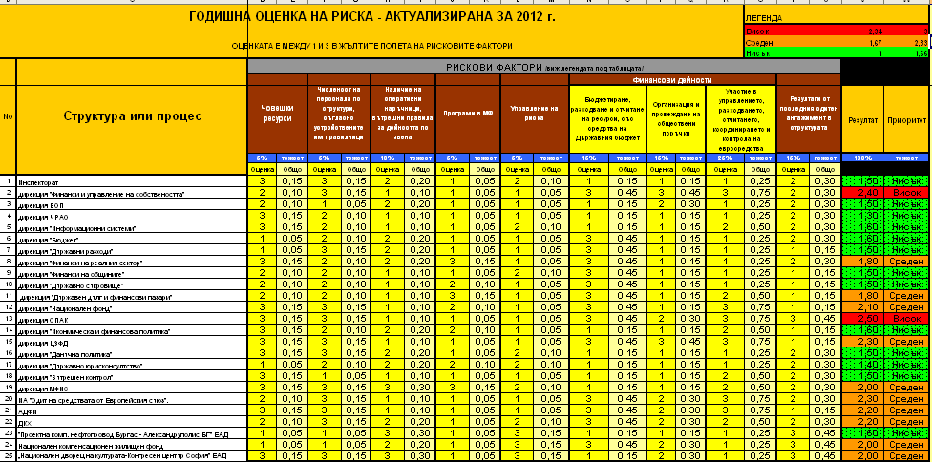
Annual risk assessing

Slide 9
How? (Single audit engagement)
Activity/Process understanding ;
Defining of risks;
Assessing and measuring of risks;
Identifying and assessing controls ;
Specific audit objectives and audit plan and program

Slide 10
WHO?
MoF
– CAE/9 internal auditors
Whole PS
– 247 IAU/479 internal auditors

Slide 11
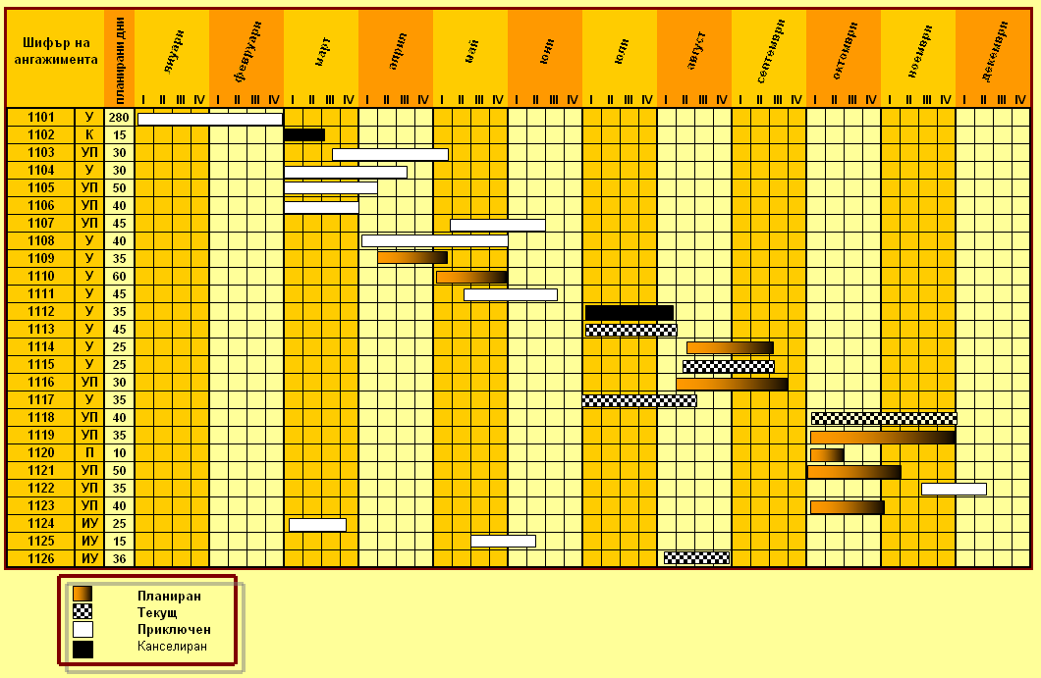
Ongoing monitoring

Slide 12
THANK YOU!
QUESTIONS?
STEFAN BELCHEV
Tel. +359 2 9859 5251
s.belchev@minfin.bg

