Slide 1

Public Finance Management Information System,
The Republic of Moldova model
Elena Saharnyan,
Director of the State Enterprise ‘Fintehinform’
October 6, 2015

Slide 2
Public Finance Management
Information System of MoF
1996 - the first Treasury process was automated.
PFMIS supports all stages of the budget process:
  Budget development and approval;
  Budget execution (management of budgetary allocations, accounting of legal commitments, revenue recognition, and payments);
  Accounting and reporting;
  Collection of financial/non-financial reporting.
PFMIS was implemented as a set of interacting subsystems (adapted commercial packages and in-house solutions)
The system users are:
  MoF and Treasury (450 users);
  Central and local authorities (6,300 users).
Notes:
MoF moves to a new budget classification and introduces a new PFMIS.

Slide 3


MoF PFMIS architecture:
Servere de Aplicaţii
Web Server
Terminals
Centrul Sistemului
Users
PFMIS
SIMF/BPS
Acces Intern
Budget development and approval
BD
E-Alocatii &TREZ
Allocations management
Commitment management;
Revenue recognition and payments;
Accounting of budget execution;
Ministerul Finantelor,
Trezoreria de Stat,
BD
Web Portal
Acces Extern
SIMF/SAP(BW)
Analiza sofisticată
BD
SIMF/CNFD
Financial reporting collection
Autoritatilr Publice Centrale
Autorităţile Publice Locale, Instituţiile Publice

Slide 4
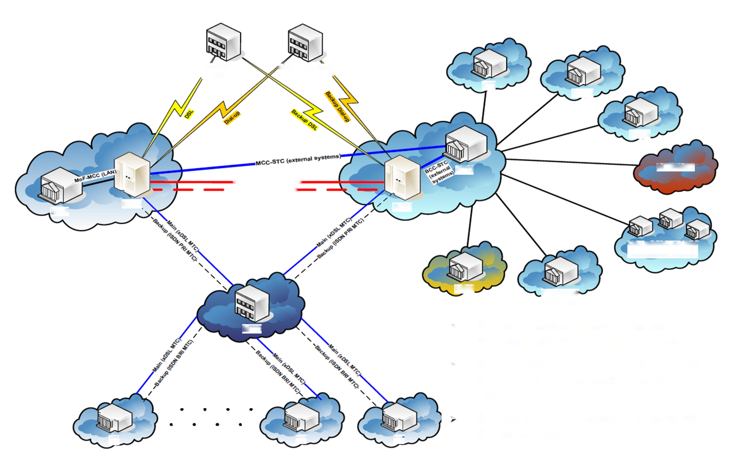
MoF PFMIS telecommunications structure
Commercial Banks
Moldovan Post Service
STI
NHIC
DSL
Backup Dial-up
Dial-up
Backup DSL
NSIA
MSS-STS (external sysrems)
BСС-STС (external sysrems)
STC
INTERNET
FOCL МСС-ВСС (STC)
FOCL MCC-BCC (STC)
MoF
MCC
BCC
Main (xDSL MTC)
Main (xDSL MTC)
Backup (ISDN PRI MTC)
Backup (ISDN PRI MTC)
Other Ministries and State¹ Institutions within the Governamental Network
NBM
Customs
Service
MoF is connected to the government secure data transfer network
The own network was created (VPN prin ADSL) standby lines backup (ISDN)
MoF has a primary and backup server room
MTC
Main (xDSL MTC)
Main (xDSL MTC)
Backup (ISDN BRI MTC)
Main (xDSL MTC)
Backup (ISDN BRI MTC)
Backup (ISDN BRI MTC)
TT
TT
TT

Slide 5

State Enterprise ‘Fintehinform’
State Enterprise ‘Fintehinform’ is a public company with 100% authorized capital owned by the state. The founder of the enterprise is the Ministry of Finance of the Republic of Moldova. (RM Government Resolution No. 516 dated June 2, 2005).
State Enterprise ‘Fintehinform’ operates under the principles of self-government in accordance with ‘State Enterprise Act’ No. 146-XIII of June 16, 1994.
The SE provides administration services, support, development and maintenance of the public finance accounting information system.
The name Fintehinform stands for Finance and Information Technology.

Slide 6
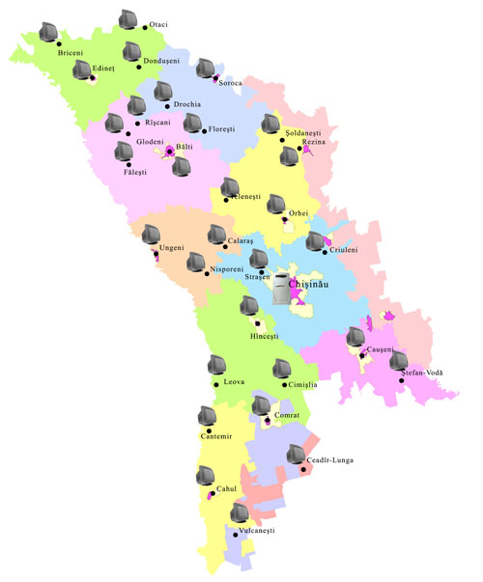
Organizational structure and responsibilities of the units
IS Development and Support Unit - 17 persons
Accounting IS Development and Support Unit - 8 persons
Administration and Technical Support Unit - 11 persons.
Data Processing and User Support Unit - 11 persons.
Information Services Implementation and Support Unit - 37 persons. (34 are in the territorial treasuries at the local level)

Slide 7
Organizational structure and responsibilities of the units
Centralized support functions:
  Software development and administration;
  Administration of databases and servers, network equipment;
  Administration of networks.
Decentralized functions:
  Servicing computer hardware in TC;
  Support of users in 37 TC, 35 FU and 2,829 budget institutions.

Slide 8

Main challenges and difficulties
Retention of highly qualified personnel (salary, personnel motivation)
Use of modern technologies (integration with public services)
Periods of adaptation to changes in legislation
Absence of IT coordinator in MoF

Slide 9
THANK YOU FOR ATTENTION!
Elena.Saharnean@fintehinform.md

