Slide 1
Risk Assessment in Estonia
Evelin Pungas
Head of Internal Control Coordination Unit
Financial Control Department
Sofia, 17.-18.04.2012

Slide 2

What are we talking about?
Risk is anything
that will prevent
you achieving your
objectives ….
“Risk Management”

Slide 3

Risk assessment
has 2 levels:
  audit level
  organisational level

Slide 4
Risk assessment at audit level
The risk assessment during the engagement’s planning phase is used to further define the initial objectives and identify other significant areas of concern.
Internal auditors document their risk assessment as part of audit strategy.
After identifying the risks, the auditor determines the procedures to be performed.

Slide 5

How they do it?
Methodology used is up to auditor / internal audit unit.
To identify risks they use:
  brainstorming
  interviews
  check-lists
and they evaluate risks through
  likelihood and impact.

Slide 6
Governance, risk management and internal control
GOVERNANCE
RISK MANAGE-MENT
SYSTEM OF INTERNAL CONTROLS
INTERNAL AUDIT
Source: “Internal Auditing: Assurance & Consulting Services” Reding, Sobel etc (2009)

Slide 7
Objective, risk, control relationship
To know what risks are present, you need to understand what objectives are being set.
To identify and implement the correct controls, you must know what risks are present.
Therefore,
OBJECTIVES
RISKS
CONTROLS

Slide 8
Legal framework
IIA Standards (regulation of the Minister of Finance)
Government of the Republic Act
The Government of the Republic regulation “Types of strategic development plans and rules for their preparing, amending, implementing, assessing, and reporting”
Emergency situations law

Slide 9
Guidelines
Risk Assessment in the Public Sector (2004)
Risk Management Manual (2011)
Manual of Assessing the Risk Management process (planned for 2012)

Slide 10
In reality
Today we have more information about these organisations where internal audit units have been formed.
Majority of state entities say that they carry out risk assessment at least annually.
Majority of ministries have created their own methodology for risk assessment process.

Slide 11
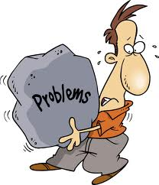
Problems
Little support from managers.
Not all entities carry out risk assessment.
Deficiencies in documenting risk assessment.
Problems of identifying and
formulating the real risks.

Slide 12

Creativity is needed
Risk management is in first line work with people! Mathematics, models and procedures are also important, but if people do not understand the nature of risk, these tools will not work.
Risk is rather an opportunity than faith to accept!

Slide 13
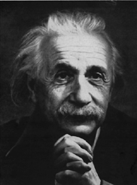
“Not everything that can
be counted counts, and
not everything that counts
can be counted”
A. Einstein

Slide 14
Thank you for your attention! evelin.pungas@fin.ee

