Slide 1
IA Reform Progress…
Where we now?
Komitas Stepanyan, Ph.D, CRMA, CRISC, CobitF
Audit Committee member, Ministry of Finance
Board member, IIA Armenia

Slide 2
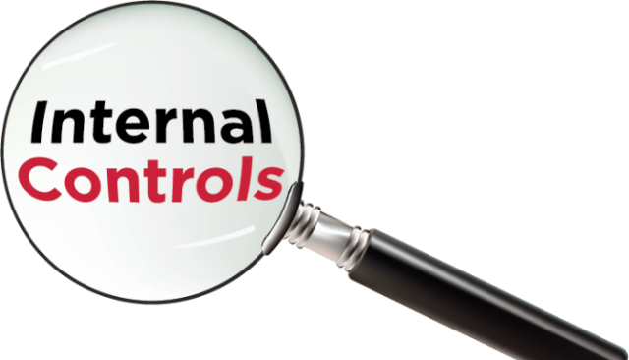
Challenges: Internal Audit Function in low capacity countries
Important
Internal audit is an integral part of the overall PFM in a country and any reforms in internal audit should be designed as part of the overall PFM reform program. Internal audit reforms in isolation of other PFM reforms are unlikely to succeed.
Internal audit will not be effective in a country with extremely weak internal controls or where managerial accountability is absent.
The establishment of internal audit should be done in a gradual and phased manner.
Even advanced countries such as France are implementing internal audit system in a gradual and progressive manner.
Internal audit reform may require first enacting a legal framework followed by extending risk management procedures beyond accounting and finance functions, creation of central harmonization unit to establish standards and procedures, recruitment, and extensive training not just internal audit staff but also management and other personnel.

Slide 3
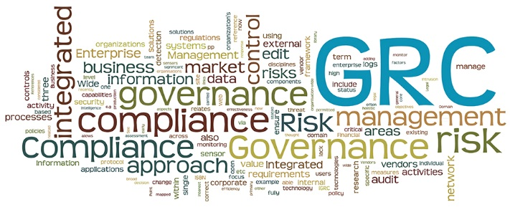
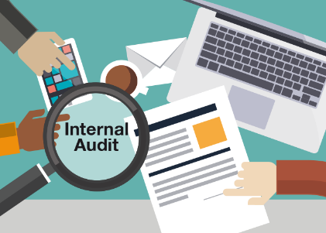
Audit committee – Important component for IA
Improve organizational governance, regardless of whether the organization is in the private or the public sector.
A subcommittee of the governing body
providing oversight of governance, risk management, and internal control practices.
to strengthen the internal audit function
Audit committees also strengthen the independence of the audit activity – How
Notes:
The audit committee should play an independent oversight and advisory role. If the audit committee is involved in making decisions, its objectivity may be impaired, which, in turn, may negatively impact its ability to remain independent.
The functional reporting of the CAE to the audit committee is the ultimate source of an audit activity’s organizational independence. The committee’s composition also is critical. It should include a majority of external members, and the chair and members should demonstrate inquisitiveness, outspokenness, and courageousness.
Independent audit committees are an important part of an organization’s governance structure. Establishing an audit committee — the majority of whose members are independent of the organization — supports the board in fulfilling its oversight responsibilities. These audit committees provide oversight by offering objective advice and recommendations to the board on whether the organization’s governance, risk management, and internal control processes are suitably designed and working as intended to achieve the objectives.
Audit committees help build trust and confidence in how the organization is managed.
The audit committee should exercise due care in fulfilling its oversight responsibilities.

Slide 4
Challenges for IA committee
a good understanding of the role of Chief Audit Executive and internal audit function
sound knowledge of the government financial and performance reporting framework
ability to maintain independence and objectivity in the context of a politically driven environment
Notes:
The audit committee should play an independent oversight and advisory role. If the audit committee is involved in making decisions, its objectivity may be impaired, which, in turn, may negatively impact its ability to remain independent.
The functional reporting of the CAE to the audit committee is the ultimate source of an audit activity’s organizational independence. The committee’s composition also is critical. It should include a majority of external members, and the chair and members should demonstrate inquisitiveness, outspokenness, and courageousness.
Independent audit committees are an important part of an organization’s governance structure. Establishing an audit committee — the majority of whose members are independent of the organization — supports the board in fulfilling its oversight responsibilities. These audit committees provide oversight by offering objective advice and recommendations to the board on whether the organization’s governance, risk management, and internal control processes are suitably designed and working as intended to achieve the objectives.
Audit committees help build trust and confidence in how the organization is managed.
The audit committee should exercise due care in fulfilling its oversight responsibilities.

Slide 5
Audit Committee Responsibilities
Review and provide oversight on the organization’s internal control framework. Keep informed on all significant matters arising from work performed by any governance, risk, and control assurance providers.
Values and ethics
Review and provide oversight on the systems and practices management establishes to:
Set and sustain high ethical standards.
Monitor compliance with laws, regulations, policies, and standards of ethical conduct.
Identify and quickly address any legal or ethical violations.
Internal control framework
Governance initiatives
Key areas of audit committee oversight
Risk management
Review and provide oversight on the establishment, implementation, maintenance, and effectiveness of risk assessment, risk management, and risk reporting practices.
Review and provide oversight on governance initiatives established by the board and maintained by the organization.

Slide 6
Audit Committee Responsibilities, cont.
The audit committee should review and provide advice to the board on the key financial management and performance reports and disclosures issued to the public.
Audit activity
Approve and periodically review a departmental audit policy or charter. Review and approve an internal audit plan. The audit plan should be risk-based and supported by appropriate risk assessments. Monitor and assess the audit activity’s performance in accomplishing the approved plan through periodic reports by the CAE.
Financial statements and public accountability reporting:
External assurance providers
Key areas of audit committee oversight
Follow up on management action plans:
The audit committee should review regular reports on implementation status of approved management action plans resulting from prior internal audit recommendations. The audit committee also should review management action plans resulting from the work of external assurance providers.
The audit committee should be advised of all audit work to be undertaken by external assurance providers, including management’s response and subsequent audit-related issues and priorities. In many jurisdictions, public sector entities are subject to audit by auditors general who have an independent legislative mandate to conduct a broad range of audits.
Notes:
External assurance providers- the last sentence
It is a leading practice for auditors general to brief audit committees, as appropriate, on their annual audit plans.

Slide 7
Audit Committee Composition
Appropriate mix of skills and experience relevant to the organization’s responsibilities.
Generally, audit committees have between 3 and 8 members
Min number
Typical audit committee has 4-5 members
Audit committees maintain institutional memory while providing new perspectives and fresh insights.
Generally, terms less than 2 years are too short. Terms of greater than 8 years may be too long.

Slide 8
Committee Member Independence
An essential feature of an effective audit committee is independence from management.
An independent audit committee member is a person who is not employed by, or providing any services to, the organization beyond his or her duties as a committee member.
Various governments express similar independence requirements.
The government in the Australian state of New South Wales mandates that an audit committee must have a majority of independent members and that these independent members must not be involved in any public sector roles in the state.
The auditor general of New Zealand and the International Federation of Accountants, recommend most of the audit committee members should be external appointments.
The Canadian government requires that a majority of the members be from outside government.
Notes:
An essential feature of an effective audit committee is independence from management. By providing an independent source of advice to the board, audit committees play a key role in an organization’s governance structure. To ensure the audit committee’s independence, it is a leading practice for the majority of its members to be independent from the organization. An independent audit committee member is a person who is not employed by, or providing any services to, the organization beyond his or her duties as a committee member. Various governments express similar independence requirements. The government in the Australian state of New South Wales mandates that an audit committee must have a majority of independent members and that these independent members must not be involved in any public sector roles in the state. The auditor general of New Zealand and the International Federation of Accountants, recommend most of the audit committee members should be external appointments. The Canadian government requires that a majority of the members be from outside government.

Slide 9
Challenges, Pros and Cons
To find appropriate people who are independent of the organization with sufficient knowledge of the organization, government financial reporting framework and an ability to identify, evaluate and resolve the risks.
To have a supportive and positive culture from the top
Internal
External
Members have sufficient knowledge of the institution
Members does not have sufficient knowledge of the institution
Members not devoting enough time to their duties
Members have deep professional knowledge, skills and experience on GRC domains & Internal Audit
BUT – an audit committee is not always required, necessary or even appropriate in all situations

Slide 10
Case study – Audit Committee in Ministry of Finance, Armenia
Minister of Finance, Chairman of AC
Internal and Independent
Adviser to the Minister
Adviser to the Minister
External and Independent
President, IIA Armenia
Board member, IIA Armenia

Slide 11
IA Reform under the P-D-C-A model
Act
Plan
Check
Do

Slide 12
IA Reform under the P-D-C-A model

Slide 13
IA Reform
2nd iteration

Slide 14
Case study – What we have now!
Simplified approach for Internal Audit Universe
Mosely process-based, when it is applicable
Any auditable unit MUST be connected to organization’s high level objectives
Simplified Risk Assessment approach for annual planning
Simplified Annual Plan
New templates for engagement implementation
New engagement feedback form
3 days intensive training for audit leaders
Intensive training for up to 100 auditors in public sector

Slide 15
Audit Universe - Template

Slide 16
Annual Plan – Template => Audit engagement program
Audit Engagement Program
Sub process 1
Risks | Controls
Sub process 2
Risks | Controls
Sub process 3
Risks | Controls

Slide 17
20 simple steps for engagement implementation

Slide 18
Audit engagement program

Slide 19
C o n c l u s I o n
Reform is a journey and not a destination…
PFM and/or Public Sector Internal Audit is not an exception ☺

Slide 21
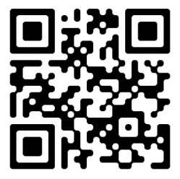
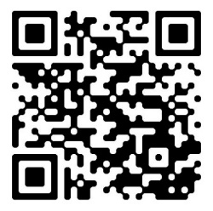
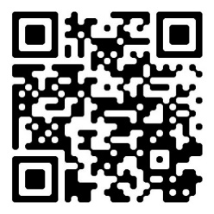
Q&A
Thank You !
Contact me:

