Slide 1



Hungarian Integrity Management Development
Budapest 04 July 2018
Marianna dr. Szabóné dr. Gál, Deputy Head of Department
National Protective Service, Corruption Prevention Department

Slide 2

Topics
Summary of measures taken in the field of fighting corruption
Role of NPS in education and training of professional ethics and anti-corruption
Joint work with Ministry of Finance
Integrated risk management system

Slide 3
Government measures taken to strengthen integrity

Slide 4
New approach for spreading integrity culture
2007-2008 “Twinning Light” project of the State Audit Office and the Dutch Audit Office
State Audit Office launched its ÁROP-1.2.4 “Mapping Corruption Risks - Strengthening Integrity Based Administration” priority project
SAO’s Integrity Survey (2011-2017)

Slide 5
SAO’s Integity Survey (2011-2017)
2011: 1095 organisations completed the Survey
2017: 3346 organisations completed the Survey
standard questionnaire method (155 questions, 16 topics)
NPS’s contribution to promoting SAO’s Integrity Survey

Slide 6
Conclusions of the 2017 Survey
integrity awareness has been strengthened since 2011
the notion of integrity reached the majority of the public sphere
inherent vulnerability risk factors and risk factors increasing vulnerability of public organisation have decreased
the level of controls remained the same

Slide 7
Measures, initiatives
IACA, GRECO, OECD
Joint declaration on co-operation (SAO, Supreme Court, Ministry of Interior, Prosecutor General, Public Procurement Authority, Hungarian Competition Authority)
National Anti-Corruption Programme 2015-2018
(2 Action Plans for implementation)

Slide 8
Integrity Management System
Government Decree No. 50/2013 (II.25.) on the system of integrity management at public administration bodies and the procedural rules of receiving third parties representing private interest
Definition: “operation of an organisation in compliance with the applicable rules, the objectives, values and principles defined by the head of the official organisation and the body governing it.”

Slide 9
Integrity Management System
the operation of the integrity management system -responsibility of the head of the organization
assisted by an integrity advisor in this work.
it is compulsory for every public administration institution operating with a staff exceeding 100 people to appoint an advisor

Slide 10
Tasks of integrity advisors
receiving and investigating reports on events violating integrity
informing the managers and staff about ethical conduct
giving advice in questions concerning professional ethics
from 2016 : coordination of integrated risk management system

Slide 11
Integrity advisors training
350 qualified integrity advisors
National Protective Service, National University of Public Service
Training materials on integrated risk management system with the assiastance of the Ministry of Finance

Slide 12
The role of National Protective Service
From 2014 the Ministry of Interior fulfils the tasks of corruption prevention
by the National Protective Service
October 1st 2014 establishing the
Corruption Prevention Department

Slide 13
Corruption Prevention Department
Strategical planning
Methodological support, integrity management development
Ensuring the continuous evaluation of the corruption situation and the governmental anti-corruption actions and provisions
Case-studies, integrity advisors network development
Thematical website operation
International cooperation (OECD-SPIO, EPAC/EACN, B.A.K.)

Slide 14
Results
62 events (workshops, conferences, professional days)
1800 participants
7 methodological guidelines (local governments, state administration organisations)

Slide 15
Training programmes in numbers
Training programmes at NUPS: 10 000 persons
Trainings and workshops for public officials: 500 persons
Integrity advisor specialised training programme: 50 + 100 persons
Trainings for law enforcement and public prosecutors: 200 persons
In-house trainers of NPS: 10 persons

Slide 16
Aims, target groups and themes of trainings
Specific skills for public servants to become integrity advisors
Integrity management for local and county level executives
Information on integrated risk management system for county-level public officials
Capacity building of police and prosecutors
Capacity building
Awareness raising
Sensitisation

Slide 17
Cooperation with Ministry of Finance
Amendment of laws (integrated risk management system)
3 Guidances on integrated risk management system
Workshops on integrated risk management system
Tailor-made recommendations for budgetary organisations volunteering to introduce and integrity management system
Training materials

Slide 18
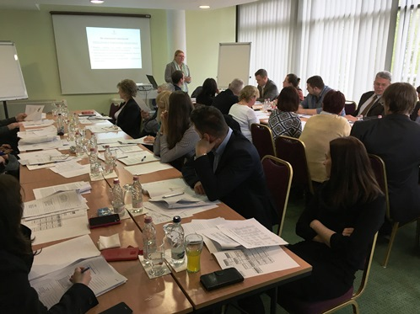
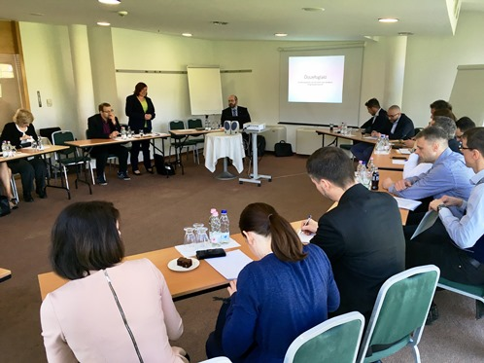
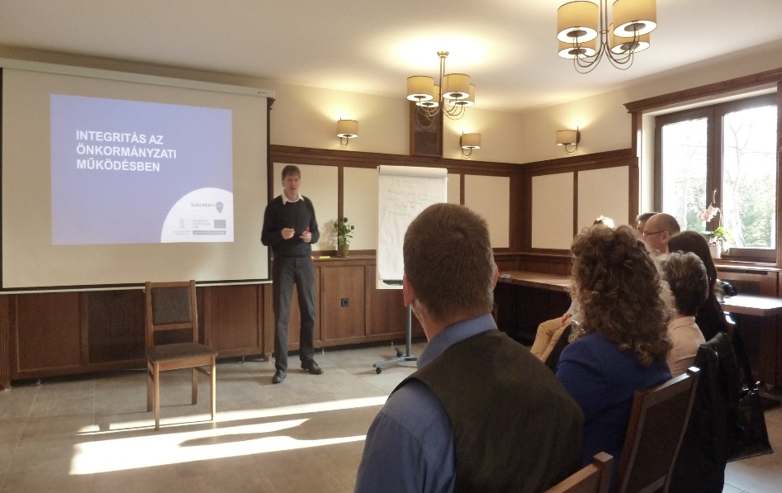
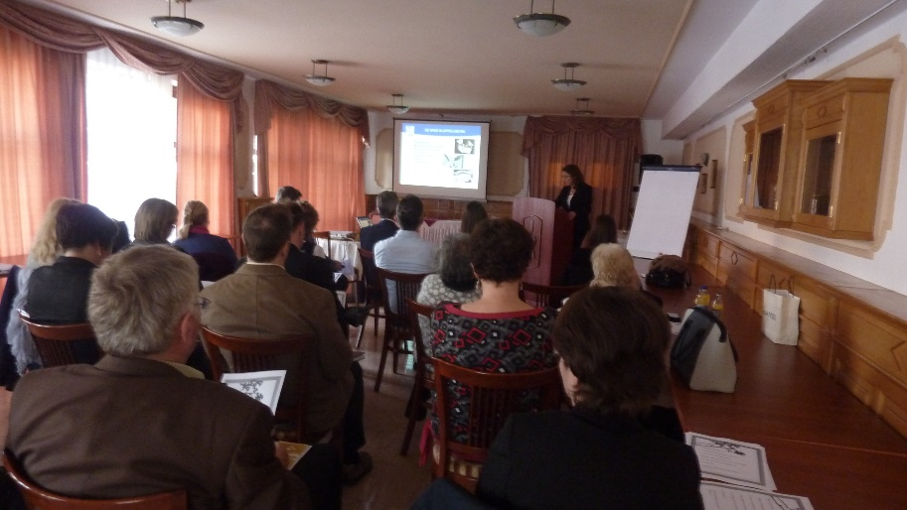
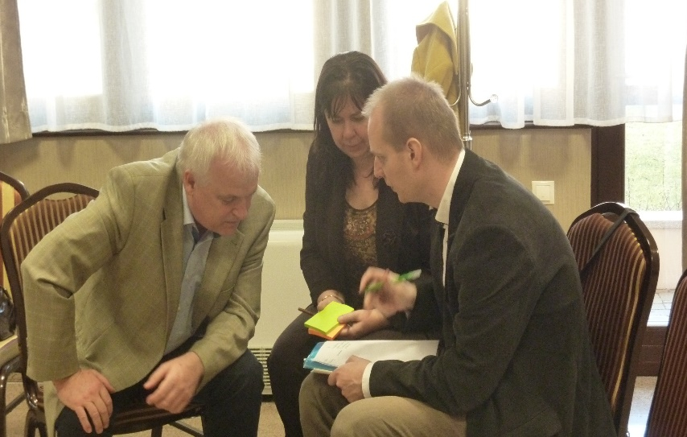

Snapshots

Slide 19
Integrated risk management system

Slide 20
Previously…..
Central organisations supervised by government
Definition of integrity management
Main elements of the integrity management system
Integrity advisor
  Shortcomings:
  Limited scope
  Duplications with risk management within internal control system

Slide 21


Novelty of risk management
  Covers all budgetary organisations
  Risk management includes organisational values and goals
  Emphasis on processes
  All processes covered
  Coordinated team effort

Slide 22
From fragmented to global
General aim
Strategic aim
Main processes
Sub-processes

Slide 23
Thank you for your attention!
szabonegm@nvsz.police.hu

