Slide 1
A good practice of harmonisation between reforms: public internal control and anti-corruption Edit Németh, Head of CHU Ministry of Finance

Slide 2
SETUP OF PUBLIC INTERNAL CONTROL SYSTEM OF HUNGARY
Parliamentary level
External audit – State Audit Office
Financial audit of local governments - Treasury
Governmental level
Financial Inspection – Government Control Office
Financial implementation of the budget, first level control activities and ex-post controls of certain subsidies –Treasury
Audit of EU Funds – Directorate General for Audit of European Funds (EUTAF)
Organisational level
Internal control system which includes an internal audit function

Slide 3
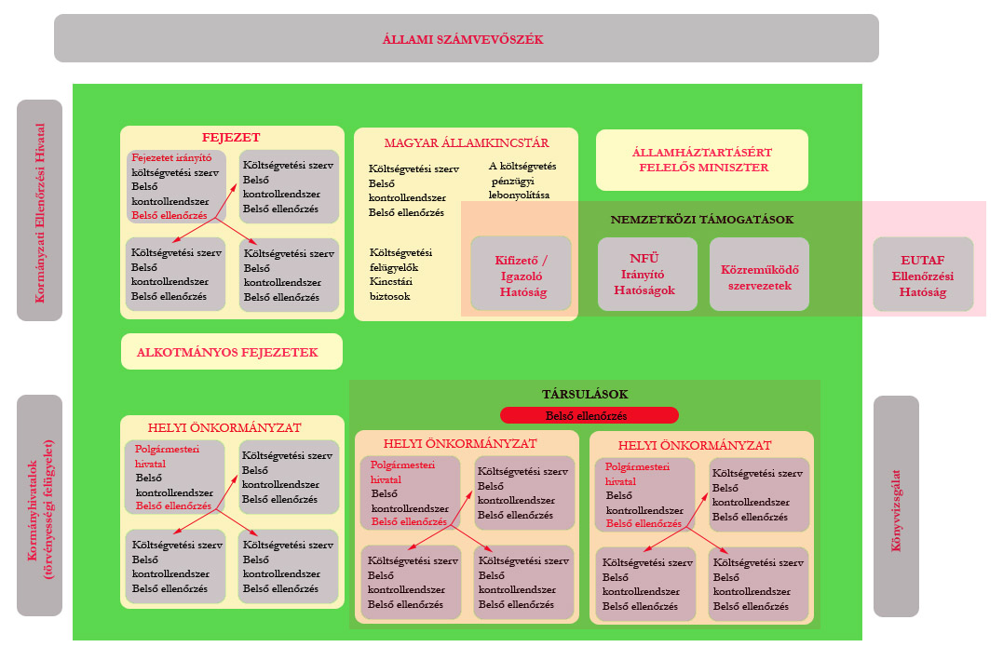
State Audit Office
Chapter
Treasury
Ministry of Finance
Government Control
Office
EU Funds
Local governments
Government
Offices
Chartered
Auditors

Slide 4
A SHORT OVERVIEW ON THE DEVELOPMENT OF THE HUNGARIAN PIC SYSTEM
The roots of the Hungarian regulation of the public control system go back to 1989 – this was the date of establishment of the State Audit Office (SAO) – the Hungarian Supreme Audit Institution
1992 – the Parliament accepted the Act no. XXXVIII of 1992 on public finances (PFA)
1995 – establishment of the Hungarian State Treasury
2000 – Financial Audit Department within the Ministry of Finance – ancestor of the latter Central Harmonisation Unit
2003 – the Government accepted the Hungarian Public Internal Financial Control (PIFC) Development Strategy (Policy Paper)

Slide 5
2003 – the establishment of the new Public Internal Financial Control System (PIFC) – as the part of the accession negotiations to EU
- MoF adopted the IIA standards for use by the public sector
- MoF elaborated the new government decree on internal audit of public organisations
2004 – first Annual Report on PIC
- First version of IA Manual was published
- As a result of the continuous improving work the IA Manual was revised twice (2006, 2009, 2013)

Slide 6
2009 – PIFC system reviewed – COSO model integrated – the 5 well known components: control environment, risk management, control activities, information and communication, monitoring
National IA and IC Standards issued by MoF
Internal Control Manual issued by MoF
2010 - 2014 – New government structure – amendment of the whole legislation of PIC of Hungary
New law on Public Finances
New government decree on internal control and internal audit of budgetary organisation
New ministerial decree on the registration and traning system of internal auditors
Updated versions of old guidelines

Slide 7
The challenges we faced before the good cooperation between PIC and anti-corruption reforms
Parallel and not clear legislation on risk management, handling of fraud and internal control system
Lack of inside „agent of change” at the organisations – only internal auditors understood the concept of internal control system but they couldn’t be responsible of the implementation of it
Lack of knowledge and practice of internal control at the organisations
Lack of processed based and system based approach in the activity of the organisations
Very financial oriented approach towards internal control at the organisations
Integrity management was introduced as a separate system, not part of internal control system / legislation
Lack of cooperation with the Integrity Project of SAO and later Ministry of Public Administration
Lack of trainings on internal control

Slide 8
The results of the cooperation with anti-corruption reform from 2016 to nowdays
Modified legislation
New definition – instead of fraud we use the term of violation of integrity of the organisation
New value based approach – emphasis on integrity and ethics
Integrated risk management
Role of integrity advisor in internal control system – coordination of implementation of control environment and integrated risk management
Process based approach
Appointment of process owners
Emphasis on the fact that internal control must be applied for all activities, not only for financial processes
New guidelines on internal control
New training materials and lots of new trainings
Integrated risk management training as part of the education program for integrity advisors

Slide 9
THANKS!
Q&A

