Slide 1
Internal Audit planning of an audit: EC practices
Selection of current practices following EC IAS methodology from audit engagement to kick-off

Slide 2
IAS mission
From IAS audit Charter:
"The mission of the Internal Audit Service is to enhance and protect organisational value by providing risk-based and objective assurance, advice and insight. The IAS helps the Commission accomplish its objectives by bringing a systematic, disciplined approach in order to evaluate and improve the effectiveness of risk management, control and governance processes."

Slide 3
The Commission’s governance and internal audit environment
College of Commissioners
Audit Progress Committee (APC)
First Vice-President Timmermans
Administrative reporting
Internal Audit
DG
Internal Audit Service
DG
Directorate-General
Internal Audit
Internal Audit
A.B. Board
A.B. Board
Executive Agencies
A.B. Board
Community Agencies
Executive Agencies
Community Agencies
Executive Agencies
Autonomous Body/ Community Agency
3
Notes:
3
Purple lines are internal audits inside the Commission
Light blue lines refer to audits and reporting to Community Agencies
Mention the respective analogies within a private sector company – shareholders (parliament) – board of directors (college) – audit committee (APC) – executive management / divisions (DGs/EAs)

Slide 4
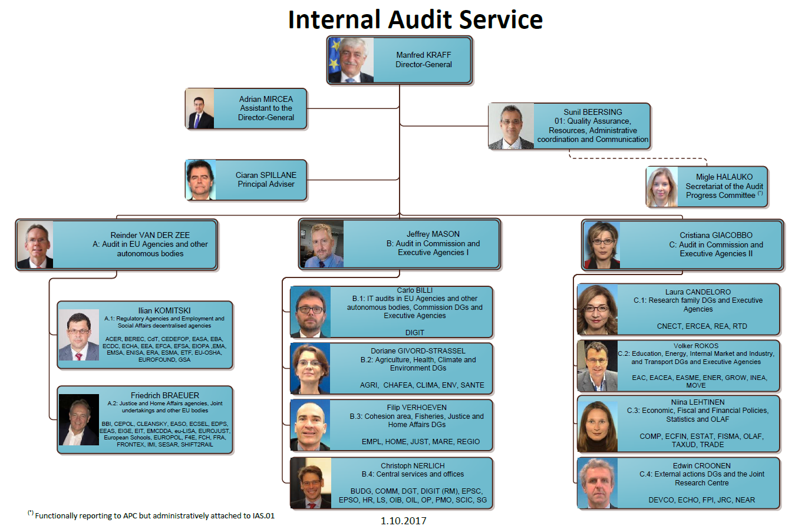
Notes:
Co-trainer to talk through the new structure.
Confirm the centralisation of the internal audit function of the Commission from February 2015 involving for the Commission DGs the loss of IACs and the increase in staff /revision of structure of the IAS.
The reorganisation has also had an impact on the planning and reporting of the IAS – A number of changes that can be summarised but perhaps principally the issuing for the first time by the IAS in February 2016 a conclusion on the state of internal control to every DG and service to contribute to their 2015 AARs. This replaced the former IAC opinion on the state of control which is one of the key building blocks in the Director Generals statement of assurance. ( see also comments on slide 23)

Slide 5
Practice 1: from Audit Plan to Audit Engagement
The Annual Plan is part of a multi-annual strategic plan, based on an in-depth risk assessment updated annually
Annual audit plan contains indicative audit title, general objective, audit budget, year of completion, Unit responsible – see example 1
The Unit refer to its capacity planning and matches the availability of auditors with the needed skills and auditors’ interest
Teams of 2-3 auditors, audit budget generally in the range of 90-200 days depending on the scope

Slide 6
Practice 2: audit scheduling
Indicative milestones agreed with HoU in the audit creation form (see example 2)
Take into account:
Average time dedicated to audits
Team or 2/3, experienced/newcomers
In general 25-40% for preliminary survey, 40-65% for fieldwork, 20% for reporting
IT or other specific expertise needed
Overlapping with other annually recurring activities (RA, SAP, OO, APC reporting)

Slide 7
Practice 3: audit creation in audit software
Audit created in audit software (TeamMate) defining roles, time budget, milestones
This activates the possibility to charge audit hours to this engagement in timesheets (see example 3a)
Consequent monitoring of consumption of audit budget (see example 3b) and of milestones by management (radar screen)
The audit software is key to document and to supervise the audit work

Slide 8
Practice 4: Announcement Letter
Official announcement letter sent at least 1 month in advance of the opening meeting (see example 4)
Request for contact person in the audited entity, who will act as an entry point and facilitator
Sent together with Mutual Expectation paper (see next practice) + annex on personal data, where the IAS asks the DG Management to send to all staff concerned a notification of the possible use of "personal data" during the audit

Slide 9
Practice 5: Mutual Expectations paper
“What you should expect from the IAS, What the IAS expects from you”
See example 5– it contains a.o.:
timing to be expected for main audit communication/steps
Rights and obligations of auditors and auditees

Slide 10
Practice 6: Opening Meeting
The opening meeting is organised with the contact person and/or other representatives of the Director General to:
Provide more details about the audit objectives, the scope, and the audit methodology to be followed;
Have an exchange of views on the audit and its timing and the issues of interest and expectations of the Directorate or Unit;
Identify the main contact points and how and with whom the audit findings will be validated during the fieldwork;
Present two important documents : Mutual Expectation Paper / Obligations related to Data protection;
Discuss logistics and timelines.

Slide 11
Preliminary Survey
Aims to obtain a better understanding of the audited process and of the related risks to better define the objectives and scope of the engagement, by:
Review of relevant documentation
Interviews
Data analysis
…
Documented in the audit software tool
Output: Engagement Planning Memorandum

Slide 12
Practice 7: Engagement Planning Memorandum (EPM)
The main output of the preliminary survey is the EPM (see example 6)
The EPM represents the actual planning of the audit
It contains:
The objective of the audit
The audit scope
The timeline
The human resources for the engagement
The audit programme
together with process description, background information, main figures, summary of previous related audits, audit methodology, etc.
Reviewed by management and QA and approved by management

Slide 13
Practice 8: Detailed audit programme
Either:
RCM (Risk and Control Matrix)
Used for financial/compliance audits
See example 7
or
PAM (Performance Audit Matrix)
Used for performance/comprehensive audits
See example 8

Slide 14
Practice 9: Communication to auditees: Scoping Memo
The Scoping Memo is an extract of the EPM sent to the auditees as input for the kick-off meeting
See example 9

Slide 15
Kick-off Meeting
Meeting to be held by the IAS with the Director(s)-General or Head(s) of Service(s) concerned.
The IAS will be represented by the Audit Head of Unit and, when appropriate, the Audit Process Director and/or Director-General
Purpose:
Establish an open and constructive dialogue with the management team of the DG(s) or Service(s)
Present Scoping Memo
Provide more details about
The audit objectives and planned scope,
The audit methodology to be followed
The parties that will be audited
The special security measures, if any
Ask the auditee what their expectations are (and refine EPM if necessary)

Slide 16
Questions & Answers

Slide 17
Thank you!

