Slide 1
Internal audit
Community of practice
Audit-in-Practice (AiP)
Working Group
Budapest, March 2017

Slide 2
Our Mission
IA COP offers support to its member countries
in establishing modern and effective Internal Audit system that
meets international standards and best practices and
is a key for good governance and accountability in the public sector
Our Core Values
Professionalism, dedication to reforms, commitment to sharing knowledge
and experience with the community (as professional family of peers),
trust, unity and respect to diversity of 23 member countries
Strategic Priorities
Internal Control WG - FMC implementation with emphasize on accountability and transparency (new WG)
RIFIX WG - Relationship of Internal Audit with Financial Inspection and External Audit (continuing working group)
Audit in Practice WG - Practical implementation of audit cycle, different type and models of audits, including IT solutions (AiP - new WG)
Central Harmonization Units: challenges at different stages of reform
Promotion of IACOP, including the existing knowledge products and experience gained in ongoing and previous working groups: T&C, CPD, RA, QA, Body of knowledge

Slide 3
Our Mission
IA COP offers support to its member countries
in establishing modern and effective Internal Audit system that
meets international standards and best practices and
is a key for good governance and accountability in the public sector
Our Core Values
Professionalism, dedication to reforms, commitment to sharing knowledge
and experience with the community (as professional family of peers),
trust, unity and respect to diversity of 23 member countries
Strategic Priorities
Audit in Practice WG - Practical implementation of audit cycle, different type and models of audits, including IT solutions (AiP - new WG)

Slide 4
AiP WG First Meeting
Objectives:
Expected Outcomes:
Review the complete audit cycle
Discuss the experience in application of International Standard for the Professional Practice of Internal Auditing (ISPPIA) 2210 – Engagement Objectives
Understand the theory and practice in establishing audit objectives
Agree on the next steps in the AiP WG
Solid understanding of the application of ISPPIA 2210 – Engagement Objectives
Recognition of key challenges in establishing audit objectives
Establish the next steps in AiP WG

Slide 5
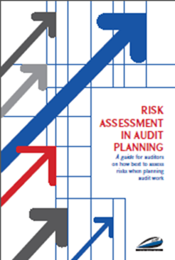
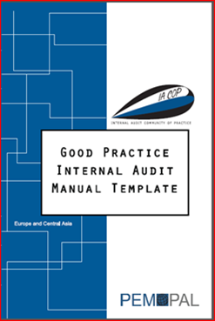
Building up on IACOP Knowledge products
A guide for auditors on how best to assess risks when planning audit work
Gives preconditions for an effective internal audit - mainly developed for the purpose of strategic and annual planning
principles of risk assessment can also be used for a specific audit planning
3.INTERNAL AUDIT PROCEDURES
3.2. Execution (include a flowchart of the execution process - audit cycle)
3.2.2. Audit Objectives and Audit Scope / engagement objectives is just one component of the audit cycle

Slide 6
Let’s start our AiP WG journey

