Slide 1
General Overview of the main IT Systems of the Hungarian State Treasury
Kristóf Kállay IT Vice-President
of the Hungarian State Treasure

Slide 2
THE HUNGARIAN STATE TREASURY
is a central budget agency with a separate operation and financial management, with an executive power, forming an independent legal entity with a national scope of competence, standing under the direction of the Minister for National Economy concerning both the functional and the regulatory aspects. The Treasury performs its tasks through the Headquarters and the County Directorates.

Slide 3
Organizational and Structural background (1)
The Hungarian State Treasury was founded on the 1st of January 1996. The central office and 19 county directorates are carrying their tasks since the 1st of January 2012.
Since 1 January 2017, as general successor of the Office of Agriculture and Rural Development, the Hungarian State Treasury performs the paying agency activities and certain other tasks related to the domestic agro-rural development subsidies. The central body of the MVH merged into the organization of the Hungarian State Treasury; its regional bodies have been allocated to the County Government Offices.

Slide 4
Organizational and Structural background (2)
As of 1 November 2017 the Central Administration of National Pension Insurance merged with the Hungarian State Treasury. As a consequence of this merger the a Hungarian State Treasury acts as central pension insurance body, central family support body, social authority and health insurance body with regard to the tasks allocated to it, and disburses pensions and pension-like benefits, family support benefits, disability benefits, and the personal allowance for the blind, established in the framework of social insurance.
Between 2007 and 2010 the Treasury's regional bodies perform their tasks in the regional network, from 1 January 2011 in the county structure.

Slide 5
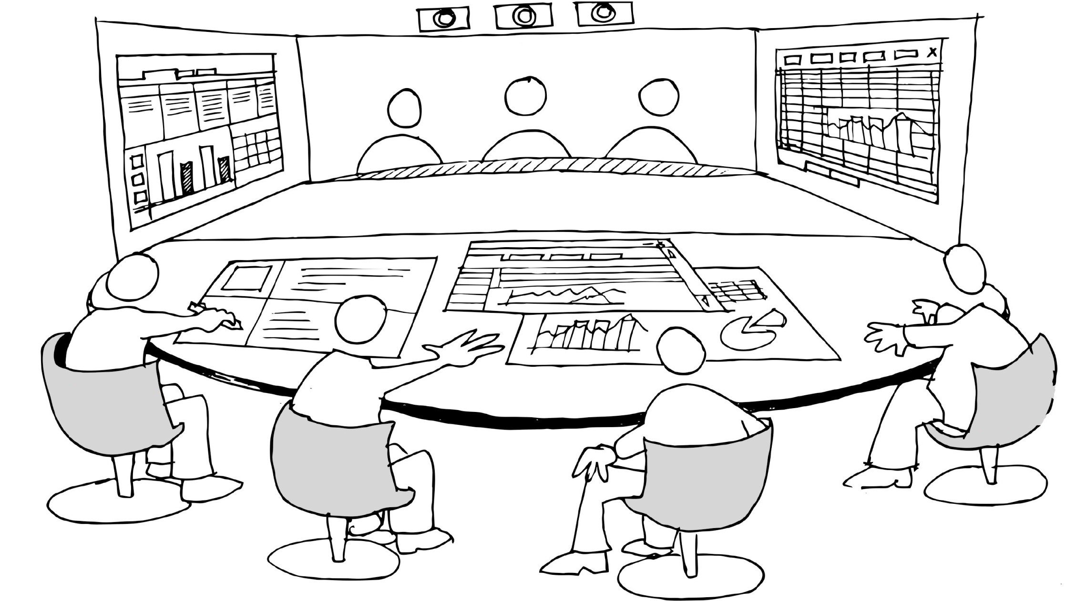
basic activities
HR
Purchases
IT
CFO
Back-office
Source: timoelliott.com
Functional leadership
Notes:
A modern backoffice lehetővé teszi az adatvezérelt döntéshozatalt

Slide 6
700
institutions
in central government
800+
programs’ appropriations
500+
centrally managed appropriations
EUR 60 bn
locally developed SW +
Excel
6

Slide 7
THE Main functions supported by IT in the Hungarian state treasury (1)
The Hungarian State Treasury performs more than 200 public tasks, which form a list that is almost boundless.
It is present in each county (19) in the form of directorates.
In the frames of the directorates operate the following:
Exchequer Offices,
Payroll Calculation Offices,
Financial and Coordinating Offices and
State Budget Offices.
IT support is available for all directorates.

Slide 8
THE Main functions supported by IT in the Hungarian state treasury (2)
The Hungarian State Treasury is responsible for the tasks below – among others:
Implementation of the central budget: appropriation management, accounting and reporting
Manage payments and earnings, bank account management
Liquidity management
Centralized payroll calculation
Social benefits (pension, family allowances)
Government securities distribution
Funding and auditing of local government
Handling of EU and domestic funds / grants / transfers (e.g. agrarian and rural development)
Funding and control of non-state education and social care providers
Budgetary Institutions Register

Slide 9
IT STRATEGY 2018-2022
Strategic goals:
Service Provision - Expanding, customer-oriented services
Customer focus - Customer-friendly service
Integration - Renewal and integration of professional systems
Developing a flexible IT utility - Infocommunication
Implementation plans:
The Treasury plans to implement the IT strategy in three phases, building on their results.
In 2018, launch short-term IT consolidation and ongoing EU projects.
Between 2019-2020, the goal is to transform IT into an organizational and operational transformation of the Treasury.
Between 2021 and 2022, the goal is to support the expansion of services.

Slide 10
IT ORGANIZATION
The Treasury's IT organizational structure consists of the following departments:
IT Operations Department
IT Strategy and Service Department
Agriculture and Rural Development IT Department
Department of IT application development and operation for Social Insurance and Family Support
IT infrastructure management Department for Social Insurance and Family Support
IT Support Department for Social Insurance and Family Support
KINCSINFO Nonprofit Ltd. supports the IT tasks of the Treasury, which carries out the implementation of project-specific project tasks and developments requiring special expertise and their coordination.

Slide 11
IT INFRASTRUCTURE
The current IT infrastructure situation as a result of treasury integration is the following:
There are currently 7 data centers in Budapest. As a result, data center consolidation is justified by the operation of 3 data centers.
The National Infocommunications Service Company Ltd. (NISZ) operates the most secure and critical IT networks of the Hungarian state as well as the network of the Treasury.
The central data centers typically use IBM main frames with Oracle database management system.
High-speed network operation of central data centers and smaller county data centers is ensured.
All professional staff and administrative staff are provided with a desktop computer or laptop for the necessary office and special system tasks.

Slide 12
Thank you for your attention!

