Slide 1


TCOP Activities in FY2019
Budapest, Hungary
June 5, 2019

Slide 2
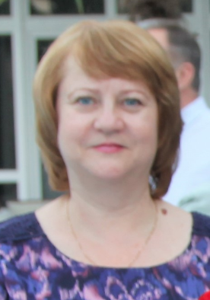
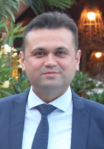
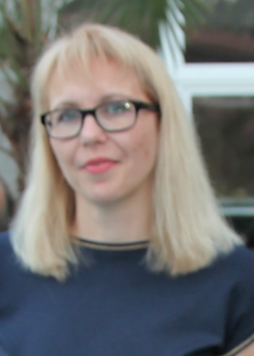
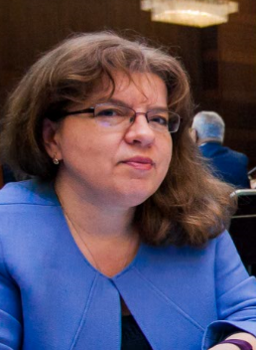
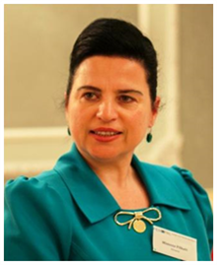
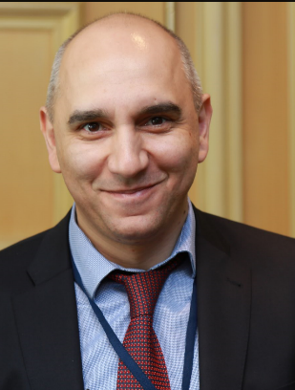
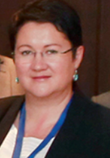
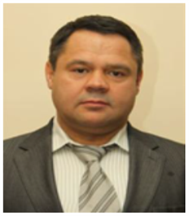
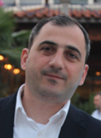
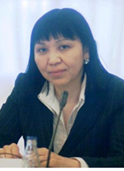

Angela Voronin,
TCOP Chair,
Head, State Treasury
Moldova
Ilyas Tufan,
TCOP Vice Chair,
Department Head, Ministry of Treasury & Finance, Turkey
Lyudmila Guryanova
TCOP Vice Chair,
Deputy Head
State Treasury
Belarus
Elena Nikulina,
PEMPAL program leader
Mimoza Pilkati
Department Director,
DG of Treasury
Albania
Executive Committee
Treasury Community of Practice
Nazim Gasimzade Department Head, State Treasury Agency,
Azerbaijan
Yelena Slizhevskaya
Resource Team
Alexander Demidov,
Deputy Head
Federal Treasury,
Russia
Zaifun Yernazarova
Department Head,
Ministry of Finance,
Kazakhstan
Levan Todua
Department Head, State Treasury, Georgia
Ekaterina Zaleeva
PEMPAL Secretariat

Slide 3
TCOP Action Plan for FY2019
(July 2018 – June 2019)
Was developed in accordance with :
  PEMPAL Strategy for 2017-2022
  Results of TCOP member surveys, including the one in Tirana in May 2018
Is aimed at achievement of PEMPAL TCOP strategic goals:
  Promotion of PFM reforms of high priority for TCOP members, with the focus on reforms of national treasuries
  Provision of TCOP members with high quality resources and knowledge services
  Establishment of highly professional community of treasury specialists in TCOP countries
  Gaining support for TCOP activities and for activities of PEMPAL as a whole from top management of treasuries from member countries

Slide 4
TCOP continues to work in 4 key thematic areas
Treasury
Function
Evolution of treasury role and functions
IT
Use of information technologies in treasury operations
Cash
Cash management
A/R
Accounting and reporting in the public sector

Slide 5
Activities implemented between July 2018 - June 2019
TCOP Plenary meetings
1 TCOP Plenary meeting with participation of 38 persons (Budapest, 2019)
Small format workshops
2 small format workshops (Vienna, 2018 and Budapest, 2019), with participation of 59 TCOP members
Thematic videoconferences
4 videoconferences with participation of 95 TCOP members
Executive Committee
4 ExCom meetings (including 3 videoconferences)

Slide 6
TCOP Thematic Groups
Cash Management Group (16 countries)
Evolution of Treasury Role and Functions Group (16 countries)
Public Sector Accounting and Reporting Group (14 countries)
Use of IT in Treasury Operations Group (11 countries)

Slide 7

Cash Management Group
The group was established in 2015 and currently includes 16 countries (Armenia, Albania, Azerbaijan, Belarus, Croatia, Georgia, Kazakhstan, Kosovo, Kyrgyzstan, Moldova, Montenegro, North Macedonia, Russian Federation, Tajikistan, Turkey and Ukraine)
Since its establishment, the group held:
  4 thematic workshops (Ankara,
  Moscow, Chisinau, Vienna)
  7 videoconferences
  1 thematic survey
The group held two events in FY2019:
  Videoconference - September 18, 2018
  Thematic workshop in Vienna – November 2018

Slide 8
Thematic Videoconference on September 18, 2018
Event objectives
To discuss preparations for November 2018 meeting of the group and further refine the meeting agenda
Key outcomes
Participants
Members of the TCOP thematic group on cash management – 22 participants from 12 countries
Ideas for news session on cash management were discussed and volunteers identified
It was confirmed that the treasuries of Russian Federation and Turkey will present their cash forecasting practices during the event
Tasks for small group discussions formulated

Slide 9
Workshop in Vienna, November 7-9, 2018
Event Objectives
To share ideas and experience how to develop soundly-based and high-performing cash flow forecasts (CFF)
Key Outcomes
Good international practice of CFF reviewed, differences from cash and appropriation controls discussed
Participants
Members of the TCOP thematic group on cash management – 33 participants from 16 countries
To explore the links between cash flow forecasting and budget execution
Participants familiarized with successful example of integration of debt and cash management functions in Hungary, as well as with approaches to CFF in Turkey and Russia
Status of CFF in member countries discussed

Slide 10
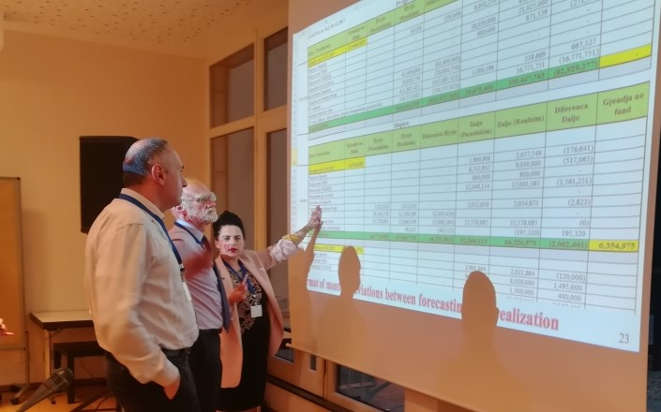
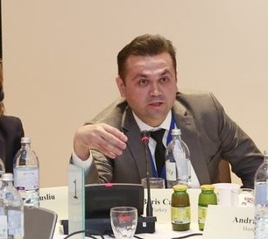
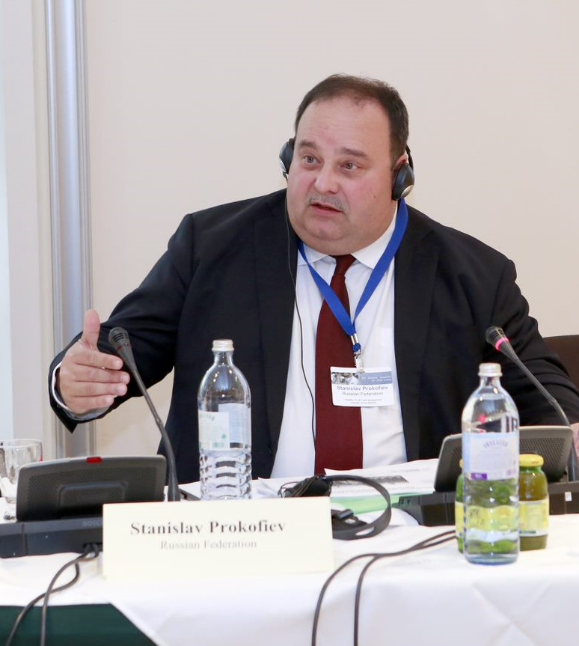
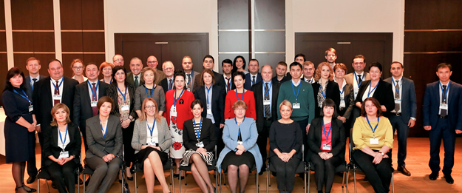
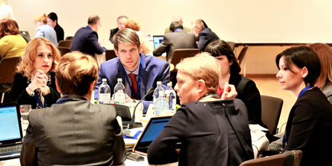
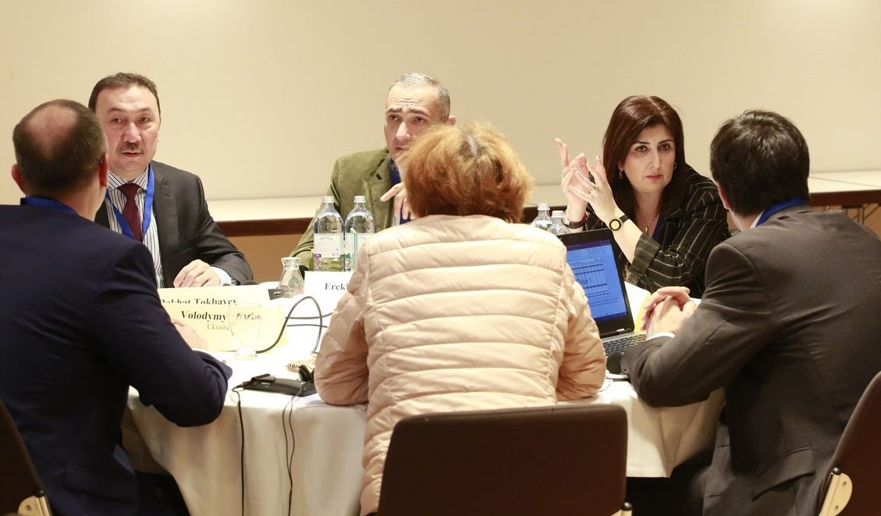

Slide 11

Use of IT in Treasury Operations Group
The group was established in 2013 and currently includes 11 countries (Albania, Azerbaijan, Belarus, Georgia, Kazakhstan, Kyrgyzstan, Moldova, Russian Federation, Tajikistan, Turkey and Ukraine)
Since its establishment the group held:
  5 workshops (Minsk, Tbilisi,
  Chisinau, Baku, Budapest)
  3 study visits (Ankara, Seoul, Vienna)
  9 videoconferences
The group held 2 events in FY2019:
  Videoconference - December 18, 2018
  Thematic workshop in Budapest – June 2019

Slide 12
Thematic videoconference on December 18, 2018
Event objectives
To share the recent developments in the use of IT in treasury operations in member countries
Key outcomes
Shared information on the progress of ongoing Albanian Integrated Financial Management System Project
Participants
Members of the TCOP thematic group on use of IT in treasury operations – 13 participants from 7 countries
To discuss ideas for the next face-to-face thematic group meeting
Proposals for the concept of the next face-to-face meeting of the group
Update by Tajikistan MoF on 2017-2018 improvements in the automation of the treasury payment processes and forthcoming launch of the medium-term expenditure planning module
Information from Belarus and Azerbaijan on the prospects for implementing e-contracts

Slide 13

Public Sector Accounting and Financial Reporting Group
The group was established in 2013 and currently includes 14 countries (Albania, Azerbaijan, Belarus, Croatia, Georgia, Kazakhstan, Kyrgyzstan, North Macedonia, Moldova, Russia, Tajikistan, Turkey, Montenegro, and Ukraine)
Since its establishment the group held:
  4 workshops (Podgorica,
  Tbilisi, Minsk and Baku)
  2 videoconferences
The group had 1 event in FY2019:
  Videoconference - January 31, 2019

Slide 14
Thematic videoconference on January 31, 2019
Event objectives
To discuss the first draft of the new knowledge product on optimizing the design of the chart of accounts (CoA) that is being prepared by Mark Silins building on the paper produced in 2014
Key outcomes
Confirmation by the participants of the relevance and usefulness of the new knowledge product for their daily work and strong interest in the paper
Participants
Members of the TCOP thematic group on public sector accounting and reporting – 47 participants (including 8 representatives from the Budget COP) from 9 countries.
The participants provided advice on priority aspects of the CoA to be covered in more detail (including making best use of FMIS capabilities, addressing GFS, IPSAS and statistical reporting requirements, using CoA to link treasury and procurement systems).

Slide 15
Evolution of the Treasury Role and Functions Group
The group was established in 2016 and currently includes 16 countries (Albania, Azerbaijan, Armenia, Belarus, Bulgaria, Croatia, Georgia, Kazakhstan, Kyrgyzstan, Kosovo, Moldova, Russia, Serbia, Tajikistan, Turkey, and Ukraine)
The group’s proposals impacted the topics of the TCOP annual plenary meetings
  2016 – Evolution of treasury role and functions (Chisinau),
  2017 – Risk management (Vienna),
  2018 – Performance measurement and monitoring (Tirana)
  2019 – Evolution of Expenditure Controls (Budapest)
The group had 1 event in FY2019:
  Videoconference - March 14, 2019 (held jointly with the meeting of the TCOP Executive Committee)

Slide 16
Thematic Videoconference on March 14, 2019
Event Objectives
To exchange the news on the recent developments in evolution of the role and functions of the treasuries in the TCOP countries
Key Outcomes
Update on the changes in institutional structure for public finance management in Turkey and discussed the lessons learnt.
Participants
Members of TCOP thematic group on the Evolution of the Treasury Role and Functions as well as Executive Committee members – 20 participants from 8 countries
Participants provided their proposals for the concept of the 2019 TCOP plenary meeting as well as shared their ideas for the future activities of the TCOP
To discuss preparation of the 2019 TCOP plenary meeting

Slide 17
TCOP Leadership participated in July 4-6, 2018 PEMPAL Executive Meeting held in Budapest
Event Objectives
Review of the results of the first year of PEMPAL 2017-22 Strategy Implementation
Key Outcomes
Following rich and informative presentations of Hungarian PFM practices the TCOP leadership agreed to continue inviting Hungarian colleagues as guest speakers/experts to TCOP events. During a visit to the Hungarian State Treasury the modalities of potential cooperation were discussed
Participants
Members of the Executive Committee – 8 participants from 8 countries
Familiarization with the PFM system of Hungary
Participation in the PEMPAL Steering Committee
PEMPAL success factors and lessons learnt from implementation of the first PEMPAL strategy successfully completed in June 2017 discussed

Slide 18
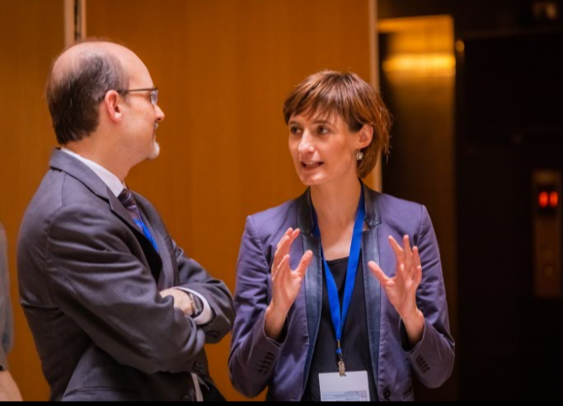

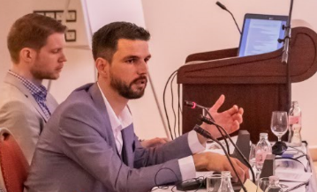
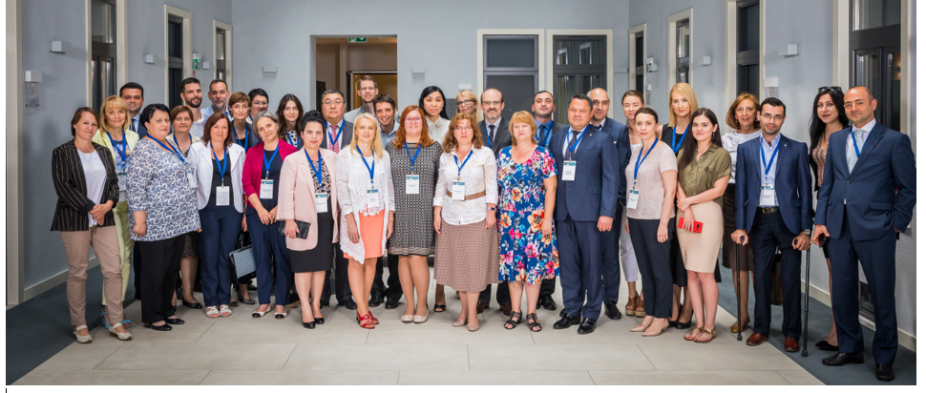

Slide 19
Knowledge Products Developed under TCOP
Practical guidelines on consolidation of financial reports, 2016
Note on Service Level Agreements with Central Banks, 2017
Report on the results of the survey on Treasury Single Account Operation Practices in PEMPAL member countries, 2016
Integration of budget classification and chart of accounts, success stories from TCOP countries, 2014
Final report on activities of the TCOP Asset Management thematic group, 2015.
Optimizing the Chart of Accounts Design (work ongoing)

Slide 20

Further Steps
Confirm TCOP thematic priorities for the upcoming period and collect proposals for TCOP future activities (thematic survey!)
Prepare TCOP Action Plan for FY2020
  identify specific topics of the next year’s activities
  identify location and timeline of events, including the 2020 TCOP Plenary Meeting
  Expand the Leadership of the TCOP
  (vacancy in the Executive Committee)
?

Slide 21
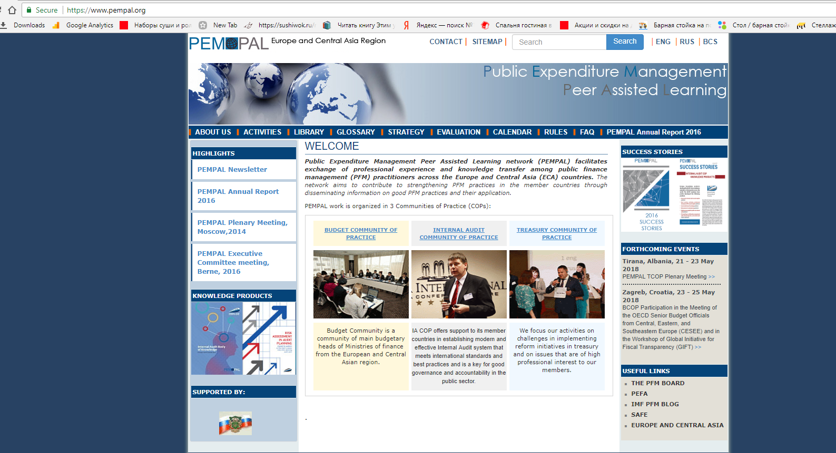
Information on TCOP Activities

