Slide 1
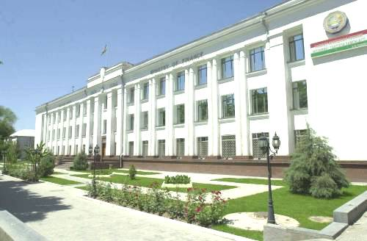
Ministry of Finance of the Republic of Tajikistan
Strategic Development Plan of Treasury system of the Republic of Tajikistan
(2011-2016 )

Slide 2
Background
1. The implementation process of the treasury system of budget execution began in 1996 in accordance with the Government of RT Regulation "On establishment of the Treasury system of budget execution." Government Resolution on January 15, 1997 approved the Regulation "On central management of the Treasury," which were defined structure, functions, powers and authority of the Central Treasury of the Ministry of Finance of the Republic of Tajikistan.
2. In 2000 the Ministry of Finance began automatization of Treasury operations
3. In 2001 there was a transformation from Soviet-style Budget classification to the new format.
4. In 2005, implemented a new budget classification that is compatible with GFS 1986
5. In 2007 PEFA assessment has been conducted
6. In February 2009 the implementation of Public Financial Management Modernization Project (PFMMP) was launched .
7. In March 2009, by the Presidential Decree # 639 of March 20, 2009, the Coordinating PFM Council had been created and the Public Finance Management (PFM) Strategy was approved.

Slide 3
Background
8. In 2010, as a part (segment) of the budget classification was introduced classification of sources of finance and administrative classification of Republican Budget, and in 2011 was implemented Administrative classification of Local budget.
10. In 2010, the Ministry of Finance has improved the existing information systems in connection with the changes in the processes of budget preparation and execution.
11. In 2011, the PFM Council Coordination approved:
a) Strategy of reforming public sector accounting system (2011-18 )
b) Strategic Development Plan for the Treasury system of the Republic of Tajikistan (2011-16)
c) The investment plan for tax administration development (2012-14 )
d) Training Strategy of the Ministry of Finance.
12. At the moment the PEFA assessment is conducting.
13. In June 2012 the Ministry of Finance will approve Budget classification (6 segments), consistent with the GFS 2001 and the Unified Chart of Accounts (UCoA).

Slide 4
MDCT Strategic Objectives
To manage the cash and banking activities of the GoT to international best practice standards
To improve the Budget Execution through the provision of accurate, timely, meaningful and targeted management information
To always ensure available funding to meet annual budget demands as approved by Parliament.
To provide a central operation on behalf of all BOs to pay all expenditures subject to budget provision on behalf of all BOs
To ensure comprehensive accounting controls are applied to all financial transactions originated by BOs

Slide 5
Strategic Functional Areas of Concentration
In order to achieve the strategic objectives, it will be necessary to undertake some root and branch reforms within MDCT, moving it from predominantly an accounting control function to a service provider .
It is recognised that the transition required will not be easy and will take some considerable time to achieve.
A critical factor during the design of the project cycle and covering the ‘How, Who and Where’ questions will be the use of an internationally recognised Project Management Methodology such as PRINCE 2 and the need for first-rate experience in delivering major projects to be within or even lead the implementation team. The choices for GoT seem to be:-
PFMMP take the lead in delivering the project
One of the DDRs in MDCT to be responsible for delivering the new functionality whilst the other DDR continues to deliver existing functionality
Contract with external suppliers/individuals to provide project management skills either in an advisory capacity or as the actual Project Manager of the project leading an in-house team in order for the necessary skills transfers to take place.

Slide 6
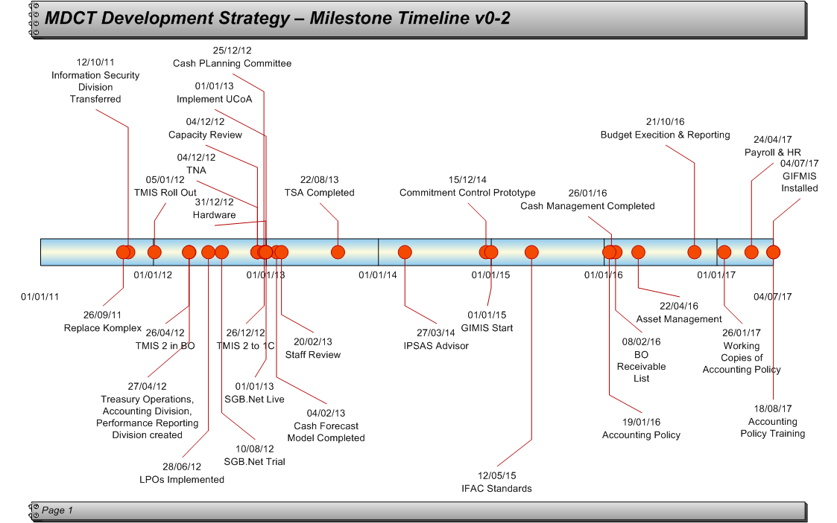
Supposed Treasury Development Timeline

Slide 7
Proposed operational development
1. Cash Management including TSA
.The objective of the cash management function is to ensure that there is sufficient cash made available to BOs at the required time in order that they can execute their budgets without interruption and deliver on promises made and committed to in their medium term strategic development plans, from which annual budgets are prepared.
2. Cash Planning and Forecasting
The objective of cash forecasting is to identify as early as possible the ‘supply’ side of the cash equation to fund the Medium Term Expenditure Framework (MTEF) of the Government.
3. Unified Chart of Accounts (UCoA) Implementation
The objective of implementing a Unified Chart of Accounts is to bring together the analysis used for budgeting with the analysis used for accounting so that performance reporting by BOs and at consolidated levels can be easily undertaken to provide comparative financial statistics. It also allows for additional analysis dimensions and for Assets and Liabilities to be easily identified.
4. Budget Execution Reporting Development
The objective of budget execution reporting development is to give output focus (rather than input) and emphasis to the reason for undertaking budgeting and financial accounting in the first place. Improvement in PFM operations including aggregate fiscal discipline, policy prioritisation of budgets and value for money will all be improved through better performance reporting.
5. Commitment Control (Prototype)
The objective of the Commitment Control (prototype) is to establish and prove the concept of commitment control in BOs with specific reference to the GoT. It will attempt to earmark budgetary funds and reduce the availability of budget at BOs at the earliest possible time in the payment cycle.

Slide 8
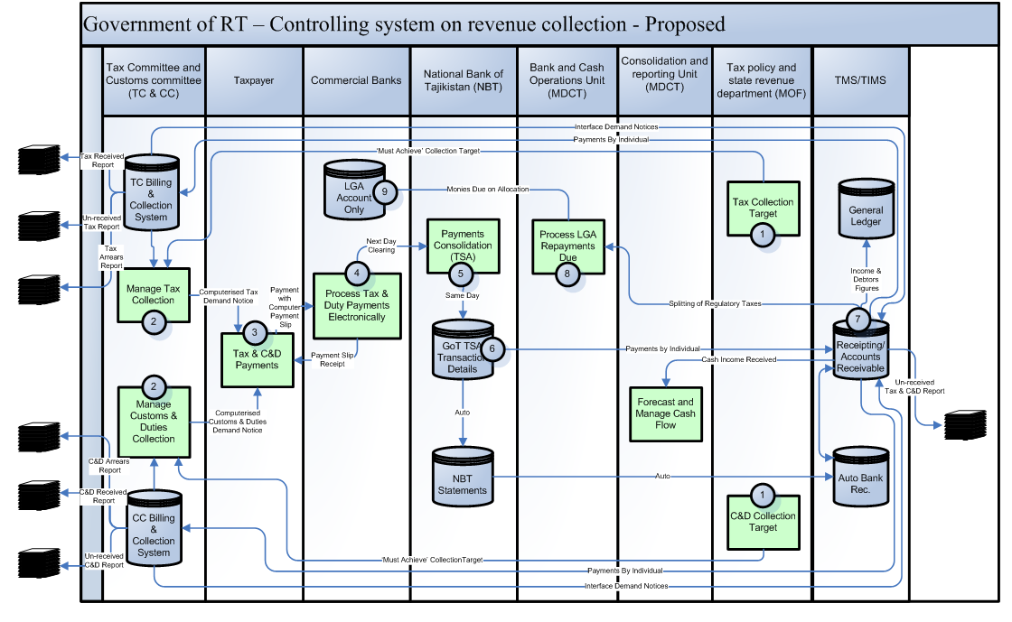
Proposed operational development

Slide 9
Proposed operational development

Slide 10
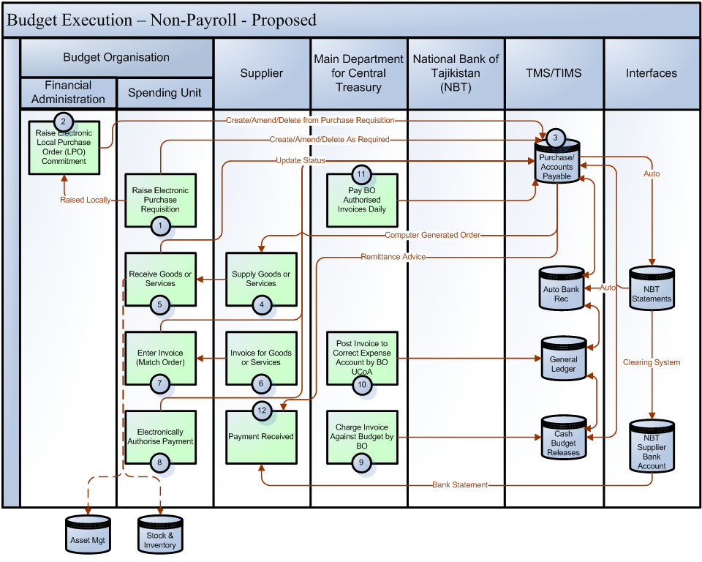
Proposed operational development

Slide 11
Proposed operational development

Slide 12
Organizational development
1. MDCT Re-organisation based on new Functions
The objective of re-organising MDCT based on the new functions required of MDCT is to ensure that the full focus of MDCT is on undertaking the new functions and delivering the benefits associated with the functions, whilst at the same time removing all redundant functionality.
2. Create MDCT Cash Operations Department
The objective of creating a MDCT Treasury Operations department is to address the new additional and specific functionality required surrounding cash, the management thereof and forecasting and planning of cash.
3. Create MDCT Accounting Department
The objective of creating an MDCT Accounting Department is to address the re-organised functionality to be provided by MDCT in respect of the accounting needs of Treasury management.
4. Create MDCT Performance Reporting Department
The objective of creating a Performance Reporting Department is to support the new focus given to performance output reporting within the newly defined functionality of MDCT. The emphasis here is that BOs are responsible for delivery of outputs having been given scarce resources and therefore have to be independently accountable for the resources they have consumed versus the outputs they have delivered.
5. Create Project Support Unit
Цель создания отдела поддержки проекта состоит в предоставлении технических ресурсов для оказания помощи Казначейству во внедрении компьютерной системы поддержки. The objective of creating a Project Support Unit is to provide technical resources to help MDCT implement computer support system.
6. Annual Review of Duties of MDCT
The objective of an annual review of the duties of the MDCT is to ensure the continuous efficient operation of the Treasury.

Slide 13
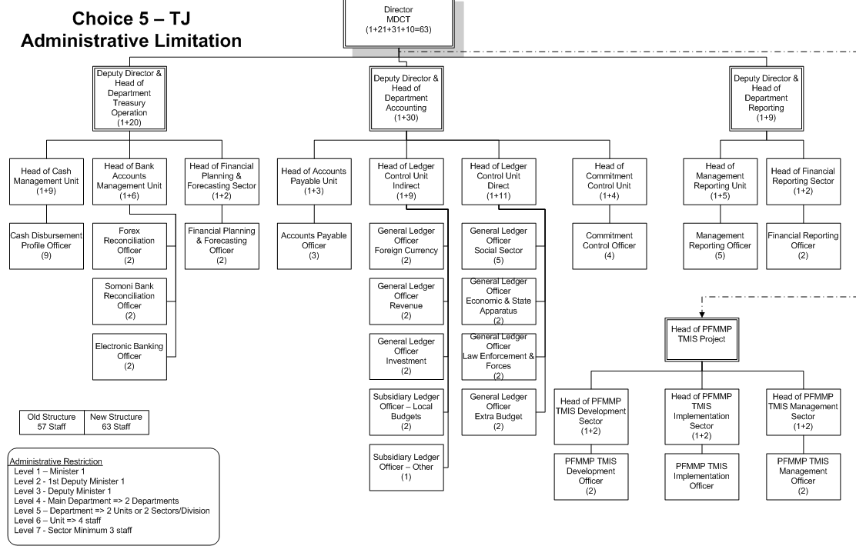
Organizational development

Slide 14
MDCT Staff Capacity Development
1. Capacity Review of MDCT
The objective of having a capacity review of MDCT is to establish and document the existing skills sets that are available within MDCT in order to identify missing skill sets required to achieve the new functionality required.
2. Training Needs Assessment (TNA) for MDCT
The objective of carrying out a TNA is to identify the type, quantity and quality of training that will be required to be undertaken by the existing workforce of MDCT in order that they will then have the necessary skills to be able to undertake and deliver the new functionality required.
3. Training on New MDCT Functions
The purpose of training on new functions introduced in Treasury, is to provide quality services to Budget organizations and that Government benefits from improved quality and control.
4. Accounting Policy Training
The objective of training staff in the accounting policy of the GoT is to ensure that there is a consistent application of the policy across all areas of Government and that the Government benefits from improved quality of accounting and controls through standard policy application

Slide 15
Computer Support Applications Development
1. Replace Komplex with TMIS 2
The objective of replacing Komplex with TMIS 2 is to include all revenue in the TMIS 2 system so that management reports can be produced directly from one system.
2. TMIS 2 Roll Out
The objective of the TMIS 2 roll out is to automate sub-Treasuries with a standard application, which could be interfaced to the central system.
3. Interface Sub-Treasuries into TMIS 2
The objective of interfacing sub-Treasuries into TMIS 2 is to improve efficiency in sub-Treasuries, reduce keying errors in sub-Treasuries and to continue to introduce computerisation facilities to remote locations.
4. SGB.Net Test System
The objective of testing SGB.Net is initially to make sure that all the current functionality required by MDCT is available, secondly to practice working with the system and thirdly to establish processes and procedures to be used with SGB.Net to satisfy MDCT needs.
5. SGB.Net Live System
The objective of installing SGB.Net is to replace TIMS 2 with a ‘next step’ budget and accounting application that will provide additional functionality compared to TMIS 2 and move MDCT another stage closer to be able to operate a full blown COTS.

Slide 16
Computer Support Applications Development
6. Hardware & Infrastructure Purchase & Installation
The objective of purchasing and installing hardware and creating a communications infrastructure is to support the installation of SGB.Net and any future IFMIS purchase.
7. Asset Management System Considered
The objective of considering an Asset Management system is to identify a technical solution to the challenges within GoT of managing, protecting and utilising assets owned by GoT.
8. Payroll & HR Combined System Considered
The objective of considering a Payroll and Human Resource system is to identify a technical and integrated solution to the challenges within GoT of paying, tracking, promoting, training and developing employees of GoT across all levels of the Government.
9. IFMIS
The objective of purchasing and implementing a IFMIS is to provide MDCT with all the functionality (and more than currently required and available) they require to operate a high quality, international standard Treasury operation.

Slide 17
Risks, Benefits and Key Challenges
Strategic Risks
The following strategic risks have been identified in relation to this development strategy:-
The MDCT Development Plan is over ambitious
MDCT staff do not embrace the change in working required
The Skill Sets required for the new functionality are not available in the market
Financing is removed by Aid Partners
Sufficient Project Management skills and experience are not available to the project

Slide 18
Risks, Benefits and Key Challenges
Major Benefits
The following major benefits are considered to be available following the full implementation of this MDCT development strategy:-
Budget execution should be substantially improved due to continuous and full BO funding availability
The financial performance of BOs will be far more transparent and open leading to greater accountability for BOs
Value-for-Money (VFM) through better and more comprehensive cash management.
Greater functionality of the Treasury operations bringing the GoT closer to international accounting standards
Improved and more widespread financial controls introduced leading to reduced opportunities for graft, misappropriations and fraud.
Improved efficiency of the MDCT through the use of more up to date technology

Slide 19
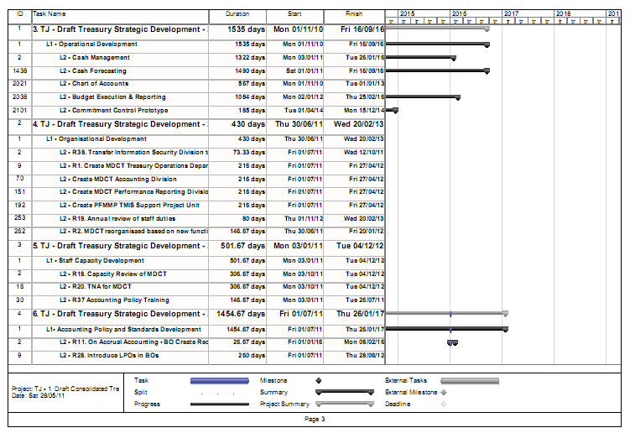
Implementation Plan

Slide 20
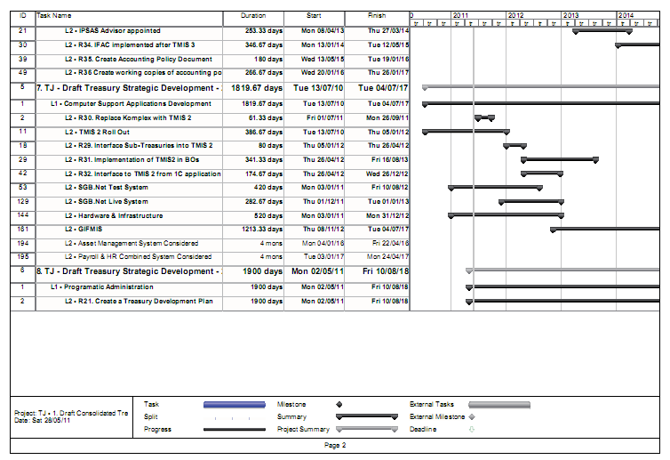
Implementation Plan

Slide 21
Thank you for your attention!

