Slide 1
Auditing Financial Management and Control
Brussels, February 28 2018

Slide 2
Content
Why assessing FMC?
Assessment tool: benefit for FMC, IA and CHU;
Configuration of FMC-assessment tool
Assignments

Slide 3
Why assessing FMC is necessary:
In a lot of countries the development of FMC still lacks behind in development compared to internal audit;
Often the key elements of FMC are in place (there is management, there are financial departments, there are reporting systems etc.)….but…also:
A lot of operational control by Top Management;
A lack of proper second lines of Defense (support, oversight, monitoring, control);
Financial Divisions play no engineering role in planning & control (except for control of the budget);
An integral entity wide planning & control mechanism is lacking;
IA departments for Top Management partly fill in the second line of control gap;
Lack of clear KPI’s (financial/non-financial);
Poorly developed or no risk management system at all;
General observation: gap between international requirements/best practice and specific country-reality (context/laws/regulations);
Etc.

Slide 4
Therefore….
A need to have a proper assessment tool to assess what specifically is necessary to make improvements (every country/institution is different);
Internal Audit’s role could (should) be internally a driving force for the development of FMC→ through their audits and consulting activities;
An assessment tool can be used to compare/benchmark instutitutions;
An assessment tool can deliver relevant information for CHU’s regarding FMC;
National Academy for Finance and Economics / Dutch MinFin developed an FMC-matrix with assessment criteria.

Slide 5
Configuration of FMC-assessment matrix
The matrix is build upon the PIFC-principles and the three lines of Defense;
The matrix puts an important accent on the interdependency of the key components and on an integral Planning & Control mechanism linking together all the constituent elements;
Managerial accountability is an important cornerstone of the matrix;
The tool should/can be used for institutional GAP-analysis for the total state-of affairs of FMC or parts of it: on the entity level.

Slide 6
Configuration of FMC-assessment matrix
First line: FMC within the primary processes / programs / projects:
Key aspects: managerial accountability (responsibility, authority, accountability), objective setting, risk and control, tasks and responsibilities, planning and control
Second line: FMC through supportive oversight / controlling / monitoring processes
Key aspects: managerial accountability (responsibility, authority, accountability), risk and control, Monitoring/planning and control
Interdependency between first and second line:
Key aspects: planning and control (reporting arrangements), coordination of control activities
Third line: Interdependency between first and second line:
Key aspects: Focus of internal audit towards FMC

Slide 7
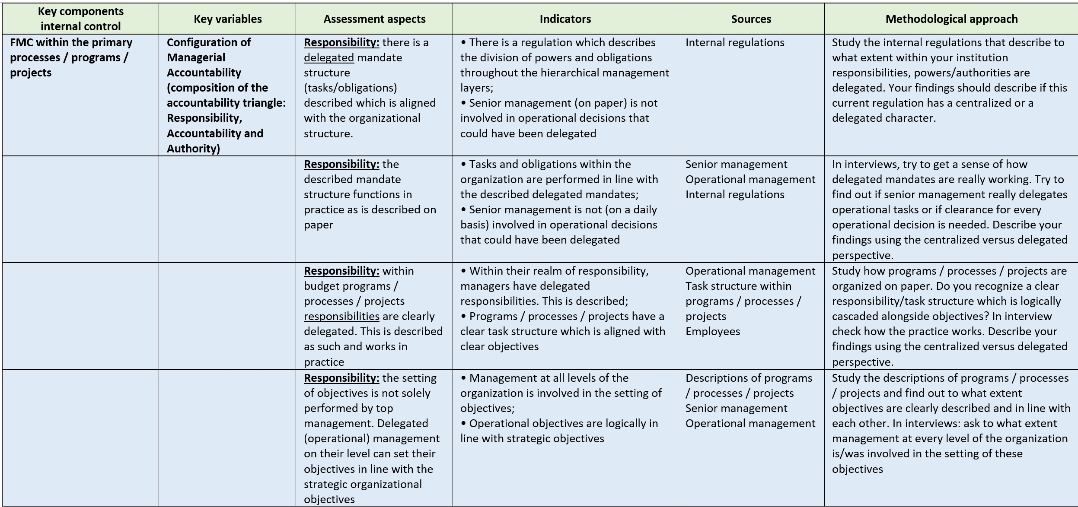
Columns of FMC-assessment matrix (segment)

Slide 8
Assignment 1:
At your table discuss the following questions (and answer them ☺):
What are the key elements IA should focus on while auditing FMC/system of internal control?
2.How does IA need to approach FMC/system of internal control? (driver? assessor? Advisor?)
3. How can the CHU assist IA on auditing the FMC/system of internal control?

Slide 9
Assignment 2
Formulate criteria/assessment aspects for each line of Defense.
Each table takes 1 line + interdependency (4 tables)
Table 1: first line: define criteria/assessment aspects for managerial accountability AND risk and control
Table 2: second line: define criteria/assessment aspects for managerial accountability AND risk and control
Table 3: interdependency: define criteria/assessment criteria for planning and control arrangements AND coordination activities
Table 4: internal audit: define criteria/assessment criteria for internal audits role towards FMC

