Slide 1
Organizing the document flow and the business day in the automated system of the Federal Treasury
Deputy Head
of the Federal Treasury Office
For Vladimir Oblast
V.N. Nutretsov

Slide 2
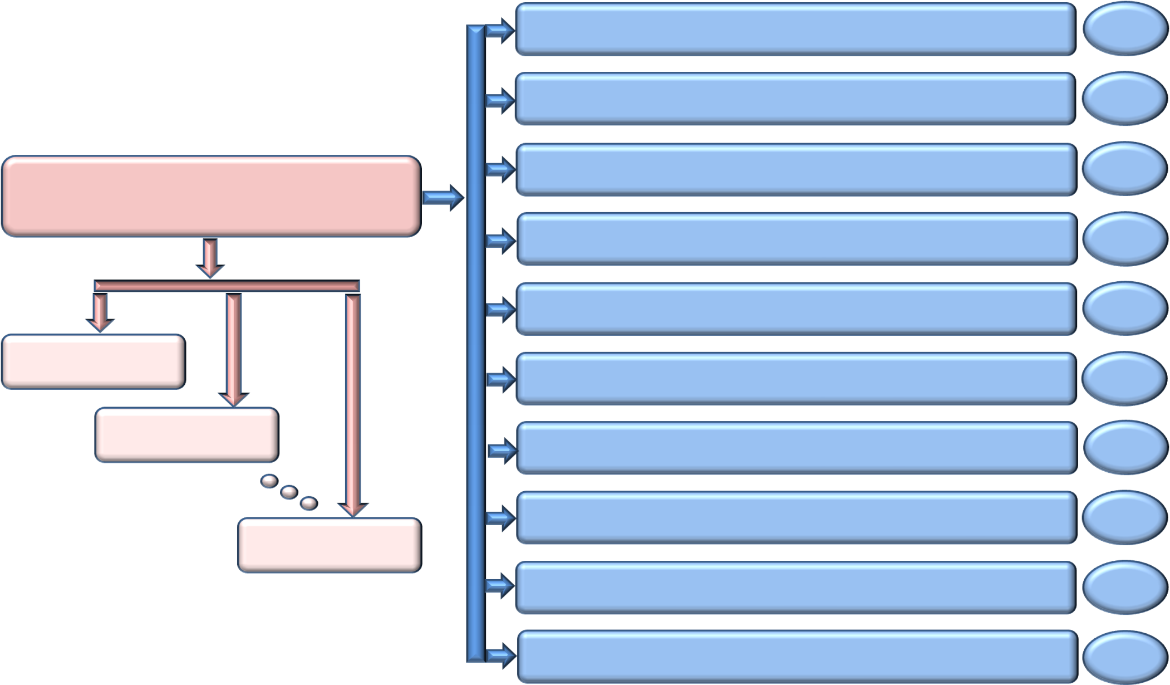
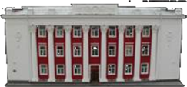
The structure of accounts opened for the Federal Treasury Office for Vladimir Oblast
Account 40101 “Income allocated by the Federal Treasury bodies between tiers of the budgetary system of the Russian Federation”
1 account
Account 40105 “Funds of the Federal Budget”
1 account
Account 40501 “Accounts of organizations that are in federal ownership. Financial organizations”
2 accounts
Federal Treasury Office for Vladimir Oblast
Account 40201 “Funds of budgets of constituents of the Russian Federation”
1 account
Account 40601 “Accounts of organizations that are in public (except for federal) ownership. Financial organizations”
1 account
Territorial Department No. 2
Account 40204 “Funds of local budgets”
127 accounts
Territorial Department No. 3
Account 40701 “Accounts of non-governmental organizations. Financial organizations”
80 accounts
Account 40302 “Funds received on interim order”
121 account
Territorial Department No. 19
Account 40116 “Funds for payment of cash to organizations”
279 accounts
Account 40816 “Funds of the budget of the Union state”
1 account
2

Slide 3
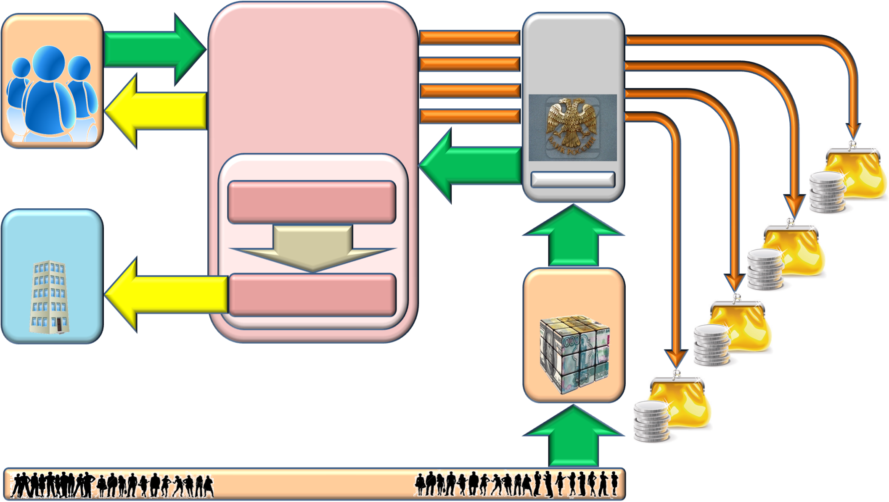
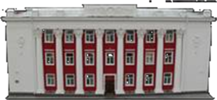
Accounting for receipts and their allocation between budgets of the budgetary system of the Russian Federation in the territory of Vladimir Oblast
Federal Treasury
Office for Vladimir Oblast
Revenue administrators
Documents of the budget revenue administrators
Transfer of revenues to the budget
Bank of Russia for Vladimir Oblast
Information on received revenues
Personal
accounts
Transfer of revenues to the budget
Putting together reports
Receipts on the bank statement
Account 40101
Federal Budget
Revenue department
Inter-regional operational office
Forms of analytical accounting
Settlement documents
Budget of a constituent of the Russian Federation
Operational
budget reports
Department for budget accounting and reporting on budget operations
Credit institutions
Local budgets
Reporting
Financial bodies of a constituent of the Russian Federation and of municipal formations
Reporting
Extra-budgetary funds
Settlement documents
Payers
3

Slide 4
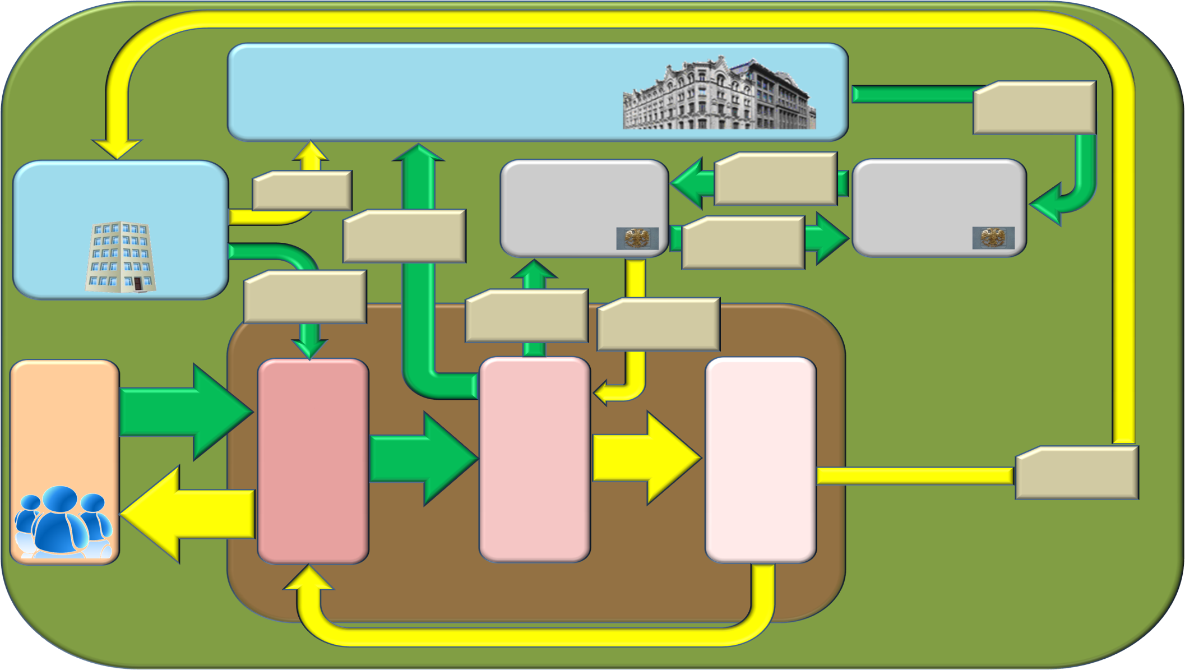
The scheme of the document flow while carrying out cash payments from personal accounts of clients of the federal level
Federal treasury
Settlement documents for support of accounts No. 40105, 40302, 40501
Interregional operational office
Institution of the Bank of Russia for Vladimir Oblast
Support of accounts No. 40105, 40302, 40501
Bank of Russia
Reporting
Account No. 40105
Treasury Single Account No. 40105
Consolidated request
Account No. 40302
Transfer of account balances
Account No. 40501
Expense schedules
Settlement documents for writing off from accounts No. 40105, 40302, 40501
Bank statements on accounts No. 40105, 40302, 40501
Department of budgetary accounting and reporting on budget operations
Payment documents
Department of expenses
Operational department
Clients
Payment documents that passed through control
Information on operations on accounts
Reporting
Statements from personal accounts
Operations of the previous business day
Federal Treasury Office for Vladimir Oblast
Operations of the current business day
Information on recording operations in accounting
4

Slide 5
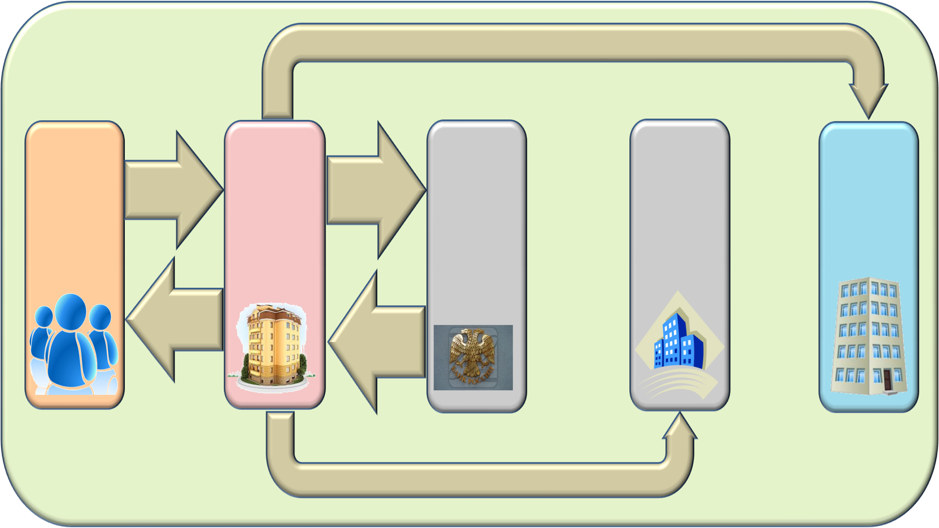
The scheme of the document flow when carrying out cash payments from personal accounts of clients of the regional and municipal level
Reporting
Information necessary for execution of budgets
Federal Treasury Office for Vladimir Oblast
Settlement document for writing off from accounts of budgets
Financial bodies of a constituent of the Russian Federation and of municipal formations
Federal Treasury
Bank of Russia for Vladimir Oblast
Clients
Payment documents
Account 40201
Accounts 40204
Account 40601
Accounts 40701
Statements from personal accounts
Accounts 40302
Bank statement from accounts of budgets
Reporting
5

Slide 6
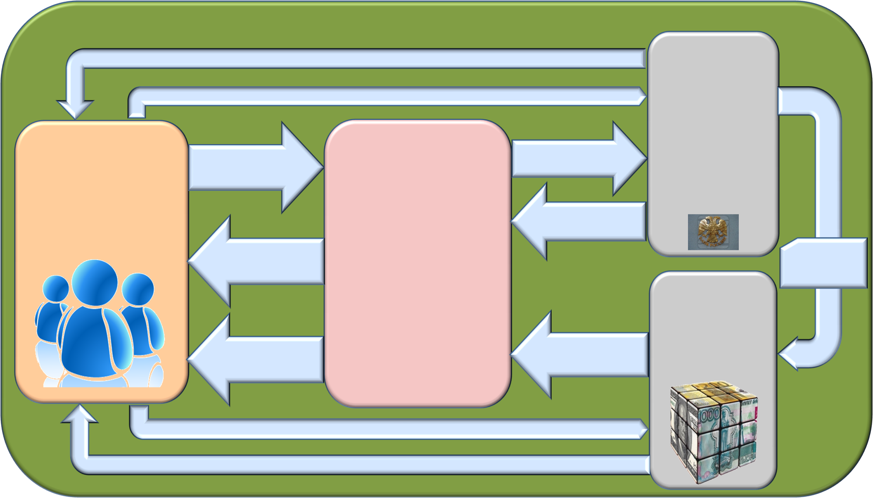
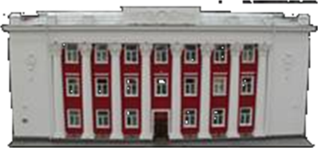
The scheme of the document flow while providing clients with cash money using money cheques
Cash money
Bank of Russia for Vladimir Oblast
A cheque drawn up according to the set procedure
Accounts of budgets
Settlement documents for support of cash accounts
A request to receive cash money with a cheque
Federal Treasury Office for Vladimir Oblast
Clients
Accounts 40116
Bank statements from accounts of budgets and cash accounts
A cheque signed by authorized persons
Support of cash accounts
Credit institutions
Statements from personal accounts
Bank statements from cash accounts
Accounts 40116
A cheque drawn up according to the set procedure
Cash money
6

Slide 7
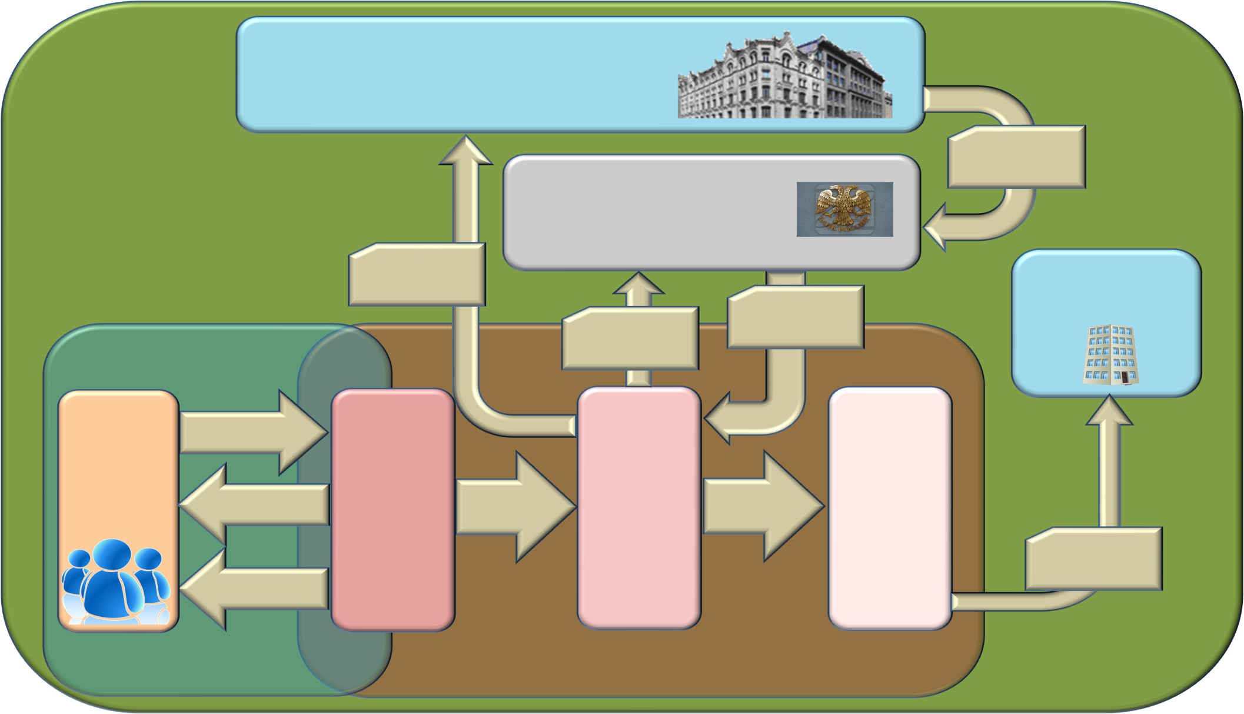
The scheme of processing documents presented by a client to the Federal Treasury Office for Vladimir Oblast
Federal Treasury
A payment order for support of accounts No. 40105
An institution of the Bank of Russia
A consolidated
request
Interregional
operational
office
Settlement documents for writing off from accounts No. 40105
Bank statements from accounts No. 40105
System of remote financial document flow (SUFD)
Automated system of the Federal Treasury (ASFK)
Office of the Federal Service for the Execution of Sentences
A request for cash spending
Spending
Department
Operational department
Budget accounting and reporting department for operations of budgets
A protocol on refusal
A request for cash spending in status “003”
Information on operations in accounts
Operational
reporting
A statement from a personal account
Federal Treasury Office for Vladimir Oblast
7

Slide 8
Thank you for attention!
8

