Slide 1

PEM PAL
IA COP
Internal Control Working Group
Introduction to PIC Terminology
Jean-Pierre Garitte
Moscow
18 October 2016

Slide 2
Objectives of PIC
A Public Internal Control System can provide assurance that governments funds are being spent wisely.
PIC represents a structured model that provides reasonable assurance that operations comply with the principles of sound financial management, transparency, efficiency and effectiveness, whilst respecting relevant laws and regulations.

Slide 3
The 3 Fundamentals of PIC
Managerial accountability
  = Financial Management and Control (FMC)
Functionally independent internal audit
Central Harmonization Unit (CHU)

Slide 4
Managerial accountability (FMC)
Managers at all levels are accountable for the activities that they carry out.
First level of control should be at the level of the manager.
Each manager is responsible for establishing and maintaining adequate managing and control systems to carry out the tasks of planning, programming, budgeting, accounting, controlling, reporting, archiving and monitoring.
Risk assessment is a task to be carried out by management.

Slide 5
Functionally independent audit
Budget and spending centers equipped with independent internal audit.
Internal audit will support management with objective assessments of the internal control system.
Auditors report directly to the top manager in the hierarchy.
Role of internal audit is formally outlined in a charter, to be signed by management and internal audit.
Internal auditors must comply with Code of Ethics.
Internal audit is not involved with managerial tasks.
Internal audit does not sanction or punish.
Internal audit is different from inspection and revision.

Slide 6
Central Harmonization Unit (CHU)
A central structure to manage the development of PIC.
CHU is responsible for promoting and developing internal control and internal audit, based on international standards and best practices.
CHU coordinates gap analysis and policy development.
CHU coordinates implementation of relevant legislation.
CHU is best placed in Ministry of Finance.
  CHU for IA within Ministry of Finance
  CHU for FMC within Treasury or Budget

Slide 7
Central Harmonization Unit (CHU)
Within Ministry of Finance CHU is different from Internal Audit unit.
CHU does not audit Internal Audit.
CHU can coordinate training activities for FMC and IA (development of curricula).
Grant title of ‘Public Internal Auditor’.
CHU monitors PIC implementation.
CHU may evolve to Center of Excellence.

Slide 8
External audit
PIC system subject to independent assessment by Supreme Audit Institution (SAI).

Slide 9
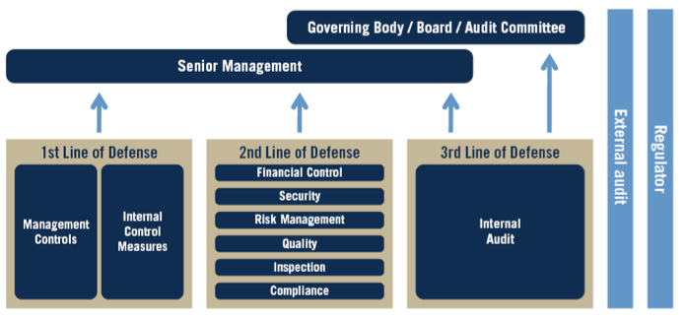
The Three Lines of Defense Model
(as conceived by the ECIIA & FERMA in Guidance on the 8th EU Company Law and endorsed in the so-named Position Paper issued by The IIA in Jan. 2013)

Slide 10
Questions & Answers

