Slide 1
FAS
Functions Staffing, Approaches
George Kurtanidze, Head of FAS
October, 2015

Slide 2
Mission
FAS was created in April 1, 2010
Automation of business processes of the Ministry of Finance of Georgia and other Government organizations.
Ensuring information security and business continuity of the automated electronic systems.
Promoting eGovernance.

Slide 3
Goals
Ministry of Finance of Georgia ICT infrastructure development and support to ensure provisioning of continuous, highly available, effective and efficient electronic services.
Development and support of Integrated Public Finance Management System and ensuring its reliable and secure functioning.
Development, deployment and support of electronic information systems.
Business process analysis, optimization and automation for the Ministry of Finance of Georgia and other Government organizations.
Development and provisioning of eGovernment system components and services.

Slide 4
FAS Organization Chart
Head of Organization
Deputy Head
Administrative Department
Research and Systems Analysis Department
Software Applications Development Department
Information Security Manager
Systems Administration Department
Operations Department
Web Resources Management Department

Slide 5
Administrative Department
Lawyer
Providing legal expertise and preparing legal documentation
Financial Manager
Financial management and accounting
Providing ongoing technical support
Procurement Manager
Administrative Clerk
Public Information Manager
Technical Support Specialist
HR Manager
HR management and official documentation processing
Procurement planning and management for all purchase requests
Official documentation processing and management
Public Information and Personal Data Management

Slide 6
Research and Systems Analysis Department
Analyst
Long term strategic planning
Relations with donors, international organizations and public sector
Project Manager
Strategic planning for existing and new services
Service level Management
Technical documentation design and architecture definition for software systems development
Product Manager
Long term project design and management
Coordination of implementation of new business processes
Facilitating professional growth of staff
Business relationship management
Software development task identification and analysis;

Slide 7
Software Applications Development Department
Programmer
Software development and modification
Team Leader
Software development process coordination and management
Technical and pilot testing and documentation
Software systems problem management
Code review and release coordination

Slide 8
Systems Administration Department
Database Administrator
Database administration
Systems Administrator
Operation systems administration
Performance tuning
Network Administrator
Backup and restore
Systems architecture development and implementation
Server and datacenter infrastructure management
Network administration
Network architecture development and implementation
Network hardware management
Network security
Systems security

Slide 9
Operations Department
Technical Support Engineer
IT systems incident management
Hotline Operator
Hotline operating
Technical troubleshooting
Tester
Software and hardware systems deployment
Software testing
User training
Trainer
Initial problem identification
Technical resource allocation
Testing scenario development
Documentation
Training material development

Slide 10
Web Resources Management Department
Web Programmer
Development and management of website information management system
Designer
Websites’ concept development, informational architecture and design;
Development, administration and information management for the corporate portal
Improvement of design and structure for all websites under the Service management;
Websites’ support and maintenance

Slide 11
Project Team
Departments
Research and Systems Analysis
Software Dev
SysAdmin
Operations
Product Manager
Team Leader
DB Admin
Tester
Project Manager
Programmer
SysAdmin
Trainer
Analyst
Programmer
NetAdmin
Operator
Analyst
Programmer
NetAdmin
Trainer
Project Manager
Team Leader
SysAdmin
Engineer

Slide 12
What We Do
State Treasury
Business Process Analysis
Application Development
Operations support,
Help Desk
Hardware, Infrastructure, Systems Management
Strategic planning
Service Agency
Budget Spenders
Citizens
FAS
Government Organizations
Revenue Service
About
420 000
Users
MOF Organizations

Slide 13
Our Key Systems
eNRMS
Natural Resource Management
PFMS
Public Finance Management System
Corporate Content and Task Management System
eDocument
eAuction
Online Auction System
Human Resource Management System
Infrastructure
High-End Servers and Storage Systems
eHRMS
eCloud
First Government Cloud
Notes:
Forest management system to add.

Slide 14
eDocument
User friendly and intuitive interface
Paperless document exchange process
ID Card based Digital Signature, Secure Log-on
Electronic exchange of documents (in Cooperation with the Ministries of Justice and Interior)
Capability of having several chancelleries within one organization
Task management and control over tasks executions
Flexible deployment and support

Slide 15
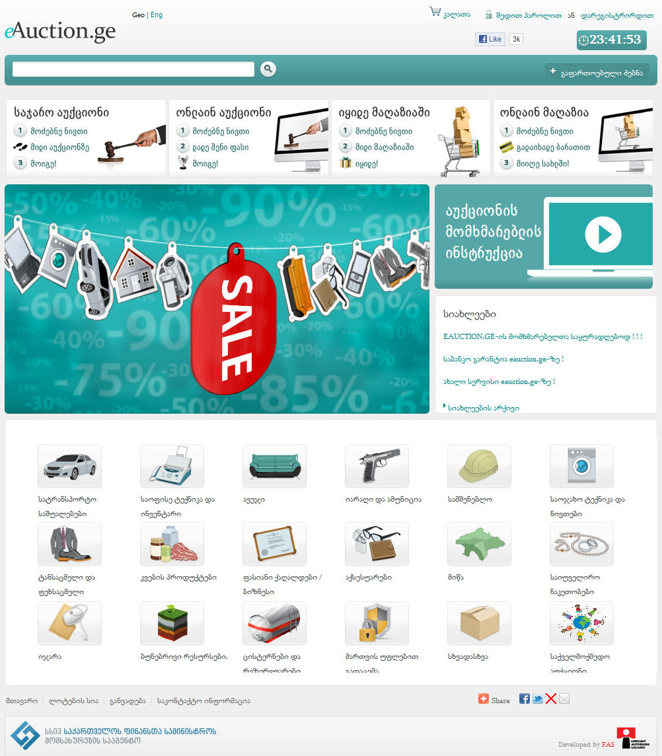
eAuction
Everyone can purchase governmental property online with delivery service
Partner organizations - 59
Users (individual) - 53720
User (legal entity) - 5940
1451 Sold lots in 2010, price increase – 8% of initial value, final value – 1 million GEL.
14090 Sold lots in 2011, price increase – 23% of initial value, final value – 204 million GEL.
11629 Sold lots in 2012, price increase – 24% of initial value, final value – 199 million GEL.
11714 Sold lots in 2013, price increase - 94% of initial value, final value - 161 million GEL.
13516 Sold lots in 2014, price increase - 55% of initial value, final value - 154 million GEL.
12817 Sold lots in 2015, price increase - 50% of initial value, final value - 178 million GEL.
Simultaneous users - 2500

Slide 16
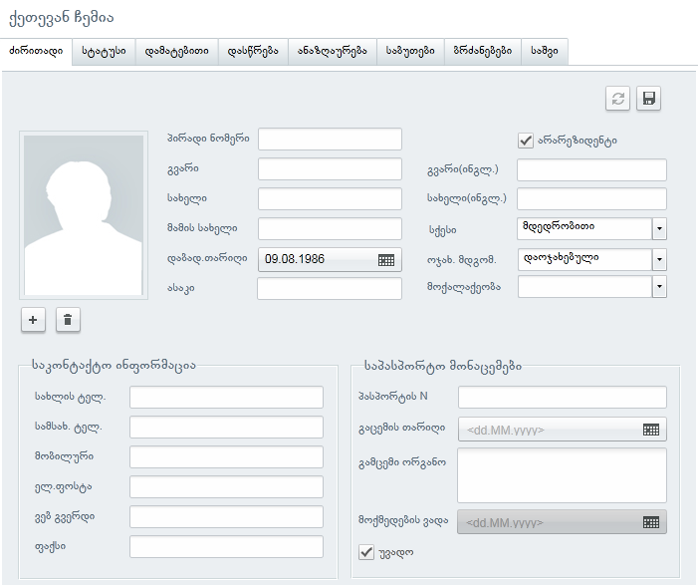
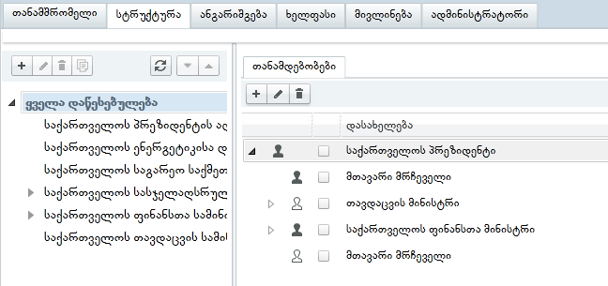
eHRMS
Personal file
Civil servants’ position movements / tracking within different public agencies
Payroll – Salaries, Bonuses and deductions
History of organizational structure and positions
Timeline of events

Slide 17
eNRMS
Social Timber
Commercial Timber
Other
Online Electronic Management
License Owner
Individual
Timber Production Company
Online Access to System
Agency of Natural Resources
Online Control

Slide 18
Web Development and Hosting Services
Ministry of Finance
Other Governmental Organizations
In Development
mof.ge
mfa.gov.ge
More than 20 governmental organizations web sites
etreasury.ge
eiec.gov.ge
ebudget.ge
hr.gov.ge
eAuction.ge
energy.gov.ge
ia.ge
Insurance.gov.ge
is.ge
newzone.mof.ge
rs.ge
culturepolicy.ge
mofacademy.ge
iec.gov.ge
license.gov.ge
stajireba.gov.ge
taxdisputes.gov.ge
procurement.gov.ge
fas.ge

Slide 19
First Government Cloud
PaaS, SaaS, IaaS
Annual SLA 99.9% Uptime
28 Organizations already using

Slide 20
Infrastructure Management
Main Data Center
DR Mirror Site
RAM: 8 TB
Storage: 300 TB
Server Cores: 1500
Virtual Servers: 600
RAM: 8 TB
Storage: 300 TB
Server Cores: 1500
Virtual Servers: 600
Communication System
Fiber-Optic Connection
Users
Internal Users: 4 500
External Users: 420 000
Internal Users: 4 500
External Users: 420 000

Slide 21
Thank YOU!

