Slide 1

PEM PAL
IA COP
Internal Control Working Group
COSO Principles
Jean-Pierre Garitte
Moscow
18 October 2016

Slide 2
Why do we need Frameworks?
A common framework will accelerate progress, by
bringing:
  A common language
  Criteria against which to benchmark
  Application guidance
  Familiarity of concepts
  More effective communication

Slide 3
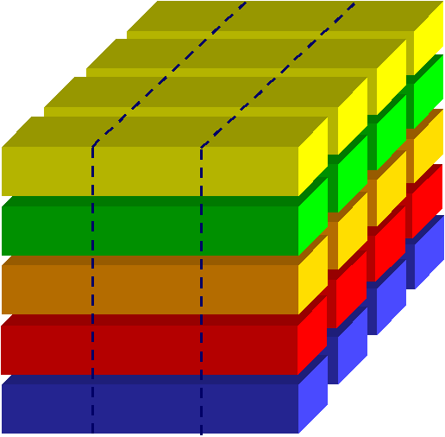
COSO Internal Control-Integrated Framework
Three Objectives
Operations
Control Activities
The COSO framework defines internal control as a process, effected by an entity's board of directors, management and other personnel, designed to provide "reasonable assurance" regarding the achievement of objectives.
Reporting
Compliance
Activity 2
Monitoring
Activity 1
Information &
Communication
Unit B
Unit A
Five Components
Control Activities
The “Tone at the top”
Risk Assessment
Entire organisation
Control Environment
Organisational culture
Notes:
3

Slide 4
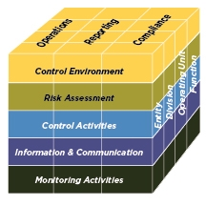
COSO 2013 Update
Environments changes... | …have driven Framework updates
Expectations for governance oversight
Globalization of markets and operations
Changes and greater complexity in business
Demands and complexities in laws, rules, regulations, and standards
Expectations for competencies and accountabilities
Use of, and reliance on, evolving technologies
Expectations relating to preventing and detecting fraud
COSO Cube (2013 Edition)

Slide 5
COSO 2013 Update
Update articulates principles of effective internal control
Control Environment
Demonstrates commitment to integrity and ethical values
Exercises oversight responsibility
Establishes structure, authority and responsibility
Demonstrates commitment to competence
Enforces accountability
Risk Assessment
Specifies suitable objectives
Identifies and analyzes risk
Assesses fraud risk
Identifies and analyzes significant change
Control Activities
Selects and develops control activities
11. Selects and develops general controls over technology
Deploys through policies and procedures
Information & Communication
Uses relevant information
Communicates internally
Communicates externally
Monitoring Activities
Conducts ongoing and/or separate evaluations /internal audits
Evaluates and communicates deficiencies

Slide 6
COSO 2013 Update
Focus on principles of effective internal control for public sector
Control Environment
Demonstrates commitment to integrity and ethical values
Exercises oversight responsibility
Establishes structure, authority and responsibility
Demonstrates commitment to competence
Enforces accountability
Risk Assessment
Specifies suitable objectives
Identifies and analyzes risk
Assesses fraud risk
Identifies and analyzes significant change
Control Activities
Selects and develops control activities
11. Selects and develops general controls over technology
Deploys through policies and procedures
Information & Communication
Uses relevant information
Communicates internally
Communicates externally
Monitoring Activities
Conducts ongoing and/or separate evaluations /internal audits
Evaluates and communicates deficiencies

Slide 7
Which principles could be of primary interest to the public sector?
  Accountability
  The organization holds individuals accountable for
  their internal control responsibilities in the pursuit
  of objectives.

Slide 8
Which principles could be of primary interest to the public sector?
  Identification and analysis of risk
  The organization identifies risks to the achievement
  of its objectives across the entity and analyzes risks
  as a basis for determining how the risks should be
  managed.

Slide 9
Which principles could be of primary interest to the public sector?
  Development of control activities
  The organization selects and develops control
  activities that contribute to the mitigation of risks to
  acceptable levels.

Slide 10
Which principles could be of primary interest to the public sector?
  External communication
  The organization communicates with external
  parties regarding matters affecting the functioning
  of internal control.

Slide 11
Which principles could be of primary interest to the public sector?
  Evaluations and internal audit
  The organization selects, develops and performs
  ongoing and/or separate evaluations to ascertain
  whether the components of internal control are
  present and functioning.

Slide 12
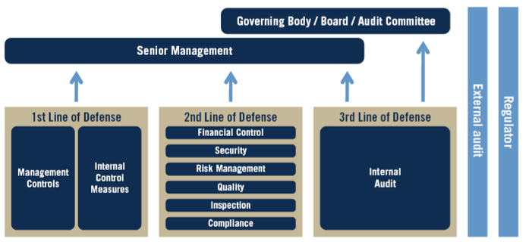
The Three Lines of Defense Model
(as conceived by the ECIIA & FERMA in Guidance on the 8th EU Company Law and endorsed in the so-named Position Paper issued by The IIA in Jan. 2013)

Slide 13
Questions & Answers

