Slide 1



Information Security
PFMS
LEPL Financial-Analytical Service, Ministry of Finance
October, 2015

Slide 2
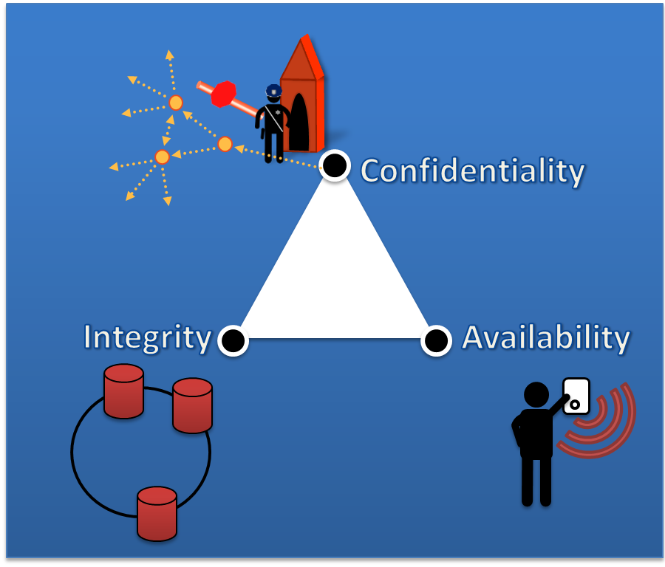

C I A
& Non-Repudiation (Accountability)

Slide 3

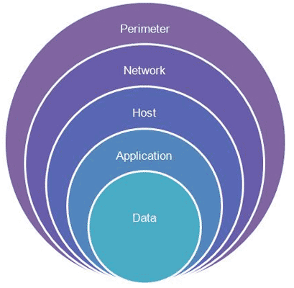
Defense in Depth
Security Domains for PFMS
Risk Management
Software Development Security
Access Control
Physical Security
Network Security
Business Continuity

Slide 4

Risk Management
Ad Hoc vs. Policy Based
Organizational vs IT
Octave Allegro
Information Asset Profiling
Infrastructure
Notes:
Forest management system to add.

Slide 5
Software Development Security
Layered Security – incorporation of a series of safeguards and risk mitigation countermeasures on different layers of the application to eliminate single points of complete compromise
KISS (Keep It Simple, Stupid) – Keep the design and implementation details of the solution as simple as possible.
Open Design – Review of the design should not lead to the vulnerabilities. System must be attack resistant even if the design is open.
Leverage Existing Components – Reusing existing component instead of implementing it from scratch reduces attack surface
Single Point of Failure – Designing solution to eliminate any single source of complete compromise. Identify and control all the single points of failure that could not be eliminated
Data Validation and Input Filtration
Garbage Collection
Residual Maintenance Hooks
Covert Communication Channels
Race Conditions

Slide 6
Access Control Methods
  Administrative
    Personnel management, acceptable usage policy
  Physical
    Network segregation (firewalls for back office)
    perimeter security
  Technical
    Logical network segregation (VLANs, DMZ, user network)
    Custom authentication protocol WCF/SOAP Application Level Security
  Accountability
    Intel Security (McAfee) SIEM
Notes:
Access control administration is centralized and methods used are administrative, physical and technical

Slide 7
General Architecture
Notes:
Access control administration is centralized and methods used are administrative, physical and technical

Slide 8


Access Control: User Management
ePassport
Role-Based and Granular, constrained user interface
Centralized Access Control Administration
OTP

Slide 9
User Access Control
Organization
User
User
ACCESS to Systems
eBudget
eTreasury
eDms
eHrms
PERMISSONS
Roles
Roles
Roles
Roles

Slide 10
Network and Systems Security
PKI Infrastructure – both domain and Civil Registry
SSL/TLS – Web communication is secured by encryption.
Endpoint Security for Back Office – email security, internet (proxy).
Remote connectivity – Two layers of security for remote connectivity, access only to his/her own desktop computer.

Slide 11
Business Continuity Management
Business Impact Analysis
  25 000 000 GEL for PFMS downtime first 8 hours
Preventive Controls
  Active-Active data centers
  Redundant:
    Power, UPS, Cooling, Backup, business-critical vendor support, fire detection and suppression systems
    administrators
Recovery Strategies
  Recovery Time Objective (RTO) – 15 Minutes
  Recovery Point Objective (no data is lost)
    D2D – deduplicated disk backup
    Tape backup – for long term storage, out of datacenters.
    Restore point for PFMS – second precision for the last three months, monthly backups for the rest.
Contingency Plan

Slide 12

Thank you!

