Slide 1
The Road to budva
Budva, March 3 2014

Slide 2
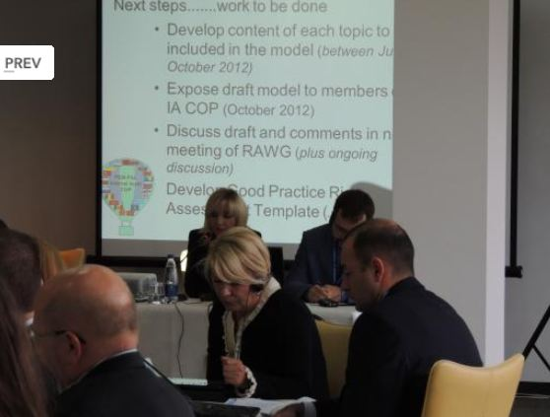
lviv
Discussed the goals
Set the tasks
Participant’s presentations
Case studies/practical examples

Slide 3
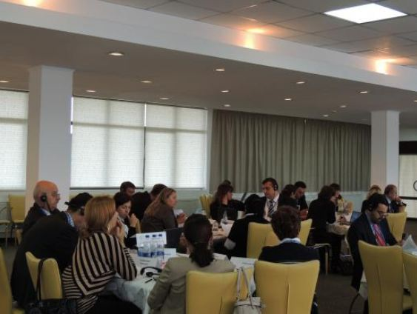
POST-LVIV AGENDA
Prepare a template
Preliminary structure approved
Basic criteria and risk factors developed

Slide 4
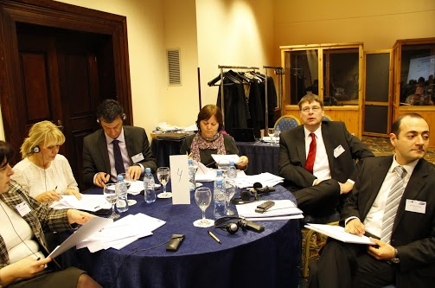
TIRANA
Risk assessment template
Risk assessment template presented
Practical tasks, based on examples from Elisia
Risk categories
Risk factors

Slide 5
PARTICIPANTS’ PROPOSALS DURING THE MEETING
Improve definitions
Closer to the public sector
More detailed definitions
Take the Guideline into account
Likelihood and probability assessment
Describe which risk levels will be used
Risk assessment
Only when the plan is compiled or changed
No provisions for addressing risks

Slide 6
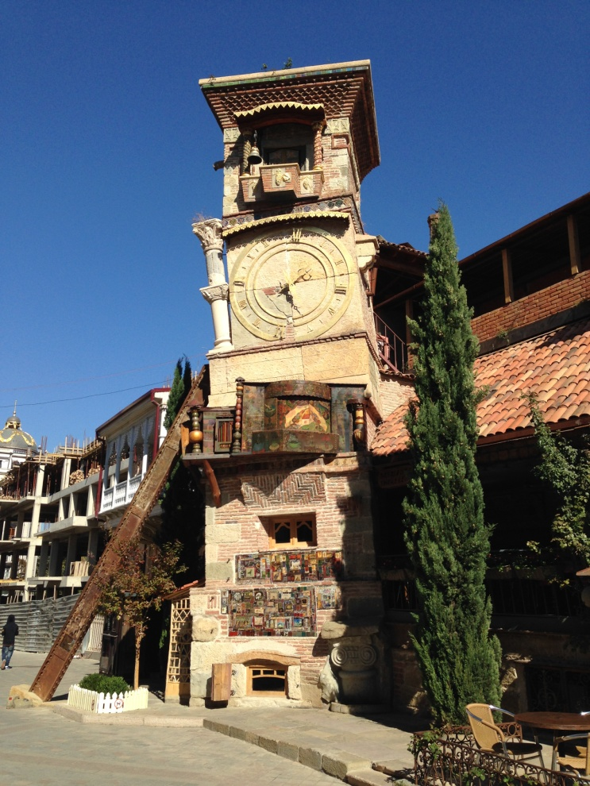
TBILISI
Action plan and ToR prepared
2
Information on participants’ proposals gathered, summarized and passed on to an expert
Taking into account participants’ proposals, develop proposals on the template
1

Slide 7
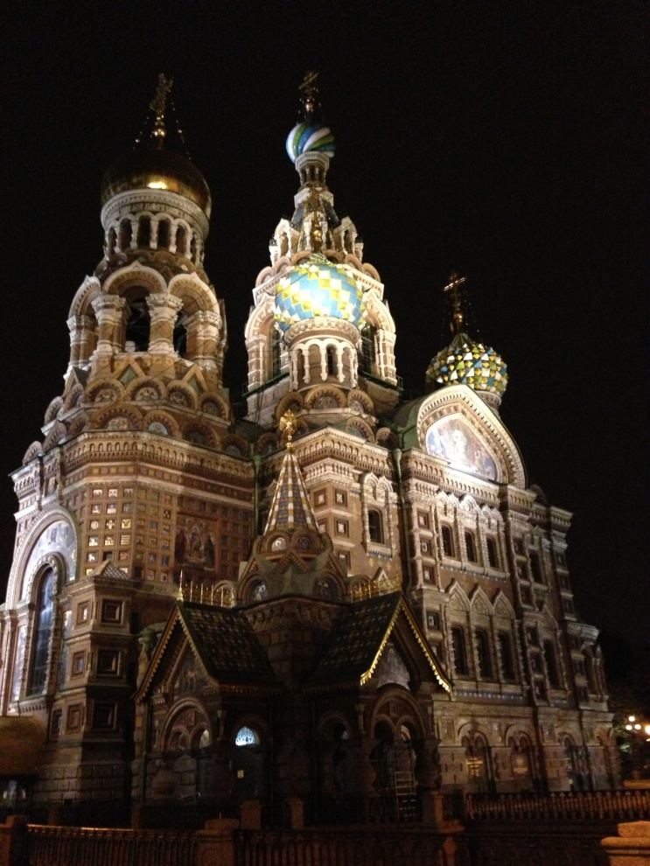
Saint-Petersburg
First draft of the risk assessment guideline presented
Worked through its chapters
Participants provided their proposals

Slide 8
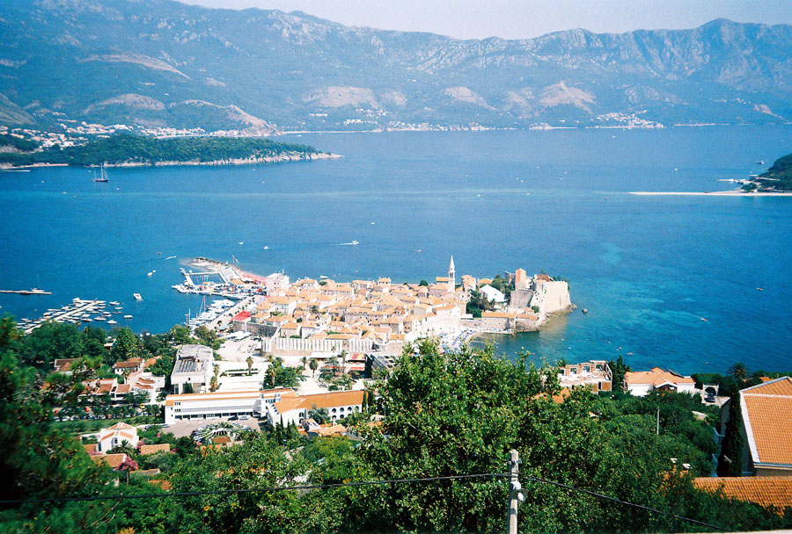
Preparation for the budva meeting
Guideline edited
Participants’ comments taken into account
Role plays prepared
As well as debates on relevant issues

