Slide 1
PEM PAL
IA COP
Audit in Practice Working Group
Internal audit and fraud
Sochi
October 2019
Dragos NICULAE – Head of QA Unit, CHUPIA RO

Slide 2



“Fraud can be defined as any illegal act characterized by deceit, concealment, or violation of trust”
WHERE?
Public or private businesses
Non-profit organizations
Government departments
Financial institutions
Public and private utilities companies
WHY?
To obtain: money, property or services
To avoid: payment or loss of services
To secure: personal or professional advantage
(excerpt from IIA’s IPPF definition of fraud)

Slide 3

IIA’s IPPF provisions pertaining fraud and internal auditor’s role (1)
IIA Standard 1210.A2
Proficiency and Due Professional Care: “Internal auditors must have sufficient knowledge to evaluate the risk of fraud …”
IIA Standard 1220.A1
Due Professional Care: “Internal auditors must consider … the probability of … fraud …”

Slide 4


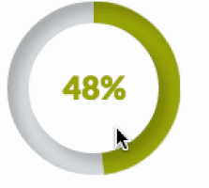

IIA’s IPPF provisions pertaining fraud and internal auditor’s role (2)
IIA Standard 2060
Reporting to Senior Management and the Board: “Reporting must also include … fraud risks…”
IIA Standard 2120.A2
Risk Management: “The internal auditors must evaluate the potential for the occurrence of fraud and how the organization manages fraud risk”
IIA Standard 2210.A2
Engagement Objectives: “Internal auditors must consider … the probability of … fraud …”

Slide 5
External Auditors
Report
Report
Board
of Directors
Audit Committee
Monitor
Management
Evaluate
Support
Setting tone at the top
Setting tone at the top
Discuss
Oversee IC system on fraud
FRAUD PREVENTION AND DETECTION ACTORS
Legal Counsel
Discuss and support
Report fraud
Other employees
Provide assurance on IC system on fraud + reccommendations
Closely work
Report fraud
Fraud Investigators
Asses IC system on fraud
Loss and Prevention Manager
Closely work
Assist investigations
Internal Auditors
Ethics Training
Cooperation
Communication

Slide 6


Board of directors
Oversee and monitor management’s actions to manage fraud risks, meaning:
    Evaluates management’s identification of fraud risks;
    Evaluates the implementation of anti-fraud measures;
    Creates the tone at the top;
    Implement policies encouraging ethical behavior and creates opportunities for employees, customers and external parties to report the violation of these policies;
    Monitors organization’s fraud risk management effectiveness by appointing one executive-level member of the management to be responsible for coordinating fraud risk management and reporting to the board.

Slide 7

Audit Committee
Evaluates management’s identification of fraud risks;
Evaluates the implementation of anti-fraud measures;
Creates the tone at the top;
Hires external auditors;
Oversee the internal audit activity;
Oversee the controls to prevent or detect management fraud.

Slide 8

Management
Oversee the actions of employees using internal controls and monitoring processes;
Assess the vulnerability of the entity to fraudulent activity;
Establishes and maintains an effective internal control system at a reasonable cost;
Discuss with investigators and legal counsel on developing controls over the investigation process, including developing investigation policies and procedures.

Slide 9

Internal Auditors
Need to be alert to the signs and possibilities of fraud within organization;
Contribute to the deterrence of fraud by examining and evaluating the adequacy and the effectiveness of internal controls;
Assist management in establishing effective fraud prevention measures by providing consulting expertise;
Could investigate (initial or full) suspected fraud;
Perform root cause analysis;
Issue recommendations for improving internal controls;
Monitoring whistleblower;
Provide ethics training;
May conduct proactive auditing to search for misappropriation of assets and information misrepresentation.

Slide 10


External Auditors
Plan and perform the audit to get reasonable assurance whether the financial statements of the organization are free of material misstatement and if misstatements were caused by error or fraud;
If there are evidence that fraud may exist, the external auditor must bring the problem to the attention of an appropriate level of management.

Slide 11


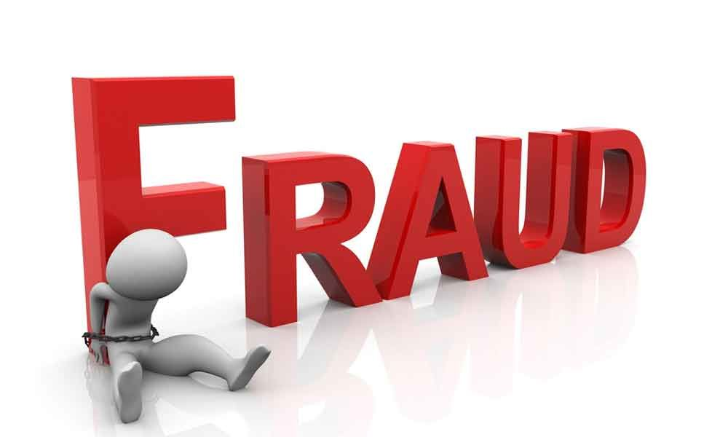
Fraud Investigators
Are responsible to detect and investigate the fraud and the recovery of assets;
Work closely with or be involved in internal audit activities so as they will have access to internal and independent auditor findings;
Work closely with legal counsel to bring legal action against perpetrator.

Slide 12

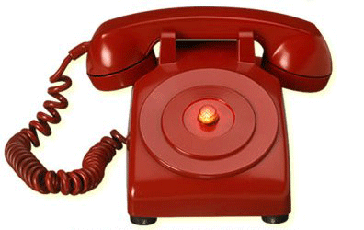
Other employees
Are the eyes and the ears of the organization;
Should report suspicions of fraud to an employee hotline, internal audit unit or a member of management.

Slide 13


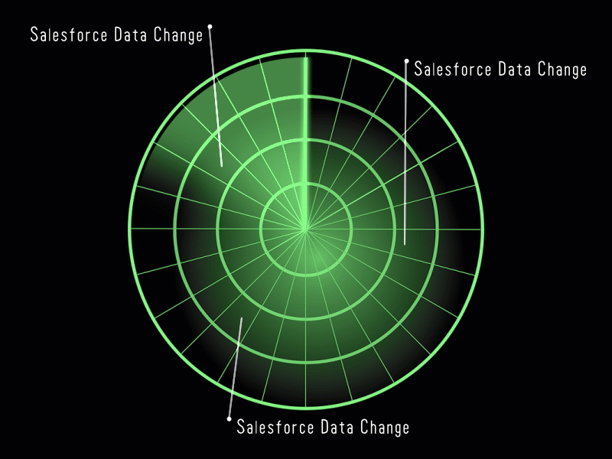
What auditors should do, related to fraud,
during the audit engagement? (1)
Internal auditors are not expected to have knowledge equivalent to that of a person whose primary responsibility is detecting and investigating fraud.
Audit procedures alone, even when carried out with due professional care, do not guarantee that fraud will be detected.
A well designed internal control system should help prevent or detect fraud. Tests conducted by internal auditors improve the likelihood that important fraud indicators will be detected.

Slide 14

What auditors should do, related to fraud,
during the audit engagement? (2)
Should consider fraud risks in the assessment of internal control design;
Is not expected to detect fraud, but is expected to obtain reasonable assurance that objectives are being achieved and control deficiencies are detected;
Has sufficient knowledge of fraud to identify red flags. This includes: characteristics of fraud, techniques to commit fraud, various fraud schemes, etc.
Should be alert to opportunities that could allow fraud. If significany control deficiencies are detected, additional tests conducted could be used to identify if the fraud occured;
Should evaluate whether management is actively retaining responsibility for oversight of the fraud risk management program;
Evaluate the fraud indicators and decide whether any further action is necessary or whether an investigation should be recommended.

Slide 15


What auditors should do, related to fraud,
during the audit engagement? (3)
The skepticism
Professional skepticism is an attitude that includes a questioning mind and a critical assessment of audit evidence.
A skeptical internal auditor neither assumes that management or employees are dishonest nor assume unquestioned honesty.
Inadequate professional skepticism is frequently cited as a significant reason why fraud has not been detected.
The Audit Committee’s oversight and support of the internal audit activity helps the internal auditor to maintain independence and objectivity as well as to keep an attitude of skepticism.

Slide 16
What auditors should do, related to fraud,
during the audit engagement? (4)
Communicating with the Board
The relationship between CAE and the Board includes both reporting and oversight functions.
In discussions with the Board, CAE may include
- All fraud audits performed;
- The fraud risk assessment process;
- Fraud or conflict of interests and results of monitoring programs concerning compliance with law, code of conduct, and/or ethics;
- The internal audit activity’s organizational structure as it pertains addressing fraud;
- Coordination of fraud audit activity with external auditors;
- Overall assessment of the organization’s control environment;
- Productivity and budgetary measures of internal audit’s fraud activities;
- Role of internal audit in fraud investigations.

Slide 17

IA system and FRAUD - RO good practices
Key = Clear guideline/provisions
Definition of irregularities (from point of view of auditors)
No make confusion with errors caused by the weaknesses of the IC in place

Slide 18
IA system and FRAUD - RO good practices
It represents the significant deviation from the procedural and methodological rules, respectively from the legal provisions, applicable to the audited activity / action, resulting from an action or omission that has or could have the effect of damaging the budget of the entity or possible indications of fraud.
A deviation from the normative and procedural provisions applicable to the audited activity / action is of irregularity if the auditors consider that it can have a major immediate impact on the objectives, the patrimony or the image of the entity, imposing, depending on the circumstances, taking immediate investigation measures. or correction by legal persons, without expecting the normal course of the steps of an internal public audit mission.

Slide 19
IA system vs FRAUD - RO good practices
National IA Law (based on standards)
- auditors are not involved in fraud investigations/no establishment of financial impact
- auditors identify suspicions (red flags)
A clear system of reporting of suspicions (to managers and at the same time to the control body in charge)
                Deadline = 3 days from findings
Protection of auditors (IA law, warning law, civil servant law=administrative code, etc)

