Slide 1

Internal Audit Community of Practice (IACOP)
Audit in Practice (AiP) Working Group Meeting
52th IACOP meeting
Sochi - Сочи, Russian Federation, October 28-29, 2019
Scott Layton
Vice President, Managing Partner
Global Finance Transformation
IBM

Slide 2
How to Assess Internal Controls
in a Digital Environment
Scott Layton
Vice President, Managing Partner
Global Finance Transformation
IBM

Slide 3





Intersection of the Digital & Analog Trail Worlds
Dual Trail
Fluidity
Gaps
Fluency

Slide 4






Auditing the Black Box
Algorithms
Machine Learning
Artificial Intelligence
Cloud
Blockchain

Slide 5



Digital Auditor
Skills
Tools
  IT and system tools
  ML/AI Programming skills
  Leveraging data lakes
  Data Extraction
  AI driven auditing tools
  Red flag indicators
  AI indicated risk based sampling
  Democratization of Technology

Slide 6
Best Practices for Internal Audit Report Writing
15 mins – Presentation

Slide 7







Uses of an Audit Report
Provide Assurance
Communicate Findings
Create Action
Independent Controls Perspective
Consultative
Quantitative Controls Assessment

Slide 8






Aligning to the Audience
Senior Executives
Opinion / Aggregated Reports
Material Issues
Significant Defects
Assurance
Audit Executive
Opinion / Findings
Risk Themes
Assurance
Audit Committee
Opinion / Aggregated Reports
Material Issues
Significant Defects
Assurance
Business / Line Team
Opinion / Findings / Recommendations
Audit Findings
Consulting Recommendations

Slide 9





Writing Best Practices
Quality Assurance
Failed
Poor
Non-existent
Missing
Ineffective
Erroneous
Undetected
Not effective
Inadequate
Excessive
Incomplete
Inconsistent
Not Consistently effective
Not always effective
Upline Review
Review Process
Formal Training Program
Internal Consistency
Technology
Control
Root Cause
Opinion
Defect or Execution
Recommendation

Slide 10
Best Practices in Combatting Fraud and Corruption
IT and other Innovations
20 minutes

Slide 11
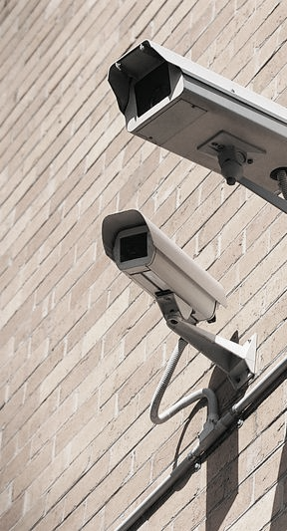











Cognitive Financial Surveillance
To Combat Financial Schemes and Fraud…
We need to…
Conduct Risk
…Think in new ways
Proactive
Behavior
Machine Learning
Client Suitability
…Take a Holistic Approach
Market Abuse
Email
Activity
Complaints
Trading
Voice
Notes:
Conduct Risk – Collusion, Insider Trading
Client Suitability – Mis-selling, Misrepresentation
Market Abuse – Pump and Dump, Front Running
Complaints – Sales Malpractice

Slide 12
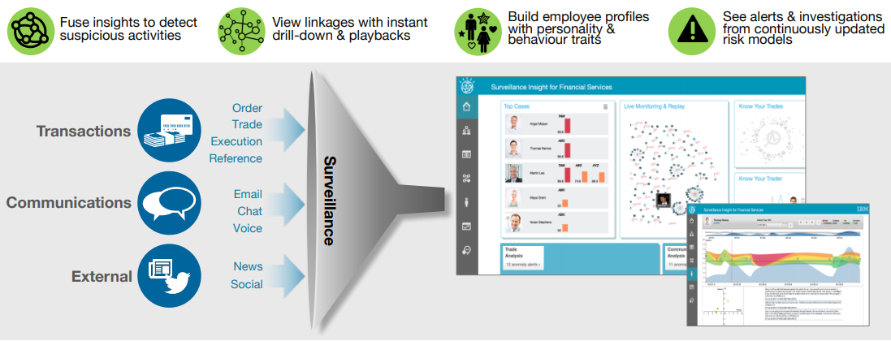
Surveillance Insight for Financial Services
Notes:
Reduced Cost of employee non-compliance & misconduct
Faster detection of sophisticated scenarios
Risk based prioritization of alerts and reduced false positives
Nando’s and Poker Party Examples

Slide 13
14% of all fraud is committed through expense reimbursement
Most Common Fraudulent Expense Claims
Victim organizations that
lack anti-fraud controls
suffer greater MEDIAN losses –
in fact
TWICE as MUCH
45%
35%
29%
28%
Personal purchases claimed as business expenses
Additional Mileage
Tips recorded higher than what was actually given
Submitting more than allowed for an item
Machine Learning
Hybrid Cognitive Risk Model
Rules-Based
Elaborate fraud schemes
Detect weak signals
Learn from historical patterns
Legal requirements
Transparency
Accountability
Data source: Chrome River / SurveyMonkey online Survey of 1072 business travelers, conducted February 2016
Notes:
Hybrid Cognitive Risk Model
Cognitive Technology can identify fraudulent patterns in a highly regulated environment, balancing complexity and transparency

Slide 14
Bayesian Network Risk Model
Expense Analytics tools employ cutting edge network models to identify fraud scenarios
Overuse of Cash Expense
Cash Pooling
Total Cash in Year
Fictitious Expense
Not in Frequent Item Set
Unusual Expense
Rare Expense
Merchant Category
Non-Business
Venue
Fraud Risk
Personal Items
Inappropriate Expense
Black List
Adult Venue
Expense Location
Risk
Use Cases
Scenarios
Features
Note: the network shown here is for illustrative purpose only.
Notes:
Advantages of a Bayesian Network
Bayesian Network based risk model detects fraud in a mutually exclusive and collectively exhaustive way
Cognitive Analytics
Bayesian Network model allows to extract complex patterns indicative of different expense fraud scenarios
Visualization
Advance network visualizations provide quick assessment of most important risk components at a glance
Remediation
Drill down capabilities facilitate investigations and root cause analysis, in alignment with remediation procedure

