Slide 1

PEMPAL
Moscow 23-25th October 2019
Presentation on Albanian Public Sector Accounting and Financial Reporting
Alma Beja
Treasury General Director
Ministry of Finance and Economy
alma.beja@financa.gov.al

Slide 2
General Background
Public accounting and financial reporting in Albania is currently done on cash bases with elements of accruals for certain specific categories of assets and liabilities.
The Republic of Albania does not presently have public sector accounting standards per se. Instead, Albanian Public Sector Generally Accepted Accounting Principles (PS GAAP), which is codified in a complex, fragmented and ambiguous legal framework (laws and MoFE instructions).
Public Accounting methodology is responsibility of MoFE.
The main achievements:
the successful implementation of the Albanian Government Financial Information System (dual accounting, automatic financial consolidation etc.)
unified chart of accounts for all level of governments and fully harmonized between budgeting and accounting (easer financial consolidation, easer budget monitoring)

Slide 3
Project “Development of Public Sector Accounting and Financial Reporting”
(WB, SECO)
    Development of public sector accounting and financial reporting in line with IPSAS;
    Development of MoFE capacities and of professional accounting skills for public accounting practitioners;

Slide 4
ALBANIA IPSAS IMPLEMENTATION CAPACITY BUILDING PHASED APPROACH
PHASE 1
PHASE 2
PHASE 3
PHASE 4
PHASE 5
PHASE 1
Address short term needs:
Deliver training aligned to roll-out of IT / implementation of IPSASs.
& Long term:
Recruitment, retention of finance staff
Detailed TNA for finance capability and capacity across Govt of Albania
Understand current finance skills
Test
Develop IPSAS training and sensitization courses
Develop infrastructure to support internal capacity building
Commence 1st tranche of new accountants/ accounting technicians /finance for non finance staff courses
Refine training and commence further tranches of finance cadre
.
Maintenance
2019 2023

Slide 5
ALBANIA IPSAS IMPLEMENTATION - SUCCESSIVE STEPS
PRIORITISATION OF THE IMPLEMENTATION APPROACH
Events after the Balance Sheet date*
Leases*
Revenue from Exchange Transactions*
Financial Instruments
Impairments
PHASE 4
PHASE 5
PHASE 1
PHASE 2
PHASE 3
Provisions
Related Party Transactions
Foreign Exchange
Intangibles
Employee Benefits*
Social benefits*
Tax income
Final phase
Consolidation (review IPSAS 33)
Group Accounts*
Consolidation eliminations*
Whole of Central Govt Accounts*
Preparation
Legislative Framework
Translate IPSAS
Capacity Development
IT Rollout
IPSAS 1, 2 & 3
Focus on material balances on the government financial statements
Fixed Assets
Inventories*
Investment property*
Agriculture
PPPs*
Borrowing costs
PHASE 1
2020 2021-2025 2022-2025 2024-2026 2025-27

Slide 6
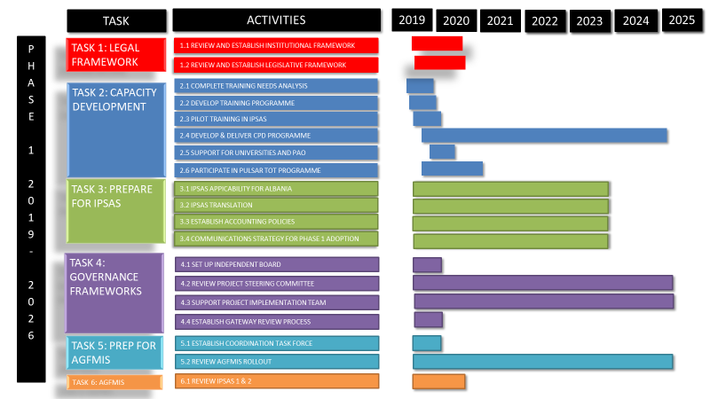

Slide 7
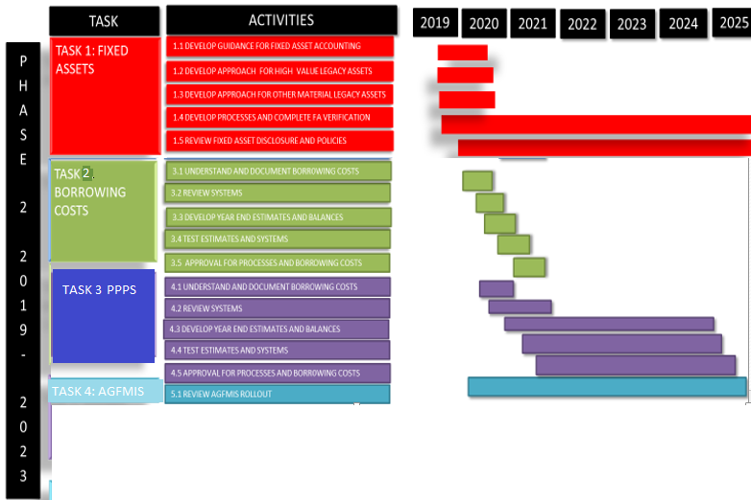

Slide 8
