Slide 1
Good practices in tackling fraud and corruption
Effective communication and reporting
Markus Erlmoser
Internal Audit Department
Federal Ministry of Finance - Austria
Sochi, 29. October 2019

Slide 2
Role of IA in detecting fraud & corruption (MoF in Austria)
Differentiation between Internal Audit Department and Bureau for Internal Affairs
  Fraud and anti-corruption as a task of Bureau for Internal Affairs
  Audit of the ICS as a task of Internal Audit
Overlaps in case selection
  Quarterly meetings between Internal Audit and Internal Affairs Bureau
    Chief Audit Executive
    Team leader Internal Audit Service
    Head of Bureau for Internal Affairs
  Cases from fraud audit with relevance to internal control systems
  Feedback from audits related to fraud or corruption
Effective communication and reporting

Slide 3
Practical examples for reporting with graphs
Internal control system based on COSO
Internal control system for tax refunds
Implementation of the Internal control system (Quick Check)
Efficiency of the internal control system for procurements
Effective communication and reporting

Slide 4
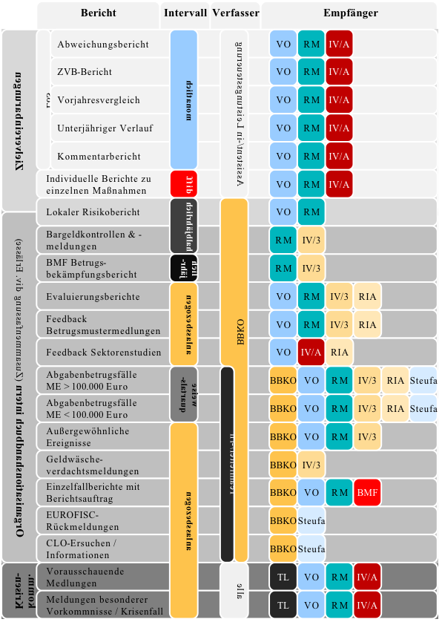
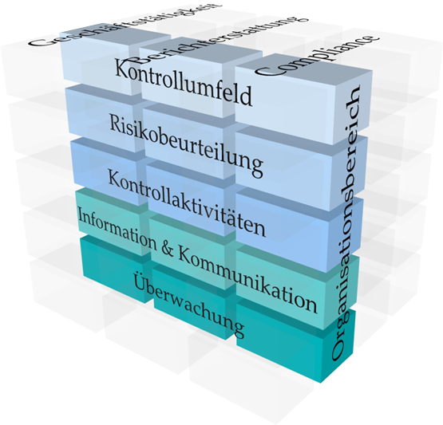
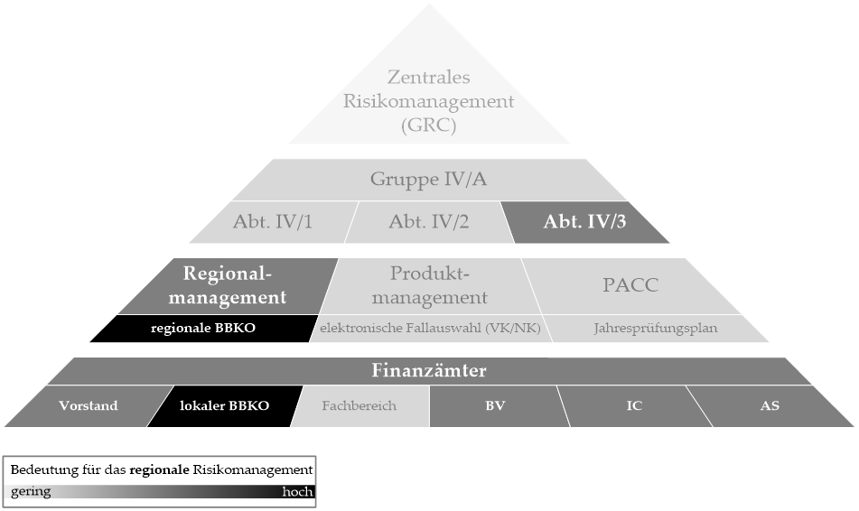
Internal control system based on COSO
Translation function for management by IAS
Explaining theoretical models
Audit of structures and their relevance to the audit topic
Visualization of report lines
Effective communication and reporting

Slide 5
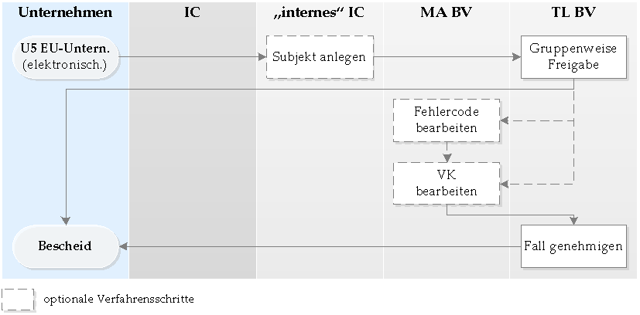
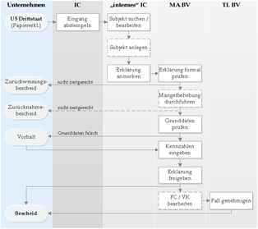
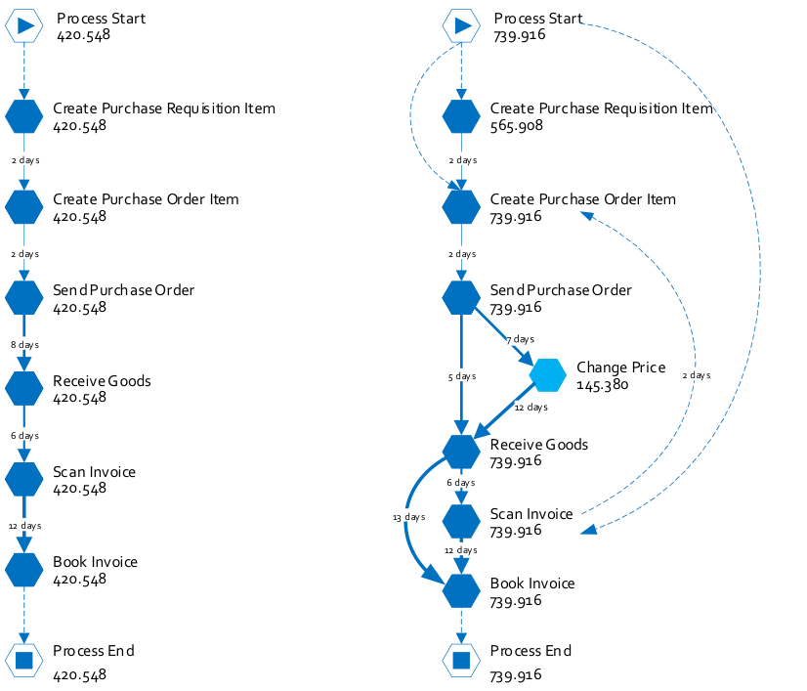
Internal control system for tax refunds
Process analysis of the refund procedure
Process mining as a method for detecting irregularities in the internal control system
  Extracting knowledge from available event logs
  Confrontation between event data and process models
Effective communication and reporting

Slide 6
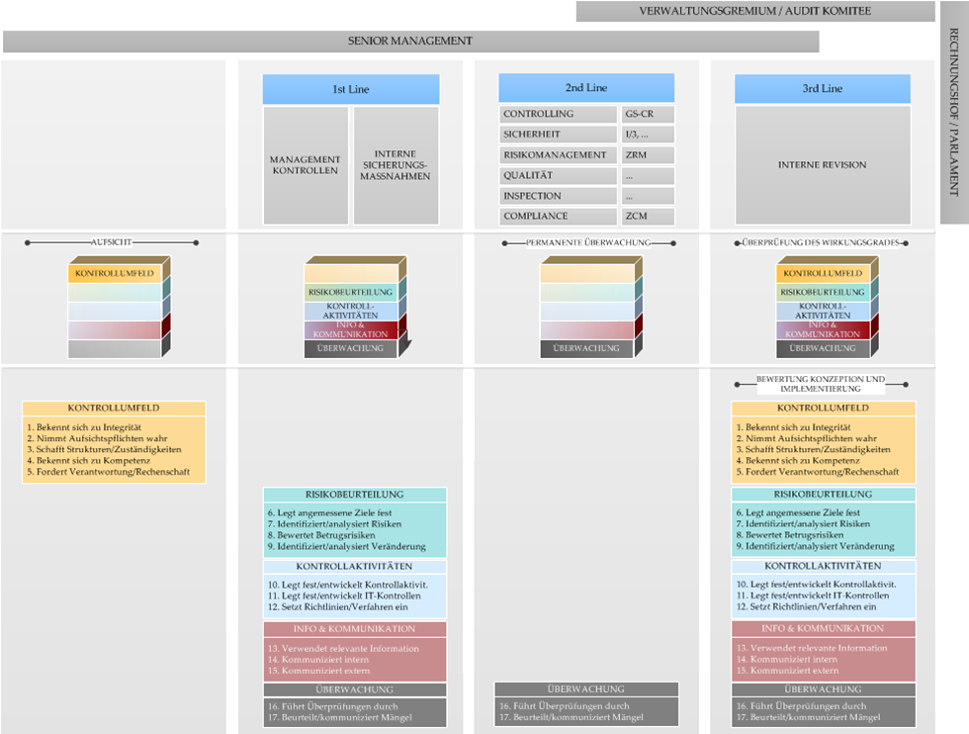
Implementation of the Internal control system (Quick Check)
Development of own audit models from different standards (e.g. COSO, 3LoD)
Assessment of the maturity of the internal control system based on the developed audit model
Effective communication and reporting

Slide 7
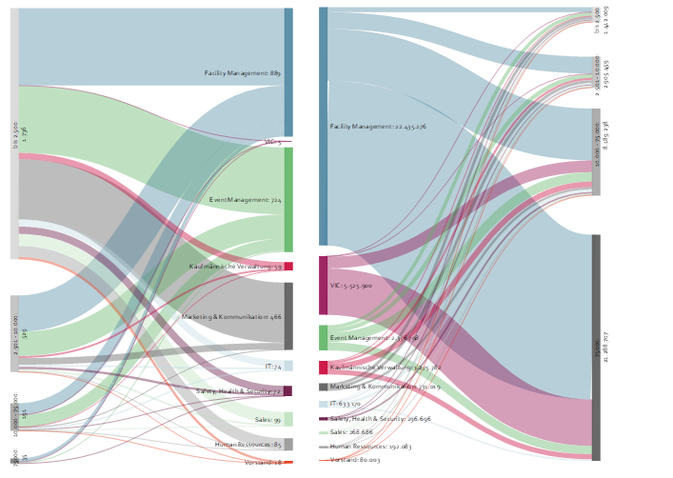
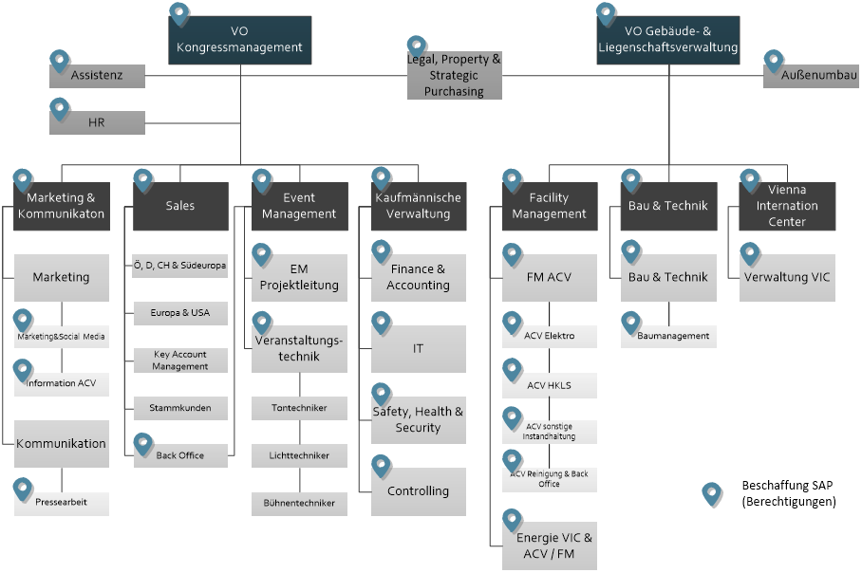
Efficiency of the internal control system for procurements (I)
Analysis of the number and amount of procurement
Analysis of system authorizations
Effective communication and reporting

Slide 8
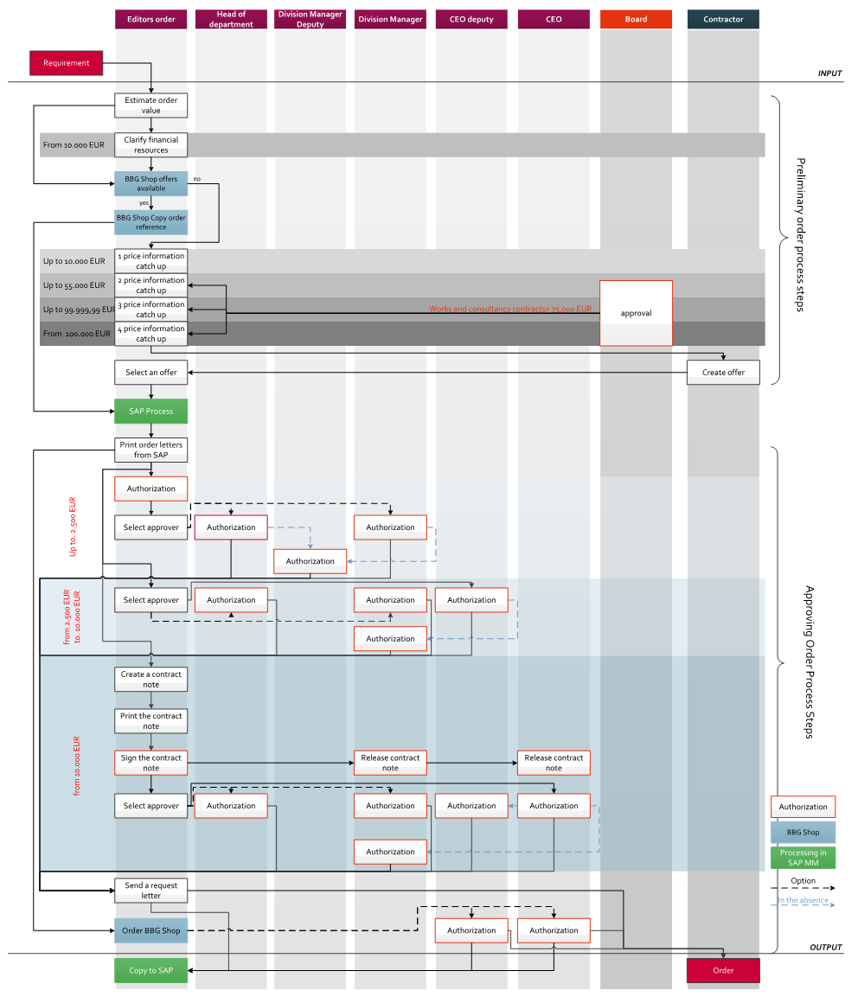
Efficiency of the internal control system for procurements (II)
Analysis of the procurement process
Showing inefficiencies in the process
Identify gaps in the internal
control system
Effective communication and reporting

Slide 9
Effective communication and reporting
Graphics trigger interest / Pictures stay longer in the mind
Graphics contain a lot of information summarized in a compact way
Data-based graphics help to find specific patterns and detect irregularities
With pictures, complex facts can be described more easily
Effective communication and reporting

Slide 10
Thank you for your attention!
Markus Erlmoser
Internal Audit Department
Federal Ministry of Finance - Austria
markus.erlmoser@bmf.gv.at

