Slide 2
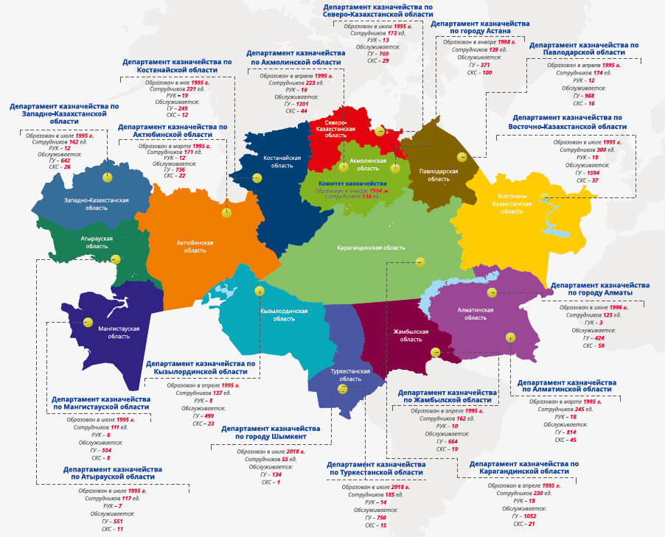
1. The Treasury of Kazakhstan. Statistics
Servicing of 4 levels of the budget: republican, regional, district, local self-government bodies
12 883 - government institutions
190 - public procurement accounts
466 - entities of the quasi-public sector
Daily volume of transactions in the treasury information systems:
- 50 000 payments through the treasury integrated information systems (TIIS)
- 60 000 receipts through the Kazakhstan Center for Interbank Settlements
- 120 000 reports generated for customers
45 000 service users
3080 – the number of treasury employees:
151 – central office
1362 – regional offices
1567 – district offices
In the structure of the treasury there are 3 departments for accounting and reporting:
- Department for revenue accounting and budget accounting
- Department for reporting on the republican budget
- Department for Local Budget Reporting

Slide 3
2. Development
PREVIOUS
CURRENT
Financial documents
reporting
Paper workflow
On-line electronic workflow
Financial Document Processing Time
TECHNOLOGY
3 days processing
Processing of up to 6 hours
Information Systems
The Treasury Integrated Information System based on Oracle E-Business Suite
Treasury - Client Information System (IS)
“Electronic invoices” IS
AIIS (automated integrated information system) "Electronic public procurement"
IAIS (integrated automated information system) "e-Ministry of Finance", subsystem "Collection and consolidation of financial and budget reporting”
“Bask-M” IS
TIIS
integration
RESULTS
Expense
Decrease in administrative expenses of state institutions (for paper - over 100 million tenge per year, for transport and time about 400 km distances in some regions);
Lack of direct contact with state institutions, reduction of administrative barriers and minimization of the “human factor” in the execution of the state budget;
Improvement of the security of document transfer;
Ensuring the transparency of operations.
Transport
Paper
Petrol
Money
Paper archives

Slide 4
3. Stages of implementation of accrual accounting and reporting in the public sector
Development of a methodology for accounting and financial reporting of the public sector
(Accounting policy, Chart of accounts, Accounting rules, Forms and Rules for the preparation of financial statements, Rules for the preparation of consolidated financial statements, Album of forms of accounting documentation, Rules for inventory)
Staff training, holding cluster workshops
Pilot project
Transfer of accounting data to new accounts and reporting forms
Development of information systems for the collection and consolidation of reporting
2014-2018
Development of a methodology for accounting and financial reporting on the revenue side of the budget
Pilot project
Accrual accounting of receipts
Recovery of previously unrecorded assets and liabilities
Formation of consolidated financial statements for the expenditure side of the budget
Generation of financial statements for receipts
Improvement of the regulatory framework and information systems
Audit of the consolidated financial statements for the republican budget in 2020
2010-2013
2019-2020
Formation of the consolidated financial statements for the republican budget for 2018
Inclusion of the consolidated financial statements in the annual report on the execution of the republican budget submitted in 2019 to the Parliament
2007-2009
Concept for the implementation of a result-oriented state planning system approved by the President of the Republic of Kazakhstan
Amendments to the Budget Code of the Republic of Kazakhstan
Section 23 “Financial Statements”
Ordnance of the Prime Minister on the implementation of accounting and financial reporting on the accrual basis

Slide 5
4. Formation of consolidated financial statements for the republican budget on the basis of the “e-Ministry of Finance” information system
3. Treasury Committee
Acceptance of statements
3.1 Acceptance of financial statements of ministries
1. Reconciliation of financial reporting forms with treasury data
2. Reconciliation of financial statements with budget statements
3. Reconciliation of financial and budget reporting data with data provided by other departments
4. Reconciliation of mutual linking of forms, tables, and explanatory note.
5. Check for compliance with budget legislation
(by consolidated amounts)
Reporting to IAIS “e-Ministry of Finance”
Return for finalization of reports submitted to the IAIS “e-Ministry of Finance”
2. Providing 31 sets of financial statements of ministries
Elimination of mutual operations,
Format-logical control within the form, between forms, between reporting sets
3.2 Formation of financial statements for budget receipts
4. Preparation of consolidated financial statements for the republican budget
Reporting to IAIS “e-Ministry of Finance”
Consolidation of financial statements at the IAIS “e-Ministry of Finance”, reconciliation, calculation and elimination of mutual operations between government agencies, the revenue side of the budget with expenses of ministries, mutual settlements.
Reconciliation of consolidated amounts.
Formation of reporting forms.
Format-logical control within the form, between forms, between reporting sets
Analysis of amounts and preparation of disclosures for the explanatory note.
Circulation of Financial statements to recipients
Return for finalization of reports submitted to the IAIS
“e-Ministry of Finance”
1. Reporting
Institutions of ministries
Format-logical control within the form, between forms, between reporting sets
The consolidated financial statements for local budgets are formed similarly.

Slide 6
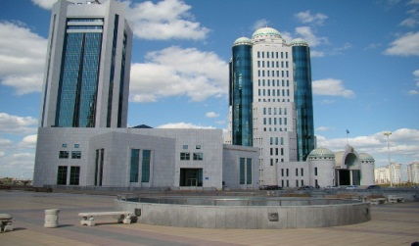
5. Annual consolidated financial statements as part of the Annual Report of the Government of the Republic of Kazakhstan
on the execution of the republican budget
Treasury Committee
forms
Data on the execution of the republican budget on a cash basis
Consolidated financial statements on an accrual basis consisting of:
Consolidated balance sheet
Consolidated Statement of Financial Performance
Consolidated Statement of Cash Flows (Direct Method)
Consolidated Statement of Changes in Net Assets / Equity
Explanatory note
Ministry of finance
The annual report of the Government on the execution of the republican budget includes:
Government
of the Republic
of Kazakhstan
Parliament
of the Republic of Kazakhstan
Review and approval
Report on the execution of the republican budget
Analytical report on the execution of the republican budget
Explanatory note
(since 2019) Annual consolidated financial statements on the execution of the republican budget
- Consolidated balance sheet
Consolidated Statement of Financial Performance
Consolidated Statement of Cash Flows (Direct Method)
Consolidated Statement of Changes in Net Assets / Equity
Explanatory note
Accounts Committee for Monitoring the Execution of the Republican Budget
Based on the results of the financial statements audit, presents:
a conclusion on the objectivity of the information provided, reflecting the findings and recommendations for both the entire consolidated statement and individual statements of ministries
Art. 45 of the Law of the Republic of Kazakhstan “On state audit and financial control,”
shall be enforced from 01.01.2020

Slide 7
Thank you for your attention.

