Slide 1


TCOP
Results and Plans for the Future
Budapest, Hungary
July 5, 2018

Slide 2

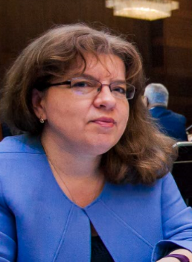
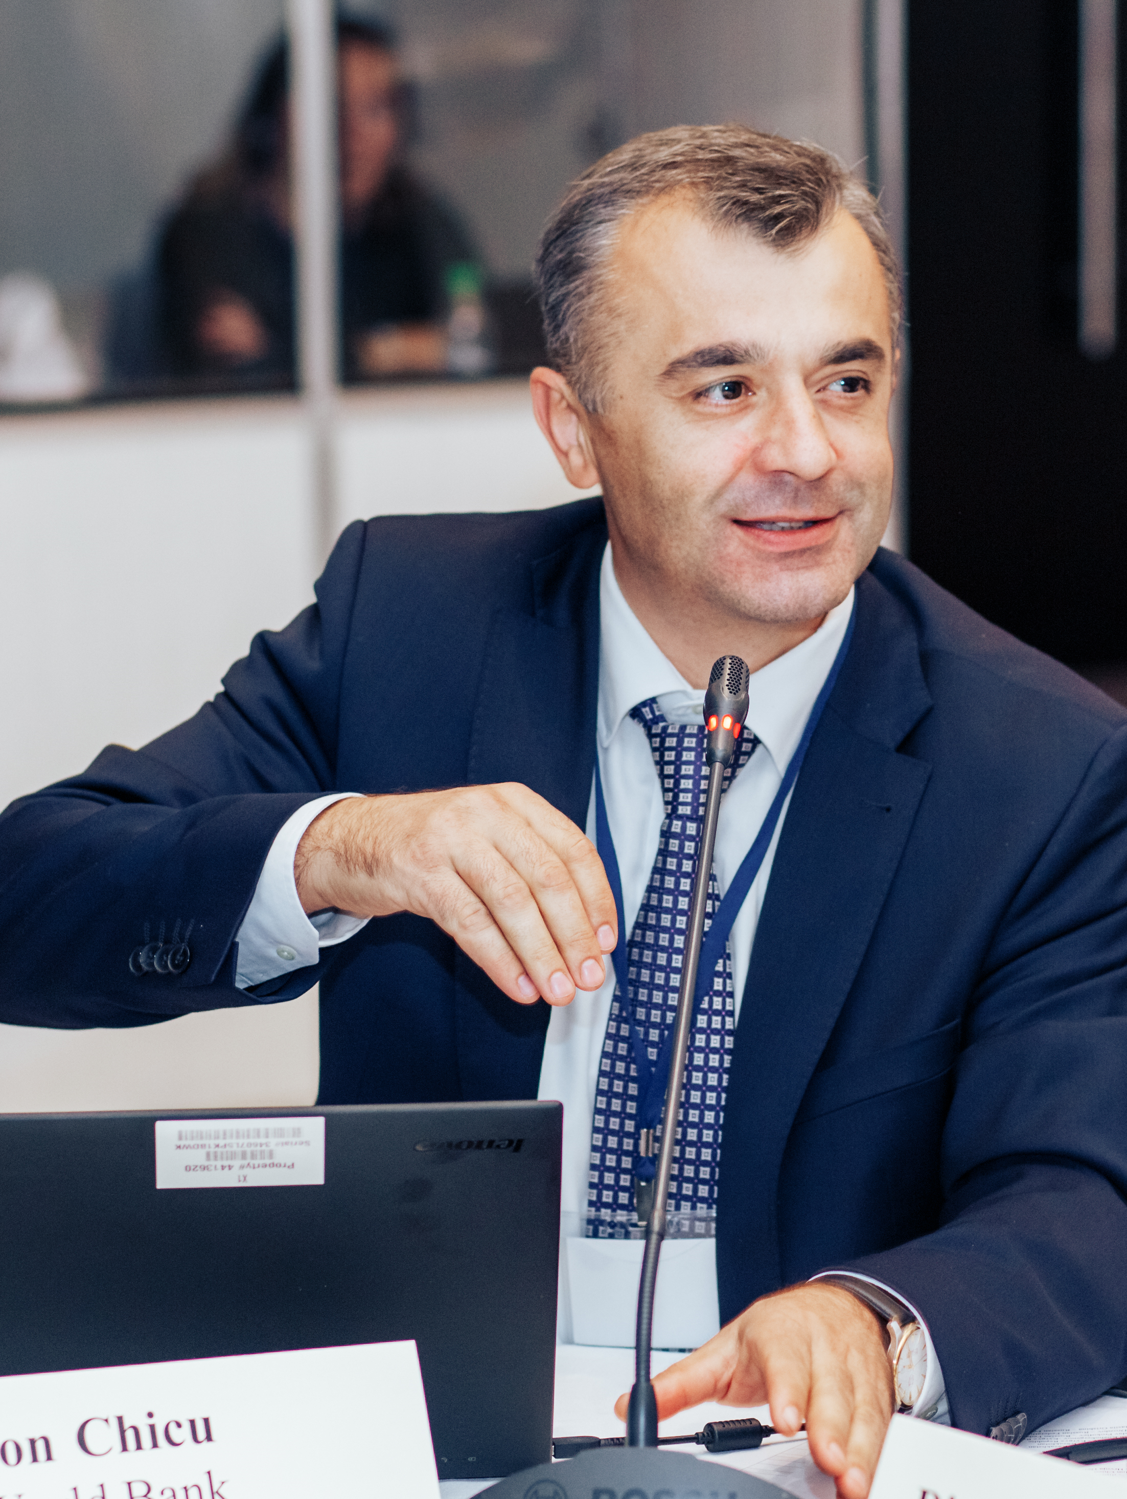
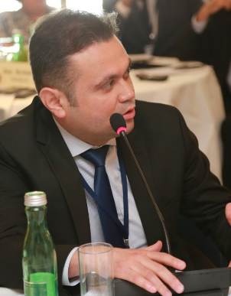
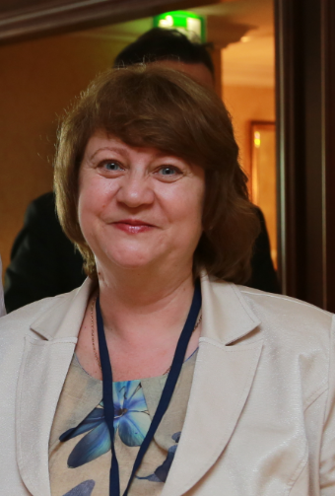
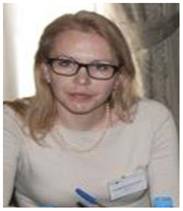
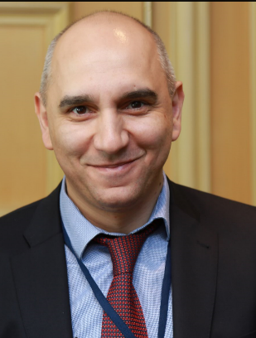
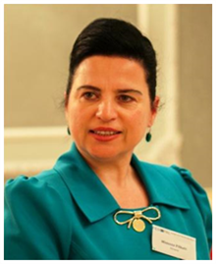
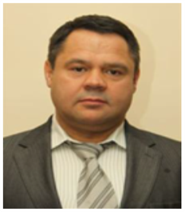
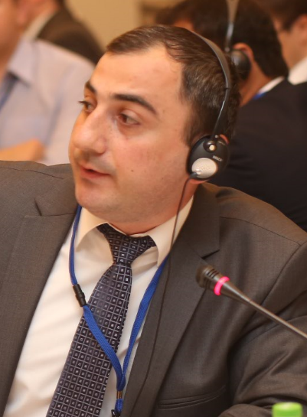
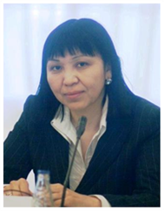
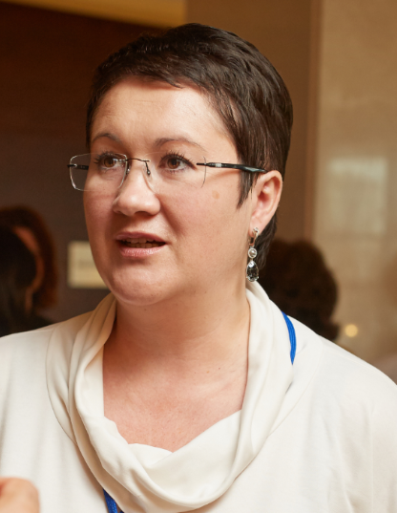
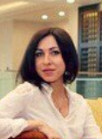
Elena Nikulina,
PEMPAL program leader
Ion Chicu
Former TCOP coordinator
Ilyas Tufan,
TCOP Vice Chair,
Department Head, Treasury,
Turkey
Angela Voronin,
TCOP Chair,
Head,
State Treasury,
Moldova
Ludmila Gurianova
TCOP Vice Chair,
Deputy Head
State Treasury
Belarus
Executive Committee
Treasury Community of Practice
Mimoza Pilkati
Deputy Dep. Head
State Treasury
Albania
Nazim Gasimzade Department Head, State Treasury Agency,
Azerbaijan
Albania
Alexander Demidov,
Deputy Head
State Treasury,
Russia
Levan Todua
Department Head, State Treasury, Georgia
Zaifun Yernazarova
Department Head,
Ministry of Finance,
Kazakhstan
Yelena Slizhevskaya
Resource person
Ekaterina Zaleeva
PEMPAL Secretariat

Slide 3

TCOP Strategic Plan
Was developed in accordance with :
  PEMPAL Strategy for 2017-2022
  Results of TCOP member surveys, including the ones in Vienna in June 2017 and in Tirana in 2018
Is aimed at
achievement of PEMPAL TCOP strategic goals:
  Promotion of PFM reforms of high priority for TCOP members, with the focus on reforms of national treasuries
  Provision of TCOP members with high quality resources and knowledge services
  Establishment of highly professional community of treasury specialists in TCOP countries
  Gaining support for TCOP activities and for activities of PEMPAL as a whole from top management of treasuries from member countries.

Slide 4
TCOP continues to work in 4 key thematic areas
Function
Evolution of treasury role and functions
IT
Use of information technologies in treasury operations
Cash
Cash management
A/R
Accounting and reporting in the public sector

Slide 5
Activities implemented between July 2017 – June 2018
TCOP Plenary meetings
1 TCOP Plenary meeting with participation of 44 TCOP members from 15 countries (Tirana 2018)
Small format workshops
3 small format workshops (Chisinau and Baku), with participation of 116 TCOP members
Thematic videoconferences
3 videoconferences with participation of 54 TCOP members
Executive Committee
4 ExCom meetings (including 3 videoconferences and a face-to-face meeting in Tirana)

Slide 6
TCOP Thematic Groups
Cash Management Group(13 countries).
Evolution of Treasury Role and Functions Group (15 countries)
Public Sector Accounting and Reporting Group (14 countries)
Use of IT in Treasury Operations Group (11 countries)

Slide 7

Cash Management Group
Established in 2015. The group includes 13 countries (Albania, Azerbaijan, Belarus, Georgia, Kazakhstan, Kyrgyzstan, Macedonia, Moldova, Russian Federation, Tajikistan, Turkey, Croatia and Montenegro)
From the moment of its establishment, the group held:
  3 thematic workshops (Ankara, Moscow, Chisinau)
  6 videoconferences
  1 thematic survey
The group held 1 event in the reporting period:
  Thematic workshop in Chisinau– October 2017.

Slide 8

Key Outputs of
Cash Management Group’s Activities
The group explored the experiences of Albania, Azerbaijan, Georgia, Moldova, Turkey and Russia in cash management
Members of the group enhanced their understanding of such aspects as TSA operation, active cash management tools, cash balance targeting, interaction with central banks, interaction with debt management function.
Knowledge products were developed – Report on the thematic survey on TSA operation in TCOP countries, and Note on servicing agreements with central banks.

Slide 9

Use of IT in Treasury Operations Group
Established in 2013. The group is comprised of 11 countries (Albania, Azerbaijan, Belarus, Georgia, Kazakhstan, Kyrgyzstan, Moldova, Russian Federation, Tajikistan, Turkey and Ukraine)
From the moment of its establishment the group held:
4 workshops (Minsk, Tbilisi, Chisinau, Baku)
3 study visits (Ankara, Seoul, Vienna)
8 videoconferences
During FY2018 the group held 3 events:
  2 videoconferences: on December 12, 2017 and on March 1, 2018
  Thematic workshop in Baku – April 10-12, 2018

Slide 10
Main Results of the Group’s Work
Exposure to the experience of some countries in FMIS implementation and discussion of its potential application in TCOP countries (Azerbaijan, Austria, Belarus, Georgia, Kazakhstan, Russia, Turkey, South Korea)
Deeper understanding of issues related to establishment of IT support services in the ministries of finance/treasury offices
A joint discussion of approaches to automation of accounting and financial reporting at the level of budget users with the TCOP accounting group (Baku 2018)
Review of the resources of the World Bank’s FMIS COP
Provision of PEMPAL library with materials from the completed activities to make them available for further use

Slide 11
Key results of the Group’s work – country examples
Belarus colleagues made use of the TCOP peer experts’ opinion in the process of conceptualizing their new FMIS
Colleagues from Georgia got new ideas in Seoul on integration of a treasury information system with a public procurement system.
Colleagues from Tajikistan developed a better insight into the Turkish information system’s functionality and it helped them in adaptation of it to their country’s needs.

Slide 12
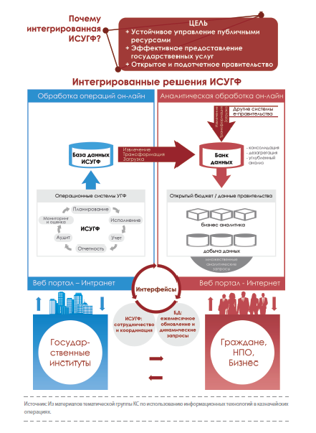
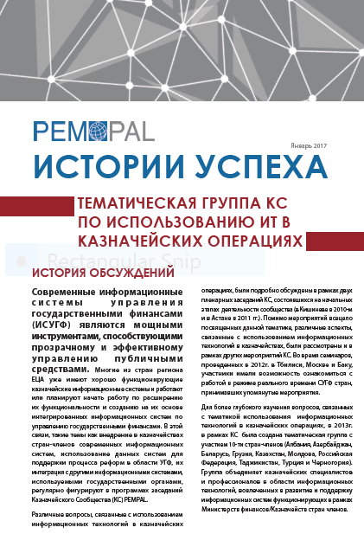
Publication of Group’s Success Story
Notes:
Краткая характеристика (демонстрация) нового вебсайта PEMPAL. Со слайда есть гиперлинк на сайт PEMPAL. Отметить особо библиотеку, и показать где находится информация о мероприятиях КС. Упомянуть про Новости, анонсы мероприятий и 3 языка сайта. В конце упомянуть еще раз про Продукты знаний и показать где размещены на сайте.

Slide 13

Public Sector Accounting and
Financial Reporting Group
In 2013 special groups were established to work in 3 areas:
  - Accounting of Government Assets
  - Consolidation of Financial Reports
  - Accounting Standards
The latter continues its work and currently includes representatives from 14 countries (Albania, Azerbaijan, Belarus, Croatia, Georgia, Kazakhstan, Kyrgyzstan, Macedonia, Moldova, Russia, Tajikistan, Turkey, Montenegro, and Ukraine)
Since its establishment the Group on Accounting Standards has held:
  4 workshops (Podgorica, Tbilisi, Minsk and Baku)
  1 videoconference
In FY2018 the Group had
Thematic workshop in Baku, Azerbaijan: on April 12-13, 2018.

Slide 14
Main results of the group work
Peer expert support provided to several countries, including Belarus, Georgia and Montenegro, regarding the implementation of international standards
Guidelines to identify mismatch between national methodology and international standards reviewed with examples of application
Experience of several countries explored regarding implementation of accounting standards aligned with international standards
Approaches to automation of accounting and financial reporting at the budget user level discussed jointly with the IT group (Baku 2018)

Slide 15
Evolution of Treasury Role and Functions Group
Established in 2016. The Group includes 15 countries (Albania, Azerbaijan, Armenia, Belarus, Bulgaria, Croatia, Georgia, Kazakhstan, Kyrgyzstan, Moldova, Russia, Serbia, Tajikistan, Turkey, and Ukraine)
The Group’s proposals shaped the agendas of TCOP’s annual plenary meetings
  2016 – Evolution of treasury role and functions (Chisinau),
  2017 – Risk management in treasury operations (Vienna),
  2018 – Measurement and monitoring of treasury performance (Tirana)
In FY2018 the Group held a
  Thematic videoconference- April 2018 (experience of reorganization of the Moldovan treasury system)

Slide 16
Knowledge Products Developed under TCOP
Practical guidelines on consolidation of financial reports, 2016
Note on Service Agreements with Central Banks, 2017
Report on the results of the survey on Treasury Single Account Operation Practices in PEMPAL member countries, 2016
Integration of budget classification and chart of accounts, success stories from TCOP countries, 2014
Final report on activities of the TCOP Asset Management thematic group, 2015.

Slide 17
Plans for FY19
Cash management group is planning for the fall a meeting combined with a study visit (destinations under consideration – Hungary, Sweden, Austria)
IT group is planning a meeting for the spring, possibly combined with a study visit (destination to be determined)
Accounting group is going to explore a possibility of a joint meeting with PULSAR program. The work on the new version of the paper on design of the budget classification integrated with the chart of accounts is also planned
Group on Evolution of the role and functions of treasuries will continue thematic videoconferences and will be preparing the agenda of the 2019 plenary (5 countries expressed interest to host TCOP plenary in 2019)

Slide 18
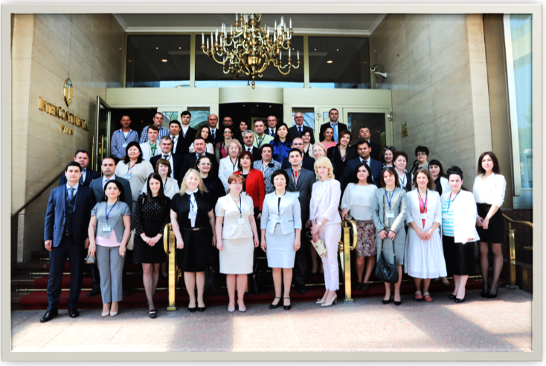
Thank you for your attention!

