Slide 1

Latin America experience and PULSAR FINCOP
TCOP Meeting of the PEMPAL Public Sector Accounting and Reporting Thematic Group
Moscow, Russia, 23-25 October 2019
Dmitri Gourfinkel, PULSAR FINCOP Co-Task Team Leader
Senior Financial Management Specialist, The World Bank Group
October 24, 2019

Slide 2
PSA reforms in Latin America: main findings and trends
Indirect adoption of IPSAS through development of national standards
Role of the legal framework and institutional arrangements
It is hard to achieve 100% of compliance with IPSAS:
  Regulatory differences (consequence of indirect implementation)
  Difficulties in implementation at entity level
  Consolidation challenges: use of different accounting frameworks («mixed-group»)
Strong link with use of IFMIS (in-house vs. COTS)
Budget system implications
Change management and training efforts
IPSAS implementation it is a multiannual project: 5-8 years

Slide 3

FOCAL
FOCAL: Forum of Accountants General of Latin America
Establishment: November 18-19, 2014, in Santiago, Chile
17 country members: Argentina, Bolivia, Brazil, Chile, Colombia, Costa Rica, Ecuador, El Salvador, Guatemala, Honduras, Mexico, Nicaragua, Panama, Paraguay, Peru, Dominican Republic, Uruguay
Development partners: WB, IMF, and IADB
Strategic objective: Promote the development and strengthening of PSA as a language of transparency and accountability Latin American countries
Accounting function organization: As part of MoF, SAI or independent
Main discussion topics:
  IPSAS implementation strategy and monitoring;
  Consolidation of financial statements;
  Fixed asset management and valuation;
  Tax revenues recognition;
  IFMIS implementation;
  Financial and fiscal reporting.

Slide 4

FOTEGAL
FOTEGAL: Forum of Treasurers General of Latin America
Establishment: April 15-16, 2010, in Lima, Peru
17 country members: Argentina, Bolivia, Brazil, Chile, Colombia, Costa Rica, Ecuador, El Salvador, Guatemala, Honduras, Mexico, Nicaragua, Panama, Paraguay, Peru, Dominican Republic, Uruguay
Development partners: WB, IMF, and IADB
Strategic objective: Promote institutional coordination between country members in order to improve the development and strengthening of public policies related to treasury function
Treasury function organization: As part of MoF
Main discussion topics:
  Payment management and revenues collection;
  Cash management;
  Asset and liability management;
  Fiscal risks;
  Collaboration between treasury, accounting, budgeting, and debt teams

Slide 5


CReCER
CReCER: Accounting and Accountability for Regional Economic Growth
First conference: June 13-15, 2007, in Mexico City, Mexico
10 conferences so far: Mexico (2007), El Salvador (2008), Brazil (2009), Panama (2010), Argentina (2011), Nicaragua (2012), Colombia (2013), Ecuador (2015), Mexico (2017), Costa Rica (2019)
Development partners:
  Global: WB, IADB, IFAC, and GPPC
  Regional: AIC, OLACEFS, GLENIF
  Local: MoF, SAI, PAO
Strategic objective: To leverage knowledge sharing, collaboration and networking to support efforts to improve the overall public and private sector financial reporting and accountability framework and thus boost economic growth and development
Main discussion topics:
  Public and private sector accounting and auditing
  Transparency and Accountability
  Strengthening of PAO
  eGovernment

Slide 6

PULSAR FINCOP: opportunities for collaboration
Joint meetings to discuss common topics
Public Sector Accounting Framework Assessment methodology (PAFA/REPF II Tool) assesses the gap between the country’s PSA and IPSAS + link with PEFA methodology
PSA stock-taking survey and PSA ECA regional reforms book. LAC region experience
Technical notes on critical PSA topics

Slide 7

PULSAR FINCOP: Consolidated List of Priority Topics
How to ensure political support and resources for PSA reforms
Legislation and regulation of PSA: good practices
Similarities and differences between GFSM and IPSAS, including training and updates on IPSAS/GFS2014
IPSAS implementation sequencing (horizontal vs. vertical)
PSA reforms approaches and practices in subnational governments
Institutional arrangements for the accounting function, e.g. outsourced, co-sourced, centralized, shared services, etc.
Accrual accounting: impact on budget reporting, including templates
Accrual budgeting: advantages and disadvantages
How to develop financial and budget literacy programs
Information systems: integration of PSA into IFMIS
Unified Chart of Accounts for financial, budgeting, and fiscal reporting
Consolidation at the ministry and whole government levels, including SOE
Identification, classification, and measurement of fixed assets, including PPE, infrastructure, heritage, intangible assets, and natural resources
Revenue recognition from exchange and non-exchange transactions
The role of internal and external auditors to support PSA reforms

Slide 8
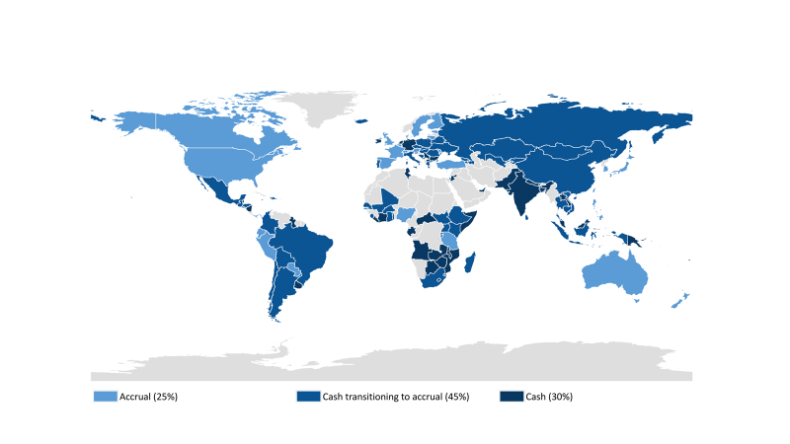
IFAC: Currently 25% of governments report on accrual…
Source: IFAC / CIPFA International Public Sector Financial Accountability Index (data from 150 countries).

Slide 9
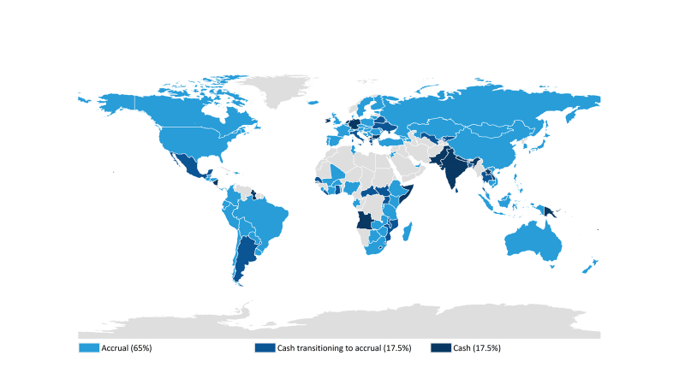
IFAC: …within 5 years 65% will report on accrual
Source: IFAC / CIPFA International Public Sector Financial Accountability Index (data from 150 countries).

Slide 10

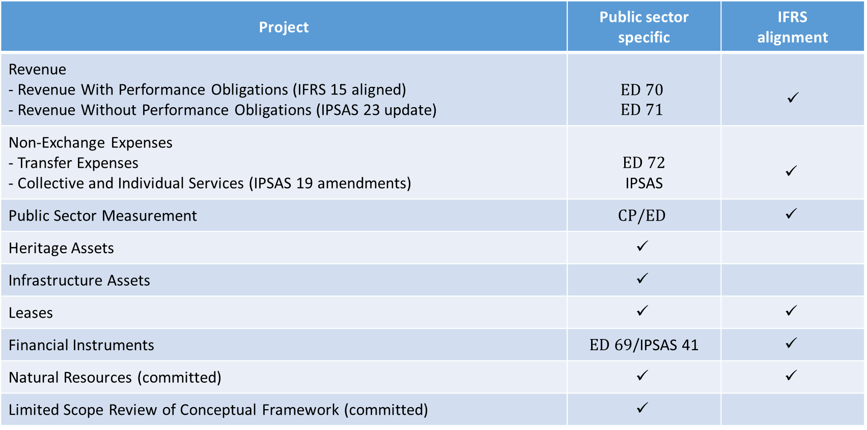
IPSASB: Current work program
Project | Public sector specific | IFRS alignment
Revenue - Revenue With Performance Obligations (IFRS 15 aligned) - Revenue Without Performance Obligations (IPSAS 23 update) | $$ED 70 \\ ED 71$$ | $$✓$$
Non-Exchange Expenses - Transfer Expenses - Collective and Individual Services (IPSAS 19 amendments) | $ED 72$ IPSAS | $$✓$$
Public Sector Measurement | $$CP/ED$$ | $$✓$$
Heritage Assets | $$✓$$
Infrastructure Assets | $$✓$$
Leases | $$✓$$ | $$✓$$
Financial Instruments | $ED 69$/IPSAS 41 | $$✓$$
Natural Resources (committed) | $$✓$$ | $$✓$$
Limited Scope Review of Conceptual Framework (committed) | $$✓$$

Slide 11

IPSASB: Research programme
Projects selected for research:
  Discount rates
  Differential reporting
  Presentation of financial statements
  Tax expenditures
IPSASB to facilitate rather than undertake research itself
Research / scoping to be completed by mid 2020
Volunteers needed to lead or participate in research groups!

