Slide 1
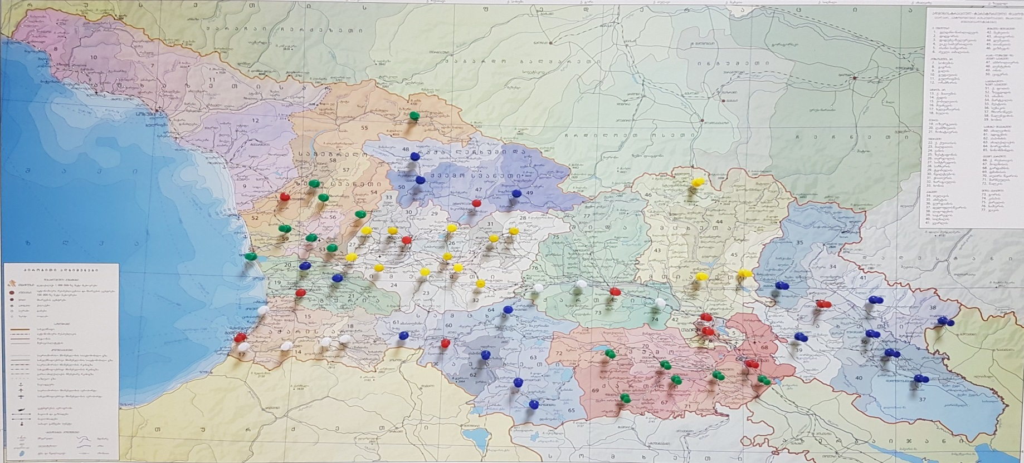
Public Internal Control Department
MOF of GEORGIA
Sakartvelo
Irma Gelantia-Akhvlediani
11-14 June, Armenia
2018

Slide 2
PIFC Annual reporting Practice in Georgian Public Sector
What is the Annual report based on:
Georgia Law on PIFC declares who are to send annual reports to the CHU;
All ministries
Autonomies republics
Legal Entities of Public law
Local Governments
Who is interested in Annual report?
Management
SAI
Cabinet of Ministers
Parliament
Donor organizations
EU review missions
Civil society, NGOs
Irma Gelantia-Akhvlediani
Deputy Head of the Public Internal Control Department

Slide 3
PIFC Annual reporting Practice in Georgian Public Sector
How CHU works on Consolidated Annul report?
Recommended forms for annual reports – pure quality of reports
Online questionnaires – with required documentations
Interviews with IAUs in their working environment
Based on this CHU prepared:
Statistics
Planed VS Conducted engagements
Institutional development of IA
Recommendations - given VS fulfilled
Challenges:
How to count “Add value to the organization” by IAUs?
What amount of Budget is covered by Internal audit engagements?
What should be done with managers who do not implement recommendation given by IA?
How to free IA from Inspection?
Irma Gelantia-Akhvlediani
Deputy Head of the Public Internal Control Department

Slide 4
Irma gelantia-akhvlediani CHU i.gelantia@mof.ge +995 591 100 825 www.pifc.gov.ge www.mof.ge
Thank you
Irma Gelantia-Akhvlediani
Deputy Head of the Public Internal Control Department

