Slide 1


PEMPAL -PEMNA TCoP exchange in 2019
Moscow, Russia
October, 2019

Slide 2
PEMNA TCoP Workshop
(Moscow, October 1-3, 2019)
The Public Expenditure Management Network in Asia (PEMNA) Program was founded in 2012 and has two communities of practice: Treasury and Budget.
Member countries include Brunei, Cambodia, China, Indonesia, the Republic of Korea, the Lao People's Democratic Republic, Malaysia, Myanmar, Mongolia, the Philippines, Singapore, Thailand, Timor-Leste, and Vietnam. Russia participates as an observer.
The T-COP event in Moscow included sessions on (i) Public Sector Accounting and Whole of Government Financial reporting, (ii) Cash management and optimization, (iii) Public Procurement, and on (iv) Commitment controls.
This three day workshop is unique as it has been held for the first time outside of Asia.
Notes:
It has the three following objectives: (i) the peer-to-peer learning between high officials from PEMNA MoF, (ii) an in-depth knowledge exchange with the Treasury of Russia regarding their treasury functions and reforms, and (iii) an exchange with the PEMPAL Secretariat and T-COP Co-chair on the evolution of PEMPAL.
The event was attended by over 90 MoF officials from PEMNA member countries and Russia. It was co-chaired by the Head of the Treasury of Russia and the Head of the Vietnam State Treasury (as current TCOP Chair) and include representatives form the MoF of South Korea.

Slide 3

Indonesian Experience: the Implementation of Accrual Based Accounting in Indonesian Government Financial Statements
Rahmat Mulyono
Deputy Director of Accounting System
Directorate of Accounting and Financial Reporting
(Directorate General of Treasury, Ministry of Finance of The Republic of Indonesia)

Slide 4
Accounting Basis in Public Financial Management Reform
Before 2004
2004 - 2014
2015 – beyond
  Single-entry recording system
  Cash-based reporting (Cameral system)
  No accounting standards
  Absence of integrated recording systems
  Irreconcilable data sources
  Significant time lag of recording and reporting
  Low demand for reliable financial reports
  Deficiency of competent accounting personnel
  Scattered IT supports
  Maintaining daily transaction recording based on cash transaction events
  Creating corollary entries on transactions affecting the position of capitalized assets or liabilities
  Requiring year-end adjusting entries to reflect new balances of receivables, inventories, investments, and payables (periodical approach)
  Minimizing the issue of complex reconciliation
  Generating budget accountability reports in line with the cash-based budget model
  Producing accrual information wherefrom balance sheet is constructed
  Double Entry
  Cash Ledger and Accrual Ledger
  Accrual Basis
  Electronic Web Based Reconciliation
  Development of Accounting Policies based on IGAS, Acc. System, and Chart of Accounts (CoA)
Report:
Budget Accountability
Report
Budget Realization Report;
Balance Sheet;
Statement of Cash Flows;
Notes to the Financial Statements.
Budget Realization Report;
Statement of Changes in the Excess Budget Balance;
Balance Sheet;
Statement of Operations;
Statement of Cash Flows;
Statement of Changes in Equity;
Notes to the Financial Statements.

Slide 5
Accounting Principle and Standards Used:
The Indonesian Government Accounting Standards (IGAS)
The IGAS is promulgated by Government Regulation number 71 year 2010
Governed
by Ministry Of Finance
Central Government:
  1 Central Government (CGFS)
  87 Reporting Entities (Line Ministries) with 28,303 Spending Units
Governed
by Ministry Of
Home Affairs
Local Government:
  34 Provinces
  416 Municipalities
  98 Cities
Total 636 Entities
  The Gaps with IPSAS
IGAS is adapting International Public Sector Accounting Standards (IPSASs).
In recent development, IGAS prepared to converge with few aspect of IPSAS which cannot be followed when prepared in 2010.
Many aspects of IGAS considered to be aligned with IPSAS mainly on accrual based aspects.

Slide 6

The Indonesian Government Accounting Standards (IGAS)
 | Cash towards Accrual | Accrual
 | Conceptual Framework | Conceptual Framework
PSAP 01 | Presentation of Financial Statements | Presentation of Financial Statements
PSAP 02 | Statement of Budget Realization | Statement of Cash-based Budget Realization
PSAP 03 | Statement of Cash Flows | Statement of Cash Flows
PSAP 04 | Notes to the Financial Statements | Notes to the Financial Statements
PSAP 05 | Accounting for Inventories | Accounting for Inventories
PSAP 06 | Accounting for Investment | Accounting for Investment
PSAP 07 | Accounting for Fixed Assets | Accounting for Fixed Assets
PSAP 08 | Accounting for Construction in Progress | Accounting for Construction in Progress
PSAP 09 | Accounting for Liabilities | Accounting for Liabilities
PSAP 10 | Correction of Errors, Changes in Accounting Policy, and Extraordinary Events | Correction of Errors, Changes in Accounting Policy, Changes in Accounting Estimation and Discontinued Operations
PSAP 11 | Consolidation of Financial Statements | Consolidation of Financial Statements
PSAP 12 | - | Statement of Operations
PSAP 13 | - | Accounting of Public Service Agencies
PSAP 14 | - | Accounting for Intangible Assets
On progress:
Leases
Joint Arrangement
Service Concession
Revenue from Exch Transaction
Revenue from Non Exch. Transaction
Investment Property
Events after the rep. date
Employee Benefits
Agriculture
Provisions, Contingent Liabilities, and Contingent Assets
Financial Instruments: Disclosure, Presentation

Slide 7
Financial Statements for Spending Units and State Treasurer
Notes to the Financial Statements
Notes to Financial Statements
Statement of Changes in Equity
Statement of Operations
Balance Sheet
Financial Reports
Budget Realization Report
Budget Accountability Report
Statement of Changes in the Excess Budget Balance
Statement of Cash Flows
Cash Basis | Accrual Basis
√
√
 | √
 | √
 | √
√
√

Slide 8
Outcome and Challenges of the Implementation of Accrual Accounting
Outcome
Improvement in accountability of Government performance
Increase in top management support and commitment
Challenges
Lack of capable human resources
Inadequate government internal control system
Increase in public awareness on government accounting
Compliance level to laws and regulations
Integrated accrual based information

Slide 9


Modernizing National Accounting Standards and Whole of Government Reporting
Bonnie Sirois

Slide 10
Reform Planning and Challenges:
Relationship with GFS and Budgets
 | Budget | IPSAS Cash | IPSAS Accrual | GFS
Objective | Budget Management | Accountability and Decision Making |  | Macroeconomic Analysis
Basis of Recording | Obligation Basis | Cash Basis | Accrual Basis | Accrual Basis
Scope | Budget Sector | Entity, Controlled Entities Optional | Controlled Entities | Whole of Government
Accounts | Appropriations, allocations/ apportionments, commitments, obligations, payments | Cash balance, cash receipts, cash payments | Assets, liabilities, revenue, expense, net assets/equity | Assets, liabilities, revenue, expense, equity
Reports or Financial Statements | Budget execution | Statement of cash receipts and payments Notes | Statements of financial position, performance, cash flows, Notes | Various statistical reports
https://www.ipsasb.org/system/files/meetings/files/1-1.6-Agenda-Item-GFS_Tracking_Table_Final.pdf

Slide 11
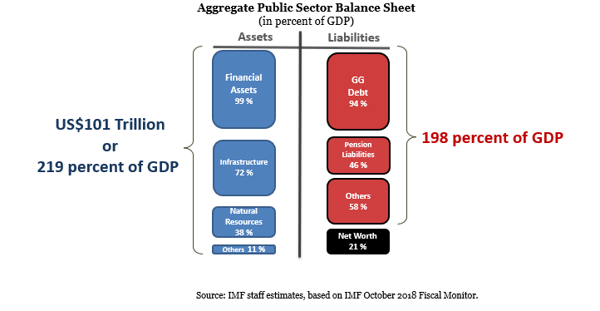
The Public Sector Balance Sheet

Slide 12
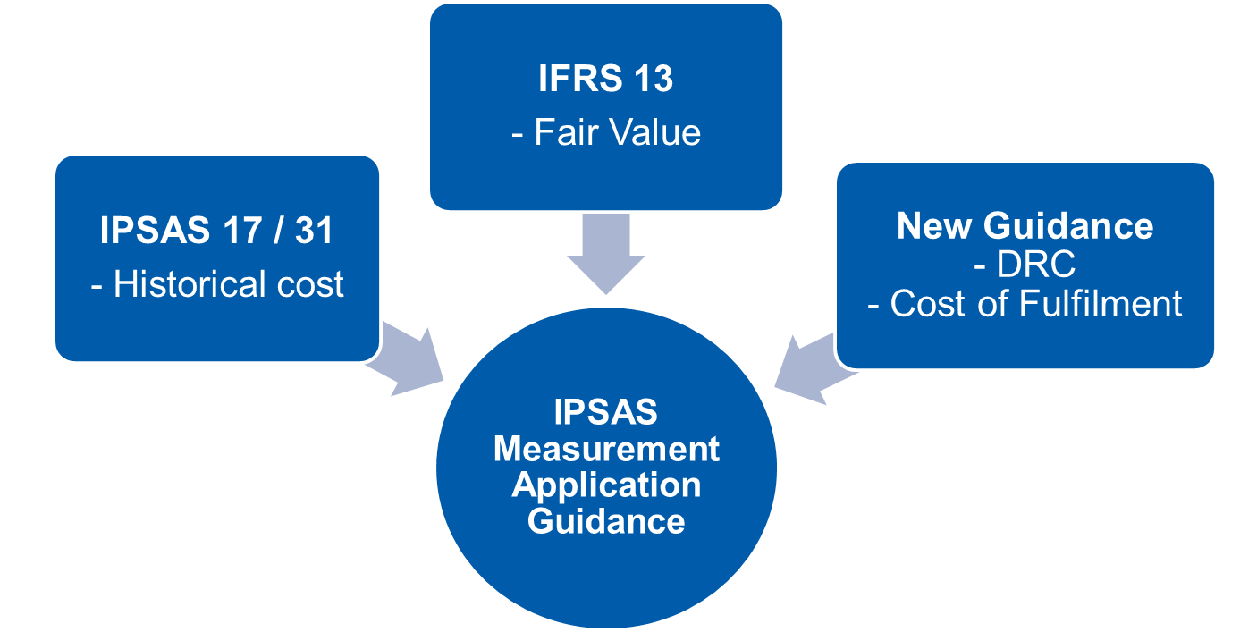
Measuring Assets and Liabilities:
IPSASB Public Sector Measurement Project
Development influenced by comparisons with:
IVSC standards
GFS requirements
Source: International Public Sector Standards Board
https://www.ifac.org/publications-resources/measu
rement
Notes:
This Consultation Paper is the IPSASB’s first step in establishing a comprehensive measurement framework for the public sector. The Consultation Paper focuses on better aligning the IPSAS measurement requirements with those established in the Conceptual Framework. This project sets out to:
Issue amended IPSAS with revised requirements for measurement at initial recognition, subsequent measurement, and measurement-related disclosure;
Provide more detailed guidance on the implementation of historical cost, replacement cost, fulfillment cost, and fair value, and the circumstances under which these measurement bases will be used; and
Address transaction costs and borrowing costs.

