Slide 1
Central ASP service for municipalities in Hungary
Dávid Deák
Junior Project Leader
Hungarian State Treasury
Budapest

Slide 2
Municipality ASP
Application Service Provider (ASP)
application service center
Use of a service from the Internet, instead of buying software for your own.
KÖFOP-1.0.0-VEKOP-15-2016-00008 - „Extending the Municipality ASP center (ASP 2.0)”
(The project has been financed from EU funds via the Public Administration and Civil Service Development Operational Programme.)
55.000.000 EUR
Providing integrated specialist systems to support municipal tasks
an additional 26.000.000 EUR of local government application
September 2015 – June 2019

Slide 3
Project consortium
Active, close cooperation between the members of the consortium and external suppliers was required to establish electronic administration
Governmental Information-Technology Development Agency (GITDA)
Hungarian State Treasury
Ministry of Interior
NISZ National Infocommunication Service Provider Ltd. (100% state-owned)
KDIV KOPINT-DATORG Information-Technology and Asset Manager Ltd. (100% state-owned)
KINCSINFO (100% state-owned)
IdomSoft Ltd. (100% state-owned)

Slide 4
Project goals
Building a National Cloud-based Infrastructure
Network Development, Infrastructure Expansion
Data warehouse development
Central supporting for connection
Introduction of new sector specific systems
Functional expansion of existing sector specific systems
External data connections
Improve IT security
30 000 users
~3000 municipalities

Slide 5
Elements of the Asp system
Framework system
Provides a unified interface and access for specialist systems, unified user and authority management, and access to system-level management (business) functions
Supporting systems
Applications for daily administrative, customer service, and operation tasks of the municipal ASP system.
Sector specific system
In the context of e-government, integrated systems have been introduced in the ASP system that effectively support the day-to-day work of muncipalities.
Data warehouse
Supporting the activities of local government control and monitoring at the top level of government
Simplification and uniformity of reporting
Supporting the activities of the governmental
Management information and operational decision support for municipalities

Slide 6
Current service portfolio
Framework
Financial management system
Local tax management system
Document management system
Industrial & commercial management system
Property cadastre
Inheritance registration system
Local government single point of contact portal
Municipality portal solution (optional)
Integration between the systems, external data connections and e-administration building blocks

Slide 7
Framework system
User management
Access Management (authentication, roles and rigths)
Operating system services
Log management
Data storage, data backup
Document storage
External and internal data communication and integration
System management, monitoring
Electronic payment support
Master data management
Creating and managing templates, forms
E-learning framework
The framework provides the identification of the users of the ASP system, the integration of sector specific systems, and the production of statements.
The ASP systems are accessible from the framework.
In the framework, a separate area of ​​operation has been created for each municipality, thus ensuring the separate management of the data per municipality.

Slide 8
Management system
Financial and accounting tasks of the public finance organization
Provide statutory data supply obligations to municipal users with appropriate rights to perform their duties.
The integrated computer system ensures a single entry of the effect of the economic event at both the bookkeeping accounts and the related accounting records, budget and financial accounting records.
Bills | Voucher regulation | Cashflow | Account Assignment
12 359 084 | 23 869 521 | 5 147 731 | 176 850 789

Slide 9
E-government services of the municipality asp
Local government single point of contact portal
Centrally provided intelligent online form templates (60+)
Online form management tool
Integrated e-administrative services (eID, e-delivery, e-authentication, etc.)
External and internal data connections (interoperability)
Complete back-office support of the process
Document management system
Integration between the sectoral specific systems

Slide 10
Technical and software architecture
Architectural priorities
compliance with the e-Government policy principles laid down in the domestic e-Government strategies
the e-Government policy criteria set by the Ministry of Interior. This also means that the alignment with the objectives of the European Union is ensured
Great emphasis on:
increasing the rate of use of open source software,
the reuse of existing solutions,
improving the transparency of local government operations,
IT security
helping to protect personal and non-personal data.
4

Slide 11
Technical and software architecture
a modular build-up of an integrated service portfolio
using a unified operating environment
ASP framework system (main element)
and the professional systems of the portfolio that are supporting the back-office tasks of local governments.
Service is based on a central hardware infrastructure and a SOA based architecture

Slide 12
Technical and software architecture
Clear goal to develop technologies that ensure the scalability of the service:
data access layer’s technology,
database manager solutions.
This makes it easier to serve both small and large municipalities that have significant difference between their user numbers, data volumes and system loads.
Development
Scalability is ensured also by the monitoring system of the ASP service, as such performance and alert indicators have been defined, those help the operation of the service, and provide metrics for future expansions and enhancements.

Slide 13
Technical and software architecture
The infrastructure designed, procured, installed and deployed by NISZ Ltd. provides services to more than 16 specific systems and support systems of the Municipality ASP service.
The main features of the infrastructure were the following:
Redundant architecture, with 50-50 servers per site for operating the virtual servers (1 600 CPU cores and 38,4 TB memory per site)
7 physical data base servers per site and 3 data warehouse servers with a total 4.5 TB capacity and 20 Hadoop servers with a total 736 TB JBOD disk capacity
Net 750 TB storage capacity and 1 200 TB tape storage per site
High-speed redundant network and boundary protection (spine-leaf architecture)
6 operational planes, more than 150 virtual networks, thousands of firewall rules, 250 virtual storage volumes, and more than 700 VMware based virtual servers.

Slide 14
Technical and software architecture
The operating systems, mostly open source SUSE Linux Enterprise (with manufacturer support) servers are used, and in some cases Microsoft Windows servers are also in use.
The specific professional systems run on VMware blade servers
horizontal and vertical scalability of the infrastructure, and allows flexible management of the virtual servers’ resources.
For licensing metrics:
The physical servers (hosts) are covered with licenses, so the number of virtual servers (guest) can be changed freely.
In the data base layers PostgreSQL, MariaDB and in some cases Microsoft SQL components are used.
On the database level:
multi-tenant model
to separate the data of the individual municipalities from each other
to achieve flexible saving and loading of data.

Slide 15
Technical and software architecture
Important objective:
interconnection with external systems and base registries had to be done via the Central Governmental Service Bus (KKSzB) technical interoperability platform.
to improve interoperability
reuse existing solutions:
the use of the national eID cards for user authentication
employees can only acces the applications by identifying with their own electronic identity card
the electronic administration service provision process, where the project has integrated the centrally provided regulated electronic administrative services (e.g. e-identification, e-authentication, e-delivery, intelligent online forms, etc.,

Slide 16
MAIN results, benefits and impacts
Connected municipalities at all levels of interoperability
Former local administrative silos are gradually disappearing
Easier cooperation within the public administration
Unified advanced e-government services can be provided to the end-users without threatening local government autonomy.
The central system is more sustainable economically than the island-like previous local systems of the local governments:
On the national level ~12,8 million euros yearly can be saved with the use of the central Municipality ASP in comparison with the previous costs of the local governments.

Slide 17
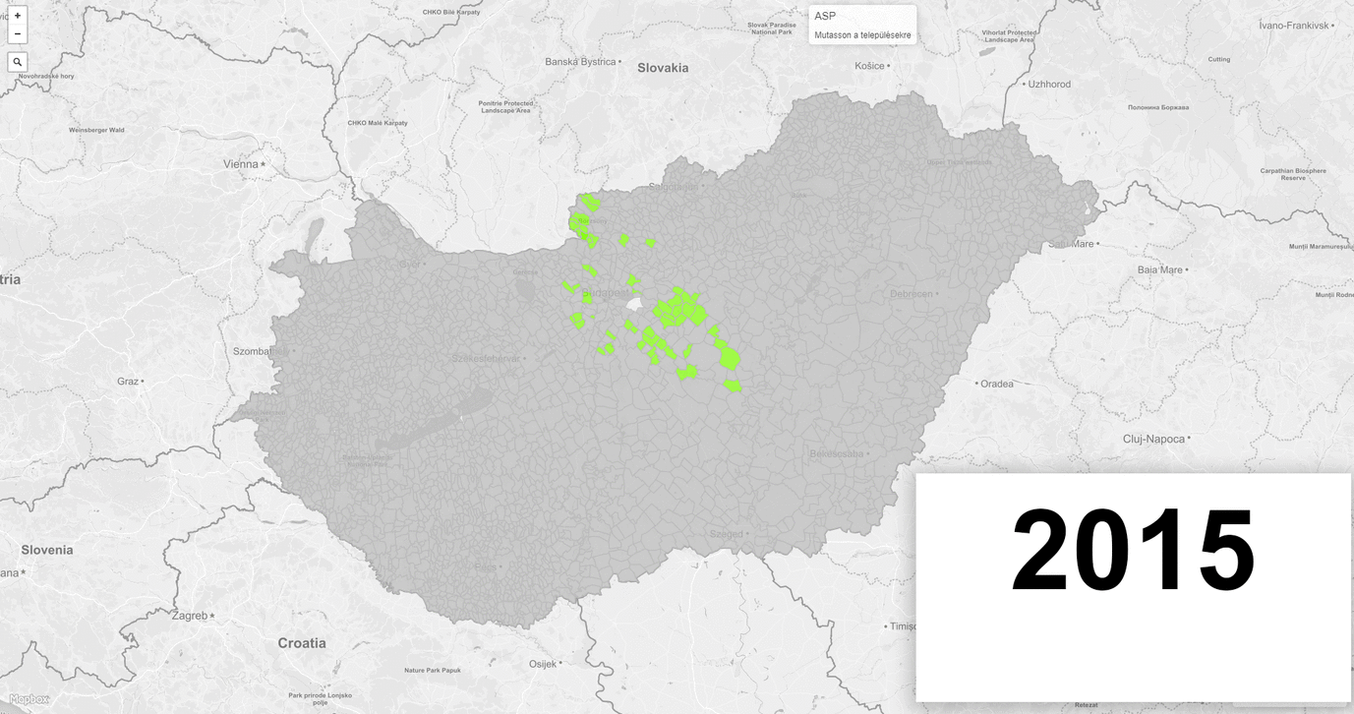
The pace of joining

Slide 18
THANK YOU FOR YOUR ATTENTION!

