Slide 1

PEMPAL-Treasury COP
Introduction to the Cash Flow Forecasting and Analysis Tool (CFAT)
Virtual Worksop: 21 September, 2023
Mike Williams
mike.williams@mj-w.net

Slide 2
The IMF (FAD) has prepared
An excel-based tool for preparing cash forecasts and supporting the decisions that flow from them; and an associated guidance note. Initially aimed at low income countries; but others have found it useful
Intended for the use of those (in the treasury or elsewhere), with responsibility for preparing cash flow forecasts
The tool is primarily for the practitioner; but it also makes recommendations on the presentation of the forecasts and policy advice to senior decision makers
The tool and its guidance note are accompanied by a separate “How To Note” with advice on building cash management capacity in fragile states, and low income countries. Sailendra Pattanayak, Racheeda Boukezia, Yasemin Hurcan, and Ramon Hurtado “How to Build Cash Management Capacity in Fragile States and Low-Income Developing Countries” (IMF 2022) https://www.imf.org/en/Publications/Fiscal-Affairs-Department-How-To-Notes/Issues/2022/03/01/How-to-Build-Cash-Management-Capacity-in-Fragile-States-and-Low-Income-Developing-Countries-498003

Slide 3
Cash Flow Forecasting
Efficient cash management requires ability to forecast daily cash flows across the TSA
  To facilitate orderly achievement of budget targets; to ensure that budgeted expenditure is smoothly financed avoiding delays; and to give early warning of any problems
  To devise the strategies for active cash management
    Both to ensure cash availability and to smooth cash flows
A smoother cash flow means:
  Lower average cash balances
  Reduced net borrowing costs
    Interest on cash balances always less than interest on marginal borrowing
    Interest can be earned on any temporary cash surpluses
  Less pressure on central banks’ monetary policy operations
Characteristic of all modern government cash management systems

Slide 4
To Recall Some Key Characteristics
Cash Plans
Based on budget profiles
Cash Forecasts
Focus on cash under control of MoF, not budget definitions
Revenue “forecasts” may also be constrained to budget target
Independent of control totals
Focus on what “will” happen” not what “should” happen
Aimed at ensuring that cash is available when required
Supports control of appropriations, monitoring performance and preparation of annual borrowing plan

Slide 5
The Cash Forecasting Analytical Tool (CFAT): Key Characteristics
1. The excel tool is primarily for the practitioner; but it also makes recommendations on the presentation of the forecasts and policy advice to senior decision makers
3. Covers all cash flows that have a material impact on TSA – i.e. those cash balances over which the Treasury has control. It is not a budget performance monitoring tool
4. Focus is budget year, but especially three months ahead
5. Handles both monthly and weekly forecasts (or a mix)
6. Uses GFSM14 Format. An emphasis on economic classification – although can use a mixture
7. Supports management assessment of policy responses to forecasts (and risks arising)
2. Top-down mechanism – relying on known flows and past patterns, But designed to incorporate bottom-up information (MDAs, RAs)

Slide 6
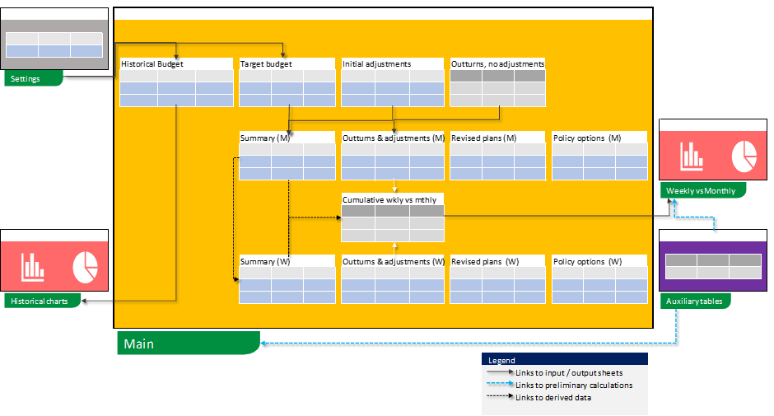
Spreadsheet Structure
User Options
  Extent of detail (forecast lines; scope to add more)
  Monthly or weekly
  Rounding conventions
  Number of past years
  Fiscal year (calendar or otherwise)
  Data classification
  Adjustments – to ensure cash is identified, and it is cash under control of MoF/Treasury
  Graphs to support decision making

Slide 7
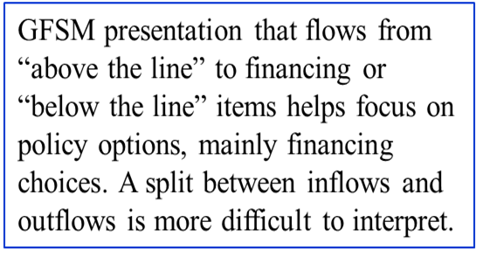
GFSM Presentation
The emphasis is on the economic classification of cash flows; but the tool can be adapted to use other classifications (administrative, program, sectoral, etc) if there are no other data available.

Slide 8
The Inputs and Outputs
Inputs
Outputs
Previous year outturns [as available, choice of weights]
The Budget – revenue, expenditure and financing
Forecasters’ adjustments:
In-year outturn data (from bank statements and/or IFMIS) and revised plans
In year revised forecasts from MDAs/RAs
Cash Plans – profile for budget year, updated during the year
3 month rolling forecasts – weekly and/or monthly
Policy options
Worksheet that forecasters might submit to Cash Management Committee etc
Showing forecast, impact of sensitivities, scenarios, risk etc
Possible policy responses and impacts
To identify cash
To modify budget numbers

Slide 9
Adjustments to Focus both on Cash and on Cash under Control of MoF/Treasury
Potentially large number of adjustments
May be technical or simply reflect forecasters’ latest views
If specifically identified, monitor v respective revenue or expenditure flow
Revenue: retention of non-tax receipts by MDAs; recognition of timing
Main Examples? Focus on material changes only
If forecasters’ general adjustments, add below deficit/surplus line
If coverage of TSA add below the change in cash line
Expenditure: previous year outstanding obligations and/or arrears; links to flows in a previous period (e.g. grant-supported projects), netting tax re subsidies to SoEs
Financing and TSA: pre-funding, accounting for bond or loan amortisation, imprests; earmarked revenues
Different choices (and flexibility): e.g.:

Slide 10
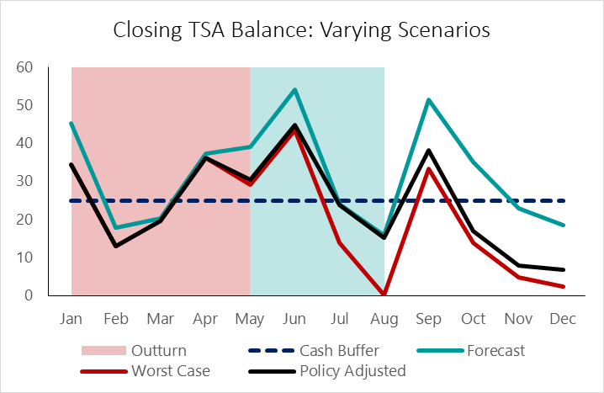
Presenting the Forecast
Forecasters should identify
Graphs to help decision making
What might go wrong
Possible responses

Slide 11
Annex: Guidance Note: Table of Contents
ACRONYMS - 2
INTRODUCTION - 3
OVERVIEW OF THE TOOL - 4
KEY CHARACTERISTICS - 4
THE TARGET VARIABLE - 7
DATA FORMAT AND CLASSIFICATION - 8
THE FORECASTING TOOL - 10
TOOL STRUCTURE - 10
Overview - 10
The tool’s worksheets - 11
USING THE TOOL - 14
Initial Choices - 14
Adjustments - 16
The End of the Budget Year - 20
THE DETAILED FLOWS - 21
Previous Year Outturns - 21
THE BUDGET YEAR - 23
IN-YEAR OUTTURN DATA AND REVISED PLANS - 23
Outturn Data - 24
Revised Plans - 26
Inputs from MDAs/RAs - 26
WEEKLY FORECASTS - 28
POLICY OPTIONS - 30
ANNEX A: GLOSSARY - 33
ANNEX B: ANALYZING FORECAST ERRORS - 36
ANNEX C: THE BUDGET YEAR CASH PLAN: SOME CHOICES - 38
Revenue - 38
Expenditure - 39
Financing - 41
ANNEX D: THE BRIDGE TABLE - 43
ANNEX E: BUILDING THE WEEKLY FORECASTS - 46

Slide 12
Annex: Some Operational Details
CFAT needs Microsoft Excel 2013 or later.
Macros must be enabled. Select "Enable Macros" if/when prompted.
It is less straightforward to enable macros in recent versions of excel. See guidance at: https://www.ablebits.com/office-addins-blog/enable-disable-macros-excel/
CFAT will continue to be modified and improved, based on user feedback.
Future versions of CFAT will also address any detected bugs and make other changes to respond to user requirements.
If you have any questions, comments, or requests please feel free to contact ngallardo@imf.org and/or mike.williams@mj-w.net
Thank You !

