Slide 1
PEM PAL Budget Community of Practice (BCoP) “The Role of Austria's Parliament in Budgeting” The Austrian Federal Budget Law Reform Vienna, 30th January 2014
Kristina Fuchs
Parliamentary Budget Office

Slide 2
Content
Overview
Multi-Annual Budgetary Planning
Accrual Budgeting and Accounting
Performance Budgeting
Challenges for Parliament

Slide 3
The Austrian Federal Budget Law Reform

Slide 4
Reform of the Federal Budget Law
Vision: to improve budgetary decision-making
Legal basis of the framework: Budget law reform in two stages (2009 and 2013) Unanimous decisions in Parliament
Reform addresses weaknesses of the traditional system
No binding medium-term perspective
Prevailing focus on inputs
Monopoly of cash-perspective
Objective: design of the federal budget as a comprehensive steering instrument for resources, outputs and outcomes
Permanent involvement of Parliament and the Austrian Court of Audit in the reform process by establishing a parliamentary advisory board
.

Slide 5
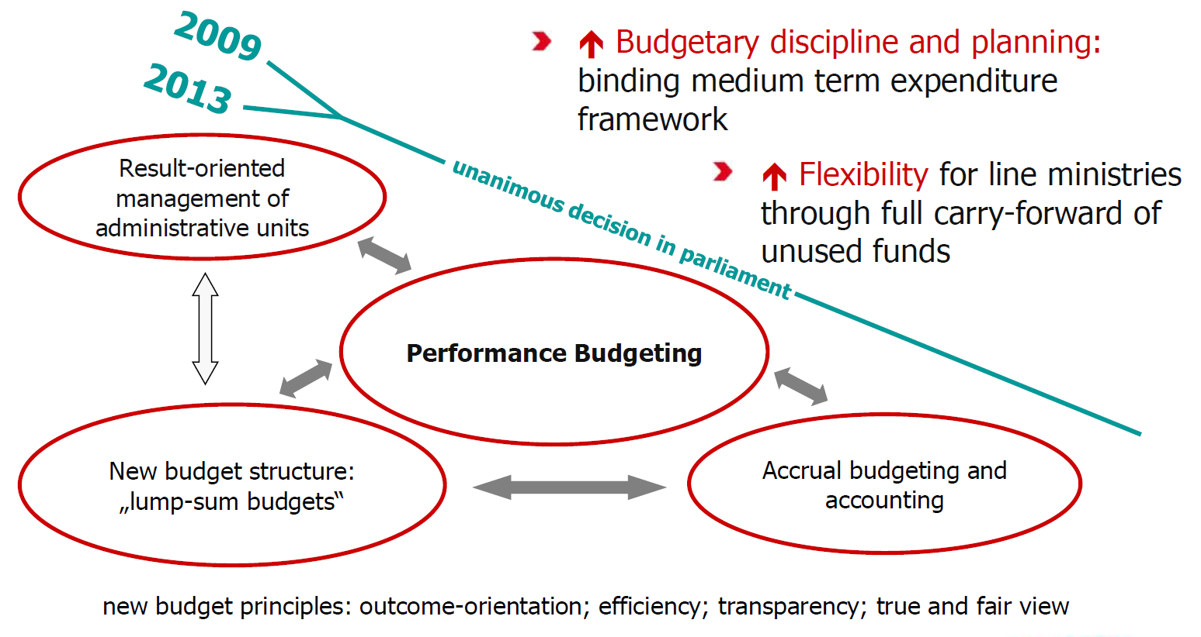
Principles of the new Federal Organic Budget Act
Source: MoF

Slide 6
Implementation: 2 Stages, 3 legislative amendments
Amendment of…..
Constitution: 1st and 2nd stage: objectives, tools, principles
Budget Law
(1st stage since 2009):
New budget management on macro-level
New organic Budget Law
(2nd stage since 2013):
new budget management on micro-level
Unanimously adopted in Parliament in Dec 07
Unanimously adopted in Parliament in Dec 09

Slide 7
Constitutional Amendments
2009:
National objectives for public finances
Macroeconomic stability
Sustainable public finances
Gender Equality
Medium-term expenditure framework
2013:
New budgetary principles:
Focus on Outcomes
Efficiency
True and Fair View
Transparency

Slide 8
Medium Term Expenditure Framework

Slide 9
1st Stage: Medium Term Expenditure Framework (MTEF)
 | Rubrics (= five main budgetary headings) | n+1 | n+2 | n+3 | n+4
1 | General Government Affairs, Court and Security
2 | Employment, Social Services, Health and Family
3 | Education, Research, Art & Culture
4 | Economic Affairs, Infrastructure and Environment
5 | Financial Management and Interest
Budgetary discipline and planning:
Binding MTEF & strategy report which explains the ceilings of the MTEF but not individual appropriations.
Strategy report as an explanatory document
Source: MoF

Slide 10
1st Stage: Medium Term Expenditure Framework (MTEF)
MTEF law sets legally binding expenditure ceilings
for 4 years in advance on a rolling basis (n+4 is added annually)
for 5 headings (cover several ministries) and
30 budget chapters (ministry specific)
MTEF sets ceilings for staff capacity for each line ministry
MTEF = binding for budget planning and execution
Heading level: n+1 to n+4
Budget chapter level: n+1 (&n+2)
Two kinds of expenditure ceilings
75 % of expenditure is nominally fixed
variable according to predefined indicators for expenditure areas with high sensitivity to the business cycle
- >

Slide 11
1st Stage: Medium Term Expenditure Framework (MTEF)
Budgetary Cycle: Spring
Government presents Federal Medium-Term Expenditure Framework Act together with the strategy report up until April 30th at the latest
Parliament debates MTEF every year (amendment for the year n+4)
Parliament may modify expenditure ceilings by amending MTEF legall
The MTEF has been adapted several times especially in the first periods and has now become a more stable instrument.

Slide 12
1st Stage: Medium Term Expenditure Framework (MTEF)

Slide 13
First lessons learned
Austrian MTEF: Focus on budget discipline, sensitivity to the business cycle and on expenditure.
It seems that the framework contributed to a general government deficit lower than anticipated during the last couple of years, it helped to introduce a longer-term oriented policy debate.
MTEF was an important step to make the budgetary process more predictable and to foster fiscal discipline.
Counter-cyclical effects are important, they help to stabilize the economy.
Besides MTEF Austria introduced regular long-term fiscal projections, to be presented every three years (starting from 2013).
Although not legally binding for MTEF, it provides a long-term perspective to be taken into consideration.

Slide 14
1st Stage: Reserves
More flexibility for line ministries in budget preparation and execution
Full carry-forward possibilities for unused funds without earmarking
Same rules apply for certain receipts (not for tax revenue !) over budget during the current year
„December-Fever“ (spending of the rest of the budget in december) considerably reduced
So far Ministries made extensive use of building up reserves
Positive effect on interest payments: reserves are financed when they are used and no longer when they are built
Size of reserves bears some risk
- >

Slide 15
Budget Structure

Slide 16
New Budget Structure
Total Budget
Headings
MTEF: 5 Headings
Budget Chapters
~ 30
1-10 global resource frameworks per chapter instead over 1000 appropriation line items
enacted by Parliament
Global Budgets
binding within public administration
Detail Budgets
shown in the budget
Cost Accounting
flexible steering tool, easily adaptable to specific requirements
Transparent budget structure as a prerequisite for other reform elements
Source: MOF

Slide 17
2nd Stage: Integration of Organisational, Budget and Performance Management Structures
Organisational Structure
Budget Structure
Performance Structure
Budget Chapter
Mission
Statement,
Outcome
Objectives
Line Ministry
headed by
the minister
Global
Budget 1
GB 2
Primary
Activities*
Primary
Activities
GB 3
GB 4
Primary
Activities
Primary
Activities
* to achieve outcome objectives
Budget managing bodies
Detail budgets
Explanatory budget documents based on
Multi-annual performace mandate

Slide 18
Accrual Accounting

Slide 19
2nd Stage: Accrual Accounting & Budgeting
Accrual Accounting and Accrual budgeting: from cash based to two binding perspectives: cash + accrual
Objectives: provide relevant financial information, become a management instrument
Two perspectives: use of resources and liquidity
Ceilings on cash- and accrual-based numbers
Integration of non-cash items in operating budgets: no cash appropriations for depreciation and provisions
Ongoing monitoring process during budget execution
Monthly liquidity management

Slide 20
Accrual accounting and budgeting
Orientation on IPSAS (International Public Sector Accounting Standards)
Operating Statement
(direct linkage with federal cost accounting system)
Purpose: to provide relevant financial information
Statement of Financial Position
(Balance Sheet)
Cash Flow Statement

Slide 21
Statement of Financial Position
~ Balance Sheet
Only represented as a statement of financial position
Overview of changes in assets, liabilities and net assets
Opening Balance sheet in Austria as of 2013
Line ministers prepare a statement of financial position -> Consolidation through the Ministry of Finance

Slide 22
Statement of Financial Position*
Assets
Liabilities
Short-term assets:
13.406.897.790,94
Short-term Liabilities
36.162.893.133,67
Long-term Liabilities
187.219.596.890,75
Long-term assets
76.102.292.902,39
Net Assets
-133.873.299.331,09
89.509.190.693,33
=
89.509.190.693,33
* Opening balance as of 1.1.2013

Slide 23
Operating Statement
~ Profit-and-loss account
Accrual budget consists of
budget based on the operating statement
operating statement
Overview of expenditures and revenues
Expenses/Revenues are recognized at the time of use/growth of resources

Slide 24
Cash Flow Statement
The Cash Budget consists of
Budget based on the cash flow statement and
Cash flow statement
Records inflows and outflows of funds in form of expenditures and receipts
Expenditures are recognized at the time of payment execution; expenditures are outflows of liquid funds (bank balances, cash) within a financial year, i.e. all expenditures from 1 January to 31 December.
Receipts are recognized according to the value date of the account statement; they are inflows of liquid funds within the financial year.
Payments made after 31 December must be recognized in the following financial year

Slide 25
First Lessons Learned
Federal budget consists of
cash flow statement
operating statement
Cash-perspective is still very dominant
New information on investment/depreciation, provisions, tax receivables, bad and doubtful debts
Accrual perspective adds a new level of complexity
Transition period poses challenges to public administration and requires additional explanatory comments
Parliament has to get used to new information

Slide 26
Performance Budgeting

Slide 27
Outcome Orientation: Objectives
Show outcomes and outputs to be achieved with the underlying budgets
Facilitate priority setting for politics and subsequently in the public administration
Strengthen performance accountability for line ministries and budget managing bodies
Enable administrative level to present results and achievements

Slide 28
Outcome Orientation
Budget shall develop from input orientation towards a comprehensive steering document of resources and performance based on the new constitutional principle of outcome orientation.
Implementation:
MTEF/Strategy report refers to outcomes/strategies
Performance information in the annual budget bill on the level of budget chapter, global and detailed budgets
Management with performance mandates (resources, aims, achievements)
Outcome Controlling
Reporting Requirements
Outcome-oriented impact assessment with respect to legislative proposals and other projects

Slide 29
Performance Information on Different Budget Levels
Budget Chapter
Max. 5 outcome objectives at least 1 Gender
Annual Budget Statement
Mission statement
Global Budget 1 – 5 primary activities Gender
Global Budget 1 – 5 primary activities is
Global Budget 1 – 5 primary activities included
Detail
Budget
G
Detail
Budget
e
Detail
Budget
n
Detail
Budget
d
Detail
Budget
e
Detail
Budget
r
Detail
Budget
i
Detail
Budget
n
Detail
Budget
c.
Explanatory budget documents
Objectives and Activities
Objectives and Activities
Objectives and Activities
Objectives and Activities
Objectives and Activities
Objectives and Activities
Objectives and Activities
Objectives and Activities
Objectives and Activities
P e r f o r m a n c e C o n t r a c t s

Slide 30
Outcome orientation for Parliament
Budget changes its character: Not only decisions on resources (who gets what?) but steering resources and results (who gets what for which results?)
Requires relating budget to results
Budget provides Parliament and the Public with information on
Resources
Outputs/outcomes
Recommendations of the Court of Audit
Parliament decides on outcomes and outputs as part of annual budget bill
Entails cultural change on the political level (setting priorities, transparent decision-making, etc.)

Slide 31
First Lessons Learned
Intensive discussion of objectives in budget committee and the plenary
Appreciation of new federal budget law as a considerable improvement
Appreciation of information relating financial to outcome information
Appreciation of increased transparency by providing outcome information through all levels of the budget (global budget, detail budget)
but identification of potential for improvement
More ambitious targets
More clearly defined objectives
Mid-term objectives and international comparisons
More general overviews on cross departmental targets (ie. research, gender)
Coordination between Ministries should be enhanced

Slide 32
Gender Budgeting
Application of gender mainstreaming in the budgetary process
Provisions of the Austrian Constitution and the new federal budget law
“The Federation, Laender and municipalities subscribe to the de-facto equality of women and men. Measures to promote factual equality of women and men, particularly by eliminating actual existing inequalities, are admissible.“ Art. 7 Austrian Constitution
“The Federation, Laender and municipalities have to strive for gender equality in their budget management.” Art. 13 Austrian Constitution
“In the budget management of the Federation, the relevant principles of outcome orientation - especially in accordance with the targets of gender equality - ..are to be considered.“ Art. 51 Austrian Constitution

Slide 33
Gender Budgeting and Budget Law 2013
Equality of women and men as the only outcome-oriented objective to be considered by all Ministries and Supreme Institutions
is implemented in the budgetary process in the context of
Outcome objective on budget chapter level
Activities on global budget level
Objectives and activities on detail budget level
Most of the Ministries have defined targets with impact on the society; only in individual cases have internal organisational targets been determined
New federal budget law is a lever for gender equality, but room for improvement regarding the implementation
Missing a clear distinction between gender equality targets, female promotion and social targets

Slide 34
Outcome-oriented impact assessment
New regime covers impact assessments of new regulations and projects with budgetary consequences
Streamlines previous approaches to impact assessment and sets up a unified and coherent system
Entails a two-step procedure to identify and assess substantial impacts on the overall economy, on small and medium-sized enterprises, environmental impacts, impacts in the field of consumer protection policy, on administrative costs for citizens and enterprises, social impacts, on children and impacts regarding equality of women and men
Financial impacts have to be always assessed
Provides ministry staff with an it-tool to carry out the assessments and to automatically generate necessary legal materials
Obligatory internal ex-post evaluation

Slide 35
Expectations and challenges

Slide 36
Budget Law Reform: Expectations
Improve budgetary decision-making
Stronger involvement of Parliament in objective setting
Create a more transparent budget structure
Improve medium-term fiscal discipline
Complement cash perspective by taking use of resources into account
Show outcomes and outputs to be achieved with underlying budgets
Effective steering system for federal administration and political decision making

Slide 37
Challenges for Parliament
Thorough change of budgetary structure and parliamentary possibilities of steering and controlling the budgetary process
New budget rules give executive government and administration additional powers
Need for more stringent parliamentary control of budget execution
Federal budget reform envisages a central role for parliament
However, budget process is a highly complex mechanism
Large information asymmetries
Need to realign budget procedures and budget control in Parliament

Slide 38
Challenges for Parliament
How to use new information effectively for debate and control
Promote transparency and accountability
Watch performance
Reward ambition, insist on efficient use of resources
Communicate to the Public

Slide 39
Thank you for your Attention
Contacts:
Kristina Fuchs
Parliamentary Budget Office
Parliament, A-1017 Wien, Dr. Karl Renner-Ring 3
Tel. +0043 1 40 110-2884; +0043 676 8900-2884
E-mail: kristina.fuchs@parlament.gv.at

