Slide 1
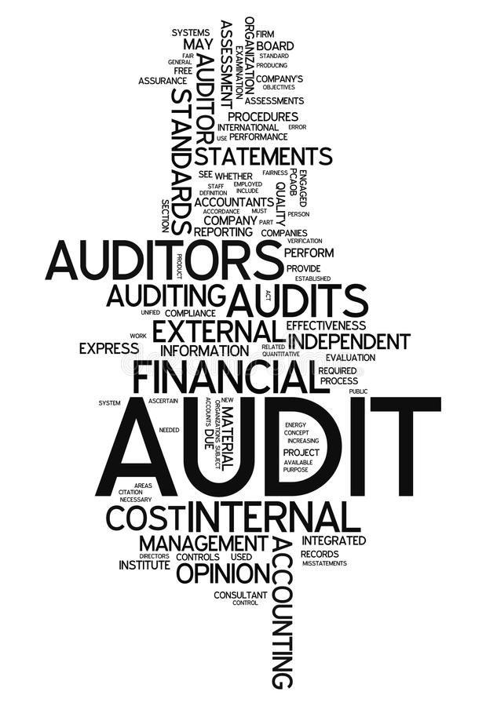
Federal Internal Audit Agency (FIA) Context-Organisation-Strategy PEMPAL, March 2017

Slide 2
Present context
Environment
Audit universe = whole of the federal government.
Within the federal government many different entities with great diversity in organizational maturity, varying levels of Internal Control & assurance, risk management, governance, reporting & transparancy.
Limited mutually, shared strategic objectives, absence of joint risk management & policy.
No joint understanding of tasks, roles and responsibilities of Internal Audit. Limited experience with Internal Audit as a governance practice.
External environment:
Increasing level of expectations towards high quality governmental services, economy, effectivenss and efficiency.
Rapidly changing context and fast evolving digitalization implies new risks and increases the need for shorter reaction times within the organisational entities.
Organisation
FIA as a service in full expansion (Audit organisation, Forensic audit)
All necessary competences not yet available to cover the full range of audit topics
Internal Audit to gain maturity:
promote collaboration with different parties,leading to added value for the global organisation
create credibility and visibility within the global organisaton
Position towards other 2nd and 3rd level control instances (Cour des Comptes, Inspection of Finance))
Develop a partnership en relationship based on trust with the different actors.

Slide 3
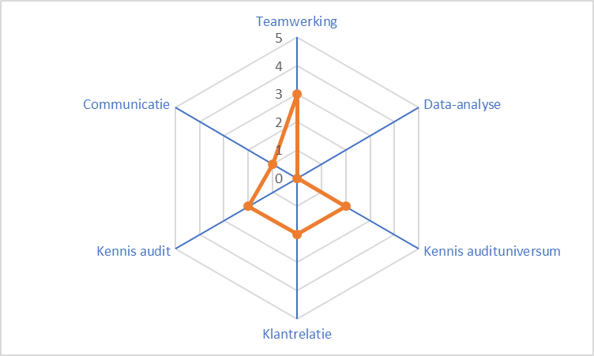
Present context FIA
Assessment FIA end 2017
Team
Good collaboration and cohesion. Smooth gradual expansion
Data-analysis
No systemic checking of data whilst auditing
Limited knowledge of systemic data within the organization
No data analytics
Knowledge audituniverse
Insufficient awareness of audit universe as a whole.
Limited insight in business objectives, organizational changes, strategic projects …
Client relations
Mainly Audit-oriented
Lilited outreach towards management & audit comittee
Limited outreach to other control instances
Knowledge audit
Sufficient knowledge auditmethodology.
To develop IT audits, financial, strategic audits.
Communication
Insufficient communication and visibility of IA within the global organisation.
Improve quality of and outreach of audit reporting.
0
1
2
3
4
5
insufficient
sufficient
good
Very good
excellent

Slide 4
FIA stakeholders
High
Collaboration, trust
Operational management, external auditors
Critical stakeholders
ACFO, Ministers, Chairpersons
Critical stakeholders
High impact on perception of IA within the organization. High impact on the functioning of the organization and the functioning of FIA.
Collaboration
High impact on others within the organization, limited impact on the functioning of FIA.
Professional link
Low impact on the organization but high impact on the functioning of FIA – professionalism.
Monitor & inform
Low impact on the organization & low impact on the functioning of FIA.
Invloed
Low
Monitor & inform
HR, ICT, Third Party,
Professional link
IIA, ISACA,
Low
High
Impact

Slide 5
FIA stakeholders
Expectations critical stakeholders towards FIA
Relationship of mutual respect and trust with ACFO and management
Emphasis on assurance. Through assurance-audits promoting of recommendations and advice, as well as the use of best practices.
Auditplan in line with strategic risks that are relevant for the organisation; both actual as well as future risks.
Conformity with IIA standards, timely reporting and quality assurance.
Add support to internal control mechanisms, risk identification and management (business processes, effective risk management, alert management of new risks and scenario’s,..).
Assure knowledge and understanding of “their” organisation - mission, vision, objectives, risks – speak the language of the ‘business’.
Communicate auditplan to management.
Timely communication of assments and recommendations.
Coordinate with 2nd line– single audit principe. Evaluation of effectiveness of control mechanisms.
Balance

Slide 6
FIA Mission
Create, improve and safeguard ‘value’ for and of the organization through risk based and objective assurance, independant advice and professional insight.
Brand “FIA”
Independant, objective and reliable partner
Added value
Agile (prepared and flexible)
Expertise and knowledge
Quality and client oriented
Continuous improvement

Slide 7
Strategy
Aligning
business
Quality &
Innovation
Service
culture
AGILE
QUALITY
VALUE
EXPERTISE
Risk
focus
Technology
Talent
model
Cost
efficient
Stakeholder
Management

Slide 8
Strategy
 | Business Aligning: Information pool Cluster guided audit operations Face 2 Face contact with management, organisation of awarenss events Facilitating risk assessment - promote network Risk Officers
 | Quality and innovation IIA standards- external evaluation FIA-audit (end 2019) follow trends and best practices High quality of recommendations (realistic, relevant, foresight) Use of new technology in audit practice (data –analytics)
 | Risk focus Continuous risk assessment Shared understanding of risk Identification of new risks (external)
 | Talent Model Nursery principal Internal rotation Training and development of internal knowledge via co –sourcingmodel (2 à 3 year) Recruit specific competences (IT, data mining) Outsourcing of specific expertise requirements

Slide 9
Strategy
 | Stakeholder management: Identify expectations per group Taylor made as a function of the stakeholder group Assess on a regular basis Communication plan nas a fuction of stakeholders expectations
 | Cost efficient Respect audit planning Lean audit Effective reporting (clear, targeted, concise) Flexibility sourcing Effective controls
 | Technology Trend setting and knowledge in new technologies (Cloud, big data,…) Understanding of risks and opportunities of new technologies
 | Service culture High quality services (technical, functional) Understanding of client expectations and perceptions Aim at continuous improvement – mastering of processes, quality and service Communicate about FIA, website

Slide 10
Timing
Risk assessment
Netwerk Risk Officers
Start FA
Single audit
protocols
Customer satisfaction
Quality IA
Check external partie
Data Analytics
01/2018
06/2018
12/2018
06/2019
12/2019
Recruiting 1
Recruiting 2
Recruiting
specific profiles
Co –sourcing model

Slide 11
Partnership ACFO - FIA
Positioning of Internal Audit and credibility
Auditplan with added value and risk management
Regular consulation
Reporting
Resources and budget
Continuous improvement and performance
A strong relationship between the audit-commitee and FIA is paramount in order to derive optimal results of the internal audit practice for the benefit of the organization
Relationship of trust between the parties
Clarify roles and emphasize communication between the different actors in the governance model
Align initiatives to enhance maturity of internal control and risk management in the organization
Clear demarcation of roles and responsibiliteis
Ttransparent lines of reporting and independance
Trust relationship Auditcomittee and Internal Audit

Slide 12
Partnership ACFO -FIA
Loyalty and open line of communication
Reporting about:
Auditactivities (significant assessments and recommendations, plans of action, follow up of action plans by management)
KPI’s about performance and functioning of internal audit (# audits according to plan, audits/FTE, % time spent audits/total,…)
Reporting evolution of resources (number, competences), evolution co-sourcing
Amendments/changes auditplan
Status introduction new techniques, auditmethodology, quality
Communication
Results risk assessment
Transparancy about decision process auditplan
Ad hoc requests management/ministers (audit requests or management support)
Fraude (forensic) issues or ethics (whistle blowers)
Possible issues about independance
Significant risks and control issues
Engagement FIA

Slide 13
Partnership ACFO - FIA
Approval and review Charter FIA, protocols etc..
Approval audit programme and annual action plan
Safeguard FIA means and resources to guarantee FIA activities
Safeguard FIA authority and status to protect FIA mandate
Ensure high level attention for audit function and results
Ensure direct, open relationship and communication with FIA, direct link between CAE and ACFO
Joint deliberations about culture and strategy of FIA. What is most desirable and valuable for the global organization?
Keep FIA informed about important changes, trends etc. – joint assessment of impact of changes in the audit programma
Follow up and review status actionplan by management – escalation procedure, make management accountable
Monitoring en evaluation of the quality and effectiveness of the internal audit function en the role of IA in risk management within the global organization.
Expectations FIA

Slide 14
Auditplan 2018
Approach Auditplan 2018
Selection of topics for the auditplan 2018 based on:
rudimentary risk-identification based on management agreements of the audit universe; identification of risk zones
Discussions with presidents of the board(s)- desiderata
Consolidation reporting IC
Risks assessments in the context of global objectives within the organisation and risktrending within IA
Ad hoc audit plan restricted to 2018
Next steps:
1st semester 2018 – implementation risk asessment all entities. Purpose: Joint understanding and awareness risks
Elaborate pluri annual audit program based on results + detailed “rolling”plan for the next 12 to 18 months
Support riskmanagement structure with “ Risk-Officers” in each entity
Facilitate continuous risk assessment within the organisation (eye for internal en external evolutions)

Slide 15
Model Auditplan 2018
GOVERNANCE & COMPLIANCE
FINANCIAL
BOCA
Strategie
DEFENSIE
IC
FAGG
IC
REGIE
Certif
2020
Subsidies
BUZA
OPERATIONAL
DIGITAL
HR
Certifi-cering
Controleket-ting salaris
JUSTITTIE
Outsourcing
DEFENSIE
Crisisbeheer
FAVV
GDPR
DIGITALISERING
IT Governance
Cyber-security
BFAST
BUZA
PPM
MOB, REGIE
Wetgeving & support
SZ
HRM gesloten centra
BIZA
MATCH IT
FEDASIL
ECHA
VVVL
Operationeel
Log gesloten centra
BIZA
Minderjarigen
BIZA
Inspectie
procedures
WASO
Toepassing
wetgeving
VVVL
Thematische audit
Voorgestelde audit FOD

Slide 16
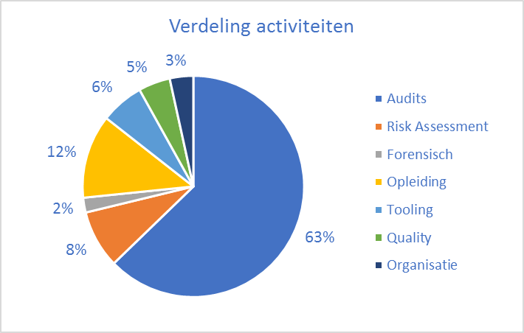
Auditplan 2018 - Summary
Audit & risk assessment
Mandays internal : 3910
Mandays external : 820 (±20%)
Budget indication : 4.683 k€ personnel – 760 k€ operational
Budget forecast 1,900 k€ personnel – 1,230 k€ operational
35 audit assignments

