Slide 1


Internal CONTROL GLOSSARY
Presentation to PEMPAL IACOP meeting in SOCHI
30-31 October 2019
EDGAR Mkrtchyan

Slide 2
goals of the presentation
TO outline the background to the development of a PEMPAL glossary for internal control
To present the proposed glossary
To discuss the added value of the glossary
TO obtain some final feedback on the glossary before publication

Slide 3
BACKGROUND
The idea of developing a glossary was first discussed at the framework of IACOP Moscow MEETING (2016) DURING WHICH key categories were selected and approved by participants for incorporation into the Glossary, designing the scope of unfamiliar terms in the field of PIC.

Slide 4
SOURCES
The glossary of terms is based on
  (i) the glossary that accompanies the IIA internal auditing standards;
  (ii) the terminology used by the European Union in promoting the concept of PIC (including PIfC);
  (iii) the terms used by COSO in defining IC and the related components of the IC integrated framework; and
  (iv) the terms used in the COSO Enterprise Risk Management Framework.
Where a term has not been obtained from one of these four main sources, the source of the glossary definition is explained in a footnote
No term has been included without an authoritative source
Terms relating specifically to internal audit have not been included

Slide 5
Grouping of terms
There are four basic groups of terms
  Generic terms that relate to Public Internal Financial Control
  Terms that relate to risk management
  Terms that relate to COSO based Internal Control
  Terms that relate to the elements of a performance Management Framework

Slide 6
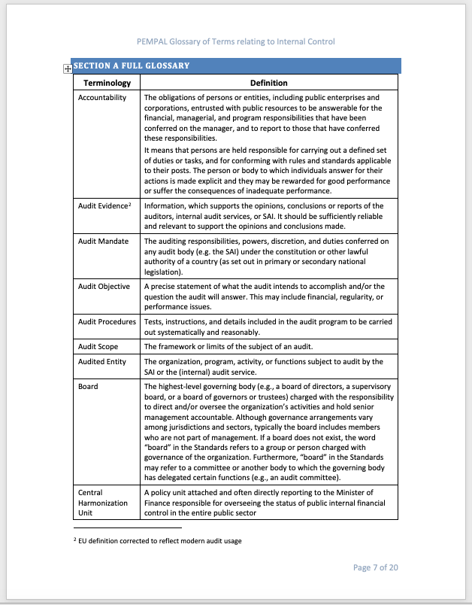
PRESENTATION
SECTION A contains a full glossary which includes all the terms proposed by PEMPAL where the terms included have been color coded

Slide 7
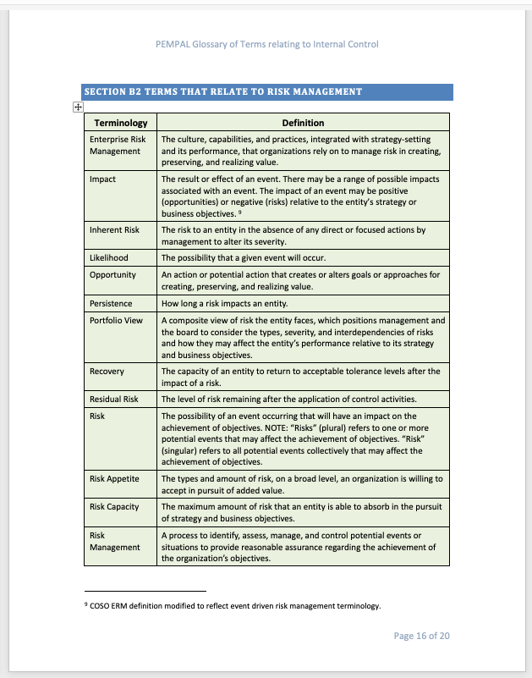
presentation
SECTION B contains a series of four individual glossaries where the color-coded sections have been grouped together

Slide 8
DISCUSSION questions
What do you feel is the added value of the glossary?
Any feedback on the terms included in the glossary?

Slide 9
KEY CONTRIBUTORS
Edgar Mkrtchyan, Head of Financial Management and Control Division of the Ministry of Finance of the Republic of Armenia
Petru Babuci, Ministry of Finance, PIFC Policy Division, Moldova, Consultant
Nodira Zikrillaeva UNDP, PCEAT, Project Leader
Alexey Kokarev. The Ministry of Finance of the Russian Federation, expert
Giuli Chkuaseli, Head of the Public Internal Control Department, Central Harmonization Unit, Ministry of Finance of Georgia
Diana Grosu-Axenti, World Bank, Consultant
Arman Vatyan, World Bank, Lead of the IACOP

Slide 10
Thankyou

