Slide 1


INTERNAL AUDIT and INTERNAL CONTROL DEVELOPMENT
IN THE RUSSIAN FEDERATION
Stanislav BYCHKOV
DEPUTY DIRECTOR
DEPARTMENT OF BUDGET METHODOLOGY
AND THE PUBLIC SECTOR FINANCIAL REPORTING

Slide 2
FINANCIAL CONTROL AND AUDIT SYSTEM
Parliamentary Control
Accounts Chamber of the Russian Federation
Control and accounts bodies
of Russia’s federal subjects
Control and accounts bodies
of municipalities
Terms of implementation
Objectives and outcomes
Decision effectiveness
Budget process
Authorization
of budget operations
Compliance
of budget procedures
with legislation
Internal financial audit
in organization
Financial inspections
(Federal Treasury,
regional control and audit bodies)
Government Financial Control

Slide 3
3
INTERNAL AUDIT DEVELOPMENT (Legal Framework)
2019-2024 Budget Spending Efficiency Boosting Concept, “Budget Spending Accountability” Chapter, amendments to the Budget Code, Internal Audit Standards
Stage III
Development and implementation of a single system of training and advanced training of internal auditors
Efficient liaison between internal financial audit and external control environment
Stage I
Transition from financial audit to implementation of internal audit covering the entire activity of organizations in the general government sector
  Budget Code (before amendments came into effect on 09.08.2019)
  Government's procedures for carrying out internal financial control and audit + methodology of MoF Russia
Stage II
Stage IV

Slide 4
INTERNAL FINANCIAL
CONTROL AND AUDIT SYSTEM
Before amendments to the Budget Code
After amendments to the Budget Code
Budget risk holder
Entity subject to IFA
Entity subject to IFA
Analysis of budget procedures (operations)
Analysis of budget procedures (operations) and identification of budget risk
Analysis of budget procedures (operations) and identification of budget risk
Identification and assessment of budget risk
Proposals on establishing control actions
Developing measures to improve the quality of budget procedures (operations)
Establishing control actions and (or) measures to improve the quality of budget procedures (operations)
Establishing control actions to minimize risk
Implementation of Risk Register
Approval of IFC map
Developing measures to improve the quality of budget procedures (operations)
Budget risk holder
Methodology
and (or) regulations block
Control action based on the Risk Register
Implementing control action and taking measures
Implementation of measures to improve the quality of budget procedures (operations) and IFC development

Slide 5
ORGANIZATION OF INTERNAL AUDIT IN MoF RUSSIA
2018 | 2019 | Type of Procedure | 2018 | 2019
 |  |  | Regulation/ automation | Regulation/ automation
32* | 12 | Planning | 12/1 | 11/0
8 | 11 | Implementation | 10/1 | 17/3
13 | 14 | Accounting and Reporting | 13/1 | 12/3
Elimination of irregularities / deficiencies
Control over execution of the budget procedure (operation), identification of irregularities
Determining causes of irregularities, assessing reliability of control
Suggestions for improving budget procedure (operation) control mechanisms:
- automation;
procedure (operation) regulation;
methodology
Identifying elements of the budget procedure (operation) and (or) inherent requirements with high risk of irregularities
Analysis of structure (elements), budget procedure (operation) execution and control requirements
Risk Register

Slide 6
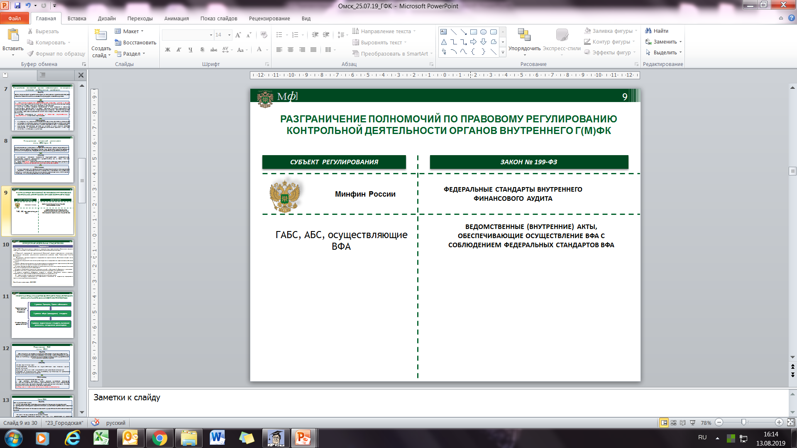
INTERNAL FINANCIAL AUDIT STANDARDS
6
FEDERAL STANDARDS:
"Definitions, principles and objectives of internal financial audit"
"Framework and organization of internal financial audit"
“Competence delegation in internal financial audit"
"Rights and obligations of executives and staff in internal financial audit"
"Planning, defining the scope of work and developing the audit program"
“Performing internal financial audit"
Regulation-targeted entity
BUDGET CODE
MoF Russia
FEDERAL STANDARDS OF INTERNAL FINANCIAL AUDIT
INSTITUTIONAL (INTERNAL) ACTS ENSURING IFA IMPLEMENTATION IN LINE WITH IFA FEDERAL STANDARDS
Organizations
subject to IFA
FEDERAL STANDARDS:
"Implementation of internal financial audit results"
"Confirmation of budget reporting reliability"
"Drafting suggestions to improve efficiency and effectiveness of budget expenditure"
+ Guidelines on application of some Federal Standards
Standards come into effect on 01.01.2020
Standards come into effect before 31.12.2020

Slide 7
7
INTERNAL AUDIT DEVELOPMENT (Legal Framework)
2019-2024 Budget Spending Efficiency Boosting Concept, “Budget Spending Accountability” Chapter, amendments to the Budget Code, Internal Audit Standards
Stage III
Development and implementation of a single system of training and advanced training of internal auditors
Efficient liaison between internal financial audit and external control environment
Stage I
Transition from financial audit to implementation of internal audit covering the entire activity of organizations in the general government sector
  Budget Code (before amendments came into force on 09.08.2019)
  Government's procedures for carrying out internal financial control and audit + methodology of MoF Russia
Stage II
Stage IV

Slide 8
RELATION BETWEEN EXTERNAL
AUDIT (CONTROL) AND INTERNAL AUDIT
Parliamentary Control
(external public audit)
Government Budget
Control
Risk-based monitoring of control and audit subjects and objects
Risk minimization and elimination of common irregularities
Discontinuation of systemic
deficiencies and errors
Discontinuation of major irregularities and abuses
Internal audit and internal control of the entity
Terms of implementation
Objectives and outcomes
Decision effectiveness
Compliance of budget
procedures
with legislation
Budget Process

Slide 9
9
DISTINCTION BETWEEN INTERNAL FINANCIAL AUDIT (IFA) AND INSTITUTIONAL CONTROL
Legal regulation
(MoF Russia)
Report
IFA analysis
(Federal Treasury)
Internal Financial Audit
Budget administrator's authorities and their regulation
Internal control (component part of any authority) | Control over subordinated organizations (separate authority) | Control over budget resources allocation conditions (separate authority)
Self-control Control by subordination Automated control actions | Checks to develop financial documents Monitoring Internal checks | Ex-ante control Desk (field) audit of budget users

Slide 10
10
INTERNAL AUDIT DEVELOPMENT (Legal Framework)
2019-2024 Budget Spending Efficiency Boosting Concept, “Budget Spending Accountability” Chapter, amendments to the Budget Code, Internal Audit Standards
Stage III
Development and implementation of a single system of training and advanced training of internal auditors
Efficient liaison between internal financial audit and external control environment
Stage I
Transition from financial audit to implementation of internal audit covering the entire activity of organizations in the general government sector
  Budget Code (before amendments came into force on 09.08.2019)
  Government's procedures for carrying out internal financial control and audit + approaches of MoF Russia
Stage II
Stage IV

Slide 11
11
THE ROLE OF INTERNAL AUDIT IN THE ACTIVITY
OF A PUBLIC-SECTOR ORGANIZATION
Manager
(governing body)
Mission, strategic objectives of public-sector organization
Managerial decisions
Function,
public service 1
Function
public service 2
Function,
public service 3
Internal Auditor’s
Reports
System of management
and control
System of management
and control
System of management
and control
- objectives, allocation of duties, KPI
- objectives, allocation of duties, KPI
- objectives, allocation of duties, KPI
- identification of risks,
risk minimization measures
- identification of risks,
risk mitigation measures
- identification of risks,
risk mitigation measures
Internal
Audit
- control actions,
implementation oversight
- control actions,
implementation oversight
- control actions,
implementation oversight
- information systems (IT)
- information systems (IT)
- information systems (IT)
- implementation reports
- implementation reports
- implementation reports
Financial
Audit
Funding/Resources
Financial Reporting

Slide 12
12
TOPICS FOR DISCUSSION
Issues of internal audit organization in small entities
Risks of delegating internal audit competences (substitution of internal audit by institutional control)
Ensuring real independence of the internal auditor (possibility to insist on their position opposing management, to pass on information on irregularities to competent authorities)
Issues related to evaluation of a public-sector organization’s accounting (financial) reporting reliability by the internal auditor (need for such evaluation, reliability criteria)

