Slide 1


SOME ASPECTS OF BUDGET REFORMS IN RUSSIA:
CITIZENS ENGAGEMENT IN THE BUDGET PROCESS
Sergey ROMANOV
DIRECTOR, DEPARTMENT OF BUDGET METHODOLOGY
AND PUBLIC SECTOR FINANCIAL REPORTING

Slide 2
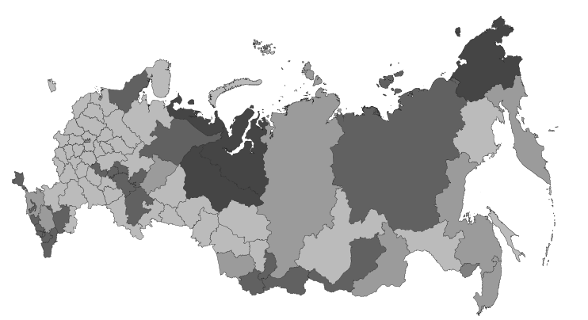
THE BUDGET SYSTEM
OF THE RUSSIAN FEDERATION
2
Federal Budget,
Budgets of Russia’s
extra-budgetary funds (3)
Level 1
Budgets of Russia's
federal entities (85),
Territorial extra-budgetary funds
Level 2
The budget system of the Russian Federation
Local budgets:
budgets of municipal areas,
city districts, settlements
(21,500)
Level 3
In line with Article 31 of the Budget Code of the Russian Federation, every constituent entity of the Russian Federation and municipality in the public sector have equal rights and are autonomous in exercising their budget rights (The Budget Autonomy Principle).

Slide 3





Government Programs
A series of public policy activities and tools to ensure achievement of public policy priorities and objectives in the area of social and economic development and national security protection within implementation of key public functions
FEDERAL BUDGET
CONTROL
ACHIEVEMENT
OF GOVERNMENT PROGRAMS’ OBJECTIVES
IDENTIFICATION OF POSSIBILITIES FOR A MORE EFFICIENT USE OF RESOURCES
REGIONAL BUDGET
outcome
CONTROL
MUNICIPAL BUDGET

Slide 4
4
Ensuring Accountability
of Budget Expenditure
Increase data quality and expand coverage of Government finance statistics
Ensure open budget process and engagement of civil society organizations
Improve public financial control
Develop internal audit system in public-sector organizations
2019-2014 Budget Expenditure Efficiency Boosting Concept, Chapter IX "Budget Expenditure Accountability"
I
II
III

Slide 5
Budget Information
Management System
Building capacity of citizens to use budget information:
Initiative budgeting development program in Russia's federal entities
Monitoring initiative budgeting practices
Promoting initiative budgeting best practices in constituent entities and municipalities
III.
Citizens Engagement
Teaching citizens to understand budget information:
Promoting budget literacy among initiative budgeting participants (information materials for target audiences)
Learning package on budget literacy for high school students
Embedding budget literacy elements in financial literacy
Organization of annual competitions of citizens budget ideas among population
II. Budget Literacy
Developing requirements, standards and methodology for open budgets at all levels of the budget system in the Russian Federation:
Developing open budget data in the Russian Federation based on new international requirements and accumulated domestic experience
Measuring budget data openness
Developing open budget data methodology for Russia's federal entities
Collection and dissemination of open budget best practices
I. Open Information

Slide 6
Areas of activities within MoF Russia's
“Citizens Budget” Project
Analysis of international standards on open budget administration, development and implementation of some tools based on best international practice, including the Open Budget Index of the International Budget Partnership
Development of methodology and monitoring of open budget data in Russia's federal entities.
Developing mechanisms of citizens engagement in the budget process at the local level based on a widely spread international practice of participatory (initiative) budgeting.
Development of actions to improve the budget literacy of the population.
Organization and carrying-out of idea competitions among population on presentation of the "Citizens Budget".
Development and publication of annual reports of MoF Russia on the best practices of Russia's federal entities and municipalities by project areas (Citizens Budget, initiative budgeting, etc.).

Slide 7
Dynamics of the volume of presented information
on eight key budget documents by the IBP Open Budget Index
Survey Section |  | 2006 | 2008 | 2010 | 2012 | 2015 | 2017 | 2019**
Document | Corresponding document in the Russian Federation | Score
1. Preliminary budget request | 1. Main areas of budget, tax, and customs-and-tariff policy | 67 | 89 | 89 | 78 | 89 | 0* | 100
2. Budget proposal of the Government | 2. Federal Budget Bill for the next financial year and planning period presented to the State Duma | 34 | 56 | 56 | 82 | 75 | 67 | 67
3. Approved budget | 3. Federal Budget Law | N/A | 100 | 100 | 100 | 67 | 100 | 100
4. Citizens Budget | 4. Main provisions of the budget law in a format accessible for citizens | 0 | 100 | 0 | 0 | 67 | 67 | 100
5. Current reports | 5. Current reports of the Federal Treasury on federal budget implementation | 89 | 96 | 96 | 96 | 82 | 100 | 100
6. Semiannual review | 6. Explanation Note to the Report on Implementation of the Federal Budget for Semester I of the current financial year | 67 | 0 | 0 | 0 | 85 | 33 | 33
7. Annual report | 7. End-year report on implementation of the federal budget | 50 | 27 | 57 | 70 | 69 | 67 | 67
8. Auditor's Report | 8. Conclusion of the Accounts Chamber of the Russian Federation on federal budget execution | 83 | 83 | 67 | 67 | 57 | 67 | 67
TOTAL |  | 47 | 58 | 60 | 74 | 74 | 72 | 81
*- because of legislative rescheduling of the budget process in 2016 ** - self-evaluation based on IBP methodology

Slide 8
Current outcomes of initiative budgeting development*
 | Indicator | 2015 | 2016 | 2017 | 2018
1. | The number of Russia's federal entities engaged in implementation of initiative budgeting practices, units | 7 | 16 | 47 | 68
2. | Amounts of regional subsidies for implementation of PB programs, bil. rubles | 1.4 | 5.1 | 7.7 | 10.5
3. | Federal budget expenditure volume, bil. rubles** | - | - | 3.8 | 3.9
4. | Со-financing by the community and business, bil. rubles | 0.4 | 0.7 | 1.1 | 1.8
5. | Total project amount, bil. rubles | 2.4 | 7.0 | 14.5 | 19.3
6. | Number of implemented projects, units | 2,657 | 8,732 | 15,942 | 18,725
* - data given based on findings following analysis of official responses of regional executive bodies to the request of MoF Russia on the experience of initiative budgeting for the corresponding period;
** - including funds of the priority project of the Russia's Ministry of Constructions "Creation of Comfortable Urban Environment" and Federal Targeted Program "Sustainable development of rural areas for 2014-2017 and until 2020" of the Russia's Ministry of Agriculture.

Slide 9
Classification of citizen participation practices
in the Russian Federation
Criterion | 1. World Bank Local Initiative Support Program (LISP) | 2. "People's Initiative" "People's Budget" | 3. Participatory Budgeting (PB) | 4. Youth Budget | 5. Citizen-led Territorial Development Program (PORT)
Launch Year | 2007 | 2011 | 2013 | 2017 | 2018
Key Features | 1. Selection of projects by citizens in community meetings. 2. Competitive selection of projects based on formalized criteria. 3. Integration in the national administrative, budget and legal systems. 4. Project implementation is funded from the budgets of federal entities with obligatory co-funding on the part of the community, local businesses, and municipalities. | These are regional variations of initiative budgeting practices that represent a synthesis of various approaches to participatory budgeting. | Allocation of a designated part of the city budget or attracted funds based on decisions of a committee consisting of citizens selected by lot drawing among those who have presented their projects for consideration and municipality representatives. The committee may propose budget initiatives in different areas of city life. | Annual allocation of funds from the regional budget for schools (up to 3 mil. rubles) for spending with participation of senior students | 1. Type of projects: construction and reconstruction of social infrastructure facilities in city districts 2. Every meeting selects 1 project and 3 delegates 3. The meeting of delegates selects 2 projects from the district 4. Voting via the official national platform for public services
Coverage of Regions | Kirov, Tver, Nizhny Novgorod oblasts, Stavropol, Khabarovsk krais, Republic of Bashkortostan and North Ossetia-Alania, Jewish Autonomous Oblast etc. | Tula, Irkutsk, Tambov oblasts etc. | 13 cities and urban settlements in Leningrad, Vologda and Kirov oblasts, since 2016 PB project launched in Saint-Petersburg | Sakhalin oblast, Komi Republic, Saint-Petersburg, Yamalo-Nenets Autonomous Okrug, Altai Krai, Moscow oblast (Balashikha city) | Sakhalin Oblast

Slide 10

Main Stages of Initiative Budgeting Development
in the Russian Federation
2015
2016
2017
2018
Initiative Budgeting Center created in the structure of the Financial Research Institute of MoF Russia
Launch of the initiative budgeting development project in the Russian Federation with participation of the World Bank
"Medium-Term Initiative Budgeting Development in the Russian Federation" Program developed
Initiative budgeting included in the MoF Russia's Government Program "Public Finance Management and Financial Market Regulation"

Slide 11
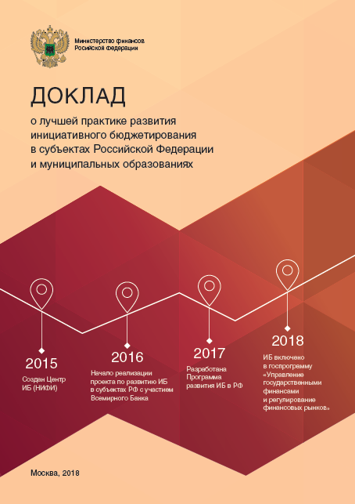
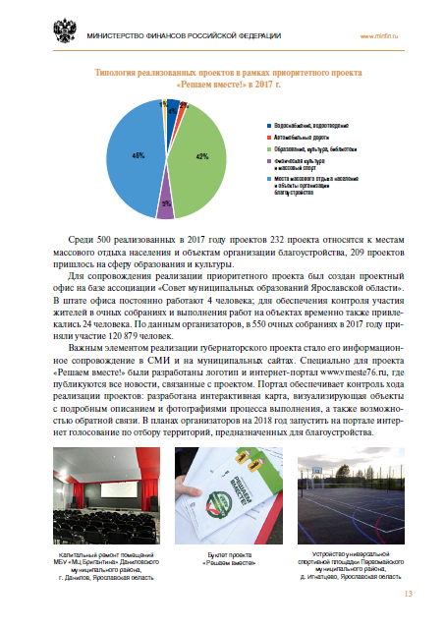

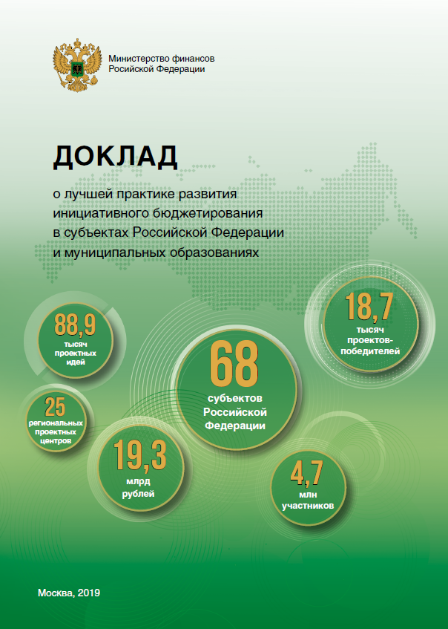
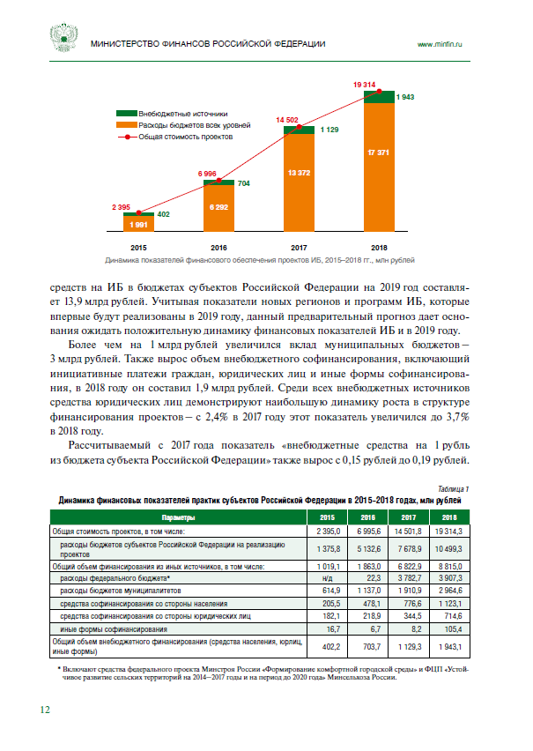

Annual publication of Best Practices Reports
Download 2018 Report
Major distinctive features of Russian initiative budgeting practices:
1. Financial contribution of citizens for purposes of implementing initiative projects.
2. Support on the part of the Government to practices of citizens engagement in development of territories through initiative projects, including introduction of initiative budgeting in the Government's budget spending efficiency boosting toolkit and increased budget openness.
3. Work on implementation of regulatory norms to allow for voluntary application of initiative budgeting
Download 2019 Report

Slide 12

Legal Framework of Initiative Budgeting
  In legislation on local governments:
capture the right of an initiative group to propose an initiative project to the local government;
expand initiative projects scope to cover decisions on issues of local importance or other issues under the local government’s jurisdiction;
integrate proposal of initiative projects with other forms of local governance implementation (conferences, meetings, public hearings);
determine initiative project contents, terms of examination and approach of how to work with it in the budget process;
establish an exhaustive list of cases when the local administration can refuse to support an initiative project;
introduce a competitive mechanism to select and evaluate the costs and benefits of projects by a peer group (committee);
invest a municipality representative body with the authority to determine the order of proposal, design, selection and implementation of initiative projects;
determine the sources of funding implementation of initiative projects, including initiative payments.

Slide 13
Legal Framework of Initiative Budgeting
In the budgetary code:
  In the Budget Code:
exclude initiative payments from the principle of general (cumulative) coverage of budget expenditure, which will allow targeting these funds specifically for implementation of initiative projects;
implement the norm on crediting initiative payments to revenues of municipalities as non-tax budget revenues;
complement competences of MoF Russia with guidance on planning budget expenditure of Russia’s federal entities (local budgets) for implementation of initiative projects;
complement competences of MoF Russia by guidance on presenting budget information in a format accessible and understandable for citizens for the purpose of raising the level of budget literacy among initiative budgeting participants.

