Slide 1
Experience of identity management at the Hungarian State Treasury

Slide 2
Speaker
Pataki Krisztina
Head of Divison
Hungarian State Treasury
Agricultural and Rural Development
IT Department

Slide 3
Necessity for using a privilege identity management system

Slide 4
Minimum requirements of the privilege identity managment system
Standardized processes
Transparency
Flexibility
„Least privilege” priciple
Reporting
Easy to automatize

Slide 5
Advantages
Identity Managment is centralised
Operational tasks are decentralised
Automatic allocation of basic identity
Paper-based administrative burdens are reduced, processes are speeding-up

Slide 6
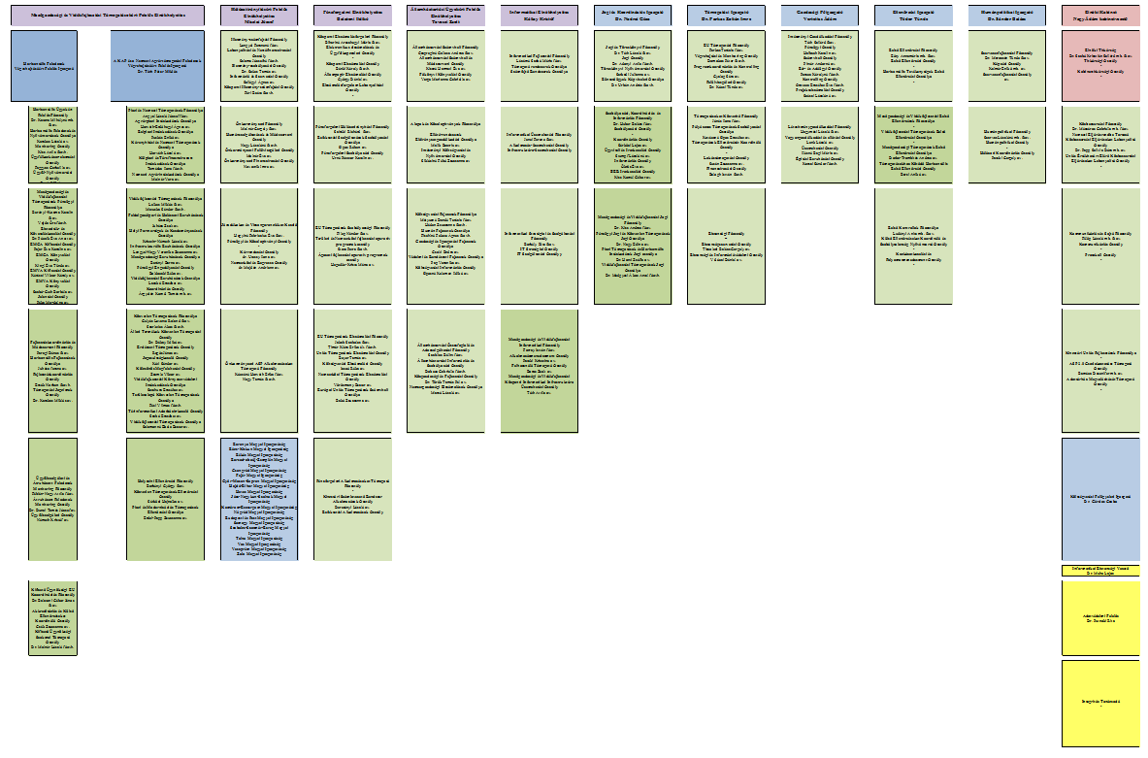
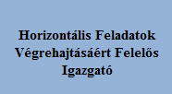
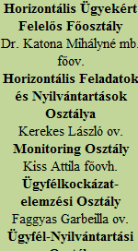
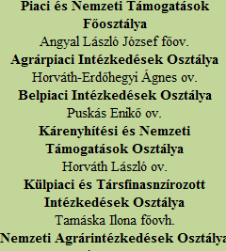
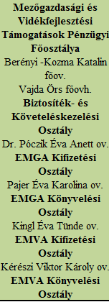
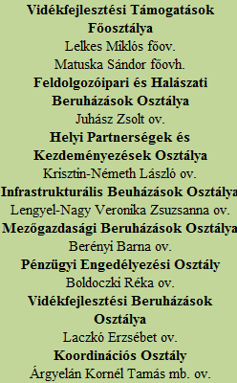
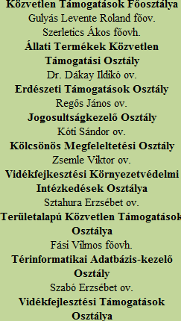
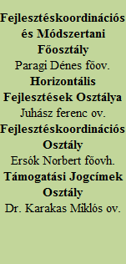
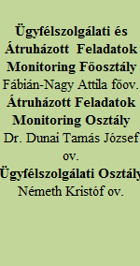
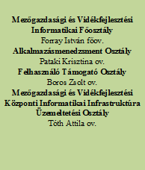
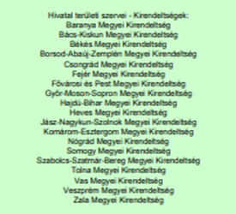
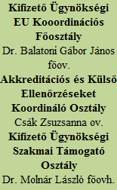
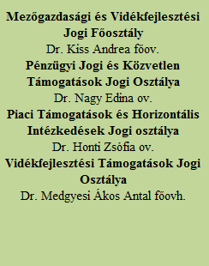
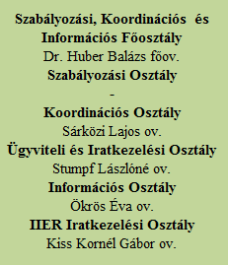

Slide 7
 | Past until 01.01.2017 | Present from 01.01.2017 | Future From ??.??.2019
Organizational structure | Agricultural and Rural Development Agency | Hungarian State Treasury departments performing paying agency’s task | Hungarian State Treasury
Identity management | IDM 9 | IDM9 (production environment) IDM 12 (Test) | IDM 12 (production environment) IDM9 (for audit purposes)
External users | 500 (IDM access is not provided) | 2500 (IDM access is not provided) | 2500+? (with IDM access)
Internal users | 2000 | 700 | 6500

Slide 8
Challenges
Users
Organizational changes
HR system
Multi-tenant systems

Slide 9
Challenges
Outdated
Lack of support
Inflexible processes
IDM UPGRADE!
Management of external users

Slide 10
Solution for the challenges
Modern technology
Platform independent
Support
Managing automatically the Data Administrator approvals
Multithreading
2 types of authentication

Slide 11
Project steps
Planning: 25%
Interviews: 25 %
Migration: 15%
Testing, preparation for the production environment start, education: 30%
Other project activities: 5%

Slide 12
Connectors
Original:
Active Directory:
SharePoint
Data Warehouses (BI)
Service Desk
Windows Identity
Unique:
IIER1
IIER2

Slide 13
Approval processes
Superior
Superior-Superior
Data administrator-Superior
Data administrator-Superior-Superior

Slide 14
Reports
Built-in reports
Unique reports
Audit Trail

Slide 15
Project completion
System plan
Requirement Specification
Release packs
Testing plans

Slide 16
Thank you for your attention!
pataki.krisztina@allamkincstar.gov.hu

