Slide 1
PEMPAL TCOP (The World Bank)
Treasury and the federal debt managing process
March 20, 2017

Slide 2
Agenda
About the Treasury Agency
Benefit of SAP Treasury
Overview of IT process landscape
Overview of SAP Treasury Units
Organisational structure / Authorisation concept
Master Data
Limit Check
Deal Entry
Collateral management
Reporting

Slide 3
The Austrian Treasury (OeBFA)
Founded in 1993 as Debt Management Office
Acts in the Name and for the Account of the Republic of Austria
Issues Austrian Government Debt
Central Cash Management
Financial Activities for Other Legal Entities of the Republic of Austria and Austrian Provinces

Slide 4
The Austrian Treasury (OeBFA)
Cash Management
Daily Liquidity management
Debt Management
Financing programs
Government bonds RAGB
EMTN-Programs (Euro Medium Term Notes)
Australian Dollar MTN-Programs – „Kangaroo Programme“
Loans and Schuldschein-Format
Austrian Treasury Bills (ATB-Programme)

Slide 5
Benefit of SAP Treasury
OeBFA uses SAP Treasury since 2015
Beginning Mid 2014 in 2 sub-projects the old treasury system was replaced with SAP Treasury
Primary objects were:
to achieve synergy with the IT procedures of the ministry of finance
to implement cross-company business processes in one system
Deal entry
Limitcheck
Book entry
Payment
Reporting

Slide 6
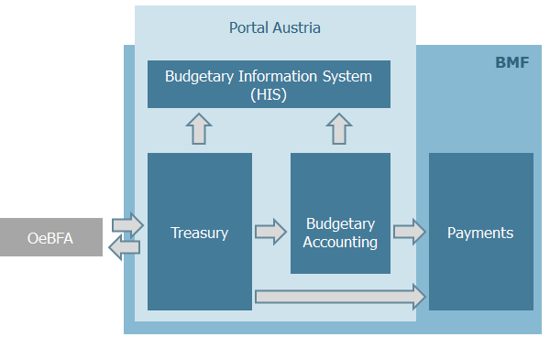
Overview of IT process landscape

Slide 7
Overview of SAP Treasury Units
Treasury
Federal Liabilities
Focus: Federal Financial Statements (BRA)
Volume: around 100 bn. EUR
Responsibility: Ministry of Finance
Federal Funding
Focus: Payments, Accounting, BRA
Volume: around 200 bn. EUR
Responsibility: Ministry of Finance
Federal Investments
Focus: Accounting, BRA
Volume: around 25 bn. EUR
Responsibility: Departments and Ministry of Finance
Debt- and Liquidity management
Focus: Debt- and Liquidity management
Volume: around 650 bn. EUR
Responsibility: OeBFA

Slide 8
Organisational structure / Authorisation concept
cross-company business processes in one system
Users: OeBFA, Federal Accounting Agency (BHAG), Ministry of Finance
System Administrator: Federal Computing Centre (BRZ)
Segregation of duties via
Authorisation concept and
Workflows

Slide 9
Master Data – Business Partner
Different kinds of data
Basic data (e.g. Name, Address, ...)
Settlement instructions
Data for Limit Check (e.g. Rating, …)
4-Eyes Principal for the maintenance of the data
Different Workflows depending on data
settlement instructions
Input: Back Office => Confirmation: Mid Office
Data Limit Check
Input: Mid Office Person 1 = > Confirmation: Mid Office Person 2

Slide 10
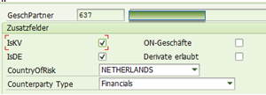
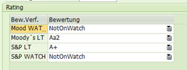
Master Data – Business Partner – Example Rating change
Person 1 changes Rating and starts workflow
Person 2 has a new workflow element in his inbox
After a control of the change he can approve or reject it
If he rejects the change, Person 1 gets a new workflow element and can make another change

Slide 11
Master Data – Market Data
Automatic Market data collection
Data provider Reuters
FX Rates, Interest Rates, Bond prices, …
Purpose of use
Real time data for fair market value checks
The real time benchmark rate is collected when a deal is saved
End of Day collection
At a specific time every day market rates are collected from Reuters and saved in a database
In the database historical rates are available for a long time horizon
This data is used for example for End of day valuation

Slide 12
Master Data – Interest Rate and Spread Curves
For valuation purposes interest rate and spread curves are necessary
swap curves, cross currency spread curves, bond curve
Also it is defined for which transaction type which curve will be used for valuation
For Austrian Government bonds the bond curve is used
For Derivatives (e.g. Interest rate swaps) swap curves are used

Slide 13
Limit Check
Specific Guidelines for the limitation of credit risk (exposure limit, term limit)
The calculation of the limit amount based on different master data is done in SAP Treasury (e.g. Rating of Business Partner)
For the calculation of the exposure limit utilisation different methods to consider default risk are used (e.g. Monte Carlo Simulation)
Before a trade is done the limits are checked within the System
If limits are breached a predefined group of people is automatically informed via E-Mail

Slide 14
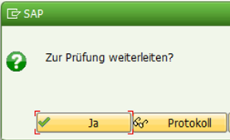
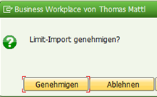
Limit Check – Example Calculation of limit amount
After the change of specific master data the new limit amount needs to be calculated and approved
The calculation happens with an own program, which calculates the limit amount for the exposure limit
Person 1 makes an update of the limits and starts a workflow for approval
Person 2 has a new workflow element in his inbox
After a control of the change he can approve or reject it
After approval the new limit amount will be directly used in the system for limitchecks

Slide 15
Deal entry
OEBFA
BHAG
Front Office
Back Office
Deal entry
automatic
Limit check
Deal confirmation
Book entry
Payment
6-eyes Principal
Automatic generation of confirmations for counterparts
Segregation of duties via pre-defined workflows
Each deal entry or amendment starts a new workflow

Slide 16
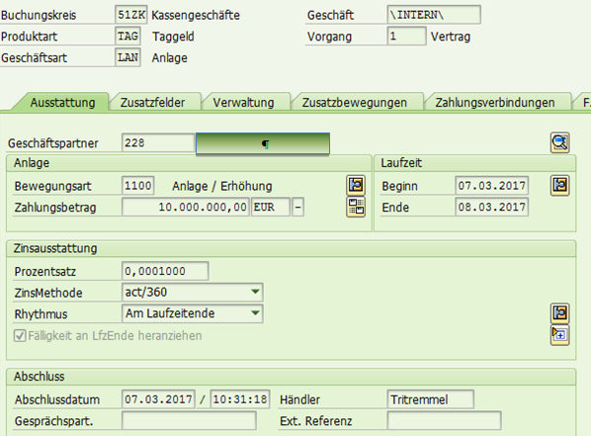
Deal entry – Example – Deposit
Front Office employee enters trade in SAP Treasury

Slide 17
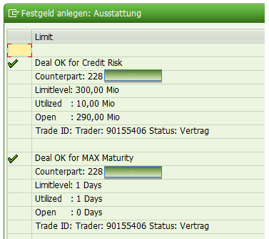
Deal entry – Example – Deposit
Before the trade is saved a manual pre-limit check is made
If the limits are not breached the trade can be saved, a limit check will be automatically made and a new workflow will be started

Slide 18
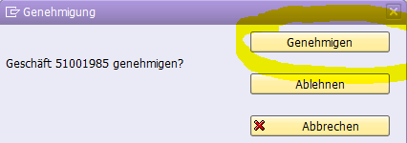
Deal entry – Example – Deposit
Back Office sees the new workflow element
All trade information like nominal value, interest rate, maturity date has to be checked
After checking the deal the Back Office can confirm or refuse the trade
At the same time the deal is confirmed a confirmation letter will be automatically generated which is sent to the counterpart via Email

Slide 19
Deal entry – Example – Deposit
Finally the Federal Accounting Agency sees a new workflow element after the Back Office has confirmed the Deal
the BHAG is responsible for the booking of the deal
and starts the payment process
Final check of payments and revenues with accounting statement of our bank

Slide 20
Collateral Management
OeBFA uses derivatives for the hedging of FX risks and for the management of the debt portfolio.
To reduce credit risk the OeBFA only contracts derivative transactions with counterparts with which an ISDA CSA (Credit Support Annex) agreement exists.
The collateral management process is done in SAP Treasury
Daily valuation of derivative deals per counterpart
Execution of Collateral payments

Slide 21
Reporting
Different kinds of reports for different recipients (OeBFA, Ministry of Finance, Federal Accounting Agency (BHAG), Austrian Court of Audit, Parliament, …)
Reports are available with real-time data or at least with daily updated data
On demand reports and predefined reports
All reports are based on one data source
Access is controlled via the authorisation concept
Report examples:
Maastricht Notification report (Debt level nominal amount, market value, Interest payments, accrued interest amount)
Position details report
Valuation report
Payment report

Slide 22
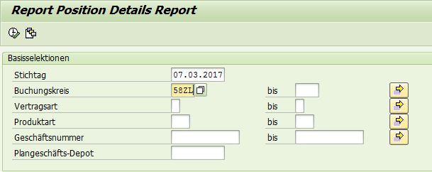
Reporting – Example – Position details report
Each on demand report offers a range of selection options
For Example: reference date, product type or deal number
Each report has a predefined number of result columns
The reports can also be exported for example to excel

Slide 23
Contact
Austrian Treasury
Austria - 1010 Vienna, Seilerstaette 24
Phone: (+43 1) 512 25 11- 0
Web: www.oebfa.at
Reuters: AFFA01…07 Bloomberg: RAGB, AUST
Managing Director, Treasury / Markets
Markus Stix, markus.stix@oebfa.at, ext. 22
Anja Tritremmel, anja.tritremmel@oebfa.at, ext. 37

