Slide 1


PEMPAL Treasury CoP Thematic Group Meeting
Use of Information Technologies in Treasury Operations
How to Connect e-Procurement and
Financial Management Information Systems
PEMPAL TCoP Workshop
Budapest, Hungary 4-5 June 2019
Cem Dener
Lead Governance Specialist &
Chair, Digital Governance CoP

Slide 2

FMIS & e-GP
Contents
FMIS and e-Procurement Basics
How to Connect e-GP & FMIS
Selected country cases

Slide 3
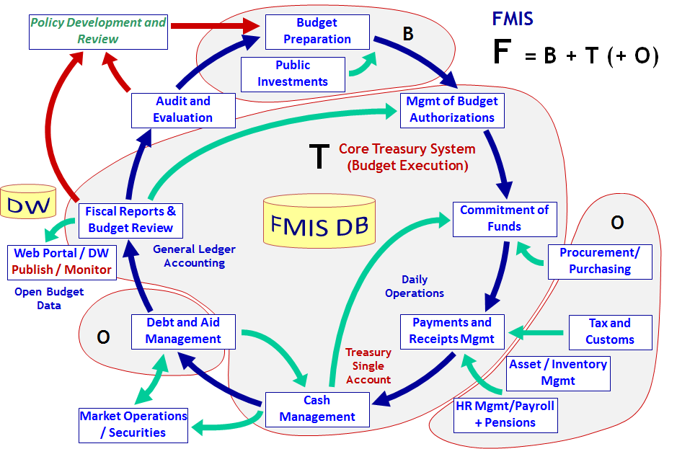
What is FMIS?
www.worldbank.org/publicfinance/fmis
Core FMIS Functions and Interfaces
Core Financial Management Information Systems (FMIS) can be broadly defined as a set of automation solutions that enable governments to plan, execute and monitor the budget.
Core FMIS = OLTP
IFMIS = OLTP + OLAP
Integrated FMIS (or IFMIS) combine core FMIS modules (OLTP) with powerful Data Warehouse (DW) capabilities and multi-dimensional data analysis tools (OLAP) for effective planning, decision support, service delivery, and performance monitoring.
Notes:
Core Financial Management Information Systems (or FMIS) can be broadly defined as a set of automation solutions that enable governments to plan, execute and monitor the budget.
IFMIS solutions combine core FMIS modules designed for Online Transaction Processing (or OLTP), with powerful Data Warehouse capabilities and multi-dimensional query tools for Online Analytical Processing (or OLAP) to support effective planning, decision support, service delivery, and performance monitoring.
Almost all countries have core FMIS solutions in place to manage their central government budget. However, fully operational and connected IFMIS solutions are rare in practice. The detailed information on IFMIS, WB funded activities supporting the transition to IFMIS platforms, and web publishing of open budget data through IFMIS, can be found in relevant web resources listed at the end of this presentation.

Slide 4


What is IFMIS?
Goals > Sustainable public resource management + Effective public service delivery + Open and accountable government
Integrated FMIS Solutions
PFM Operational Systems
Public Sector Institutions
FMIS Databases
Plan
Execute
M & E
Report
Account
Audit
Web Portal - Intranet
G2G
FMIS
E
T
L
Interfaces
OLTP
FMIS : Collaboration & Coordination
OLAP
DW : Monthly Updates & Dynamic Query Options
BI
BI
Data Warehouse
BI
Open
Budget / Gov
Data
E
T
L
G2C
G2B
Other e-Gov systems
DM
Web Portal - Internet
DM
DM
consolidation
slice & dice
drill-down
Multi-dimensional analytical queries
Citizens, NGOs, Businesses
Images: jscreationzs / FreeDigitalPhotos.net
OLTP : Online Transaction Processing OLAP : Online Analytical Processing ETL : Extract, Transform, Load BI : Business Intelligence DM : Data Mining

Slide 5
What is e-Procurement?
www.worldbank.org/publicfinance/fmis
e-Procurement & FMIS
The e-GP Working Group (WB, ADB, IDB) defined e-Procurement (e-GP) as:
“... the use of information technology (especially the Internet) by governments in conducting their procurement relationships with suppliers for the procurement of works, goods, and consultancy services required by the public sector.”
Scope of Public Procurement
Tendering > Investments, capital spending (Low volume; High value)
Purchasing > Recurrent budget expenditures (High volume; Low value)
  Observations
  e-GP systems usually cover both Tendering & Purchasing.
  Core FMIS solutions sometimes include Purchasing module.
  FMIS and e-GP are not properly linked to exchange data, in general.
  Rare to see FMIS solutions covering both Tendering & Purchasing.

Slide 6
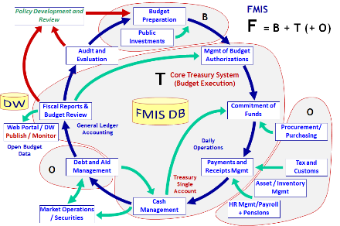
e-Procurement Modules
www.worldbank.org/publicfinance/fmis
e-Procurement (e-GP) Functions and Interfaces
Public Procurement Plan
Budget Allocations / Ceilings
Contract Completion
Program > Project > Activity
one < many < many
Announcing Tenders/Purchases
e-Notices
e-Catalog
e-GP Registries & Databases
Web Publishing / Data Analytics
Web Services/APIs
e-Authentication Digital Signature
Submission of Bids / Quotations
Big Data / ML
e-Documents (EDI)
e-Tendering
e-Monitoring
FMIS
e-Purchasing
Monitoring & Evaluation
e-Evaluation
Evaluation of Tenders/Purchases
e-Auction
e-Payments
e-Contract
Mgmt
Payment Management
Contract Signature
Activity > Contract
one < one
Contract Execution
Commitment Control / Mgmt
Other Interfaces:
Business Registry
Tax / Customs Systems
Banking / e-Payment System
Permit/Certificate Agencies
e-Procurement System is expected to cover the complete procurement cycle.

Slide 7
IFMIS & e-GP
IFMIS and e-Procurement > Integral Parts of Digital Government
Integrated Digital Solutions
(Government Cloud)
Public Sector Institutions
national, sector and
sub-national levels
e-Gov Portal
& e-Services
Government Systems *
FMIS, Tax, Customs, e-Procurement,
Health, Education, Pensions & more
G2G
G2E
Institutions
FMIS
E-GP
Tax/Cust
HRMIS
Soc Sec
Health
Operational Databases
System Management
Data Center Operations,
Help Desk, Disaster Recovery,
Information Security & more
Data Warehouse
(Open Data)
G2C
Citizens
Society > Citizen Participation
& Feedback on e-Services
Single Window | One-Stop Shop | Single Sign-on
Information Management
e-Mail, Content Mgmt, Records/Doc Mgmt,
Knowledge Mgmt, Master Data Mgmt & more
G2B
Businesses
Citizens, NGOs, Businesses
Shared
Services
PKI Services &
Digital Signature
e-Payment Services
Functional Registries
Civil Registration + e-ID Services
A simplified model of
integrated Digital Solutions
for connected e-Services
* Government Systems cover the integration (interconnectivity & interoperability) of sector applications, back office systems, as well as the improvement of institutions, capacity, regulations, processes, information management, and more (National Enterprise Architecture, e-Gov Interoperability Framework, Single Window, and One-Stop-Shops).
Images: jscreationzs / FreeDigitalPhotos.net

Slide 8
Trends & Challenges in Transition to IFMIS & e-GP
www.worldbank.org/publicfinance/fmis
Trends
Integrating core FMIS with Government Systems (including e-GP) and DW to improve data quality & value, and expand the scope
IFMIS modernization by combining traditional & agile approach
Improving interconnectivity and interoperability using Government Service Bus and web Application Program Interfaces (APIs)
  New CC API (April 2019) to link Country Systems with WB DB
Challenges
Key challenges in transition to IFMIS are Adaptive (non-technical):
Leadership & change management for transition to digital culture, and improving online service delivery
Enforcing the use of IFMIS and e-GP for daily recording of all budget transactions, commitments/contracts, and web publishing of results

Slide 9
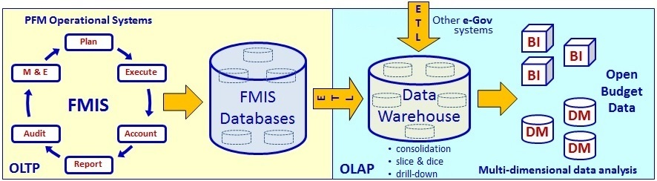
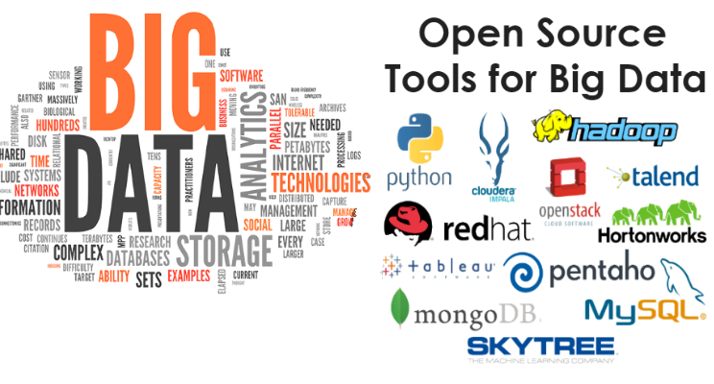
Trends
Connecting Foundations & Frontiers
IFMIS
Foundations Frontiers
Provide feedback to IFMIS for improving data quality & value
Combine “digital value” of IFMIS with “out of government” data
CGU, Brazil
Apply Machine Learning (AI)
Machine Learning Engine
Volume Scale of data
Velocity Speed of analysis
Variety Different forms
Veracity Uncertainty of data
Satellites, Sensors, Smart phones, …

Slide 10
FMIS & e-GP
Contents
FMIS and e-Procurement Basics
How to Connect e-GP & FMIS
Selected country cases

Slide 11
Public Procurement Cycle
www.worldbank.org/publicfinance/fmis
e-Procurement (e-GP)
e-Notification
e-Submission
e-Evaluation
e-Award
e-Ordering
e-Invoicing
e-Payment
Unique Procure
Package ID
e-Tendering
Data Analytics
Submission of
Bids / Quotations
Operational Acceptance Receipt of Prod / Serv
Identification of Needs
e-Notices / e-Catalog
e-Contract Management
Completion of
Warranty / Support
Evaluation
Unique
Contract ID
Preparation of
Bidding Docs
Announcement
Contract Signature
Contract Execution
Activity < one
Contract < one
Tendering
Preparation
Selection
Execution
Securities
Purchasing
Unique Activity Code
Source of Funding
Procurement Plan
Program < one
Project < many
Activity < many
Budget Allocation
Purchase Order
Commitment Control
Asset / Inventory Reg
Completing Payments
Releasing Securities
e-Authentication Digital Signature
Financial Controls
Payment/Comm Mgmt
e-Purchasing
e-Auction
e-Monitoring
e-Payment
Budget Classification / Chart of Accounts
Financial Management Information System (FMIS)

Slide 12
FMIS & e-GP > Data Exchange
FMIS & e-GP Data Exchange Options (1)
There are several critical controls that should be embedded in both FMIS and e-GP system benefiting from automated data exchange (ideally using web services/APIs)
Announcement of tenders/purchases: e-GP communicates with FMIS before the publication of each procurement notice to check the consistency of unique “activity code” (which is a part of the budget classification), unique “procurement package ID”, “allocated budget amount”, and more.
During procurement process: e-GP and FMIS can communicate during procurement activities if there are securities/guarantees to be registered under treasury single account (linked to FMIS) and checked during the procurement process.
Before contract signature: e-GP communicates with FMIS before contract signature to ensure that the contract amount is within allocated budget (and if it is above the budget this is justified and accepted). Also, financial obligations of the selected supplier (pending tax payments and other obligations) can be checked through FMIS interface to minimize the risks.

Slide 13
FMIS & e-GP > Data Exchange
FMIS & e-GP Data Exchange Options (2)
After contract signature: e-GP is expected to generate a unique “contract ID” linked to each proc package and activity code, and share contract details with FMIS for each recurrent / capital budget contract. Ideally, contract details should also include the payment schedule and other details to ensure that FMIS can capture all relevant fields for commitment/payment management.
During contract execution: FMIS is expected to capture all payments related to each contract, as well as other data fields (financial and non-financial indicators and outputs) and all contract amendments (extension of closing dates, contract value and other changes). FMIS can send regular updates to the e-Procurement system on payments and other indicators for monitoring and data analytics.
Monitoring and reporting: Both FMIS and e-GP systems can include data analytics tools to monitor and report the progress in contract execution and project results. There should be data fields that will allow for monitoring the duration and actual costs of contracts.
Standards: While recording and reporting procurement activities and contracts, e-GP and FMIS data structures can be aligned with national and international standards (e.g. GFSM, COFOG, CPV, UNSPSC).

Slide 14
FMIS & e-GP Data Exchange
www.worldbank.org/publicfinance/fmis
e-Procurement (e-GP)
Submission
Evaluation
Announcement
Contract Signature
Contract Execution
Completion of
Warranty / Support
Identification of Needs
Operational Acceptance Receipt of Prod / Serv
Preparation of Bidding Docs
Unique Proc Package ID
Procurement Notice
Contract Amount
Unique Contract ID
Procurement Data Analytics
Tendering
Preparation
Selection
Execution
Securities
Purchasing
Unique Prg, Prj, Activity Code
Source of Funding
Cleared for Signature
Payments & Amendments
Completion of Payments
Commitment Control
Payment / Comm Mgmt
Releasing Securities
Procurement Plan
Asset / Inventory Reg
Budget Allocation
Financial Controls
Purchase Order
Financial Management Information System (FMIS)

Slide 15
FMIS & e-GP
Contents
FMIS and e-Procurement Basics
How to Connect e-GP & FMIS
Selected country cases

Slide 16
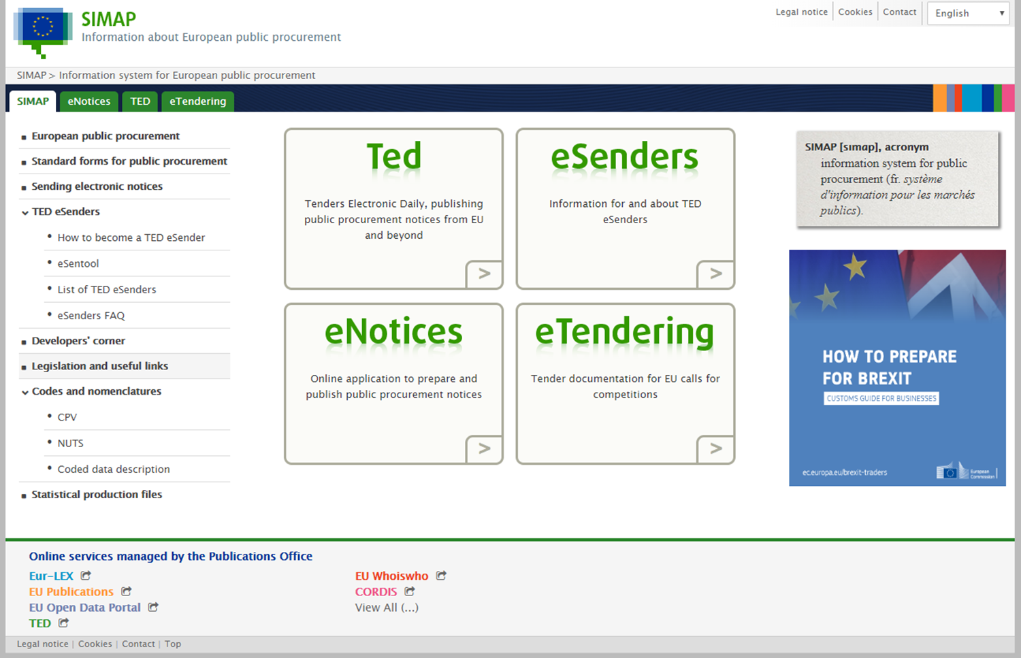
e-GP
SIMAP > European Public Procurement System
Source: https://simap.ted.europa.eu/

Slide 17
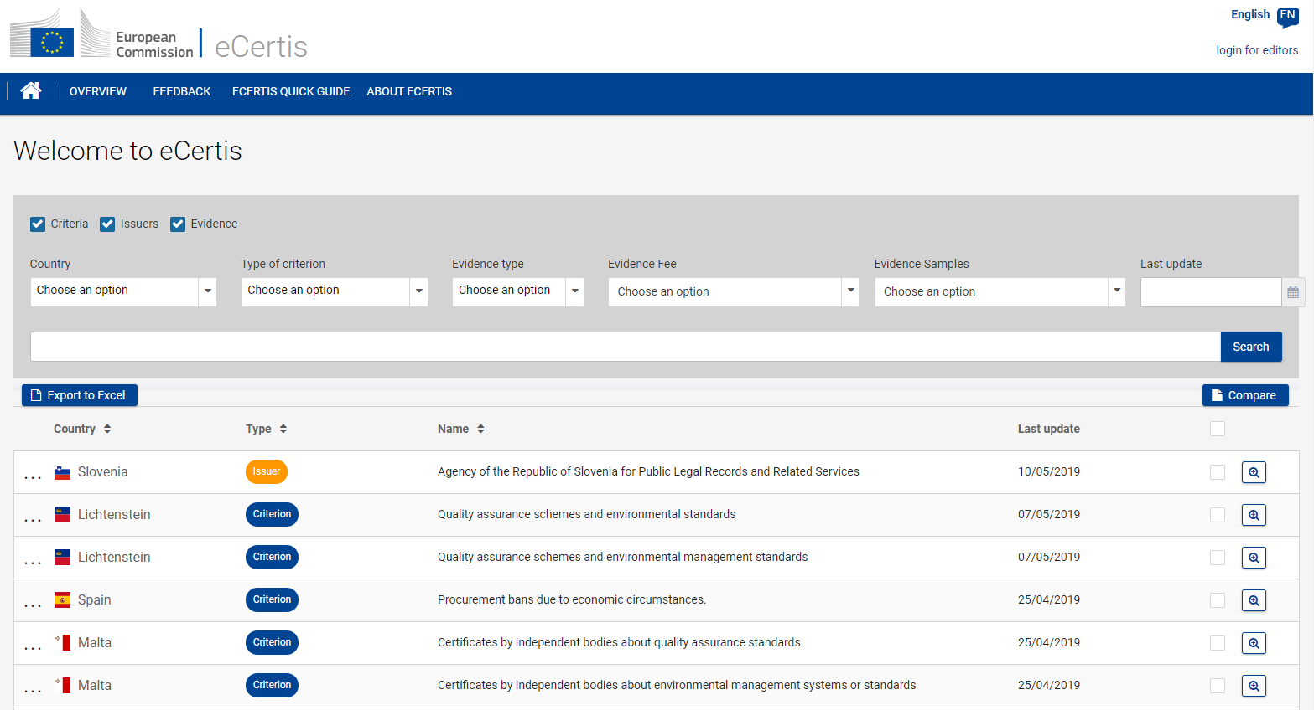
e-GP
eCertis –> EU Procurement Certification
Source: https://ec.europa.eu/tools/ecertis/search

Slide 18
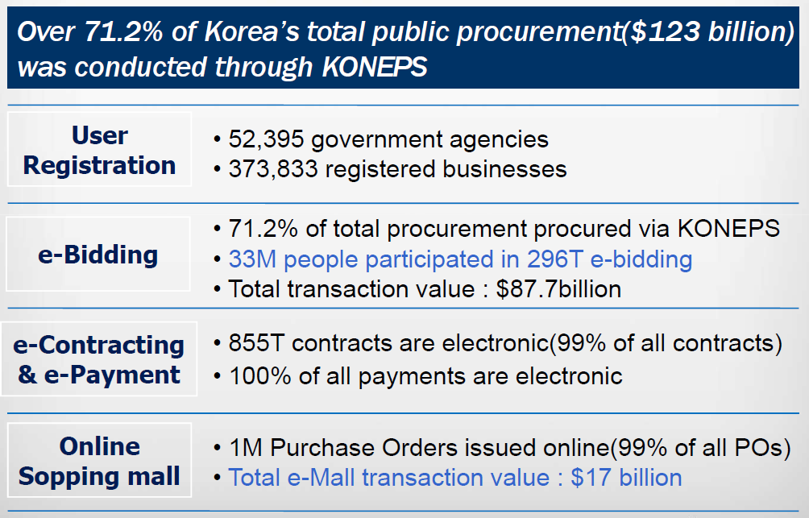
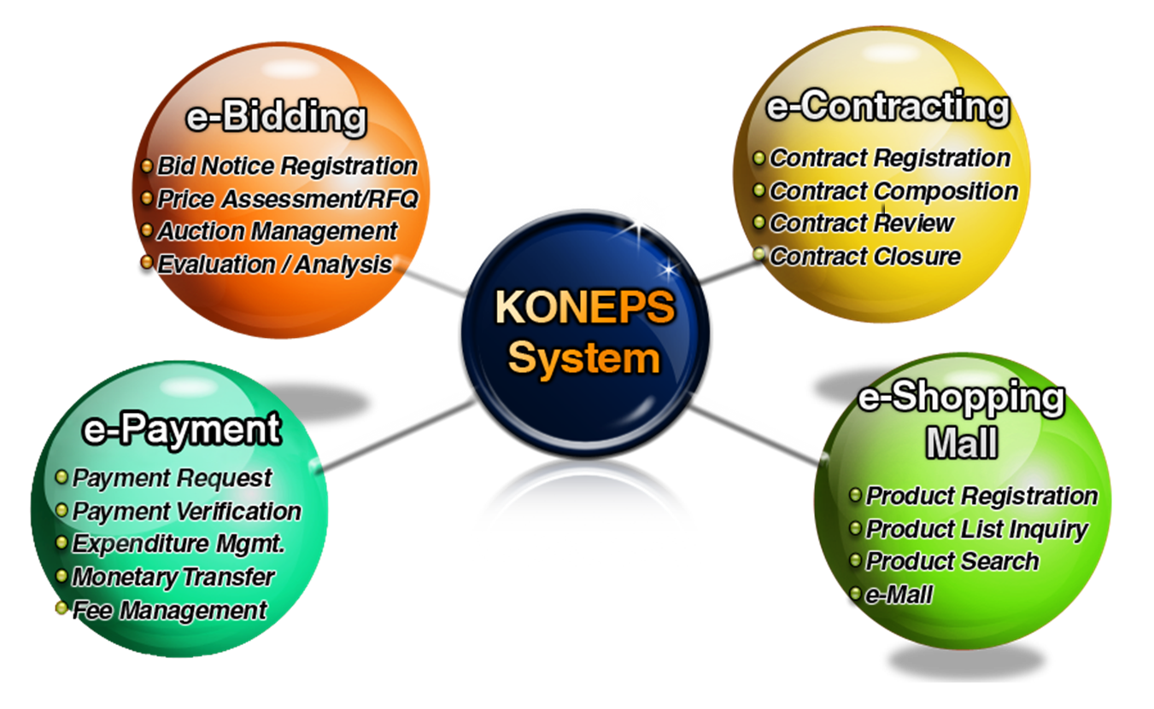
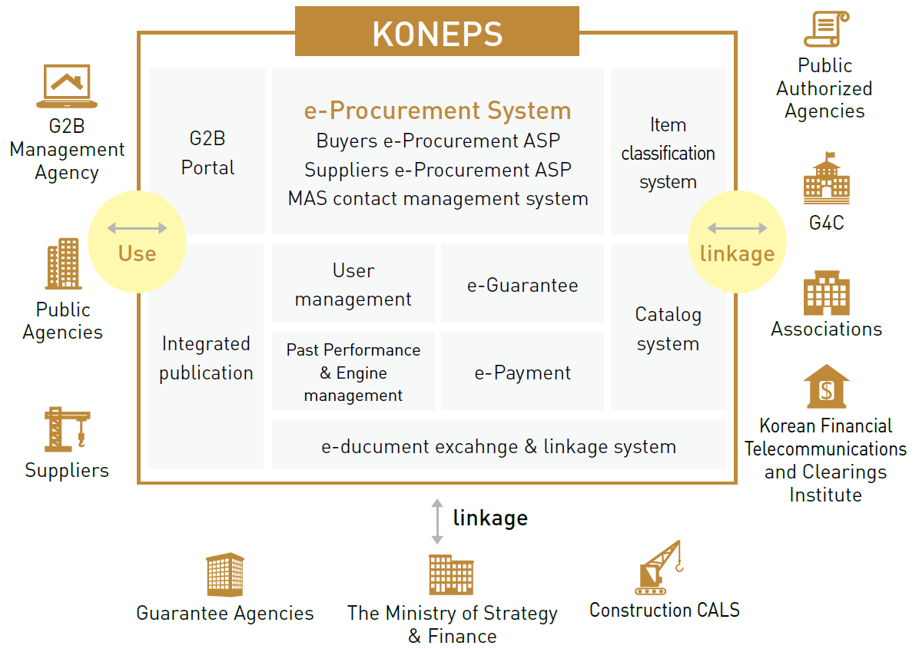
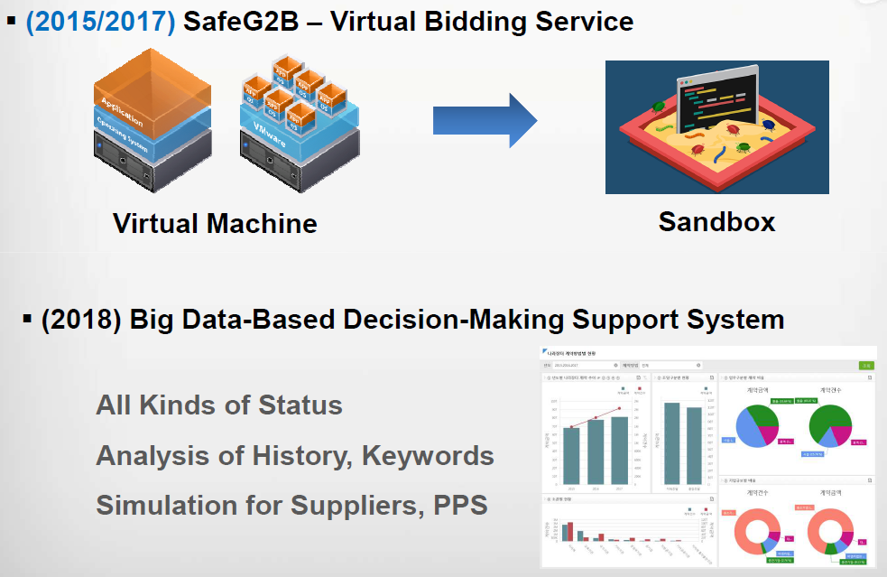
FMIS & e-GP
KONEPS > Korea Online e-Procurement System
(2017)
Source: Korea e-Procurement System: Continuous Improvement & Innovation; Heehoon Kang, Public Procurement Service (PPS), The Republic of Korea

Slide 19
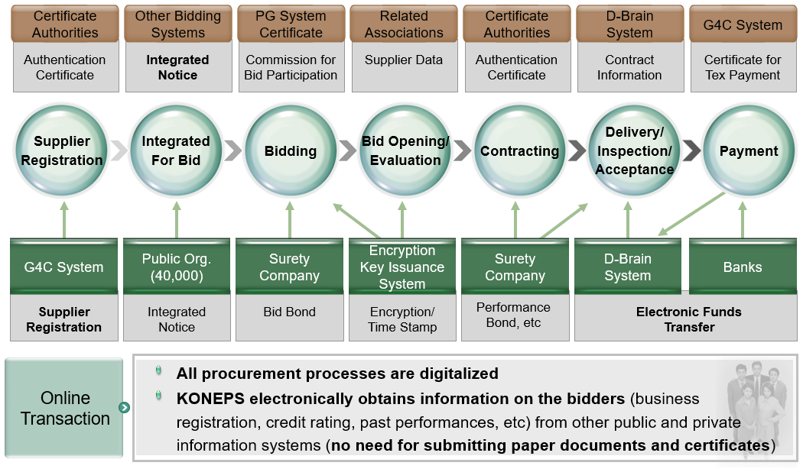
FMIS & e-GP
KONEPS > e-Tendering Processes and Interfaces
Source: KONEPS Presentation; Kang-il Seo, International Cooperation Division, Public Procurement Service (PPS), The Republic of Korea

Slide 20
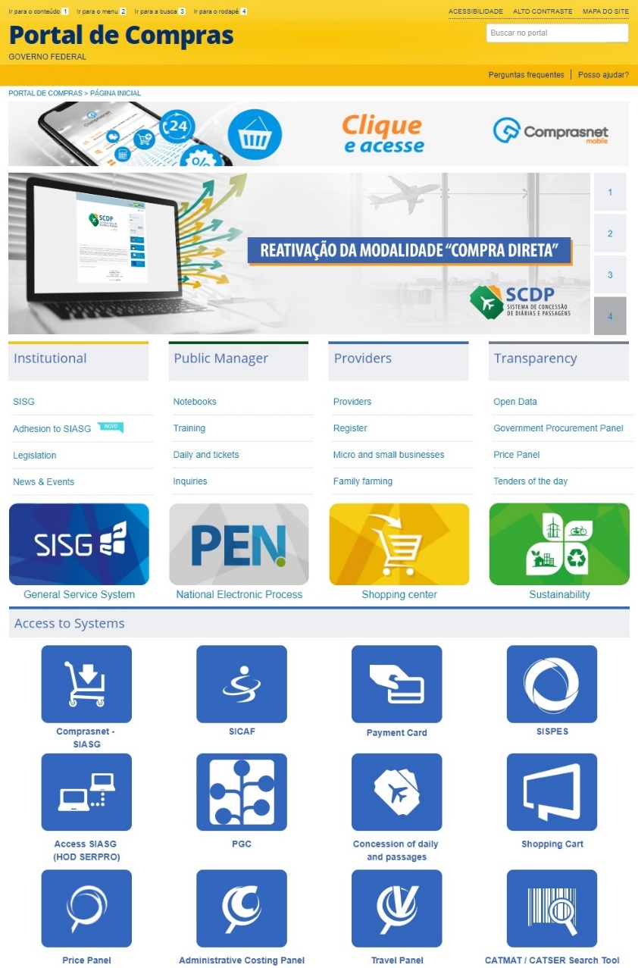
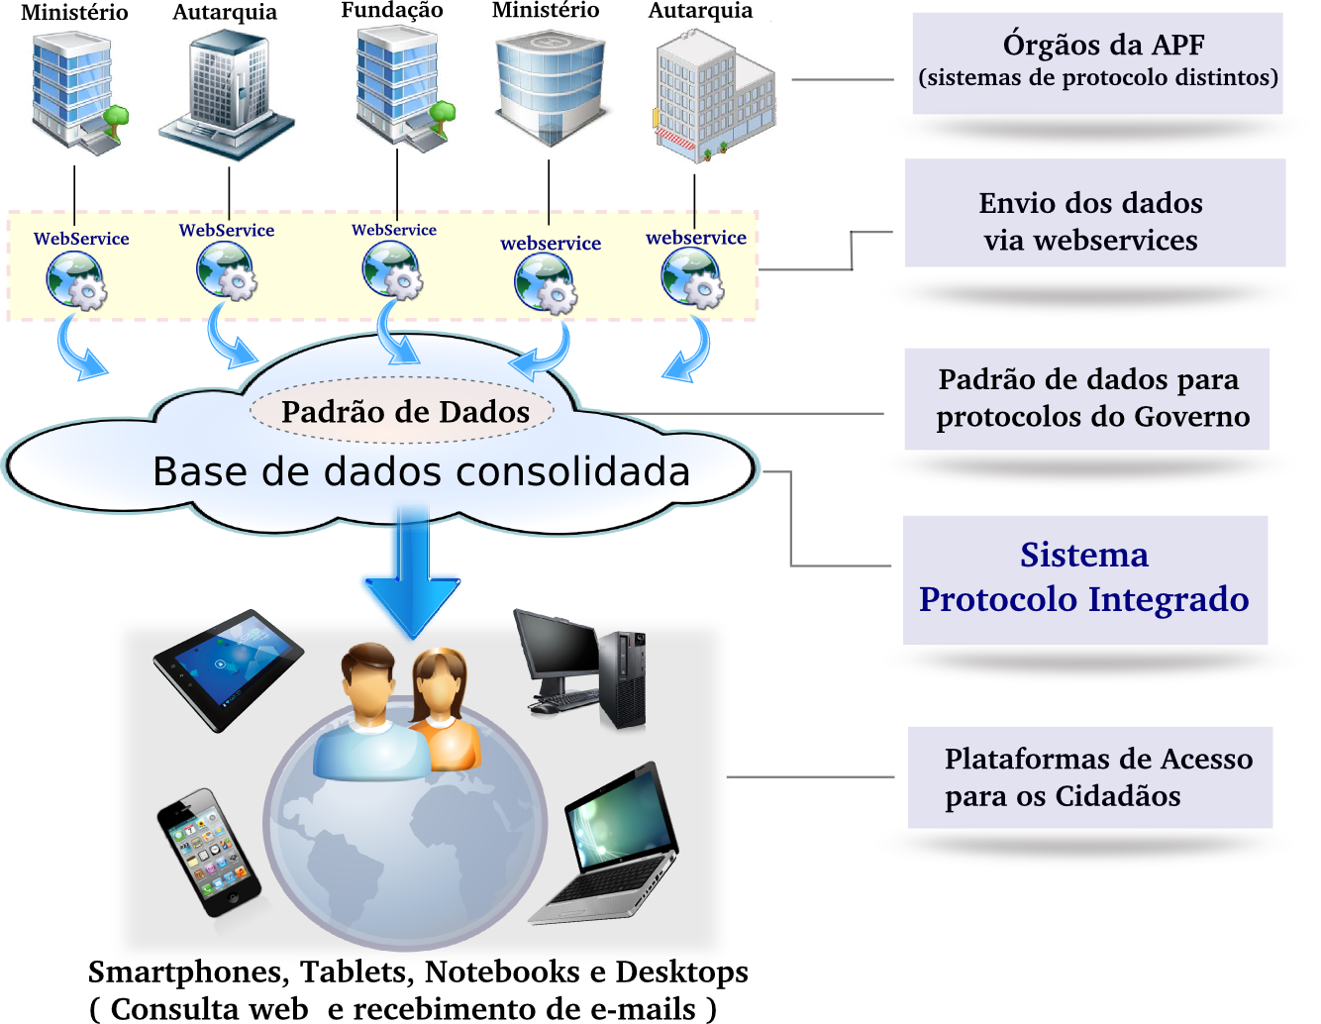

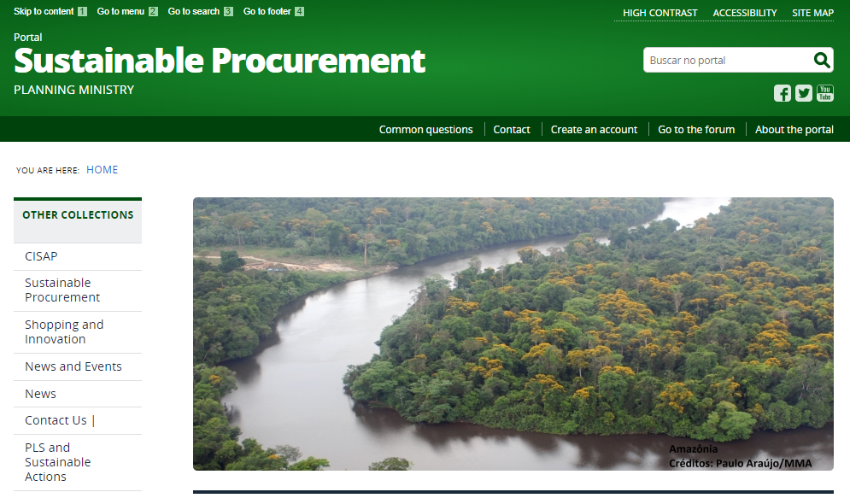
e-GP
COMPRASNET > e-Procurement System in Brazil
The National Electronic Process (PEN) is a joint initiative of gov agencies to establish a public electronic administrative process infrastructure. Each entity periodically extract, at intervals not exceeding 48 hours, updated data (including procurement) of their systems (in XML format) and post through web services (APIs) for the benefit of citizens.
Source: https://www.comprasgovernamentais.gov.br/

Slide 21
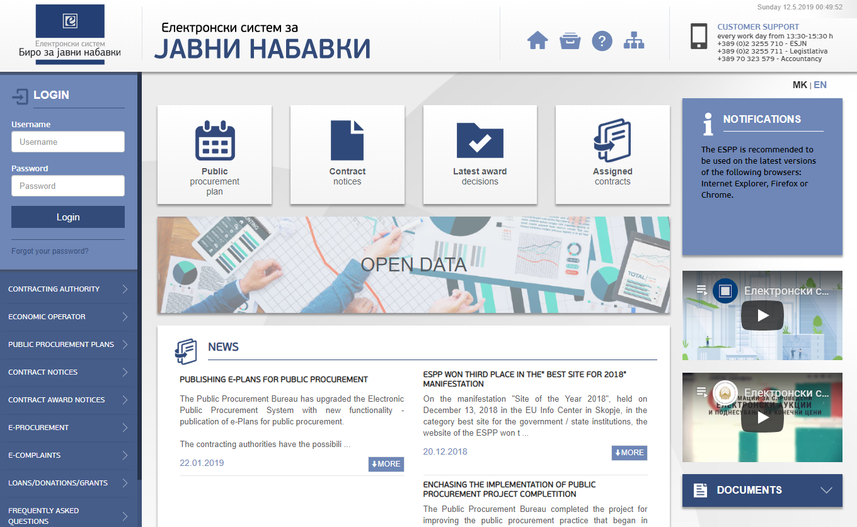
e-GP
ESPP > e-Procurement System in North Macedonia
Source: https://e-nabavki.gov.mk/

Slide 22
Thank you
FMIS CoP > https://eTeam.worldbank.org/FMIS
FMIS Web Site > http://www.worldbank.org/publicfinance/fmis

