Slide 1
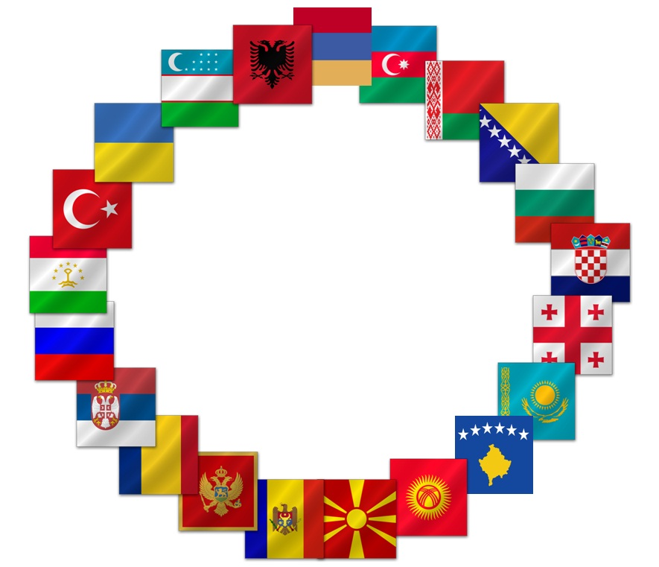
  TCOP
  GROUP 4

Slide 2
OUTLINE
Countries present: Albania, Bulgaria, Macedonia, Romania, Turkey, Belarus, Indonesia, Kyrgyzstan, Moldova, Tajikistan, Russian Federation, France, (EDB, SECO, World Bank)
What useful lessons can be applied in your countries from the Russia experience?

Slide 3
Albania
Liked approach to the analysis of costs and benefits of system
Liked integrated approach (rather than different systems with interfaces)
The way individuals make payments very interesting (request for more details)
Data warehousing (request for key indicators and how system works)
Have Oracle based Treasury system – had three questions for Russian Federation (re: standardized revenue invoice; digital archives; separation of functions between treasury and budgetary organizations)

Slide 4
Tajikistan
Interested in strategy of treasury development (particularly risks identified)
Human Resource Asset management – how it was done – system based on definition of business processes and how they are managed (additional information requested)
Form of accounting and reporting - experience of integration of international standards very useful

Slide 5
Bulgaria
Liked integrated information systems. Bulgaria achieved same results but had to continue with program indicators separately.
Have separate systems and will work to integrate all business processes.
Liked how accounting methodology was developed. Bulgaria has to comply with accounting guidelines compliant with ESA95, national guidelines, IMF’s GFS (and elements of IPSAS that are consistent with these).
Question to Russian Federation regarding cash verses accrual information. Monthly reports on cash basis, quarterly information on balance sheet and cash flows, annual reports on accrual.

Slide 6
Indonesia
Since 2007 have been developing TSA and cash management more efficient.
Have similar reforms to Russian Federation and countries alike in some ways (huge dispersed client base - see pages 41-43 of APEC book)
Interested in what kind of financial instruments do Russia use to optimize your TSA
Indonesia facing payments very slow at beginning of fiscal year until 3rd quarter and then big increases at end of year. If have this problem, how does Russia deal with it?

Slide 7
Romania
Recently restructured so very interested in other country experiences particularly Dutch and French treasuries
Russian Federation very different (size, volume, structure) but learning from Treasury internal organization and also grateful to EU institutions and World Bank for assistance
Interested in Russian approach:
  liquidity management - placement of deposits in commercial banks as Romania planning this also. Want more information about cooperation with central bank and impact on market and interest rates (any analyses would be appreciated).
  Cash to accrual – interested in any projections on impact of this transition on the deficit of the general government
  Results based budgeting

Slide 8
Macedonia
Interested in relationship between Central Bank and Treasury related to liquidity management.
Turkey
Interested in relationship between Central Bank and Treasury and what commissions and interest for TSA
Kyrgyzstan
Requested additional information about the interface between the client and the treasury system and how the client is registered.

Slide 9
Moldova
Was impressed with the thoughtful planning of reforms. Requested documents of reform sequencing, strategy as Moldova introducing many reforms at once at moment.
Interested in existence of interdepartmental committee of cash planning. Moldova had a similar group called liquidity committee but has been stopped for political reasons. Requested bylaws or guidelines from Russia for such a committee as Moldova wants to restore such a committee again.
France
France and Russia have similar systems. Cash currency circulation an issue in France – very expensive, not secure. France want to develop web portal. Asked two questions – basis of State Accounting Rules and how are they decided

Slide 10
Other
European Development Bank – Noted that Russian Federation spent a lot of time on modernizing processes before automating them.
Asked Russia would it be possible to load world bank reports to PEMPAL virtual library on the reform process

Slide 11
THANK YOU
www.pempal.org
Group 4

