Slide 1
Implementing & evaluating risk management and control activities
Audit approaches at MoF Austria
Markus Erlmoser
Internal Audit Department
Federal Ministry of Finance - Austria
Sochi, 31. October 2019

Slide 2
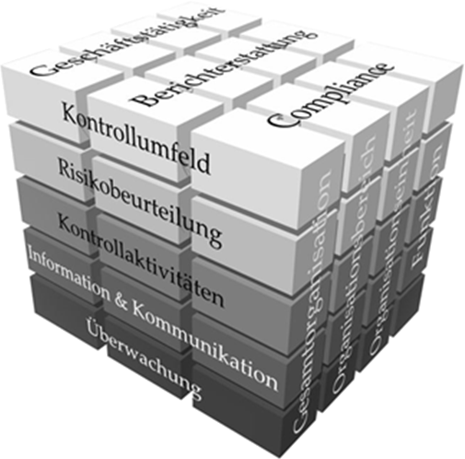
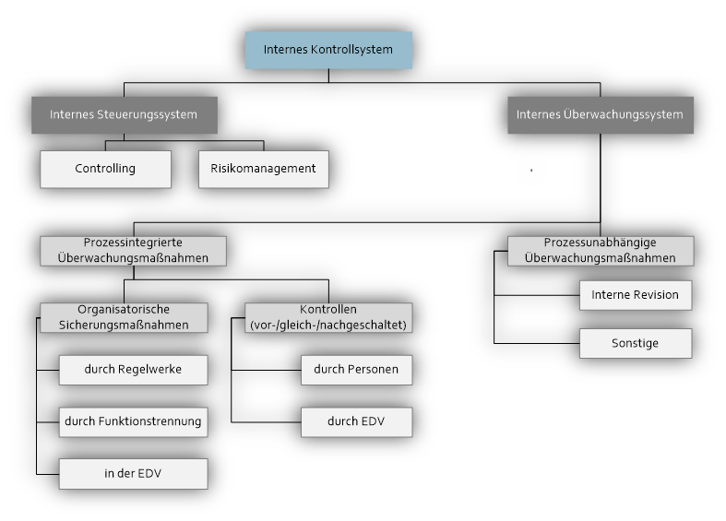
Used international standards
Internal Control System
  COSO Internal Control – Integrated Framework
    Framework 1992
    Update 2013
  IDW Auditing standard PS 261
    Institute of Public Auditors in Germany
    Basic ICS standard for auditing in central Europe
Implementing & evaluating risk management and control activities

Slide 3
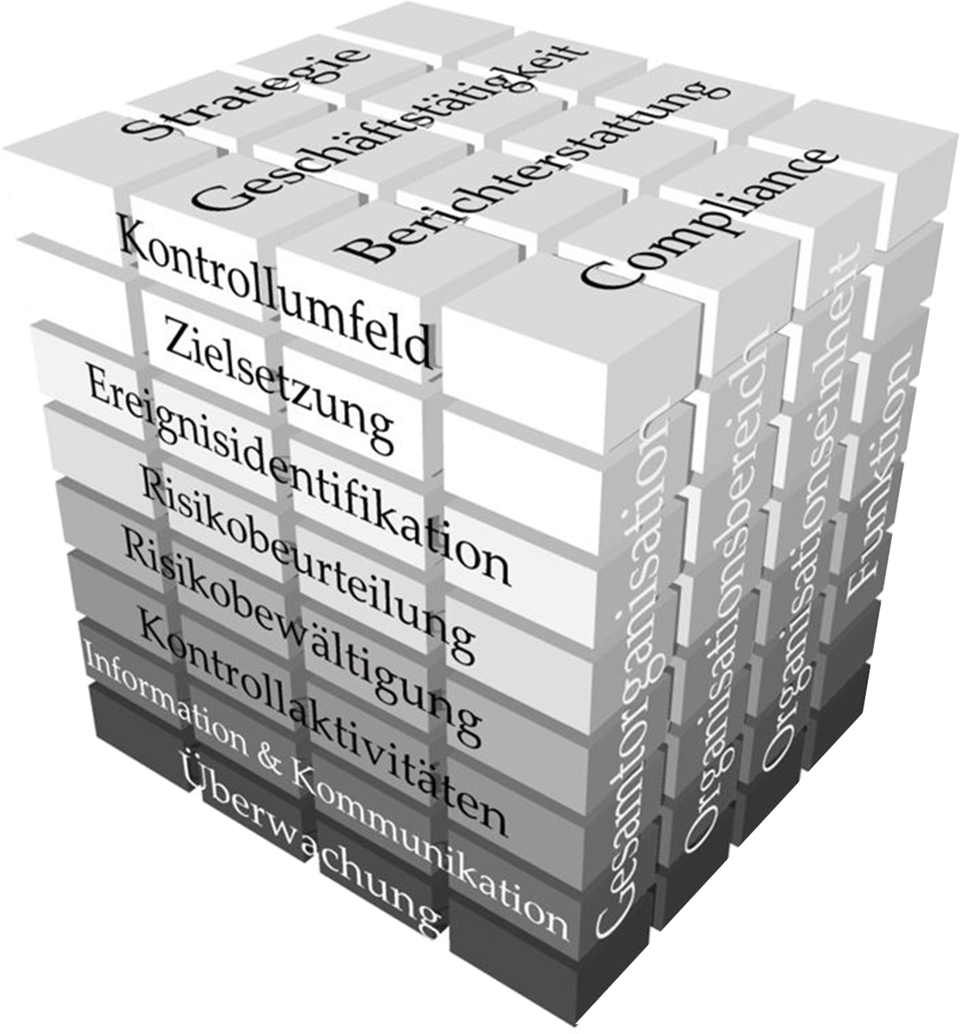
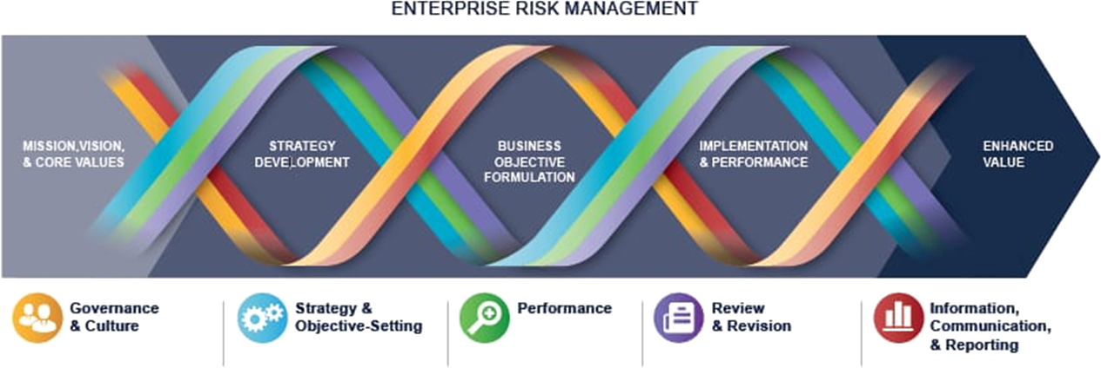
Used international standards
Risk Management System
  COSO Enterprise Risk Management Integrated Framework
  COSO Enterprise Risk Management – Integrating with
  Strategy and Performance
  DIIR, Audit Standard No. 2 – Audit
  of the RMS
Implementing & evaluating risk management and control activities

Slide 4
Audit approaches ICS & Risk Management System
Internal control system
  The main question:
    How well does the internal control system in relation to (...) cover the basic principles of "transparency", "four eyes", "separation of functions" and "minimum information", and how well is the ICS being developed?
Implementing & evaluating risk management and control activities

Slide 5
Audit approaches ICS & Risk Management
Internal control system
  Audit methods
    Guided interview
      Orientation to components of the COSO-IC
      IDW PS 261 (process-integrated monitoring system)
    Process analysis
    Document analysis (QDA based on audit topics)
    Observation
      Different hierarchical levels
      Different organizational units
    Descriptive statistics
Implementing & evaluating risk management and control activities

Slide 6
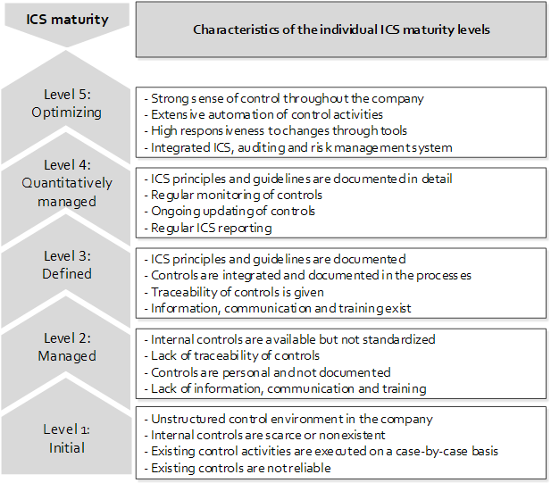
Audit approaches ICS & Risk Management System
Internal control system
  Evaluating the ICS using Capability Maturity Model Integration (CMMI)
    Reference model of the Court of Auditors for maturity assessment
    5-step model with notes on each step
Implementing & evaluating risk management and control activities

Slide 7
Audit approaches ICS & Risk Management System
Risk Management System
  The main question:
    How is the risk management system (...) structured and how is it based on its degree of maturity compared to the COSO ERM2017 model?
Implementing & evaluating risk management and control activities

Slide 8
Audit approaches ICS & Risk Management
Risk Management System
  Audit methods
    Guided interview
      Orientation to COSO ERM - Integrating with Strategy and Performance
      Based on DIIR: company monitoring and internal audit
    Content analysis guided by components and principles of the COSO-ERM model
    Document analysis (QDA based on audit priorities)
    Descriptive statistics
    Development of 200 control questions to assess the risk management system
      based on the DIIR Test Guidelines for Test Standard No. 2
      Executive Summary of IIA on COSO Enterprise Risk Management - Integrating with Strategy and Performance
      Study by the Lucerne University of Applied Sciences to assess the degree of maturity of risk management in Swiss companies
Implementing & evaluating risk management and control activities

Slide 9
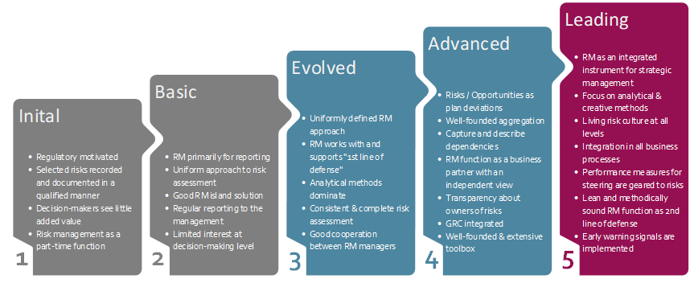
Audit approaches ICS & Risk Management
Risk Management System
  Assessing the RMS using the Risk Maturity Model - Integrating Risk Management, Compliance and Controlling
    Specially tailored to risk management
    maturity model
    5-step model with notes on
    each step
Implementing & evaluating risk management and control activities

Slide 10
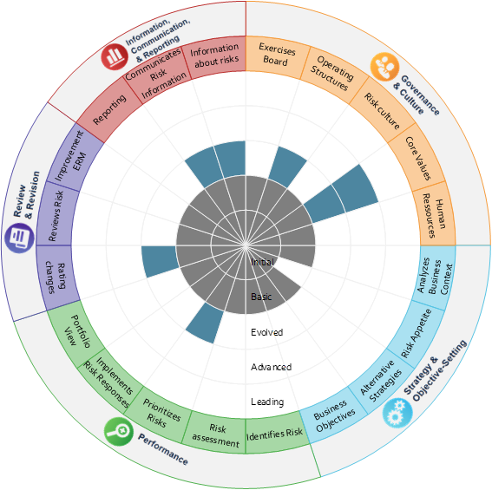
Audit approaches ICS & Risk Management
Risk Management System
  Evaluation result
Implementing & evaluating risk management and control activities

Slide 11
Audit approaches ICS & Risk Management
Integration status ICS and RMS
  Governance, Risk & Compliance (GRC) considerations
  GRC as an integrated & holistic approach
  Matching strategy, processes, technology, HR & structures improving effectiveness and efficiency
  Mutual influence of ICS and RMS
  Content comparison of examination results
  Verbal assessment of the status of integration
Implementing & evaluating risk management and control activities

Slide 12
Thank you for your attention!
Markus Erlmoser
Internal Audit Department
Federal Ministry of Finance - Austria
markus.erlmoser@bmf.gv.at

