Slide 1
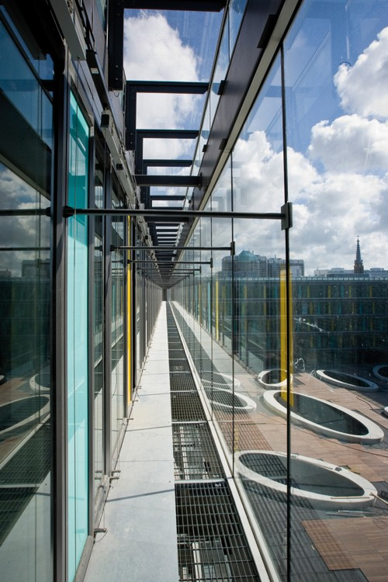
PIC in the Netherlands
Budapest, March 2017
Manfred van Kesteren

Slide 2
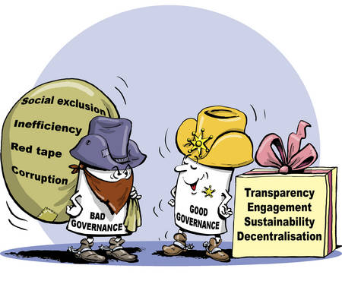
Principles of Good Public Governance and Public Internal Financial Control (PIFC)
Integrity
Transparency
Communication
Clear objectives and responsibilities
Efficiency and effectiveness
Accountability
Lawfulness

Slide 3
PIC-House: the elements and their interdependency

Slide 4
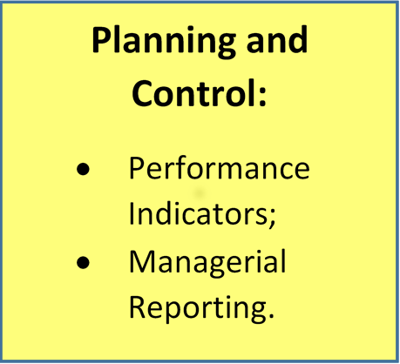
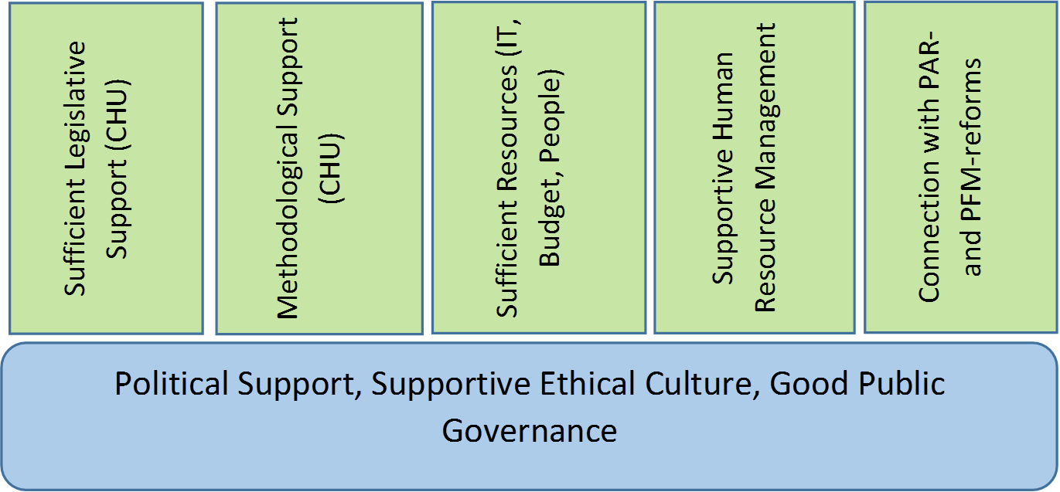

Slide 5
Role of Senior Management
Adopts, advocates and promotes the principles of Good Governance (tone at the top);
Delegates (budget, tasks, responsibilities, authorities) through a clear mandate structure which describes roles and responsibilities;
Senior management has a ‘contract-relationship’ with delegated management: clearly defined targets, reporting obligations etc.;
Financial Departments (second line) supports senior management in the set-up of the planning and control cycle (KPI’s, reporting, accounting);
Senior management remains ‘in control’ without controlling all the time→ contracts, clear reporting on the right issues, HR-obligations;
Senior management has also an accountability (e.g. minister towards parliament: ‘in control statement’.

Slide 6
Key notions regarding PIC in the Netherlands
DELEGATED Managerial Accountability is the cornerstone of PIC;
Financial Departments are the architects of Internal Control: active partners of management;
PIC is build on proper soil;
ADVISE: Perform a government-wide GAP-analysis: confront the vision and ambition with reality→ PI(F)C-strategy→ action plan→ regulatory framework;
Interconnection between PI(F)C-elements: ensure clarity of the roles and responsibilities of the three lines of defense;
Connect managerial accountability with the planning and control-cycle: linking pin between management and the architects of internal control (FD);

Slide 7
Implementing PIFC on the entity level
On the basis of CHU-support (regulations, methodology, practical guidance) the following steps can be considered:
Install a PIFC-working group at entity level: chaired by e.g. deputy Head or State Secretary. Include also Financial Division (secr.) and IA (advisor);
Working group initiates a GAP-analysis: what is? What should be?
Action plan based on GAP-analysis;
Working group guides and monitors the implementation of action plan;
Special attention points: organizational structure; position and role Financial Department; design of planning and control; budget level/authorities; financial and non-financial accounting (KPI’s).

Slide 8
M.Kesteren@minfin.nl

