Slide 1
Digitalization in the Centralized Payroll System processes (KIRA)

Slide 2
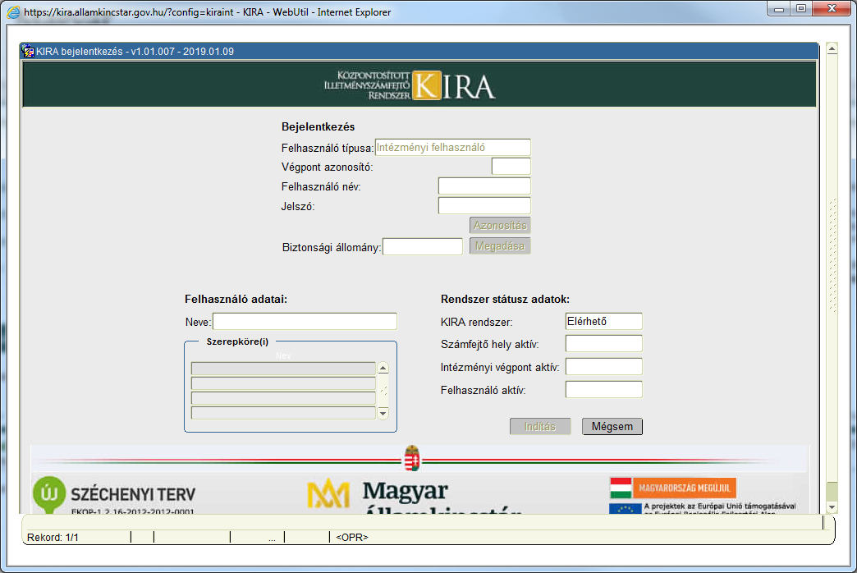
Centralized Payroll System
Payroll for the entire public sector based on the general government law 368/2011. (XII. 31.)

Slide 3
Numbers about KIRA
31 | laws and government regulations
1 000 000 | employees
13 000 | institutions
4 000 | in-house users
17 000 | external users
204 billion HUF | gross salary / month
28 billion HUF | taxes / month
110 billion HUF | transfer to bank account / month
636 366 | digital salary list users
300 | forms
500 | reports
670 | procedures
5,46 TB | data
4,23 TB | index
1 100 | DB tables

Slide 4
Goals in 2011
Professional
Flexibly follow constantly changing legislations (parameterization)
Electronic documents
Ensuring information services
IT
Centralised one database
E- documents (interface: HR, accounting systems)
Information services
Full batch process run time less than one night
Good performance

Slide 5
Realization
Project duration: 2012-2014. |  | Costs: 1,6 billion HUF | Using from: 01/11/2015
Oracle | Oracle Database 11g Enterprise Edition Release 11.2.0.4.0
 | With the Partitioning, Automatic Storage Management
 | Oracle WebLogic, Forms, Reports Server 11g (10.3.4)
 | ORACLE VM Manager
In-house developing | 8 system analysts
 | 20 programmers
 | Payroll expert teams (30-150 members)
 | IT consultants
Reached results | There was no news
 | Pay salaries in time and in correct amount
 | Stability
 | 90% of the goals

Slide 6
Development directions
Digitizing, automation
Continue with original goals
Flexible reporting
Full digitalization
Implementation of the digitizing plans of the government (digital administration law)
Paperless operation
Eliminate paper-based archives
Automatic data transfers (interfaces)
Technology update (Forms Java)

Slide 7
Digital salary list
Public available online
Central Identification Agent (KAÜ) identification
Aggregated data (tax declaration)
Exportable
Separate infrastructure
New technology (PostgerSQL, Java)
Automatic, adjustable transfer
600 000 users

Slide 8
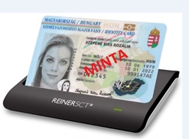
KIRA Two factor authentication
KAÜ electronic ID card authentication beside the KIRA login (user/pwd+security file)
KAÜ National Tax and Customs Administration (NAV): tax ID at National Tax and Customs Administration is compared to the users ID stored in the KIRA system
Results
In-house developing
In-house users have been using it from 01/01/2019.
Tasks
Countrywide extension Q2. 2019
Vulnerability Scan Oracle Forms upgrade
(new subproject)

Slide 9
Paperless KIRA
Scope
To be digitized:
Communication between the employer and the Treasury
Communication between courts, tax authority and the Treasury
Data exchange within the organization
Documents (generated by KIRA and archives)
Solutions
New menu in KIRA
Direct contact between applications
Personnel Administration Site (SZÜF) form
Office gate
Electronic signature
Electronic document library

Slide 10
Paperless KIRA
Results
SZÜF forms (in-house developing)
Tax certificate sent to customer gate and stored in electronic document library
Master data fixed direct in KIRA
Tasks
Law amendment initiation
Integration of the document management system (grouped automatic signature, sending to the office gate)
KIRA developments
Further new menus
Connection to the electronic document library
Archive digitalization (new subproject)

Slide 11
KIRA Institutional Account Query (31.12.2019.)
It shows the data of payroll system (KIRA) to the accountant of the institute considering the institutional specialities (chart of accounts, amount degrees)
Results
Functions, developments in Oracle
Platform decision (PostgreSQL, Java) – greenfield development
Schedule
Tasks
Starting purchases
Configure the development environment
Learning technology supported by experts
Developing
Testing, installation

Slide 12
KIRA document digitalization (31.12.2020.)
The digitalization is realized on 3 different ways
1. way:
Scanning documents from the archives and these documents are stored electronic
Scrapping 20 766 running meters, 60 million documents, 130 million pages
40 million pages scanning
Connecting to the electronic document library
Visibility by the KIRA system

Slide 13
KIRA document digitalization (31.12.2020.)
2. way:
Sending documents from KIRA into the electronic document library
In progress
3. way:
Digitizing incoming documents
In progress
KIRA

Slide 14
Future Goals
Connection to Treasury in-process projects
Technology change extension (JAVA)

