Slide 1

IFMIS AND E-PROCUREMENT INTEGRATION
RWANDA
Ministry of Finance and Economic Planning
By
MUKWENDE PLACIDE
IFMIS Coordinator

Slide 2
Contents
Country overview
IFMIS Development Background
E-Procurement Development Background
IFMIS & E-Procurement Rollout
Integration Driving Factors
Integration Services
Data Structure
Future Plans

Slide 3
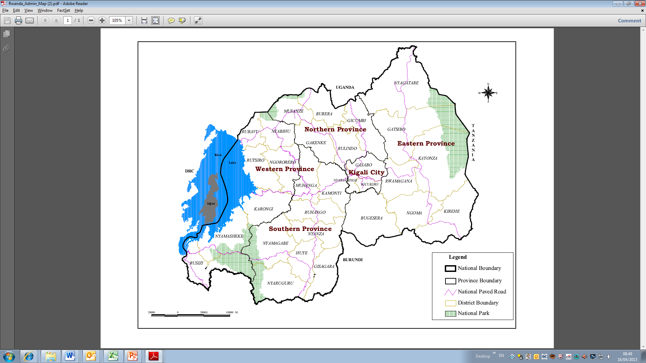
Country Overview: RWANDA
Rwanda in the heart of Africa
National Boundary
District Boundary
Province Boundary
National Park
Key facts
Capital | Kigali
Population | 12.1 million (2018)¹
Nominal GDP | RwF 7,597 billion (2017, approx. US$ 9.1 billion)²
GDP Growth | 6.1 % (2017)³
Literacy Rate | 72%⁴
External Debt (% of GDP) | 48% (End 2017)⁵
Time to Start a Business | 6 hours⁶
Credit Rating | B (stable); B+ (Stable)7
Currency | Rwandan Franc (863 FRW) = 1 US$ (17th October 2018)⁸
National Institute of Statistics Rwanda (NISR)
NISR; NBR for exchange
NISR
NISR – EICV4 FY2013/14 (% of people ages 15 and above)
MINECOFIN
World Bank Doing Business Report 2017
Fitch May 2018; Standard & Poor’s February 2018
BNR

Slide 4
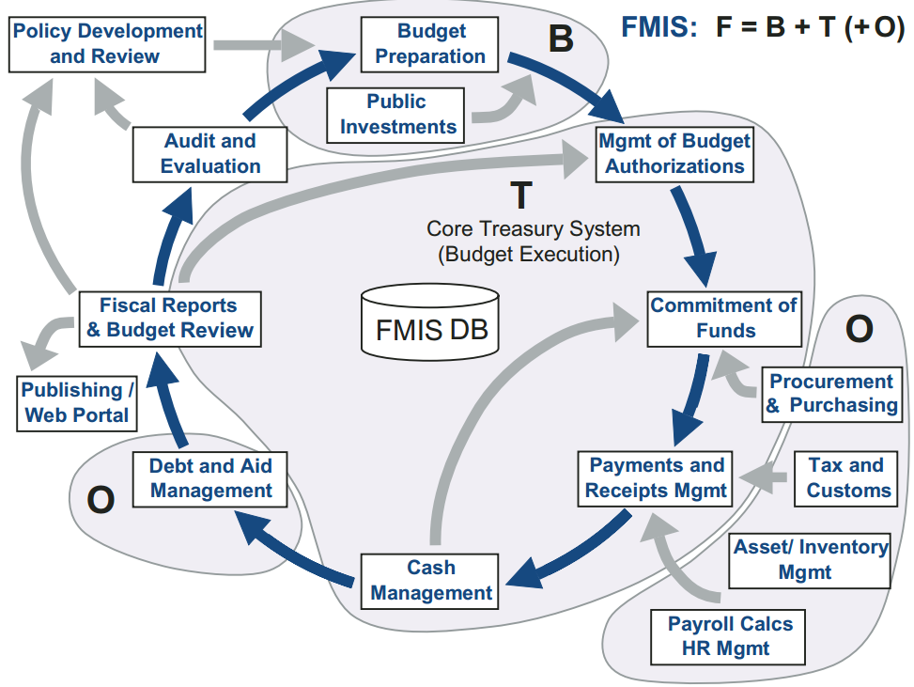
IFMIS Development Background
Setup of a Typical IFMIS: From books

Slide 5
IFMIS Development Background
Setup of Rwandan IFMIS: Functional Groupings & Systems Integration

Slide 6
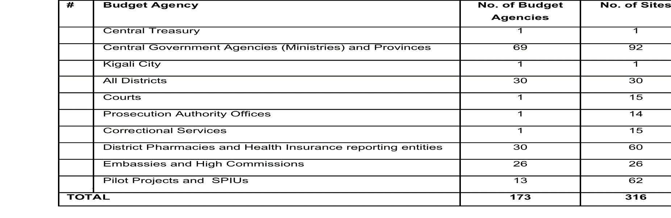
IFMIS Development Background
Phase I: 2010-2014
Initial rollout July 2010
Implemented in 173 Budget agencies
Phase one closed June 2014
Developed by E-Tools

Slide 7
IFMIS Development Background
Phase II: 2015 –To date
Initial rollout October 2015
Implemented in 364 Budget agencies and 1,239 sites
Design study and team recruitment – October 2014
Modules: Planning, Budgeting, Payables, Receivable, Accounting, Assets, Reporting, Admin, Security, Systems Integration
Development and Operational budget for 5 years
FISCAL YEAR | BUDGET (USD)
2014/2015 | 1,194,923
2015/2016 | 1,553,100
2016/2017 | 2,309,794
2017/2018 | 1,185,996
2018/2019 | 1,223,218
TOTAL | 7,467,031

Slide 8
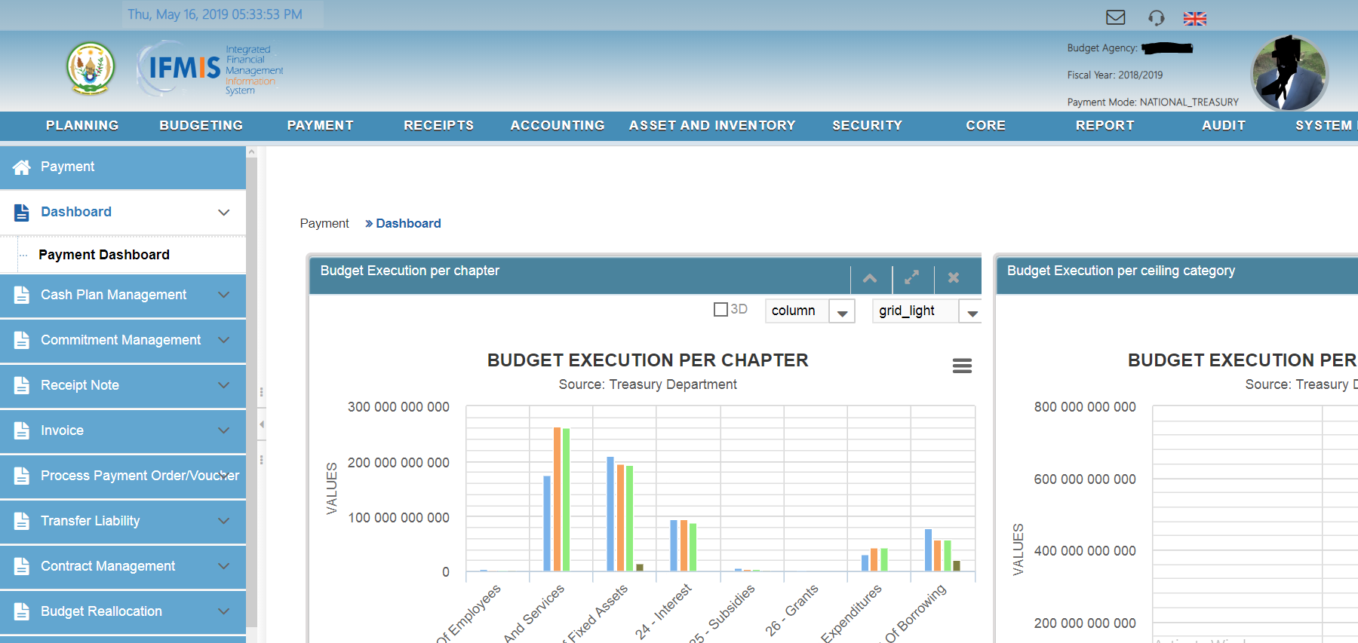
IFMIS Development Background
IFMIS Look and Feel

Slide 9
E-Procurement Development Background
2015 –To date
Developed by AOS (a Korean Company) in 2015
Piloted in 2016-2017 in 8 Budget agencies
Currently rolled out in 150 agencies
Modules:
eBidding
Products Catalog
Contract Mgmt
Shopping Mall
User Mgmt
Supplier Registration

Slide 10
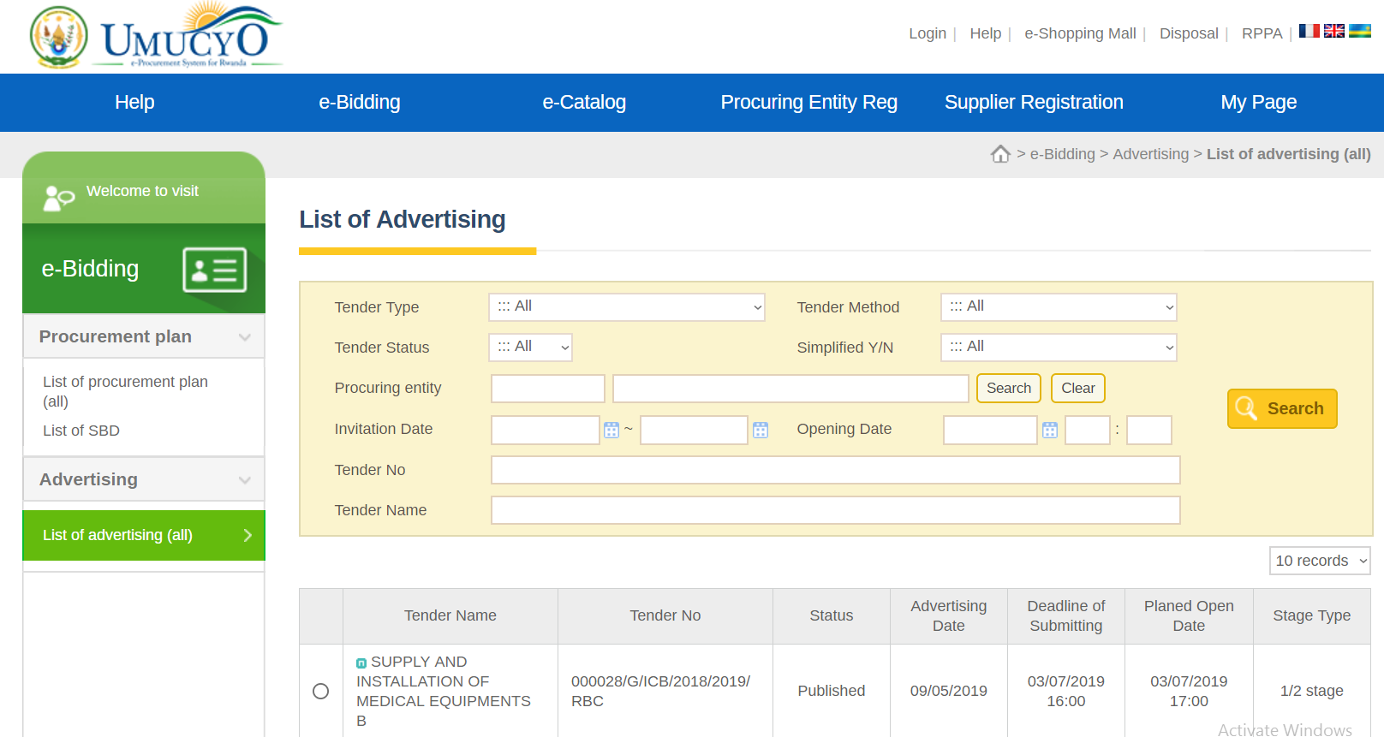
E-Procurement Development Background
E-Procurement Look and Feel

Slide 11

IFMIS & E- Procurement Rollout
1,239
IMFIS Sites
150
E-Procurement Sites
Public Sector
Central Government
Local Government
Ministries++ [19+4]
Kigali City[1]
Agencies [69]
Districts [30]
Provinces [4]
District Hospitals [43]
District Pharmacies[30]
Projects [72]
Sectors [416]
Embassies [36]
Health Centers [470]
Judicial entities [34]
Public Schools [2,846]

Slide 12
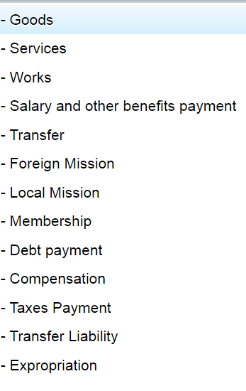
IFMIS Development Background
Transactions Examples
Small Transactions
Local transport allowance: 6$
Traffic fines: 10$.
Staff Bonus: 50$
Large Transactions
Payment of supplies: 5,000,000 $
Debt payment: 2,000,000 $
Transfer: 10,000,000 $

Slide 13
Integration Driving Factors
Procurement and Payment Business Process
Planning
Budgeting
Procurement Planning
Bidding
Contract
Ordering
Delivery
Invoicing
Payment
Clear functional boundary between IFMIS & E-Procurement:
IFMIS: Planning, Budgeting, Payment.
E-Procurement: Procurement Planning, Bidding, Contract Negotiation and Signing
Blurred functional boundary between IFMS & E-Procurement :
Ordering: Budget Executing in IFMIS and Shopping Mall in e-Procurement
Delivery: Shopping mall in e-Procurement and Assert Management in IFMIS
Invoicing: Supplier access e-Procurement and Financial officers access IFMIS

Slide 14

Integration Driving Factors
Organization Structure Setup
Planning
Budget Execution
Planning
Officer
Budget Officer
Assets Mgmt
Budgeting
Logistic Officer
Budget Officer
Payment
Accountant
Procurement Planning
Bidding
Ordering
Procurement Officer
Contract Drafting
Contract Signing
Legal Officer
Chief Budget Manager

Slide 15
Integration Services
Data Flow
I
F
M
I
S
Budget Information
E
-
P
R
O
C
U
R
E
M
E
N
T
Challenges:
Tight coupled procurement and payment services.
Contract management issues inherited from separating the procurement and payment system.
Lack of clear choice of which system must initiate the invoicing process and provide a single window for Supplier to access Government services.
Duplicated processes due to some entities that may be obliged to use other procurement systems: example STEP of World Bank.
Lack of transparent budget execution in E-Procurement
Exchange Rate
Contract Information
Purchase Order
Delivery Information
Payment Notification

Slide 16
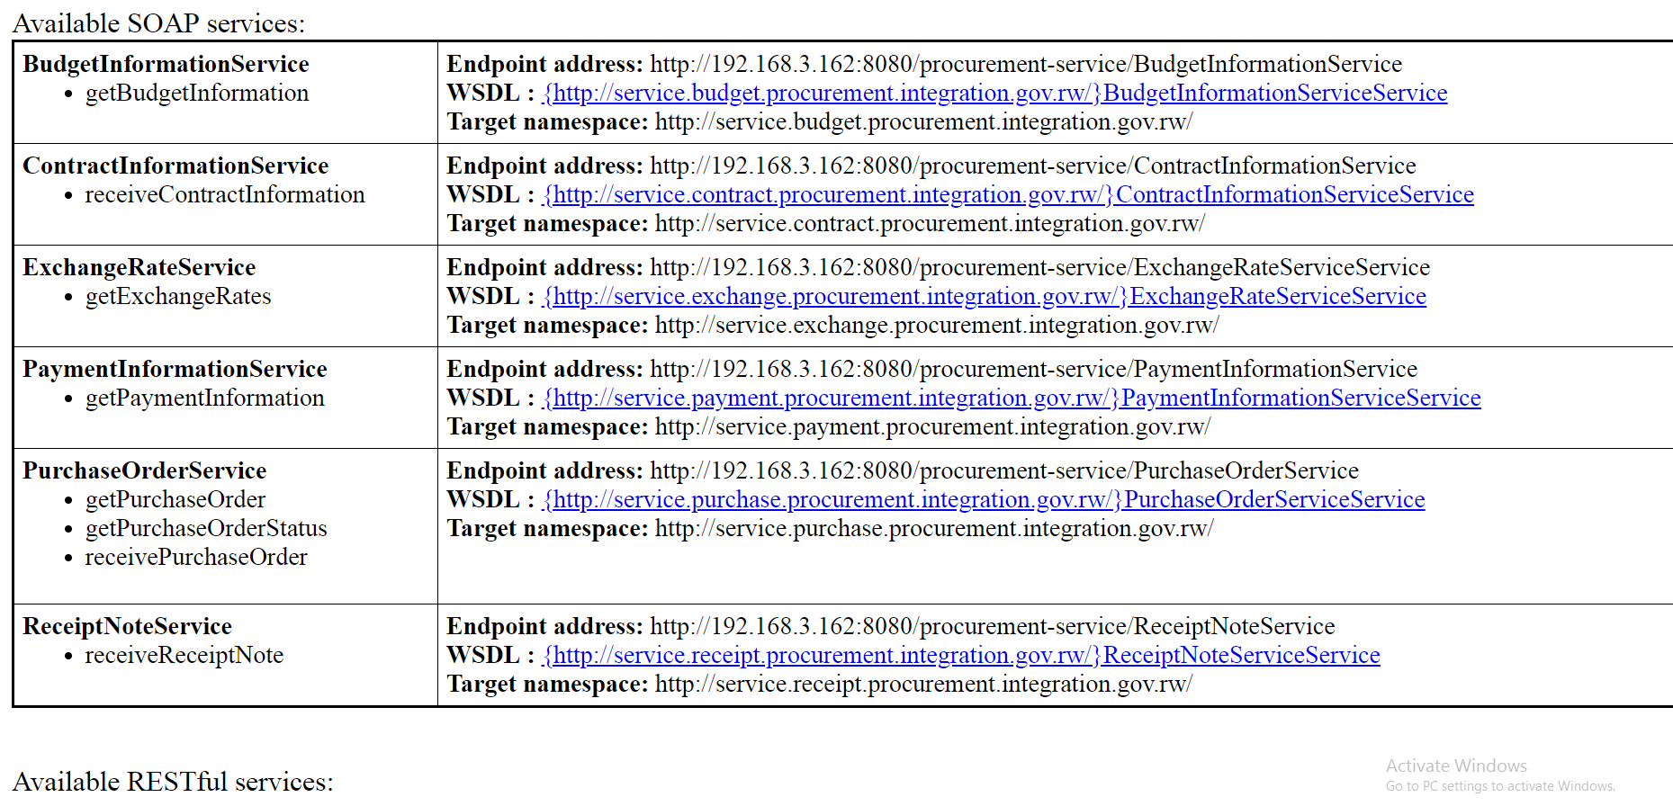
Integration Services
Web Services

Slide 17
Data Structure
Planning and Budget Definition
To which administrative unit and cost/revenue centre should the transaction be allocated?
Administrative Segment
(Authority)
In which region do the services/goods get delivered and in which region is the beneficiary that benefits from the transaction?
Against which Programme/Sub-program/Project/Output/
Activity should the transaction be recorded?
Geographical Segment
(Where)
Programs Segment
(Purpose)
Transaction
Funding Segment
(Who)
Economic Segment
(What)
Against which source and type of funding is the payment allocated, and against which source and type is revenue received?
What is being bought and what is the nature of the receipt?

Slide 18
Data Structure
Planning and Budget Definition

Slide 19
Data Structure
Planning and Budget Coding
The Chart of Accounts made up of 5 Segments as shown below:
The size of the budget line data structure is 36 digits in total as depicted below:
Segment 1 | Segment 2 | Segment 3 | Segment 4 | Segment 5
Organization | Fund | Function/ Programme | Economic | Location
2+2+3+3 | 1+2+4 | 2+2+2+2 | 1+1+1+1+2 | 1+2+2
10 digits | 7 digits | 8 digits | 6 digits | 5 digits

Slide 20
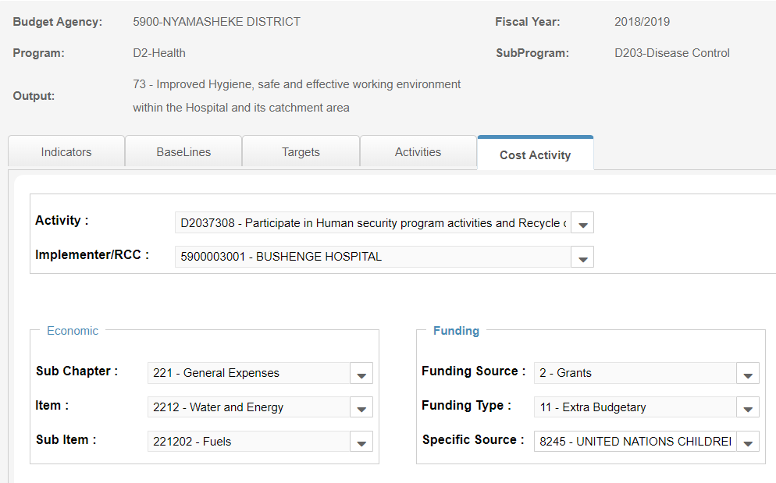
Data Structure
Expenditure Example: 5900003001-2118245-D2037308-221202-XXXXX

Slide 21
Data Structure
Asset Classification
UNSPSCs consist of eight digits representing the following four hierarchical classifications, which consist of two-digits each:
Segment: The logical aggregation of families for analytical purposes. Ex) Commercial and Military and Private Vehicles and their Accessories and Components
Family: A commonly recognized group of inter-related commodity categories. Ex) Motor vehicles
Class: A group of commodities sharing a common use or function. Ex) Passenger motor vehicles
Commodity: A group of sustainable products or services. Ex) Automobiles or cars
Scope Conversion Continuum
Raw Materials
Industrial Equipment
Equipment
Components & Supplies
Manufactured Products
Services
Segments 10-15
Segments 20-27
Segments 30-41
Segments 42-60
Segments 70-94

Slide 22
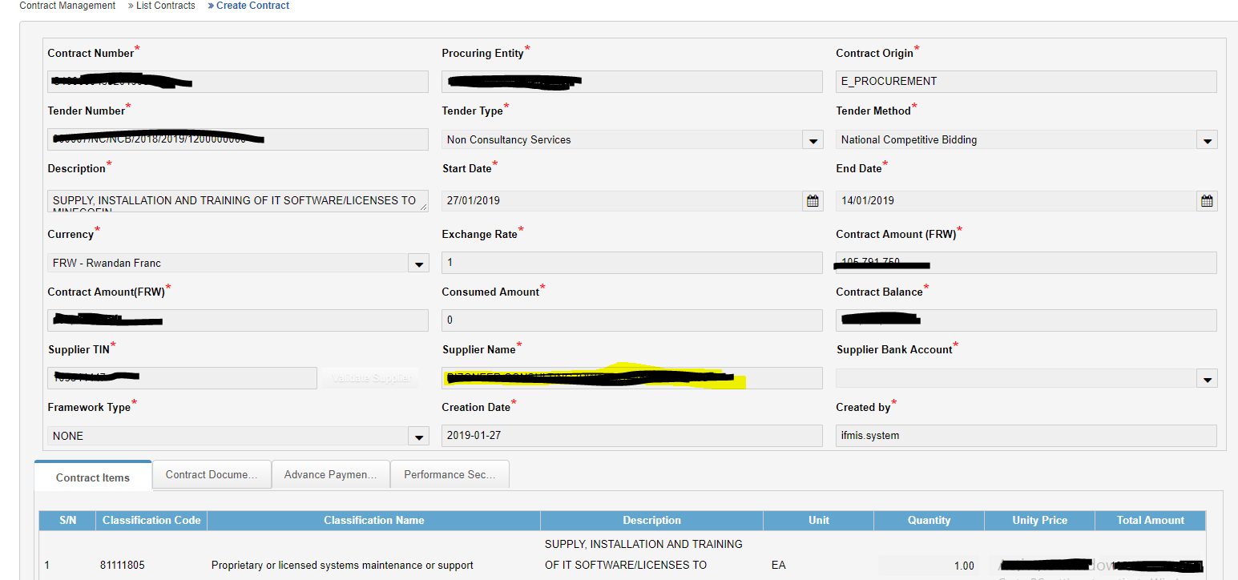
Data Structure
Contract Data
Contract Information.
Supplier Information
Lot Information
Delivery Items
Contract Documents

Slide 23
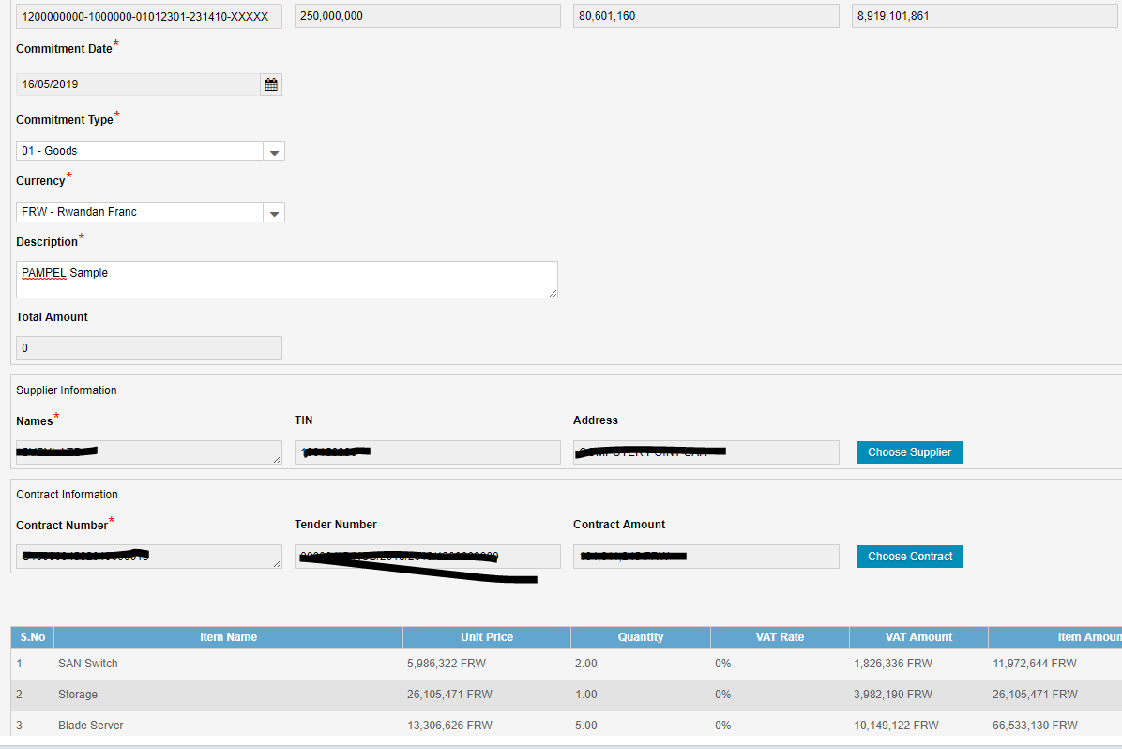
Data Structure
Purchase Order

Slide 24
Data Structure
Contract Data
Contract Information.
Supplier Information
Lot Information
Delivery Items
Contract Documents

Slide 25
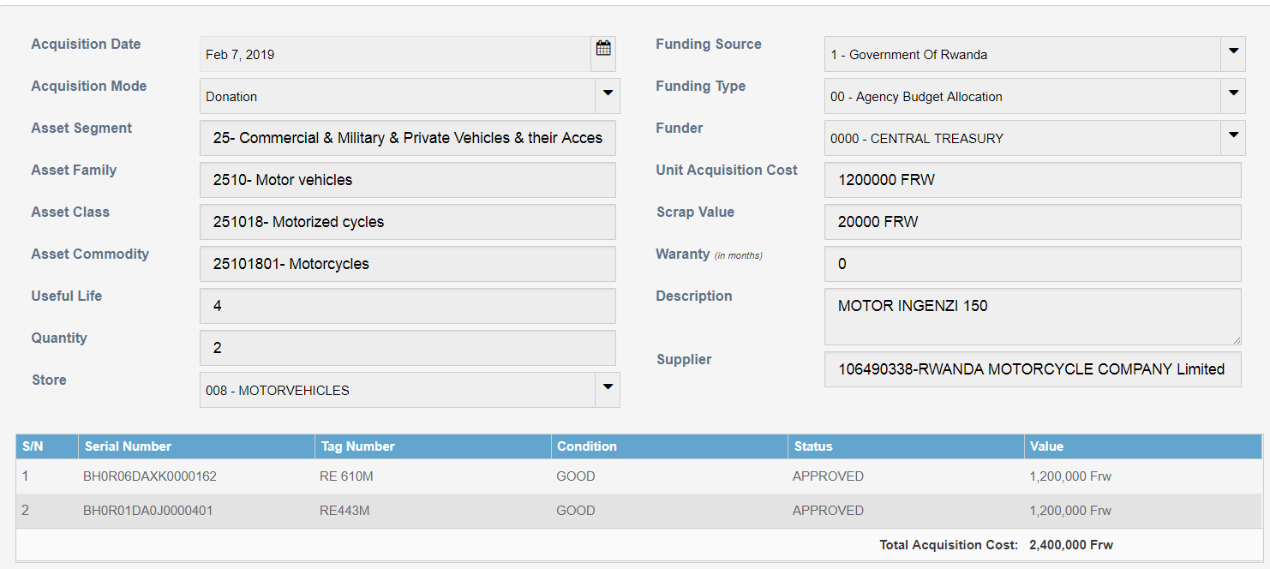
Data Structure
Delivery Information

Slide 26



Future Plan
IFMIS & E-Procurement in 2020
Modified Cash
Accounting
Accrual
Accounting
Information
System
Expert
System

Slide 27
Thank you!

