Slide 1
PEM PAL Budget Community of Practice (BCoP) “The Role of Austria's Parliament in Budgeting” The Role of Parliament in the Budget Process Vienna, 30th January 2014
Christoph Konrath
Helmut Berger

Slide 2
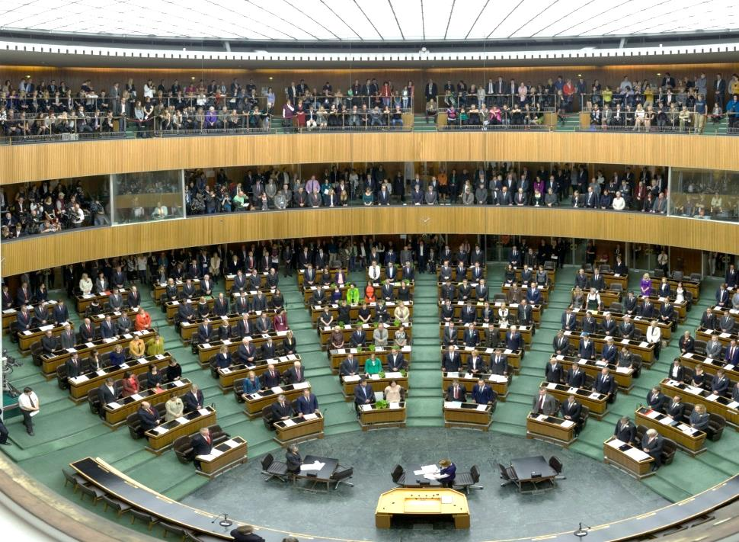
1 – Setting the context: The Austrian Parliament
The Austrian Federal Constitution establishes a semi-presidential parliamentary system
Parliament is bi-cameral with one dominating chamber – the National Council (Nationalrat)
The electoral system is based on proportional representation
Majority governments and very strong party discipline in parliament are – so far – the rule in Austrian politics
Independent (administrative) expert support for parliamentarians is a rather recent development in Austrian parliamentarism

Slide 3
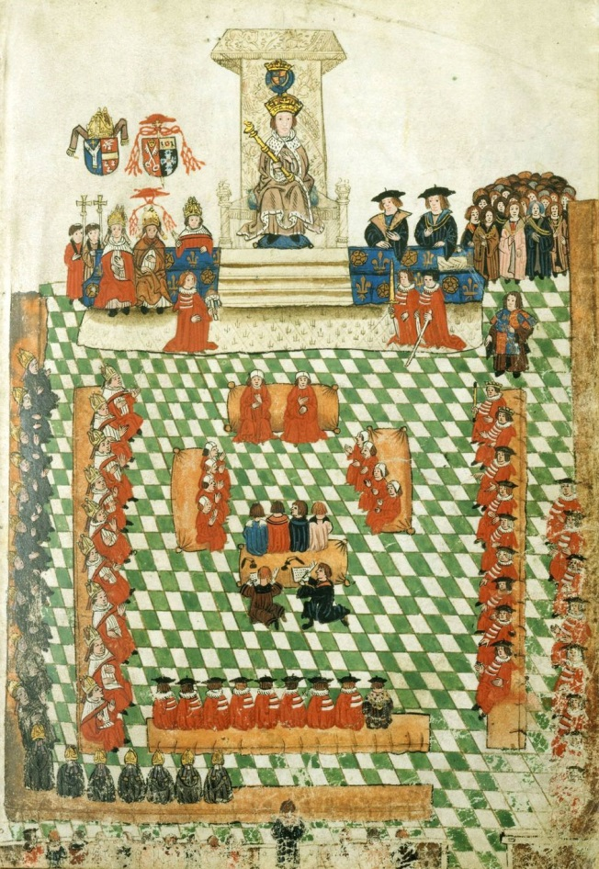
2 – Setting the context: Parliaments and the power of the purse
Approval of the budget as “the most complete and effectual weapon” (James Madison) of parliaments – an outdated view?
Information, complexity and transparency
Accountability and responsibility
Legal, economic and political constraints

Slide 4
3 – The National Council’s role in the Budget process
The Minister of Finance prepares the budget bills and presents the drafts to the National Council
The National Council discusses the draft of the Federal Medium-Term Expenditure Framework Act and the Federal Finance Act in three readings
The National Council can amend and has to approve the budget acts and Federal Medium-Term Expenditure Framework Act
The Minister of Finance may – under given circumstances only overrun the approved budget allocations after consultation with the National Council
Furthermore, the National Council and especially the Budget Committee receives a number of reports, supporting the budgetary steering and control function of the National Council

Slide 5
4 – Consideration and approval of the budget – an overview
FEDERAL GOVERNMENT
PARLIAMENT (National Council)
Minister of Finance
Council of Ministers
Plenary: Budget Speech
Plenary: First Reading
Expert Hearing
Budget Committee: Debate
BPO
Analyses
Plenary: Second and Third Reading

Slide 6
5 – Consideration and approval of the budget – an overview
Federal Government must submit the draft of the budget to the National Council at the latest ten weeks before the beginning of the fiscal year
Period from the budget speech to the approval of the budget in the National Council approximately six weeks
The parliamentary budget paradoxon:
No government document is more important than the budget
(Almost?) nobody reads the entire budget
Budget documents must be exiting to overcome the budget paradoxon:
Performance: Who has to deliver which results?
Allocation: Who disposes of which resources?
True and fair view: Financial state of the country?
Compliance: Are fiscal frameworks respected?

Slide 7
6 – Presentation of the Budget Bill
GOVERNMENT
PARLIAMENT
Minister of Finance
Council of Ministers
Plenary: Budget Speech
Plenary: First Reading
Expert Hearing
Budget Committee: Debate
BPO
Analyses
Plenary: Second and Third Reading

Slide 8
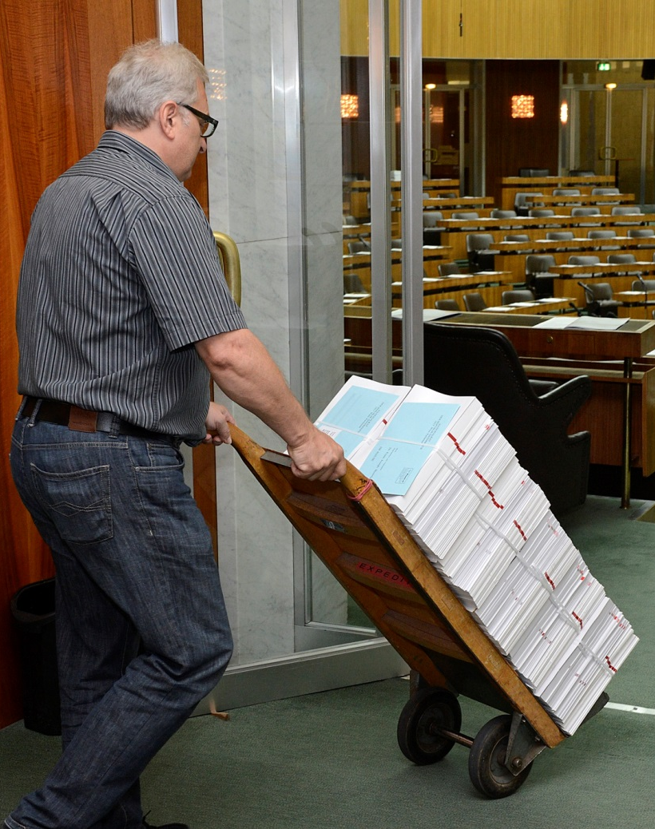
7 – Presentation of the Budget Bill
The Federal Government must present the Budget Bill (Federal Finance Bill) to the National Council at latest 10 weeks before the end of the fiscal year
Members of Parliament may present a budget bill only if the Federal Government fails to do so
If the National Council has not passed a Federal Finance Law household is managed according to the most recently passed Federal Finance Law
National Council may likewise make temporary provisions by way of a Federal Law

Slide 9
8 – Budget Speech and First Reading
FEDERAL GOVERNMENT
PARLIAMENT (National Council)
Minister of Finance
Council of Ministers
Plenary: Budget Speech
Plenary: First Reading
Expert Hearing
Budget Committee: Debate
BPO
Analyses
Plenary: Second and Third Reading

Slide 10
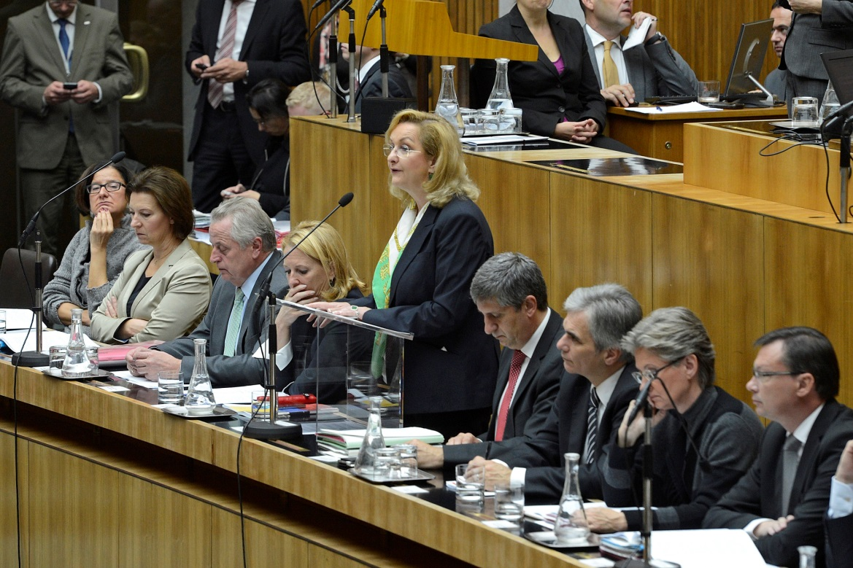
9 – Budget Speech
Parliamentary proceedings start with the budget speech by the Federal Minister of Finance
This is a very high-profile event; whole Government and the Federal President are present
The speech discusses the budget in broad political and economic terms as well as highlighting specific initiatives
It generally lasts one hour; there is no immediate debate after the budget speech

Slide 11
10 – First Reading
Traditionally, the first reading of the budget bill follows on the next sitting day and has often the character of a very broad and general debate on the Federal Government’s policies and performance
The entire day (10 or more hours) is devoted to deliberation of the government’s budget proposal with sometimes more than 100 speakers
Members of Parliament either praising or criticising government’s proposal in general terms or in a specific policy field
Minister of Finance responds to these statements during the debate or at the end of the day in general terms
At the conclusion of this debate the budget proposal is referred to the Budget Committee for further scrutiny

Slide 12
11 – Committee Proceedings
FEDERAL GOVERNMENT
PARLIAMENT (National Council)
Minister of Finance
Council of Ministers
Plenary: Budget Speech
Plenary: First Reading
Expert Hearing
Budget Committee: Debate
BPO
Analyses
Plenary: Second and Third Reading

Slide 13
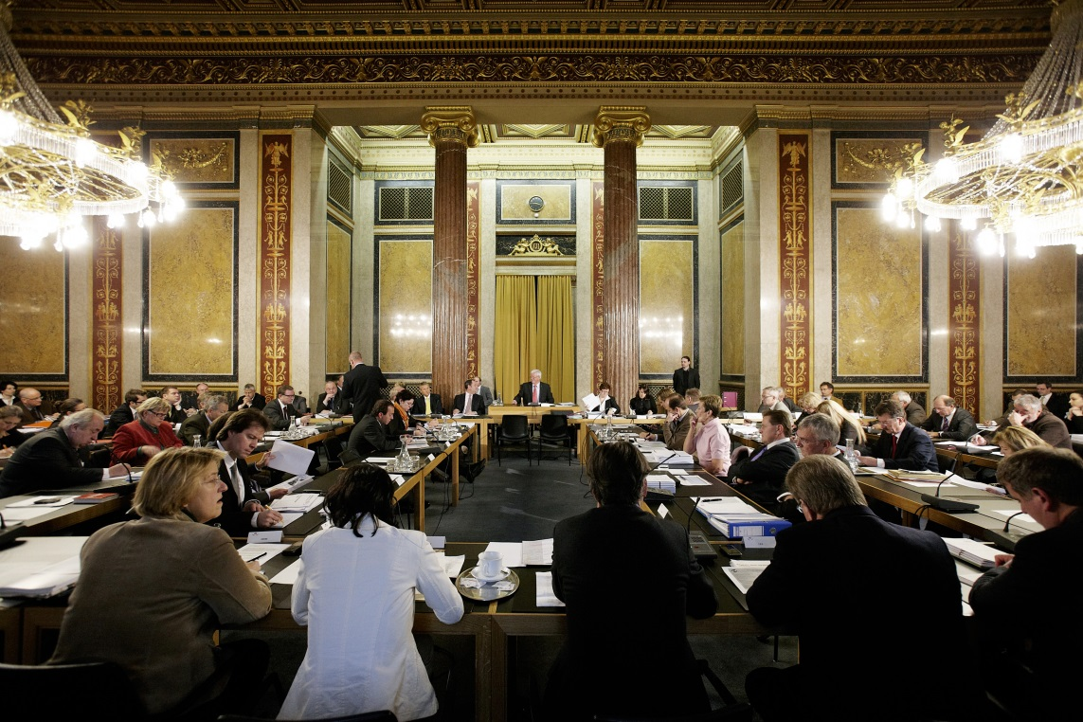
12 – Committee Proceedings – Experts and MPs
Traditionally, the Budget Committee starts to consider the budget bill in the week after the first reading
The Budget Committee will always hold a public hearing of experts nominated by the parliamentary groups
In the course of the next – approx. 7 – sitting days, the committee holds individual debates on each budget chapter (no public)

Slide 14
13 – Committee Proceedings – Budget Analysis 2013 of the BPO
The Parliament Budget Office provided the Budget Committee with a comprehensive budget analyses
Budget analyses has to be finished until the beginning of the debate in the Committee
Head of the Parliamentary Budget office gave a short summary at the beginning of the debate
Additional information and summary sheets were provided to facilitate budget overview

Slide 15
14 – Committee Proceedings – Scrutiny and Amendments
The parliamentary groups will – in addition to or as substitute for their permanent members of the Budget Committee – nominate members with expertise in the policy areas associated with each budget chapter
During these debates the Federal Minister of Finance and the responsible Line Ministers have to be present
Each member can submit a limited number of short written questions to the Federal Minister of Finance that have to be answered within four days
The committee can amend the budget bill in any way
In general only few budget appropriations are amended by Parliament

Slide 16
15 – Committee Proceedings – the New Budget structure
New budget structure with global budgets and the operating statement provides additional insights for Members of Parliament
Higher aggregated budget allocations have an impact on the parliamentary debate as it was more focused an the strategic approach instead of the former detailed questions on minor budget allocations to specific budget lines
Extensive budget documents were considered difficult to overview as information is provided in a fragmented way in various documents
Members of Parliament insisted on missing relevant information and the same time complaint on information overload
Amendments are only possible at a significantly higher level

Slide 17
16 – Committee Proceedings – Outcome Orientation
With the new budget structure in addition to financial data Members of Parliament were provided with performance information on the mid-term outcome objectives envisaged by the Federal Ministries
Thus they had the possibility to discuss and question the strategic approaches and objectives in the Committee debate
This caused a change in the way the budget was discussed was
Performance budgeting and outcome orientation was acknowledged as a great progress but the current state was repeatedly criticized
Some performance goals were underlined as extremely important, others were considered as to general and not ambitious or concrete enough
With the discussion of performance goals and performance indicators a process was launched which should ultimately lead to a continuous qualitative improvement of performance information

Slide 18
17 – Committee Proceedings – Gender Budgeting
High importance of gender equality and gender budgeting in the budget debate
All political parties took part in the discussion on gender targets
Systematic overview on objectives and meassures and common approach was missed
Very ambitious objectives (e.g. considerable reduction of the gender pay gap ) cannot be implemented in one policy field or by one ministry
Topic seems to be „female“:
Most of the speakers were female MPs
No clear distinction between gender equality objectives and female promotion (e.g. women and leadership)
More questions and statements concerning equal treatment of women, only in single cases questions concerning equal treatment of men

Slide 19
18 – Plenary: Second and Third Reading Approval of the Budget
FEDERAL GOVERNMENT
PARLIAMENT (National Council)
Minister of Finance
Council of Ministers
Plenary: Budget Speech
Plenary: First Reading
Expert Hearing
Budget Committee: Debate
BPO
Analyses
Plenary: Second and Third Reading

Slide 20
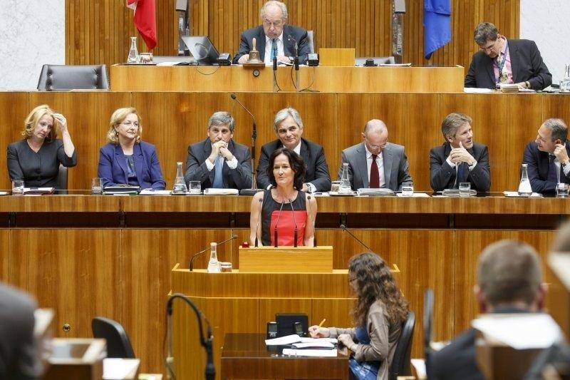
19 – Plenary: Second and Third Reading
The report of the budget committee is considered in the plenary in the second reading of the budget bill which will take 4 or 5 sitting days
Again, the debate will be structured along the budget chapters and will very often have the character of a general political debate
Nearly all Members of Parliament take the floor
Members of Parliament usually move a lot of motions (resolutions)

Slide 21
20 – Approval of the Budget
Amendments of the budget bill will usually be moved by Members of Parliament belonging to the parties in government
Usually, the National Council will vote on diverse Budget Accompanying Acts. These change legislation in various matters with financial impact.
The budget is approved by the National Council by simple majority
The Federal Council will only be notified on the approval of the Federal Budget Act by the National Council

Slide 22
21 – Parliament and the Budgetary Cycle
decides on draft approves correctness of
budget and MTEF budgetary execution
Federal Government Parliament
Approves report from Votes on budget
Court of Audit and MTEF Federal Ministries execute budget
Independent
research councils:
Input for budgetary planning

Slide 23
22 – Parliament and the Budgetary Cycle
The National Council approves the Austrian Stability Pact, the Medium-Term Expenditure Framework and annual Federal Budget
The National Council exercises permanent budgetary control on the implementation of the Federal Budget in the course of the fiscal year
The National Council is informed by different reports on the fiscal performance of the sub-national governments
The National Council discusses the Stability Program and the National Reform Program after submission to the European Commission
The National Council deals with the recommendations of the European Commission and the European Council
The National Council is not directly involved in the implementation and control of the fiscal rules
The main responsibility lies with the Budget Committee

Slide 24
23 – Parliament and the Budgetary Cycle The Fiscal Year
Spring
Federal Medium-Term Expenditure Framework Act (binding expenditure ceilings for four years at the level of the five main budgetary headings) together with the strategy report
stability program and national reform program
Autumn
Federal Finance Act together with the budget statement und personnel plan
Once within the financial year
Reports on subsidies, on reserves, on receivables etc.
Periodically
Reports on obligations, allocations commitments, budget controlling, outcome controlling, investments and financial controlling etc.

Slide 25
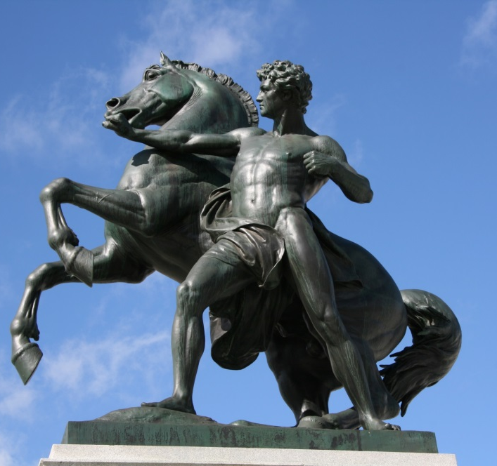
24 – Other Committees involved in budget related debates
Finance Committee: deals with all bills and motions with regard to taxation and regulations of the finance sector.
EU Committees: the Main Committee or the Standing Subcommittee on Matters of the European Union prepares opinions on propositions of the European Union as for example on envisaged Regulations and Directives.
Audit Committee: deals with the reports of the Austrian Court of Audit including specific reports on budget execution whereas the Report on the Federal Financial Statements is discussed in the Budget Committee.

Slide 26
25 – New Challenges for Parliament
Completely new budgetary structure and performance budgeting changes parliamentary possibilities of steering and controlling the budgetary process
New budget rules confer additional powers to government and administration
The new European fiscal governance framework with the European Semester influences procedures and limits national budgetary scopes
Federal budget reform envisages a central role for parliament However,
Budget process is a highly complex mechanism
Large information asymmetries between government and parliament
Need to realign budget procedures and budget control in parliament
Fragmentation of information makes it difficult to get a sufficient overview and to combine and cross-check documents

Slide 27
Thank you for your attention
Contacts:
Helmut Berger
Head of Parliamentary Budget Office
Parliament, A-1017 Wien, Dr. Karl Renner-Ring 3
Tel. +0043 1 40 110-2889; +0043 676 8900-2889
E-mail: helmut.berger@parlament.gv.at
Christoph Konrath
Head of the Department of Scientific Support and Coordination in Parliamentary Matters
Parliament, A-1017 Wien, Dr. Karl Renner-Ring 3
Tel. +0043 1 40 110-2929 (2608)
E-mail: christoph.konrath@parlament.gv.at

